Slide 1
Implementing Foundations of English into the Classroom
Michael Thompson & Joan Myers
Developmental Reading and Writing Instructors
North Iowa Area Community College (NIACC)
Mason City, Iowa

Slide 2
Objectives
Discuss implementation strategies for utilization of Hawkes’ FOE in the developmental classroom
Examine feedback of Hawkes FOE from both students and staff
Analyze student data

Slide 3
Our Pilot
2015 & 2016 Implemented Hawkes’ Foundation of English Software
Four sections meeting twice a week (1 hour classes, total of 2 hours/week)
Roughly 75 students total
Students complete first three modules

Slide 4
Our Pilot
2015 & 2016-Implemented Hawkes’ Foundation of English Software

Slide 5
Our Pilot
Sections meet twice a week (1 hour classes, total of 2 hours/week)

Slide 6
Our Pilot
Students complete first three modules
Two lessons/week
80% Mastery

Slide 7
Room Setup

Slide 8
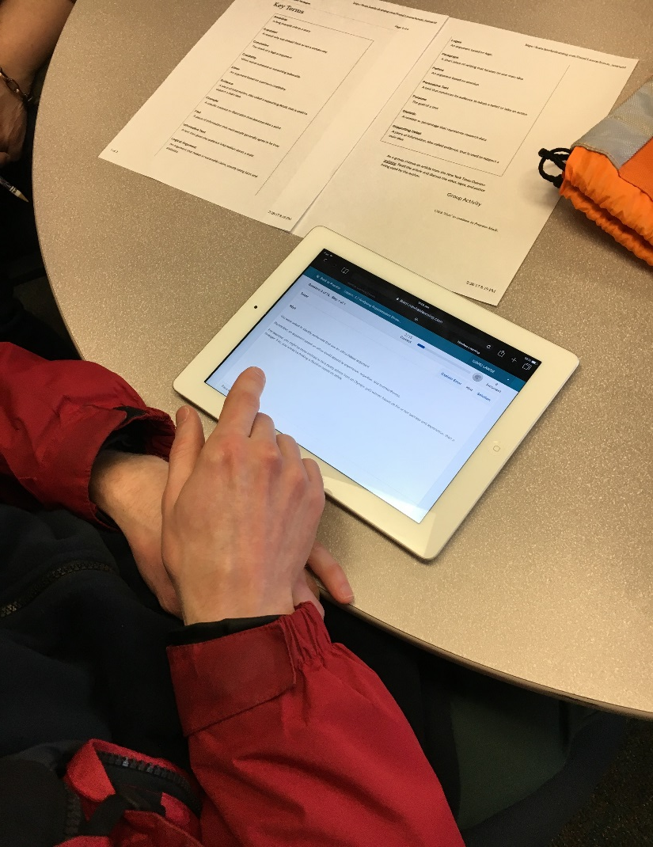

Slide 9
Our Pilot
2015 & 2016-Implemented Hawkes’ Foundation of English Software
Four sections meeting twice a week (1 hour classes, total of 2 hours/week)
Roughly 75 students total
Students complete first three modules (with reflections)

Slide 10
Course Implementation
Chose to utilize three instructors
Competency-Based Learning environment
Continuous student and instructor feedback

Slide 11
Course Implementation
Chose to utilize three instructors

Slide 12
Course Implementation
Competency-Based Learning environment
Pacing guide/schedule
Two modules per week

Slide 13
Course Implementation
Continuous student and instructor feedback

Slide 14
Course Implementation
Chose to utilize three instructors
Competency-Based Learning environment
Continuous student and instructor feedback

Slide 15
Students’ Opinions of Hawkes Software
Students find Hawkes easy to navigate and user-friendly
Students appreciate the menu screen with upcoming assignments
Students appreciate the month/days lists

Slide 16
Students’ Opinions of Hawkes Software
Students find Hawkes easy to navigate and user-friendly

Slide 17
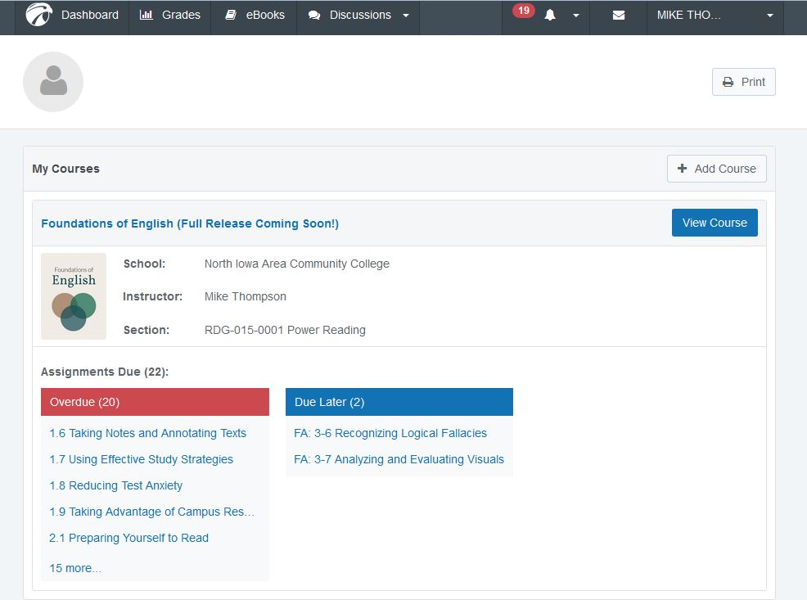
Students’ Opinions of Hawkes Software
Students appreciate the menu screen with upcoming assignments

Slide 18
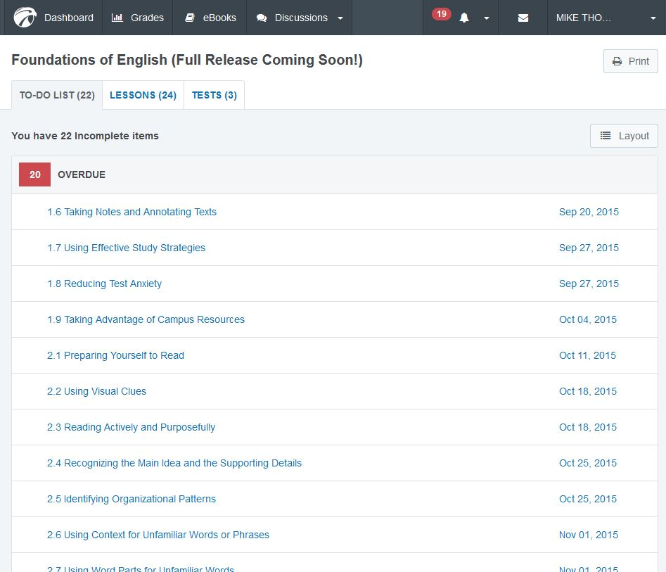
Students’ Opinions of Hawkes Software
Students appreciate the month/days lists

Slide 19
Students’ Opinions of Hawkes Software
Students find Hawkes easy to navigate and user-friendly
Students appreciate the menu screen with upcoming assignments
Students appreciate the month/days lists

Slide 20
Students’ Opinions of Hawkes (Content)
Favorite Lessons
“Not-So-Favorite” Lessons

Slide 21
Students’ Opinions of Hawkes (Content)
Favorite Lessons
1.1 & 1.2 Learning Styles
Refer to these individual findings throughout the course
Example-Music student
1.8 Reducing Test Anxiety
2.3 Reading Actively & Purposefully

Slide 22
Students’ Opinions of Hawkes (Content)
“Not-So-Favorite” Lessons
3.2 Analyzing Argumentation Strategies
Pathos
Ethos
Logos

Slide 23
Students’ Opinions of Hawkes (Content)
Favorite Lessons
“Not-So-Favorite” Lessons

Slide 24
Staff’s Opinions of Hawkes Software
Easy to Navigate reports and data
Students appreciated being able to work at individual pace, which was certainly supported by the software
Customer Service is much better than previous programs
Topics are very relevant to student life
Students are able to identify how strategies can be utilized in other classes, but need help following through
Important to provide follow-up and instruction

Slide 25
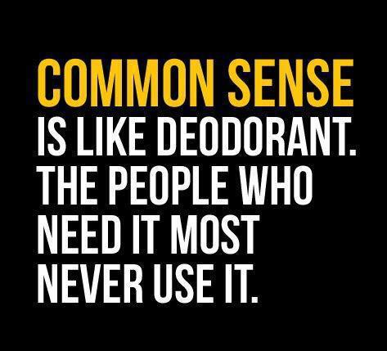
Staff’s Opinions of Hawkes Software
Easy to Navigate reports and data
“Common Sense”

Slide 26
Staff’s Opinions of Hawkes Software
Students appreciated being able to work at individual pace, which is certainly supported by the software

Slide 27
Staff’s Opinions of Hawkes Software
Customer Service is much better than previous programs
Received emails a few days before the semester started
Received email the morning of our first class
Visuals sent, personal cell numbers, given, etc.
Followed through with issues we had very quickly (staff and student tested)
Very trustworthy

Slide 28
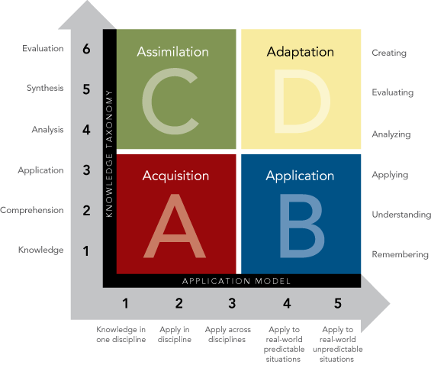
Staff’s Opinions of Hawkes Content
Topics are very relevant to student life
More so than previous programs

Slide 29
Staff’s Opinions of Hawkes Content
Students are able to identify how strategies can be utilized in other classes, but need help following through

Slide 30
Staff’s Opinions of Hawkes Content
Important to provide follow-up and instruction
Utilization of Hawke’s assessments (formative and summative) allows for more 1:1 instruction based on individual needs of students

Slide 31
Staff’s Opinions of Hawkes Software
Easy to Navigate reports and data
Students appreciated being able to work at individual pace, which was certainly supported by the software
Customer Service is much better than previous programs
Topics are very relevant to student life
Students are able to identify how strategies can be utilized in other classes, but need help following through
Important to provide follow-up and instruction

Slide 32
Staff’s Opinions of Hawkes Software
Data tracked time and student scores of formative and summative assessments
Time per lesson tracked fall of 2017
Average scores of formative and summative assessments tracked fall of 2018

Slide 33
Student Data: Time Per Lesson

Slide 34
Student Data: Average Scores of Formative & Summative Assessments

Slide 35
Student Data: Average Gains per Module

Slide 36
Staff’s Opinions of Hawkes Software
Data tracked time and student scores of formative and summative assessments
Time per lesson tracked fall of 2017
Average scores of formative and summative assessments tracked fall of 2018

Slide 37
Objectives
Discuss implementation strategies for utilization Hawkes FOE in the developmental classroom
Examine feedback of Hawkes FOE from both students and staff
Analyze student data

Slide 38
Questions?

