Slide 1
Chapter 9
Review

Slide 2
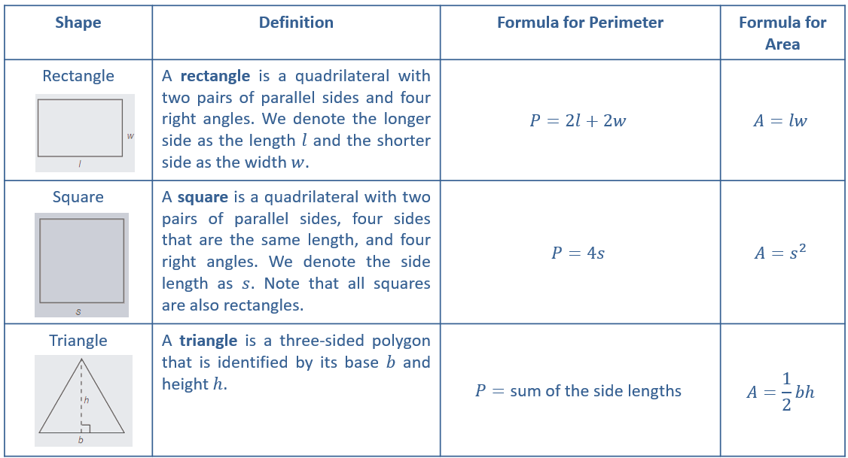
Perimeter and Area—Slide 1
Table 1: Summary of Perimeter and Area Formulas

Slide 3
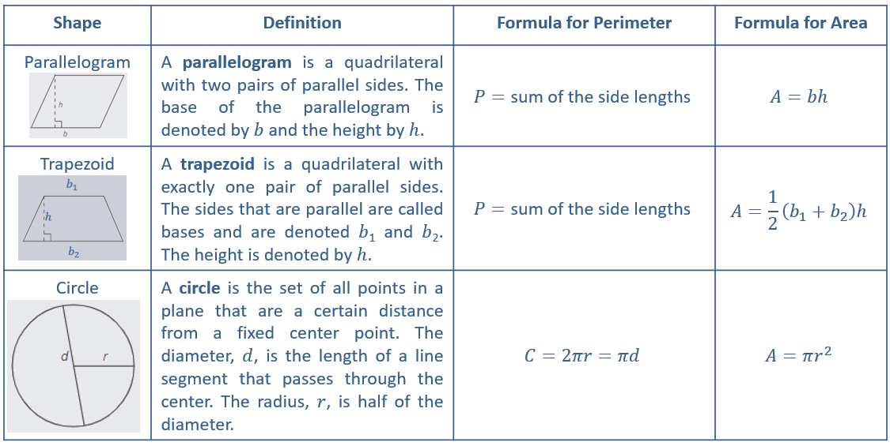
Perimeter and Area—Slide 2
Table 1: Summary of Perimeter and Area Formulas (cont.)

Slide 4
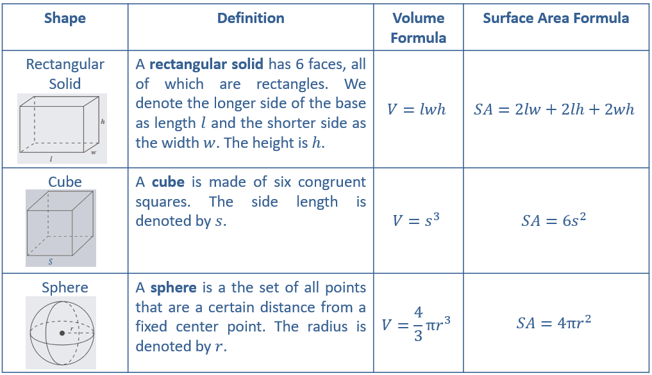
Volume and Surface Area—Slide 1
Table 2: Volume and Surface Area Formulas

Slide 5
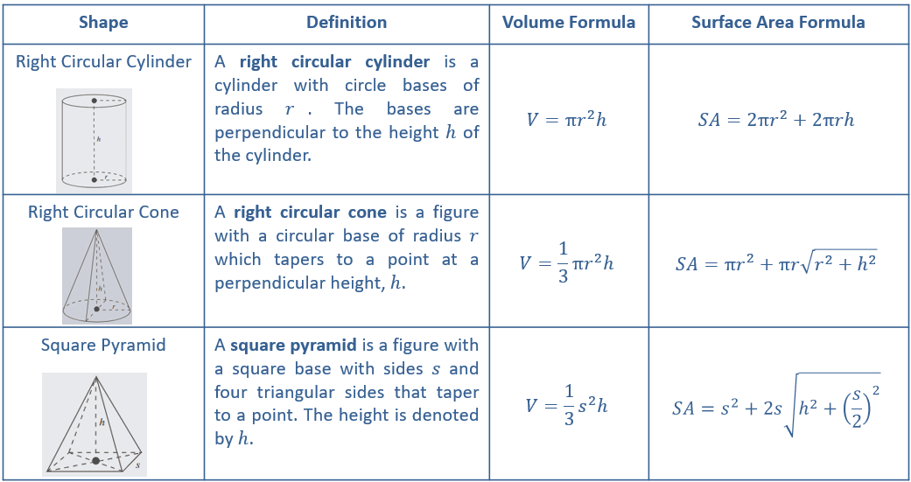
Volume and Surface Area—Slide 2
Table 2: Volume and Surface Area Formulas (cont)

Slide 6
Definition: Transversal Angles
A transversal is a line in a plane that intersects two or more lines in that same plane at different points.

Slide 7
Definition: Congruent Angles
Two angles of equal measure are said to be congruent to one another.

Slide 8
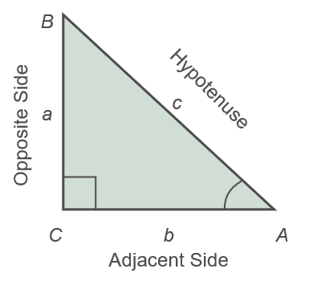
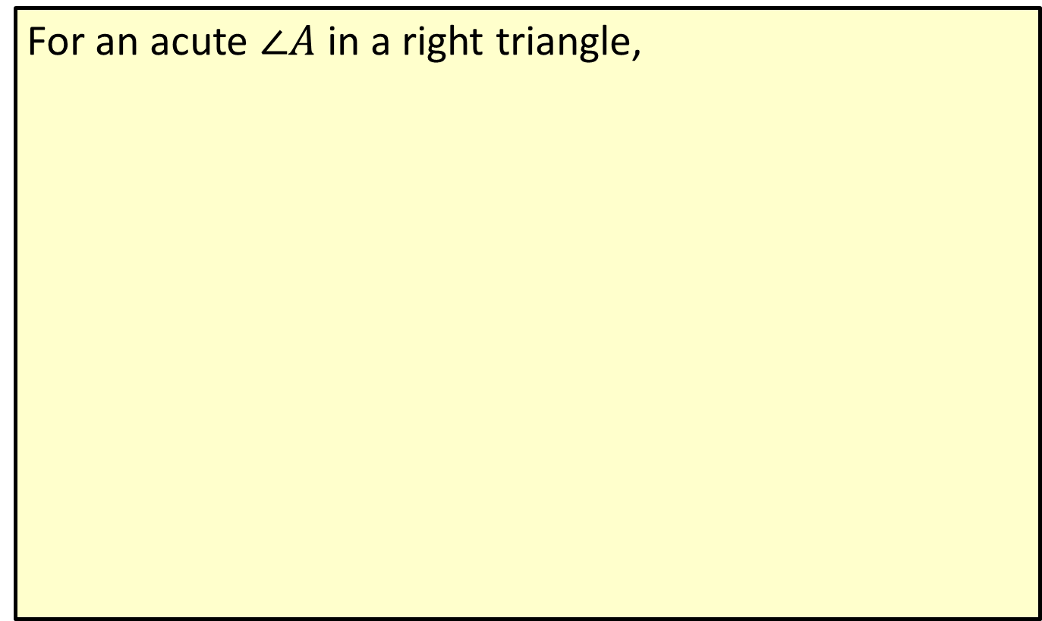
Definition: Sine, Cosine, and Tangent
For an acute $∠A$ in a right triangle,
Figure 18

Slide 9
Definition: Inverse Trigonometric Functions
The inverse trigonometric functions are used to find the angle from any trigonometric ratio. The common inverse trigonometric functions are

Slide 10
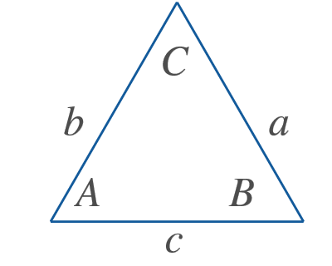
Definition: Law of Sines and Law of Cosines
For a triangle where a is the length of the side opposite angle A, b is the length of the side opposite angle B, and c is the length of the side opposite angle C, we have the following.
Figure 29
Law of Sines
Law of Cosines

Slide 11
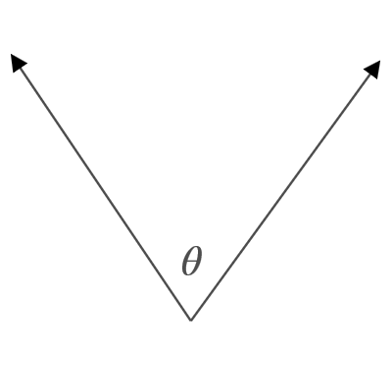

Properties: Labeling Angles—Slide 1
There are three common ways of labeling angles.
Figure 1: $∠\text{θ}$
Using a letter of the Greek alphabet such as θ or ψ.

Slide 12
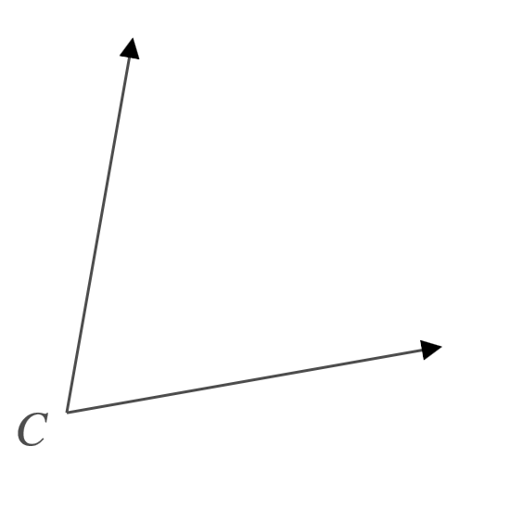
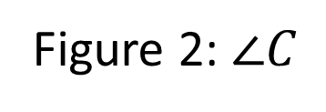
Properties: Labeling Angles—Slide 2
Figure 2: $∠C$
Using a single number or capital letter.

Slide 13
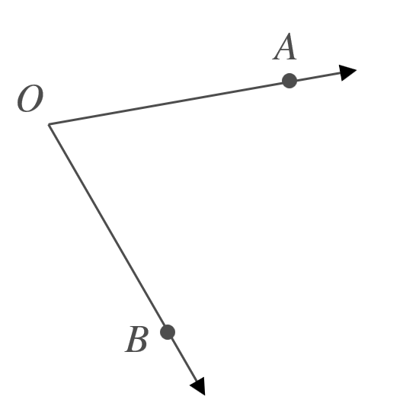

Properties: Labeling Angles—Slide 3
Figure 3: $∠$AOB
Using three capital letters with the vertex as the middle letter.

Slide 14
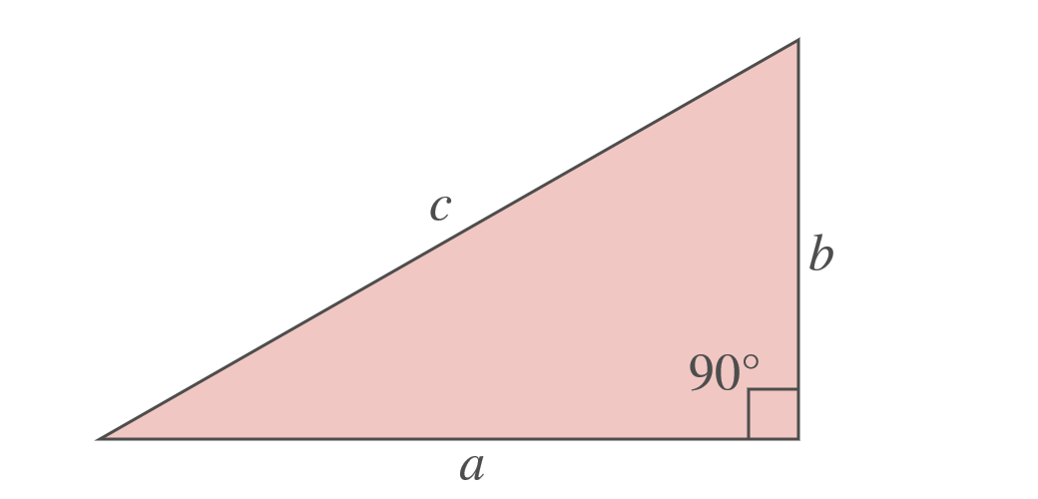
Theorem: Pythagorean Theorem
In a right triangle, the square length of the hypotenuse is equal to the sum of the squares of the lengths of the other two sides.
a² + b² = c²
Figure 12
Here, a and b are the are the legs and c is the hypotenuse.

