Slide 1
Section 6.1
Understanding Interest

Slide 2
Definition: Interest and Principal
Interest
The amount charged by a lender for borrowing money is the interest.
Principal
The principal is the sum of money on which interest is charged.

Slide 3
Definition: Interest Rate and Annual Percentage Rate (APR)
Interest Rate
The interest rate is the percentage of the principal that is charged to the borrower.
Annual Percentage Rate (APR)
The annual percentage rate (APR) is the yearly interest rate that is charged for borrowing money, including fees. APR is normally given as a percentage per year.

Slide 4
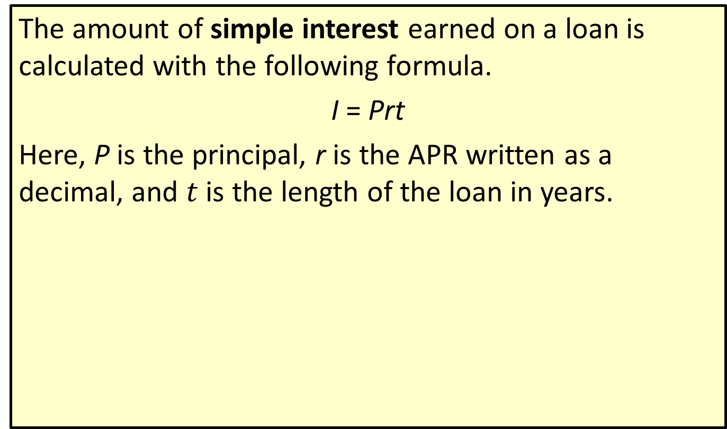
Definition: Simple Interest
The amount of simple interest earned on a loan is calculated with the following formula.
I = Prt
Here, P is the principal, r is the APR written as a decimal, and $t$ is the length of the loan in years.

Slide 5
Helpful Hint 1
A credit score is a number that ranks your risk as a borrower.

Slide 6
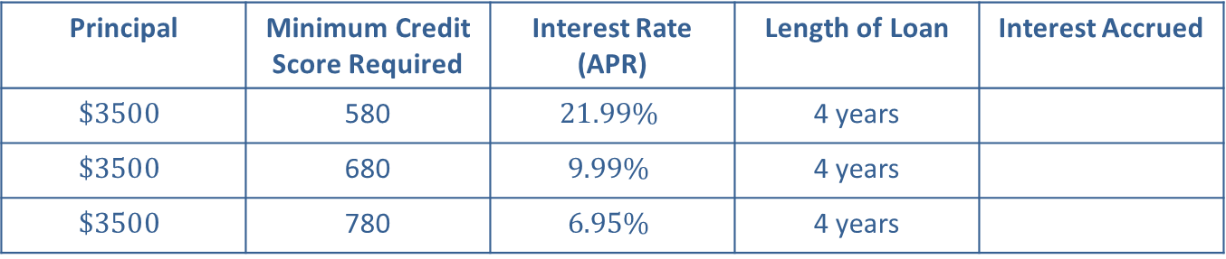
Example 1: Calculating Simple Interest—Slide 1
An online lending company is offering simple-interest personal loans based on consumer credit scores, as shown in Table 1. The better your credit score, the lower the interest rate.
Table 1: Simple Interest
Principal | Minimum Credit Score Required | Interest Rate (APR) | Length of Loan | Interest Accrued
$$\$3500$$ | 580 | $$21.99\%$$ | 4 years
$$\$3500$$ | 680 | $$9.99\%$$ | 4 years
$$\$3500$$ | 780 | $$6.95\%$$ | 4 years

Slide 7
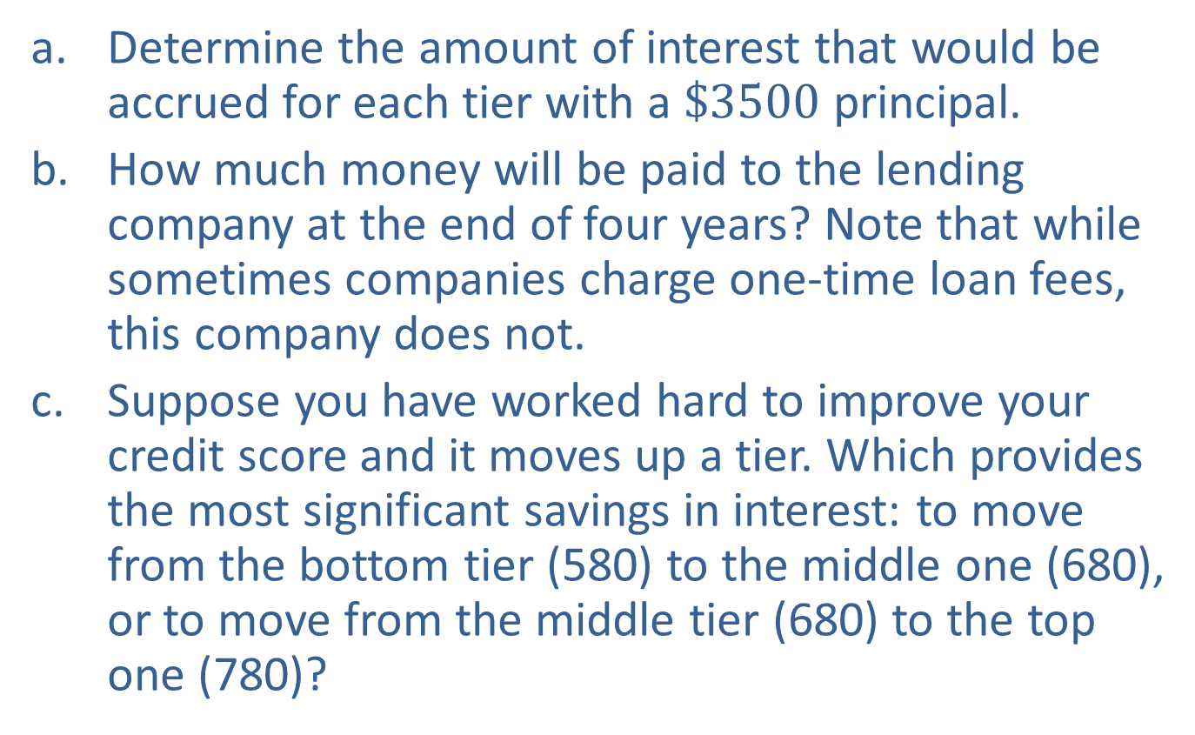
Example 1: Calculating Simple Interest—Slide 2
a. Determine the amount of interest that would be accrued for each tier with a $\$3500$ principal.
b. How much money will be paid to the lending company at the end of four years? Note that while sometimes companies charge one-time loan fees, this company does not.
c. Suppose you have worked hard to improve your credit score and it moves up a tier. Which provides the most significant savings in interest: to move from the bottom tier (580) to the middle one (680), or to move from the middle tier (680) to the top one (780)?

Slide 8
Example 1: Calculating Simple Interest—Slide 3
Solution
a. Although we are calculating simple interest for three cases in this scenario, the principal P and the time t are the same for each: P = $3500 and t = 4. The interest rate is the only value that changes.
​ By Hand
    The multiplication using the simple interest formula is shown in Table 2 for each credit-score tier. Note that since the interest rate is given as a percentage, it will need to be changed to a decimal before substituting it in the formula.

Slide 9
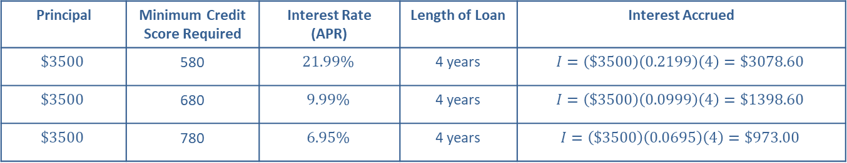
Example 1: Calculating Simple Interest—Slide 4
Table 2: Simple Interest
Principal | Minimum Credit Score Required | Interest Rate (APR) | Length of Loan | Interest Accrued
$$\$3500$$ | 580 | $$21.99\%$$ | 4 years | $$I=\left(\$3500\right)\left(0.2199\right)\left(4\right)=\$3078.60$$
$$\$3500$$ | 680 | $$9.99\%$$ | 4 years | $$I=\left(\$3500\right)\left(0.0999\right)\left(4\right)=\$1398.60$$
$$\$3500$$ | 780 | $$6.95\%$$ | 4 years | $$I=\left(\$3500\right)\left(0.0695\right)\left(4\right)=\$973.00$$

Slide 10
Example 1: Calculating Simple Interest—Slide 5
​Microsoft Excel
Excel can be used to calculate all three interest amounts. For clarity, we'll begin by labeling the columns "Principal", "Interest rate", "Length of loan", and "Interest accrued", in A1 through D1, respectively. Next enter the necessary data into the first 3 empty columns; that is, enter the values for principal in column A, interest rate in column B, and length of loan in column C. In cell D2, input the formula for interest "=A2*B2*C2" and press Enter. The value will appear as $3,078.60.
Drag the bottom right-hand corner of cell D2 down through cell D4. This will copy the formula into cells D3 and D4 while updating the referenced cells. The values $1,398.60 and $973.00 will appear in cells D3 and D4, respectively.

Slide 11
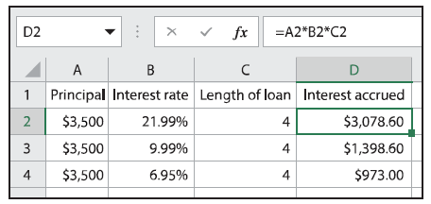
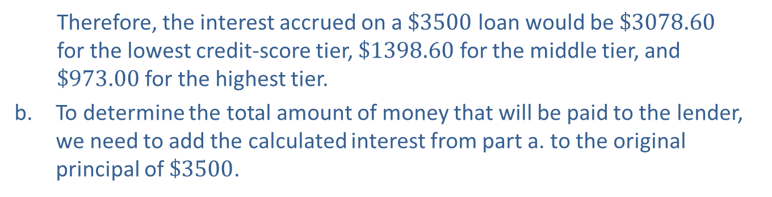
Example 1: Calculating Simple Interest—Slide 6
Figure 2
  Therefore, the interest accrued on a $\$3500$ loan would be $\$3078.60$ for the lowest credit-score tier, $\$1398.60$ for the middle tier, and $\$973.00$ for the highest tier.
b. To determine the total amount of money that will be paid to the lender, we need to add the calculated interest from part a. to the original principal of $\$3500$.

Slide 12
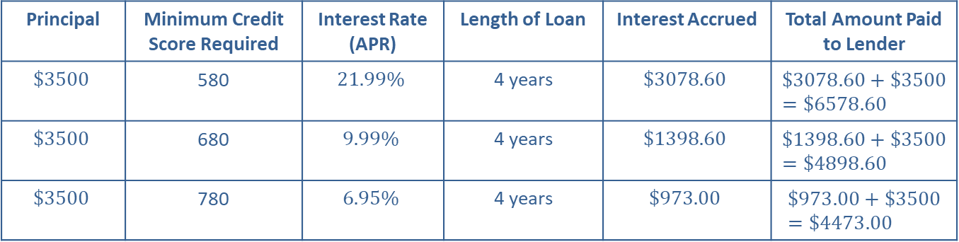
Example 1: Calculating Simple Interest—Slide 7
​ By Hand
Table 3 shows the addition in the last column.
Table 3: Simple Interest
Principal | Minimum Credit Score Required | Interest Rate (APR) | Length of Loan | Interest Accrued | Total Amount Paid to Lender
$$\$3500$$ | 580 | $$21.99\%$$ | 4 years | $$\$3078.60$$ | $$\$3078.60+\$3500=\$6578.60$$
$$\$3500$$ | 680 | $$9.99\%$$ | 4 years | $$\$1398.60$$ | $$\$1398.60+\$3500=\$4898.60$$
$$\$3500$$ | 780 | $$6.95\%$$ | 4 years | $$\$973.00$$ | $$\$973.00+\$3500=\$4473.00$$

Slide 13
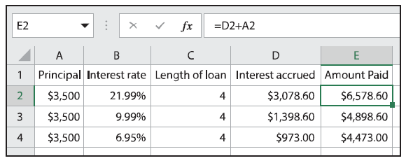
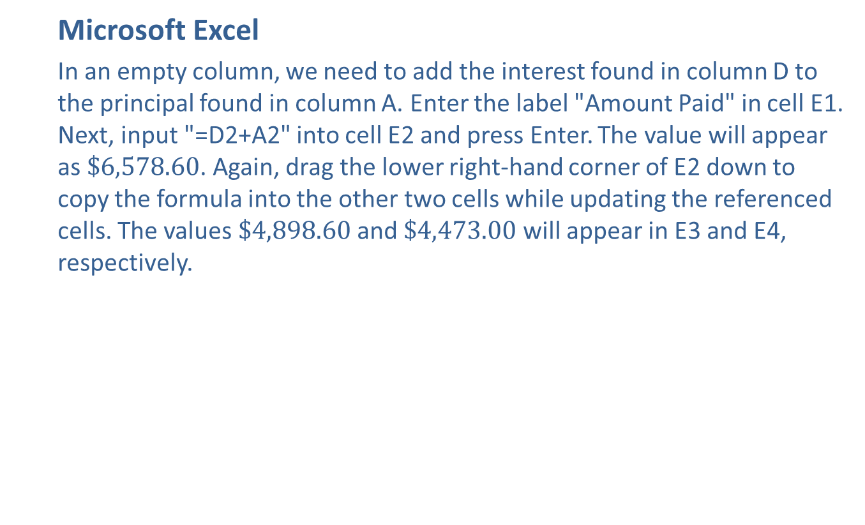
Example 1: Calculating Simple Interest—Slide 8
  Microsoft Excel
  In an empty column, we need to add the interest found in column D to the principal found in column A. Enter the label "Amount Paid" in cell E1. Next, input "=D2+A2" into cell E2 and press Enter. The value will appear as $\$6,578.60$. Again, drag the lower right-hand corner of E2 down to copy the formula into the other two cells while updating the referenced cells. The values $\$4,898.60$ and $\$4,473.00$ will appear in E3 and E4, respectively.
Figure 3

Slide 14
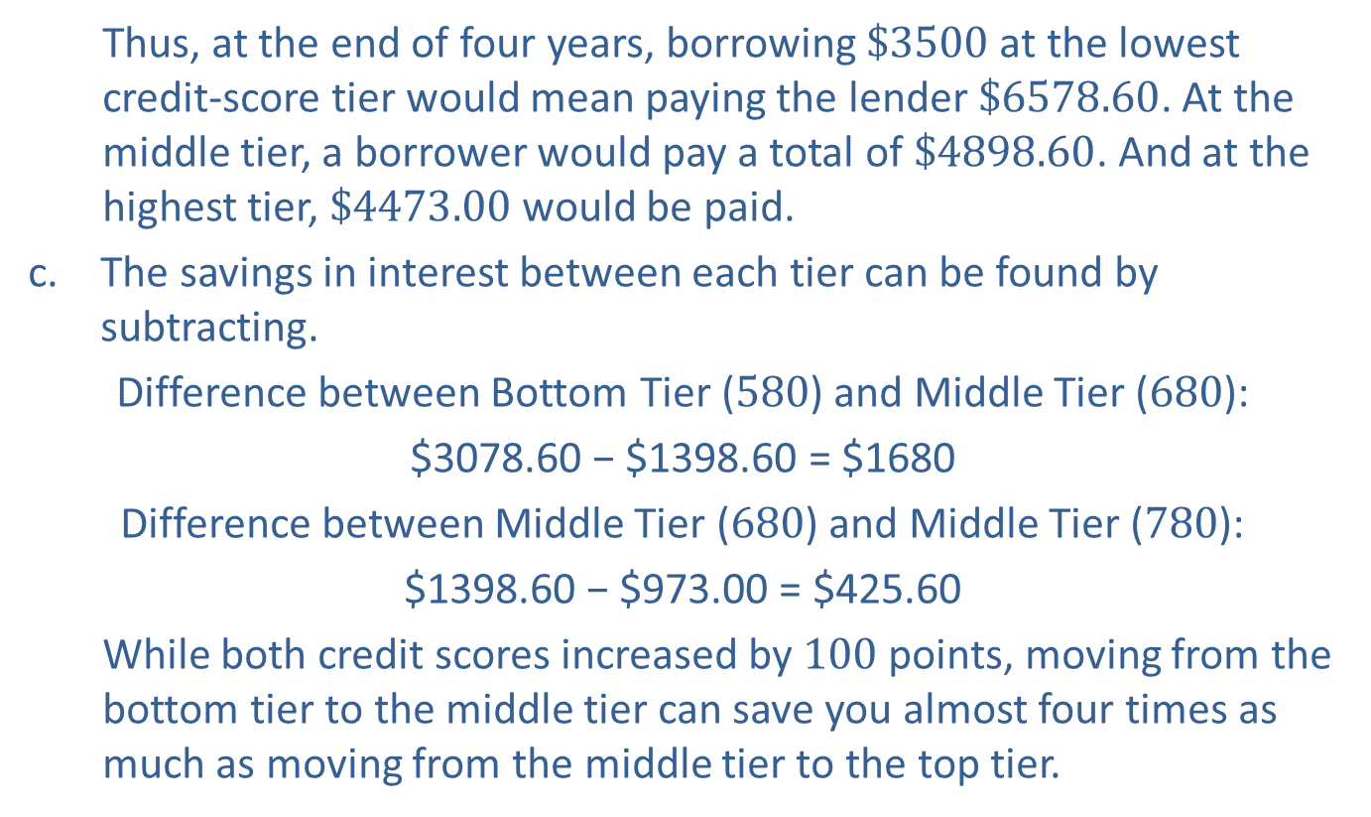
Example 1: Calculating Simple Interest—Slide 9
  ​Thus, at the end of four years, borrowing $\$3500$ at the lowest credit-score tier would mean paying the lender $\$6578.60$. At the middle tier, a borrower would pay a total of $\$4898.60$. And at the highest tier, $\$4473.00$ would be paid.
c. The savings in interest between each tier can be found by subtracting.
​Difference between Bottom Tier (580) and Middle Tier (680):
$3078.60 − $1398.60 = $1680
​Difference between Middle Tier (680) and Middle Tier (780):
$1398.60 − $973.00 = $425.60
  ​While both credit scores increased by 100 points, moving from the bottom tier to the middle tier can save you almost four times as much as moving from the middle tier to the top tier.

Slide 15
Definition: Future Value for Simple Interest
The future value, A, of a loan is the amount to be repaid at the end of the loan period. It is the principal amount plus any interest accrued. Using simple interest, future value is calculated with the following formula.
Here, P is the principal, r is the APR written as a decimal, and t is the length of the loan in years.

Slide 16
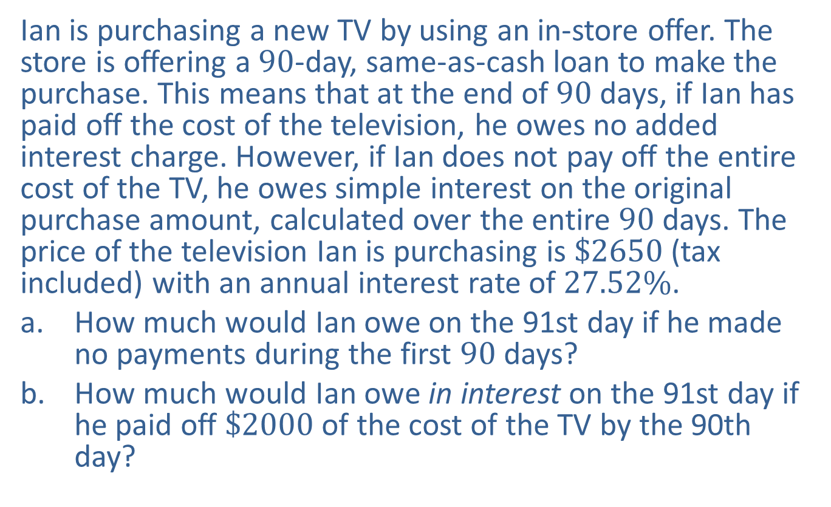
Example 2: Calculating Future Value for Simple Interest with a Partial Year—Slide 1
Ian is purchasing a new TV by using an in-store offer. The store is offering a 90-day, same-as-cash loan to make the purchase. This means that at the end of 90 days, if Ian has paid off the cost of the television, he owes no added interest charge. However, if Ian does not pay off the entire cost of the TV, he owes simple interest on the original purchase amount, calculated over the entire 90 days. The price of the television Ian is purchasing is $\$2650$ (tax included) with an annual interest rate of $27.52\%$.
a. How much would Ian owe on the 91st day if he made no payments during the first 90 days?
b. How much would Ian owe in interest on the 91st day if he paid off $\$2000$ of the cost of the TV by the 90th day?

Slide 17
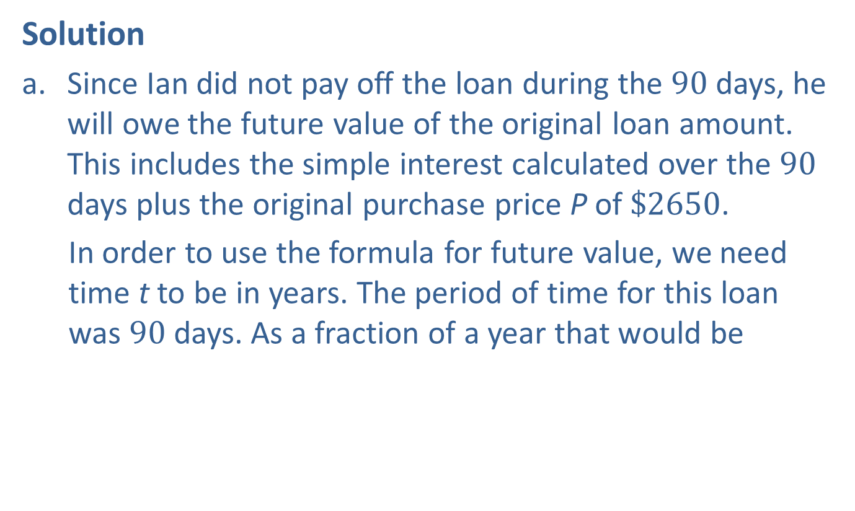
Example 2: Calculating Future Value for Simple Interest with a Partial Year—Slide 2
Solution
a. Since Ian did not pay off the loan during the 90 days, he will owe the future value of the original loan amount. This includes the simple interest calculated over the 90 days plus the original purchase price P of $\$2650$.
  In order to use the formula for future value, we need time t to be in years. The period of time for this loan was 90 days. As a fraction of a year that would be
The interest rate must also be in decimal form,
so r = 0.2752.

Slide 18
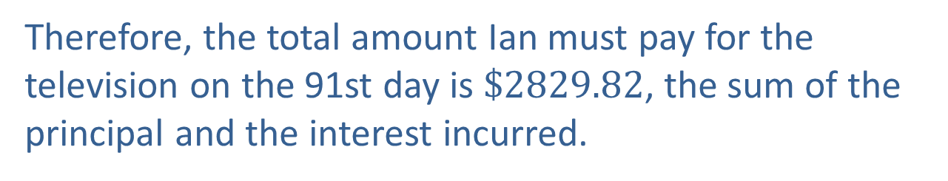
Example 2: Calculating Future Value for Simple Interest with a Partial Year—Slide 3
Therefore, the total amount Ian must pay for the television on the 91st day is $\$2829.82$, the sum of the principal and the interest incurred.

Slide 19
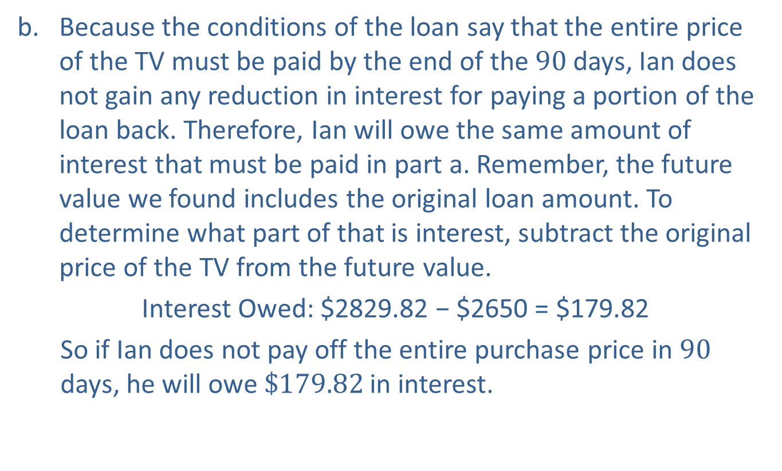
Example 2: Calculating Future Value for Simple Interest with a Partial Year—Slide 4
b. Because the conditions of the loan say that the entire price of the TV must be paid by the end of the 90 days, Ian does not gain any reduction in interest for paying a portion of the loan back. Therefore, Ian will owe the same amount of interest that must be paid in part a. Remember, the future value we found includes the original loan amount. To determine what part of that is interest, subtract the original price of the TV from the future value.
​Interest Owed: $2829.82 − $2650 = $179.82
  ​So if Ian does not pay off the entire purchase price in 90 days, he will owe $\$179.82$ in interest.

Slide 20

Skill Check 1
Find the total cost of a loan for $\$4320$ that has a simple interest rate of $15\%$ for 18 months.
Answer: $\$$5292

Slide 21
Fun Fact
Benjamin Franklin was keenly aware of the power of compound interest. Upon his death in 1790, he left a sum of about $4500 each to the cities of Philadelphia and Boston to be invested in a trust for 200 years. After the first 100 years, the cities could withdraw up to 75 % of the amount and after the second 100 years, they could withdraw the rest. Had the cities not withdrawn any money after the first 100 years, each city would have had a balance of about $77,816,613.67 after 200 years. Visit http://mathcentral.uregina.ca/beyond/articles/CompoundInterest/
Money.html to learn more.

Slide 22
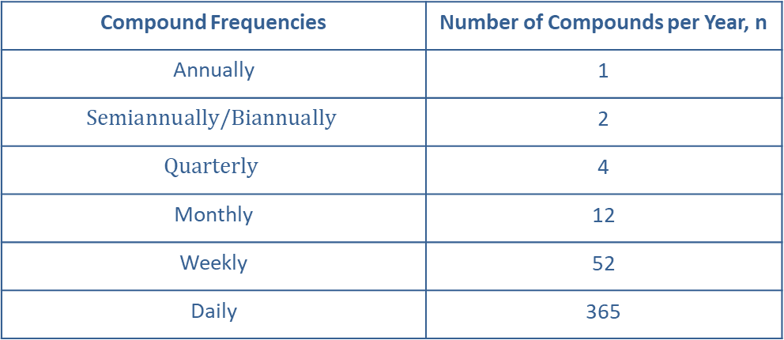
Compound Interest
Table 4: Common Compounding Intervals
Compound Frequencies | Number of Compounds per Year, n
Annually | 1
$$Semiannually/Biannually$$ | 2
$$Quarterly$$ | 4
Monthly | 12
Weekly | 52
Daily | 365

Slide 23
Definition: Future Value for Compound Interest
The future value, A, of a loan is the amount to be repaid at the end of the loan period. It is the principal amount plus any interest accrued. Using compound interest, future value is calculated with the following formula.
Here, P is the principal, r is the APR written as a decimal, t is the length of the loan in years, and n is the number of compounding intervals per year.

Slide 24
Helpful Hint 2
Linear functions grow at a steady rate. Exponential functions grow in relation to how big they are. The bigger it gets, the faster it grows.

Slide 25
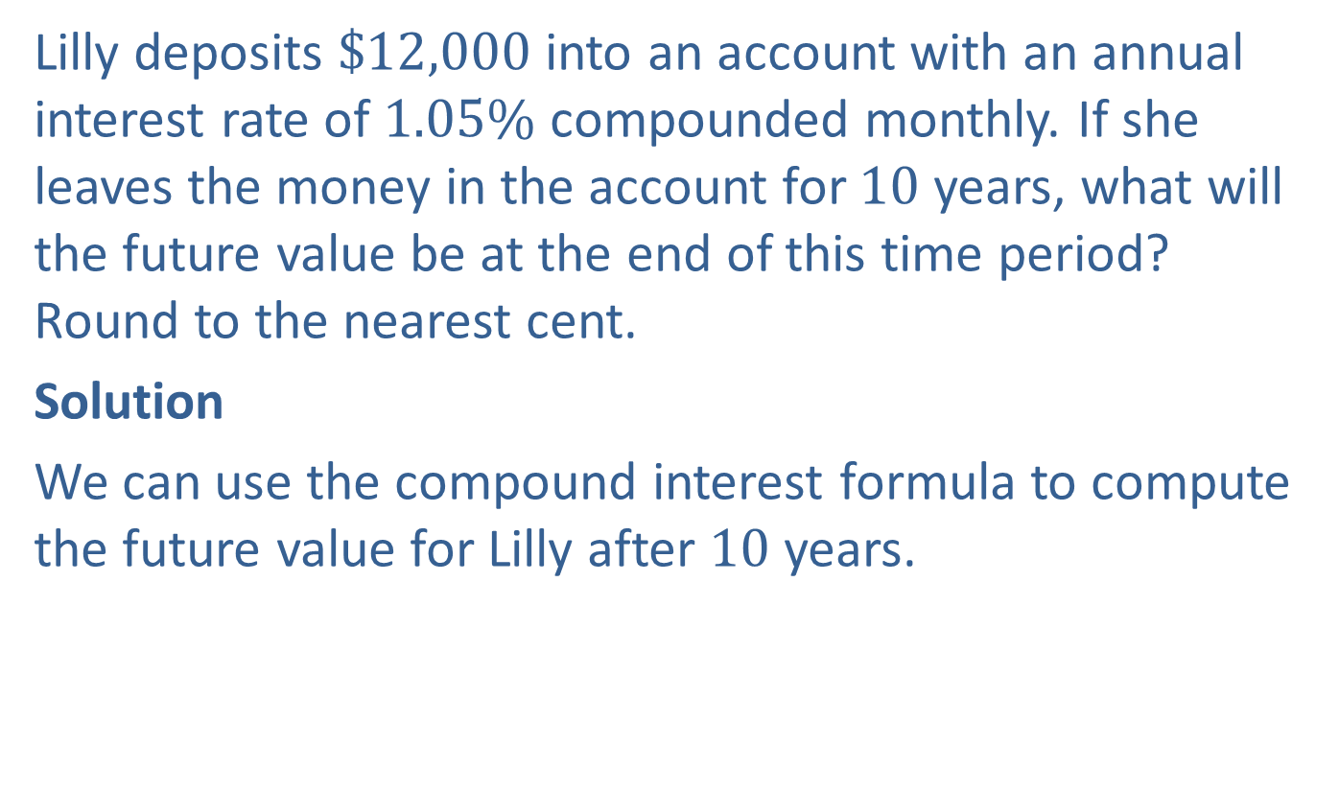
Example 3: Calculating Future Value for Compound Interest—Slide 1
Lilly deposits $\$12,000$ into an account with an annual interest rate of $1.05\%$ compounded monthly. If she leaves the money in the account for 10 years, what will the future value be at the end of this time period? Round to the nearest cent.
Solution
We can use the compound interest formula to compute the future value for Lilly after 10 years.

Slide 26
Example 3: Calculating Future Value for Compound Interest—Slide 2
  By Hand
  In this case, P = $12,000, r = 0.0105, and t = 10. Since interest is compounded monthly, n = 12.

Slide 27
Helpful Hint 3
When using the TVM Solver, any of the variables can be changed without needing to re-enter all of the data.

Slide 28
Example 3: Calculating Future Value for Compound Interest—Slide 3
TI-83/84 Plus
The TI-83/84 Plus has a built-in financial app called TVM (which stands for Time, Value, Money) that can be used to find compound interest. To access this, press apps, select Finance…, and then select TVM Solver. You will be prompted to enter values for the following variables.
N is the total number of times the account is compounded;
I% is the interest rate as a percentage;
PV is the present value;
PMT is the monthly payment, which is 0 if no monthly payments are being made;

Slide 29
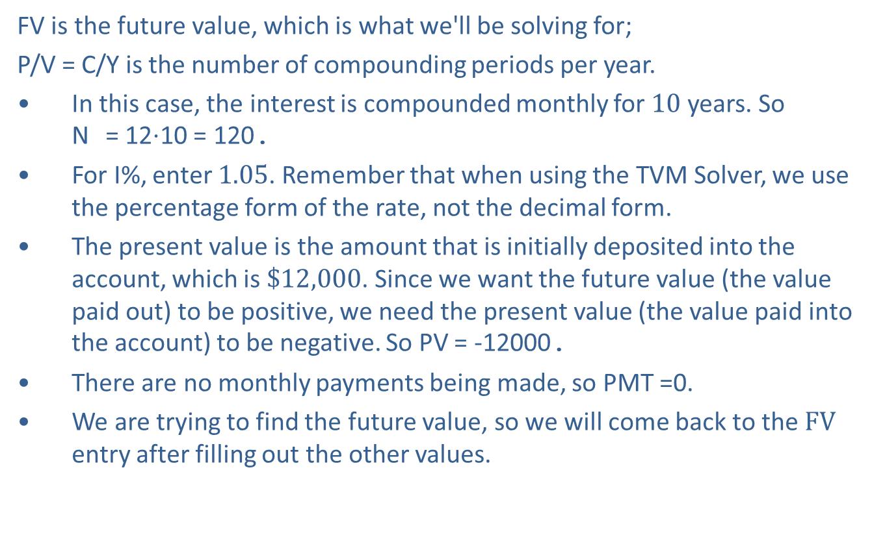
Example 3: Calculating Future Value for Compound Interest—Slide 4
FV is the future value, which is what we'll be solving for;
P/V = C/Y is the number of compounding periods per year.
​In this case, the interest is compounded monthly for 10 years. So
N = 12⋅10 = 120.
​For I%, enter 1.05. Remember that when using the TVM Solver, we use the percentage form of the rate, not the decimal form.
​The present value is the amount that is initially deposited into the account, which is $\$12,000$. Since we want the future value (the value paid out) to be positive, we need the present value (the value paid into the account) to be negative. So PV = -12000.
There are no monthly payments being made, so PMT =0.
We are trying to find the future value, so we will come back to the $FV$ entry after filling out the other values.

Slide 30
Example 3: Calculating Future Value for Compound Interest—Slide 5
​Because the interest is being compounded monthly, P/Y = C/Y = 12. (Note that once you enter a value for P/Y, the value of C/Y is automatically updated to that same value.) ​
The final option for PMT: is either END or BEGIN. This refers to whether the payments are being made at the beginning of each period or at the end. Typically, payments are made at the end of each period, so be sure that END is highlighted.
Once these values are filled out, return your cursor to the FV entry and press clear. To solve for this value, press alpha enter. The value is calculated as 13327.91542.

Slide 31
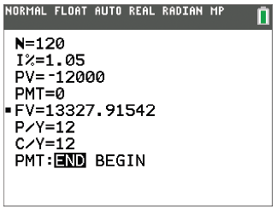
Tech Tip 1
To change the number of decimal points displayed, press the mode key, then the down arrow key once (to the FLOAT line). Next, use the right arrow key to highlight the 5 and press enter.
Figure 4

Slide 32
Example 3: Calculating Future Value for Compound Interest—Slide 6
Microsoft Excel
Excel has a built-in financial function FV(rate, nper, pmt, [pv], [type]) that calculates the future value of an account given certain information about the account, such as the interest rate and the initial value. The specific arguments for this function are defined as follows:
rate is the interest rate per period. This is the interest rate divided by the number of compounding periods per year.
nper is the total number of compounding periods. This is the number of periods per year multiplied by the length of the loan in years.
pmt is the payment made each period. This can be left blank if no payments are made.

Slide 33
Example 3: Calculating Future Value for Compound Interest—Slide 7
pv is the present value, or principal amount. Default is 0.
type refers to whether payments are being made at the beginning of each period or at the end; 0 = end of the period,
1 = beginning of the period. Default is 0.
​In this example, we have an interest rate of 0.0105 that is being compounded 12 times a year, so for the first argument in this Excel function, we have rate = 0.0105/12. Be careful to not use just the interest rate here.
​Because the interest is being compounded monthly for 10 years, we will use 12 ⋅ 10 = 120 for nper.
​There are no payments being made, so we will use pmt = 0, or leave that argument empty.

Slide 34
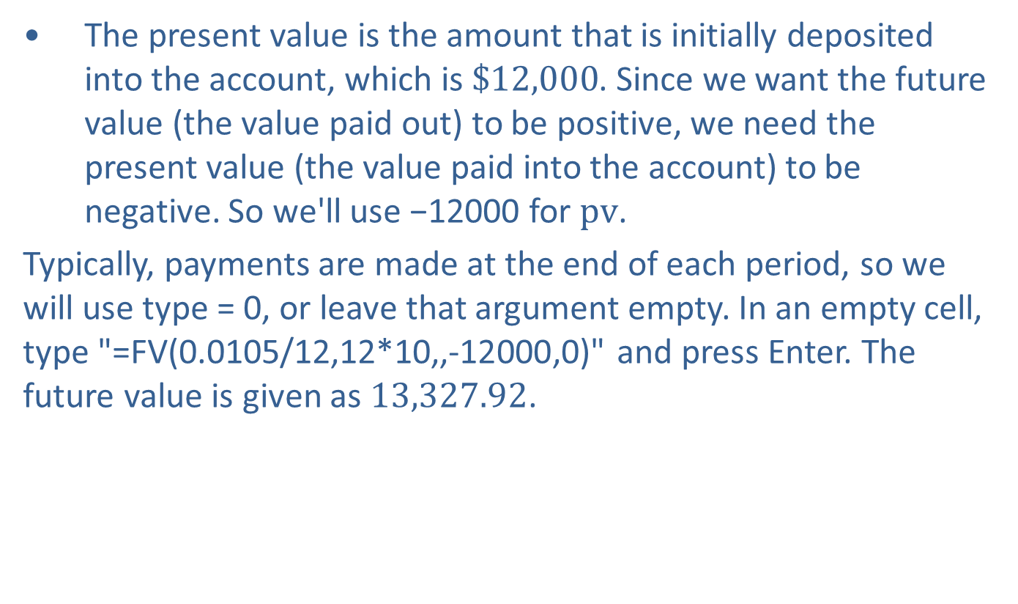
Example 3: Calculating Future Value for Compound Interest—Slide 8
​The present value is the amount that is initially deposited into the account, which is $\$12,000$. Since we want the future value (the value paid out) to be positive, we need the present value (the value paid into the account) to be negative. So we'll use −12000 for $pv$.
Typically, payments are made at the end of each period, so we will use type = 0, or leave that argument empty. In an empty cell, type "=FV(0.0105/12,12*10,,-12000,0)" and press Enter. The future value is given as 13,327.92.

Slide 35
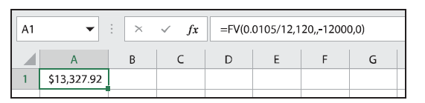
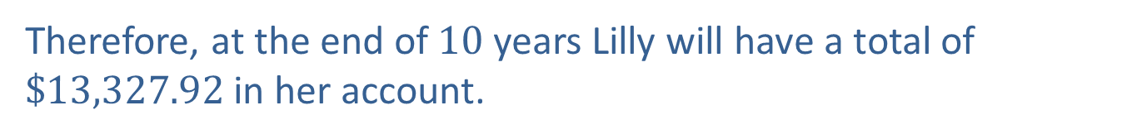
Example 3: Calculating Future Value for Compound Interest—Slide 9
Figure 5
Therefore, at the end of 10 years Lilly will have a total of $\$13,327.92$ in her account.

Slide 36

Skill Check 2
Use the information in Example 6.1.3 to find the future value of Lilly's account after 20 years.
Answer: $\$$14,802.78

Slide 37
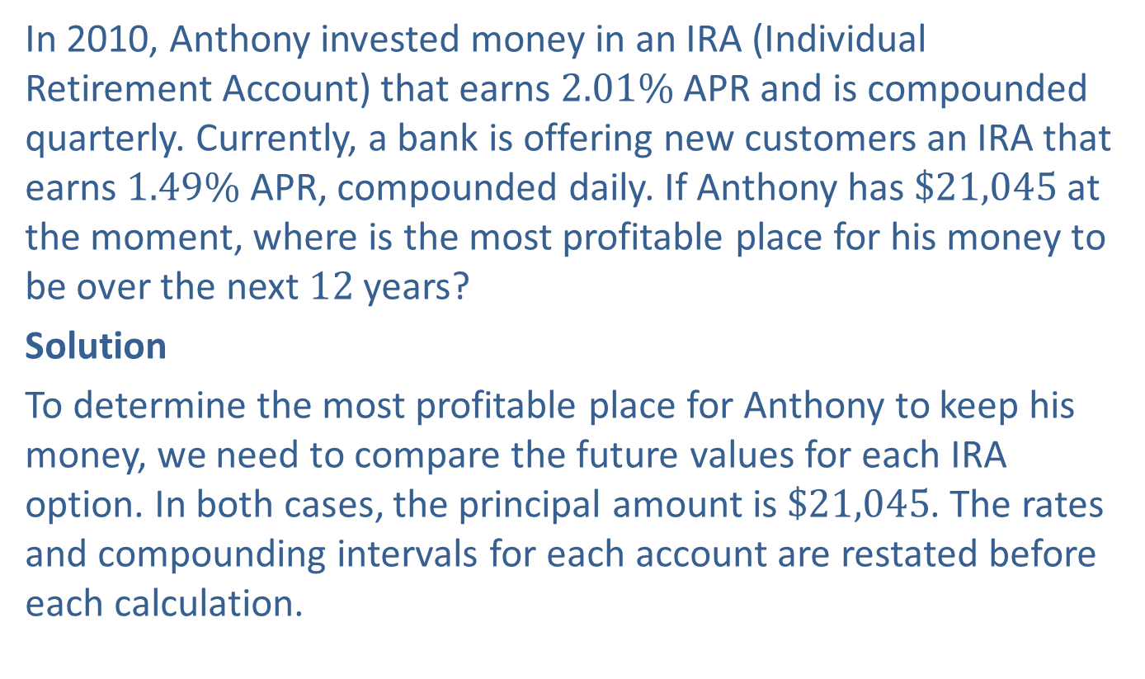
Example 4: Comparing Compound Interest Rates and Intervals—Slide 1
In 2010, Anthony invested money in an IRA (Individual Retirement Account) that earns $2.01\%$ APR and is compounded quarterly. Currently, a bank is offering new customers an IRA that earns $1.49\%$ APR, compounded daily. If Anthony has $\$21,045$ at the moment, where is the most profitable place for his money to be over the next 12 years?
Solution
To determine the most profitable place for Anthony to keep his money, we need to compare the future values for each IRA option. In both cases, the principal amount is $\$21,045$. The rates and compounding intervals for each account are restated before each calculation.

Slide 38
Example 4: Comparing Compound Interest Rates and Intervals—Slide 2
  By Hand
Current IRA:
New IRA:

Slide 39
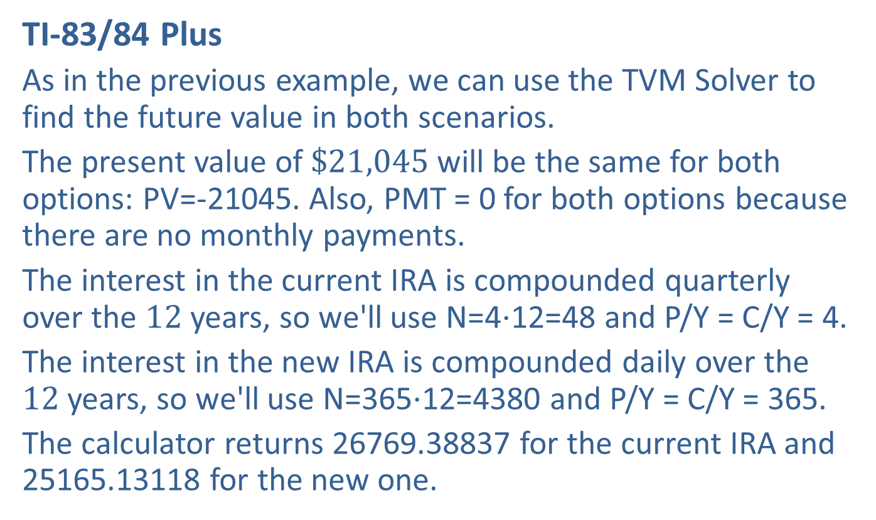
Example 4: Comparing Compound Interest Rates and Intervals—Slide 3
TI-83/84 Plus
As in the previous example, we can use the TVM Solver to find the future value in both scenarios.
The present value of $\$21,045$ will be the same for both options: PV=-21045. Also, PMT = 0 for both options because there are no monthly payments.
The interest in the current IRA is compounded quarterly over the 12 years, so we'll use N=4⋅12=48 and P/Y = C/Y = 4.
The interest in the new IRA is compounded daily over the 12 years, so we'll use N=365⋅12=4380 and P/Y = C/Y = 365.
The calculator returns 26769.38837 for the current IRA and 25165.13118 for the new one.

Slide 40
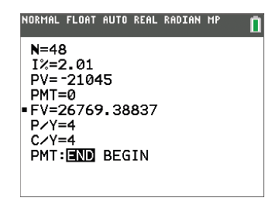
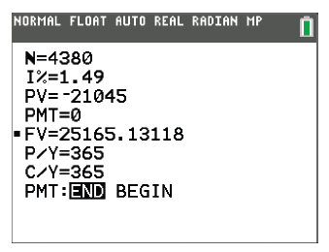
Example 4: Comparing Compound Interest Rates and Intervals—Slide 4
Figure 6
Figure 7

Slide 41
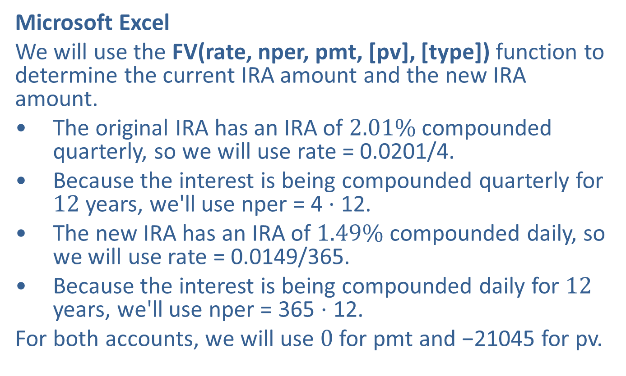
Example 4: Comparing Compound Interest Rates and Intervals—Slide 5
Microsoft Excel
We will use the FV(rate, nper, pmt, [pv], [type]) function to determine the current IRA amount and the new IRA amount.
​The original IRA has an IRA of $2.01\%$ compounded quarterly, so we will use rate = 0.0201/4.
​Because the interest is being compounded quarterly for 12 years, we'll use nper = 4 ⋅ 12.
​The new IRA has an IRA of $1.49\%$ compounded daily, so we will use rate = 0.0149/365.
​Because the interest is being compounded daily for 12 years, we'll use nper = 365 ⋅ 12.
For both accounts, we will use 0 for pmt and −21045 for pv.

Slide 42
Example 4: Comparing Compound Interest Rates and Intervals—Slide 6
To keep track of the two accounts, enter "Current IRA " in cell A1 and "New IRA " in cell B1.
Calculate the future value of the current IRA in cell A2 by typing "=FV(0.0201/4,4*12,,-21045,0)" and pressing Enter. This gives a value of 26,769.39.
Calculate the future value of the new IRA in cell B2 by typing "=FV(0.0149/365,365*12,,-21045,0)" and pressing Enter. This gives a value of 25,165.13.

Slide 43
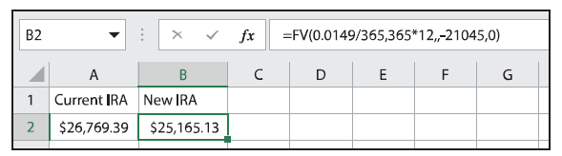
Example 4: Comparing Compound Interest Rates and Intervals—Slide 7
Figure 8
Therefore, Anthony's current IRA will earn more than the new offer. Notice that the increase in number of compounding intervals was not enough to outweigh the difference in interest rate. So Anthony would do better to leave his money in the current IRA account.

Slide 44
Definition: Future Value for Continuous Compound Interest
The future value, A, of a loan is the amount to be repaid at the end of the loan period. It is the principal amount plus any interest accrued. Using continuous compound interest, future value is calculated with the following formula.
Here, P is the principal, r is the APR written as a decimal, and t is the length of the loan in years.

Slide 45
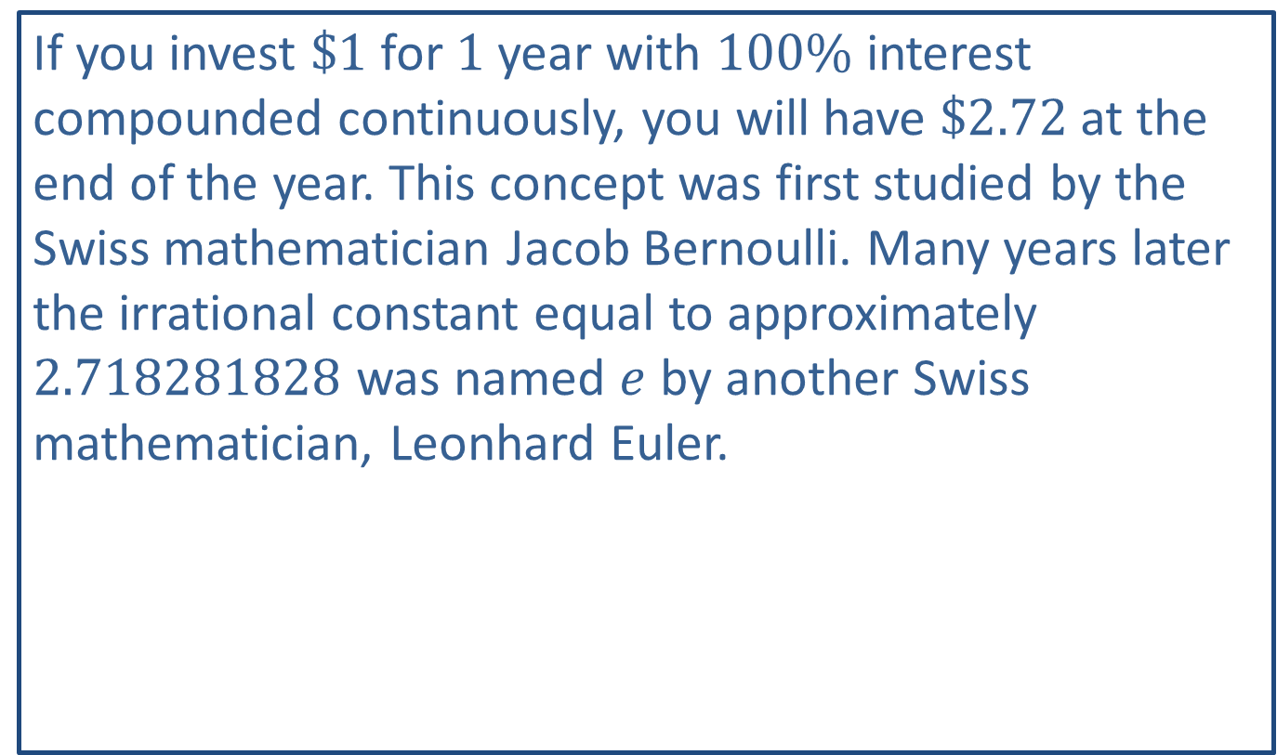
Math Milestone
If you invest $\$1$ for 1 year with $100\%$ interest compounded continuously, you will have $\$2.72$ at the end of the year. This concept was first studied by the Swiss mathematician Jacob Bernoulli. Many years later the irrational constant equal to approximately 2.718281828 was named $e$ by another Swiss mathematician, Leonhard Euler.

Slide 46
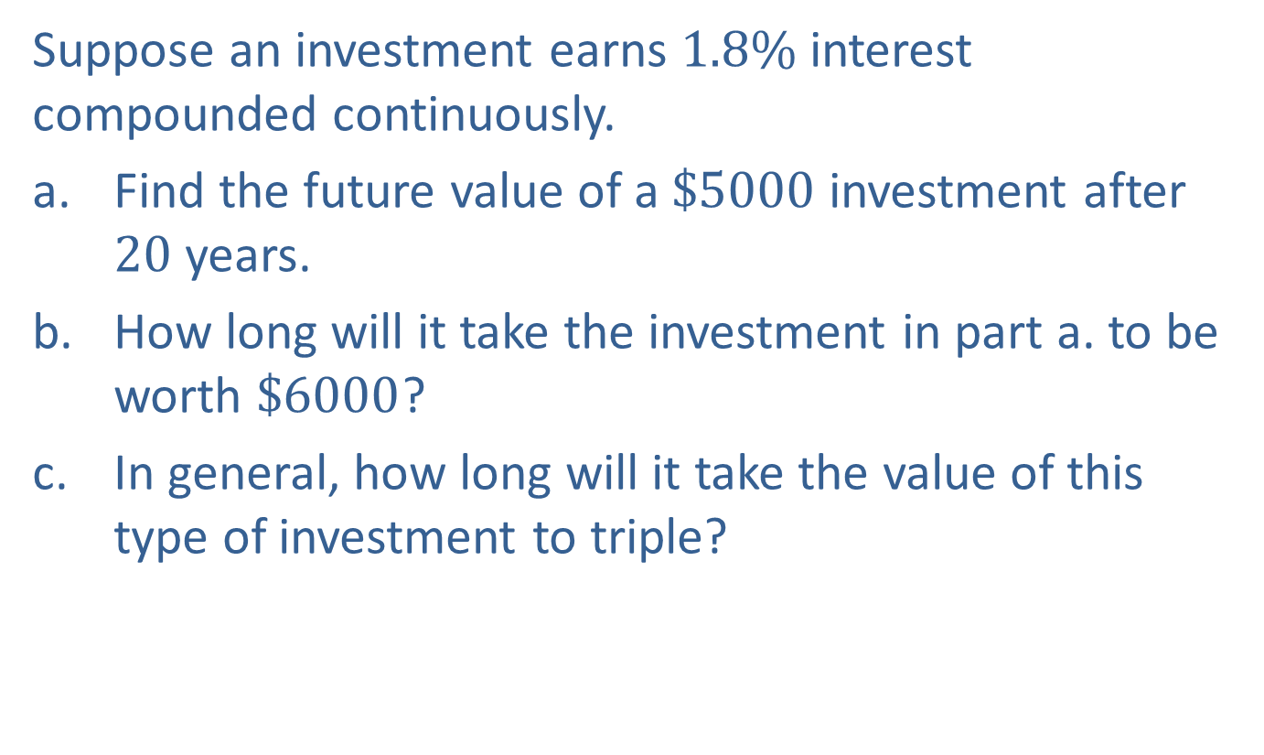
Example 5: Calculating Continuous Compound Interest—Slide 1
Suppose an investment earns $1.8\%$ interest compounded continuously.
a. ​Find the future value of a $\$5000$ investment after 20 years.
b. How long will it take the investment in part a. to be worth $\$6000$?
c. In general, how long will it take the value of this type of investment to triple?

Slide 47

Example 5: Calculating Continuous Compound Interest—Slide 2
Solution
a. We are given the following quantities to use in the formula for future value when the interest is compounded continuously.
​P = $5000 r = 0.018 t = 20
  So the future value is calculated as follows.
After 20 years, the investment will be worth $\$7166.65$.

Slide 48
Example 5: Calculating Continuous Compound Interest—Slide 3
b. ​In this question, we are told the future value we want to reach is $6000, so A = $6000. We are asked to find the time t if the rate stays at r = 0.018. Let's fill in what we know in our formula for future value.
Notice that the variable t is in the exponent. We can solve the equation for t by dividing and using natural logarithms.​

Slide 49
Helpful Hint 4
When working with the continuously compounding formula, think of e as a constant.

Slide 50
Tech Tip 2
The e button is typically the second function of the Ln button on a scientific calculator. Use the following keystrokes to calculate the future investment.
5000 * 2nd Ln 0.018 * 20

Slide 51
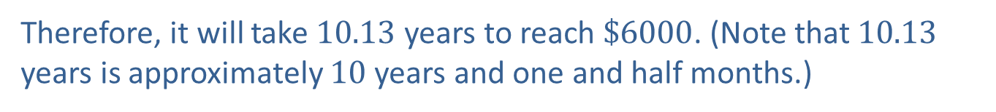
Example 5: Calculating Continuous Compound Interest—Slide 4
Therefore, it will take 10.13 years to reach $\$6000$. (Note that 10.13 years is approximately 10 years and one and half months.)

Slide 52
Example 5: Calculating Continuous Compound Interest—Slide 5
c. In order for the value to triple, the future value needs to be three times the amount of the principal. So if we let P represent the amount of the principal, then that amount tripled would be 3P. We can substitute this information along with the rate of 0.018 in the equation and solve for time once again.​

Slide 53
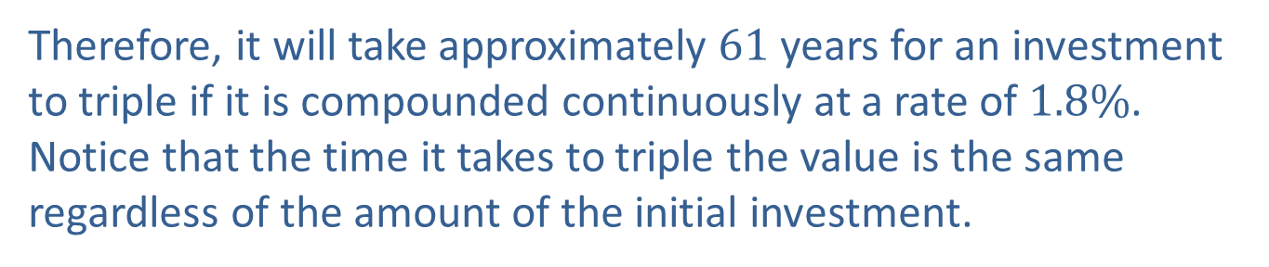
Example 5: Calculating Continuous Compound Interest—Slide 6
Therefore, it will take approximately 61 years for an investment to triple if it is compounded continuously at a rate of $1.8\%$. Notice that the time it takes to triple the value is the same regardless of the amount of the initial investment.

Slide 54

Skill Check 3
Find the future value of a $\$1000$ investment after 15 years if the investment earns $2.5\%$ interest compounded continuously.
Answer: $\$$1454.99

Slide 55
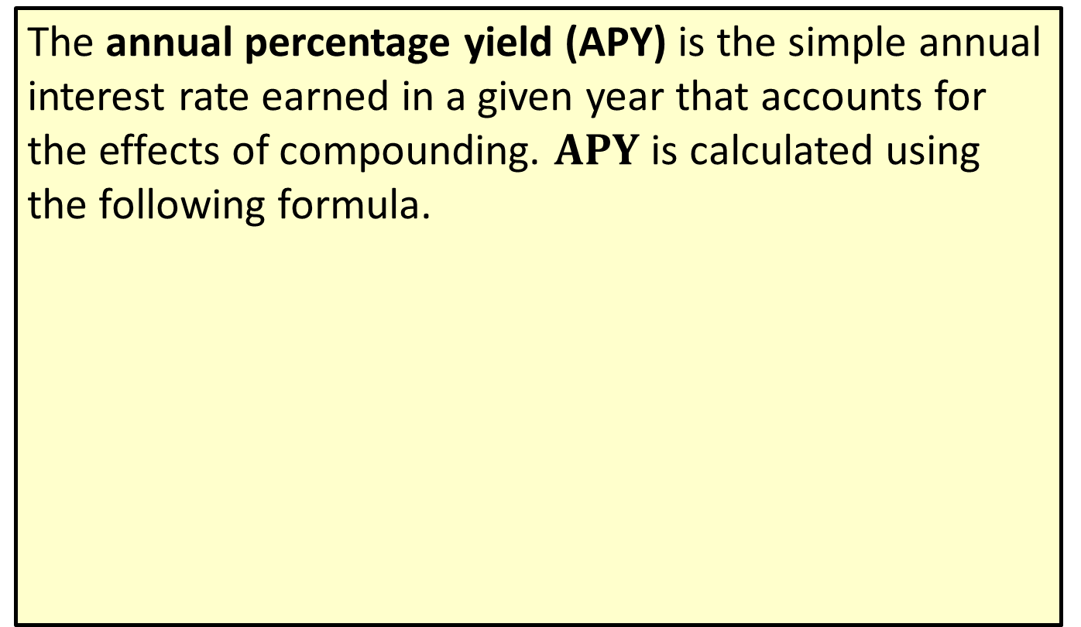
Definition: Annual Percentage Yield (APY)
The annual percentage yield (APY) is the simple annual interest rate earned in a given year that accounts for the effects of compounding. $APY$ is calculated using the following formula.
Here, r is the APR written as a decimal and n is the number of compounding intervals per year.

Slide 56
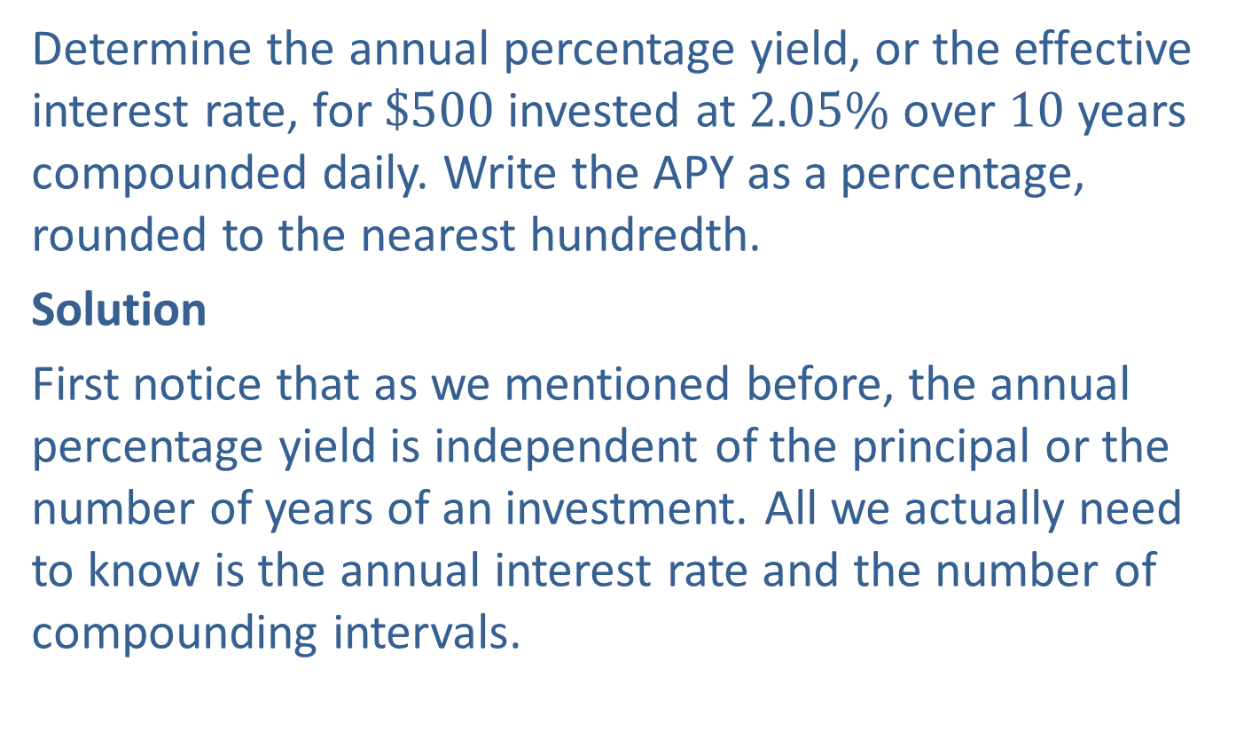
Example 6: Calculating Annual Percentage Yield (APY)—Slide 1
Determine the annual percentage yield, or the effective interest rate, for $\$500$ invested at $2.05\%$ over 10 years compounded daily. Write the APY as a percentage, rounded to the nearest hundredth.
Solution
First notice that as we mentioned before, the annual percentage yield is independent of the principal or the number of years of an investment. All we actually need to know is the annual interest rate and the number of compounding intervals.

Slide 57

Example 6: Calculating Annual Percentage Yield (APY)—Slide 2
By Hand
For this example, r = 0.0205 and n = 365. Substituting these values into the formula for $APY$, we have the following calculation.

Slide 58

Example 6: Calculating Annual Percentage Yield (APY)—Slide 3
TI-83/84 Plus
The TI-83/84 Plus does not have a function that computes the APY directly. Instead, we first need to use the TVM Solver to find the future value of this account after the 10 years. We will then use the TVM Solver a second time with this future value to find the $APY$.

Slide 59
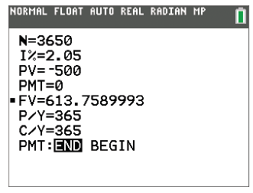

Example 6: Calculating Annual Percentage Yield (APY)—Slide 4
1st Step
We will use 2.05 for I% and $−500$ for PV⋅ PMT = 0 because there are no monthly payments. The interest rate in this account is compounded daily for 10 years, so we'll use N=365⋅10=3650 and P/Y = C/Y = 365. Solving for $FV$, we get 613.7589993.
Figure 9

Slide 60
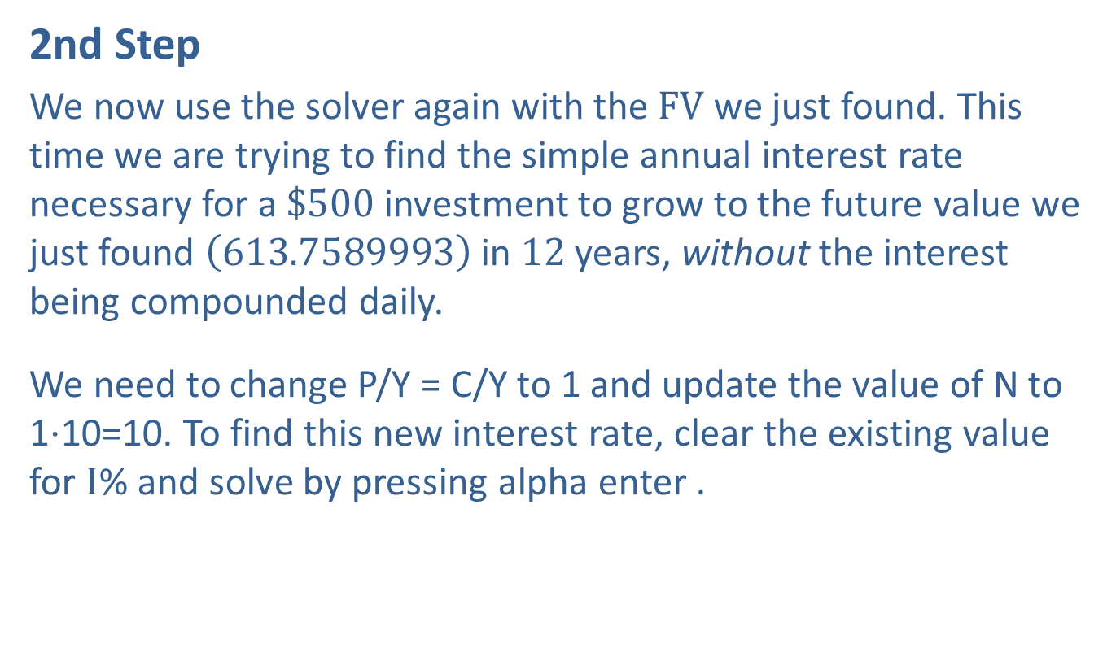
Example 6: Calculating Annual Percentage Yield (APY)—Slide 5
2nd Step
We now use the solver again with the $FV$ we just found. This time we are trying to find the simple annual interest rate necessary for a $\$500$ investment to grow to the future value we just found $\left(613.7589993\right)$ in 12 years, without the interest being compounded daily.
We need to change P/Y = C/Y to 1 and update the value of N to 1⋅10=10. To find this new interest rate, clear the existing value for I% and solve by pressing alpha enter .

Slide 61
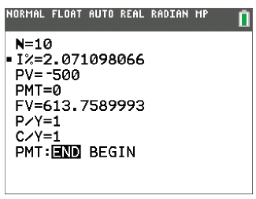
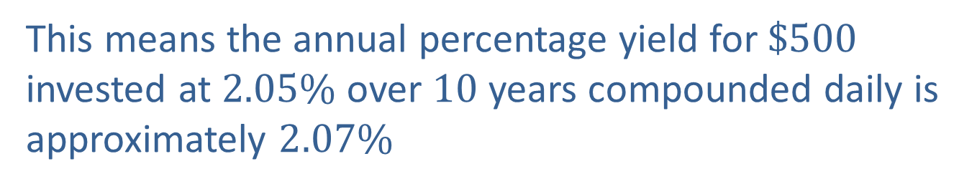
Example 6: Calculating Annual Percentage Yield (APY)—Slide 6
The calculator returns 2.071098066.
Figure 10
This means the annual percentage yield for $\$500$ invested at $2.05\%$ over 10 years compounded daily is approximately $2.07\%$

Slide 62

Skill Check 4
Determine the APY for a $4.2\%$ interest rate compounded monthly. Round to the nearest hundredth.
Answer: $4.28\%$

Slide 63
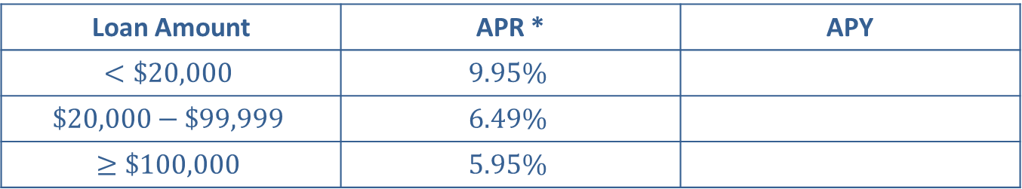
Example 7: Comparing APR versus APY—Slide 1
Suppose that the APD Bank of the South advertises the following rates for their personal loans. Determine the APY for each of the loan categories to complete Table 6. Write each APY as a percentage, rounded to the nearest hundredth.
Table 6: APD Bank of the South Personal Loan Rates
Loan Amount | APR * | APY
$$<\$20,000$$ | $$9.95\%$$
$$\$20,000−\$99,999$$ | $$6.49\%$$
$$≥\$100,000$$ | $$5.95\%$$
*Interest is compounded daily, and accrued interest is posted to the account monthly.

Slide 64
Example 7: Comparing APR versus APY—Slide 2
Solution
To find the APY for each loan category, we need the published APR as well as the number of compounding intervals per year. Notice that the footnote tells us that interest is compounded daily, so n = 365.
  By Hand

Slide 65
Example 7: Comparing APR versus APY—Slide 3
Microsoft Excel
For clarity, we'll label the columns " APR " and " APY " in A1 and B1, respectively. Enter the three different rates given as percentages in column A.
There is not a built-in function specifically for finding the APY, but we can type in the formula by using an equal sign followed by "(1+r/n)^n-1", where
n = 365 and r is the value in column A. In cell B2, type "=(1+A2/365)^365-1" and press Enter. (Notice that we reference cell A2 for the rate.) The value in cell B2 appears as 0.1046. (Note that the number of decimal places will vary depending on the width of the cell).
Click on cell B2 and drag the bottom right corner of the cell down through cell B4. This will copy the formula into cells B3 and B4. (Notice that the reference to cell A2 is updated to refer to cells A3 and A4 in the respective rows.) The values 0.06705 and 0.0613 will appear in cells B3 and B4, respectively.

Slide 66
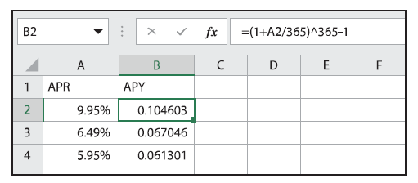
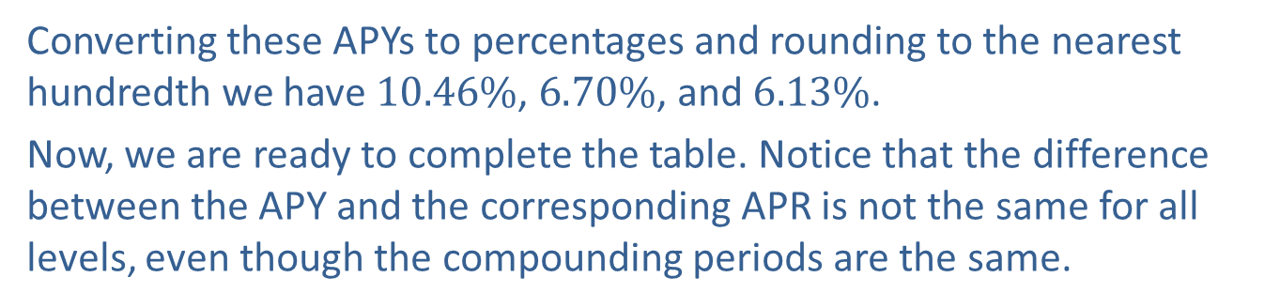
Example 7: Comparing APR versus APY—Slide 4
Figure 11
Converting these APYs to percentages and rounding to the nearest hundredth we have $10.46\%$, $6.70\%$, and $6.13\%$.
Now, we are ready to complete the table. Notice that the difference between the APY and the corresponding APR is not the same for all levels, even though the compounding periods are the same.

Slide 67
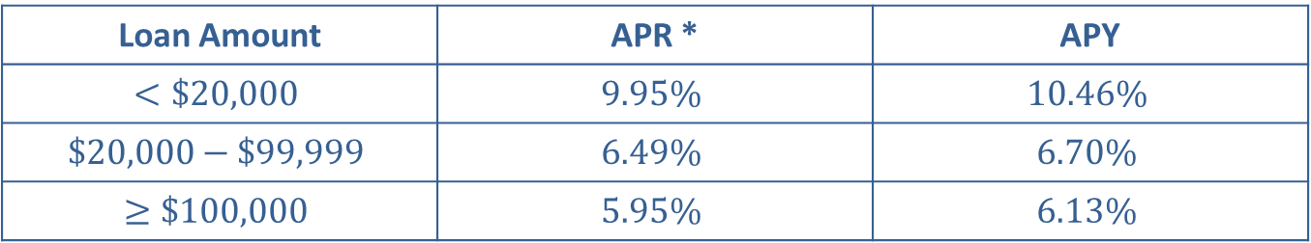
Example 7: Comparing APR versus APY—Slide 5
Table 7: APD Bank of the South Personal Loan Rates
Loan Amount | APR * | APY
$$<\$20,000$$ | $$9.95\%$$ | $$10.46\%$$
$$\$20,000−\$99,999$$ | $$6.49\%$$ | $$6.70\%$$
$$≥\$100,000$$ | $$5.95\%$$ | $$6.13\%$$
*Interest is compounded daily, and accrued interest is posted to the account monthly.

