Slide 1
Section 4.5
Proportionality

Slide 2
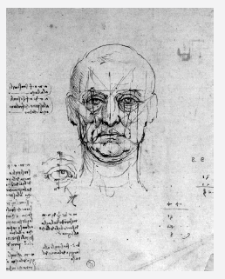
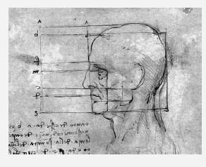
Fun Fact
Leonardo da Vinci (1452–1519), an Italian Renaissance man, was considered accomplished in many areas: painting, sculpting, architecture, music, science mathematics, engineering, inventing, anatomy, geology, cartography, botany, and writing! Here is a sample of his studies on proportions of the human head and eyes.
Figure 1
Figure 2

Slide 3
Helpful Hint 1
If A is proportional to B, then B is also proportional to A.

Slide 4
Helpful Hint 2
The term invariant literally means "does not vary;" that is, it is a value that remains unchanged.

Slide 5
Definition: Proportional to
A variable quantity A is proportional to a variable quantity B when there exists an invariant k (the constant of proportionality) such that A = kB.

Slide 6
Example 1: Finding the Constant of Proportionality—Slide 1
The scale of a model car is often given in a ratio format that indicates the relative size of the model to the real object. One particular size is built on a one eighteenth scale to the original full-size car. This indicates that for every 1-inch length on the model, the corresponding part of the actual car is 18 inches long. Find the constant of proportionality for the length of the scale model to the length of the actual car.
Solution
Since the length of the model car is proportional to that of the full-size car, we know that a constant of proportionality exists.
We can use the formula M = kR to set up an equation for the

Slide 7
Example 1: Finding the Constant of Proportionality—Slide 2
proportionality of the car, where M represents the length of the model car and R represents the length of the real car. Since the model car is built on a one eighteenth scale to the real car, we know that M = 1 and R = 18. Substituting these values into the equation and solving for k gives the following.
Thus, the constant of proportionality is
Notice that this tells us the
model has a length that is
the length of the real car. We might also
write R = 18M, which implies that the real car has a length that is 18 times the length of the model car.

Slide 8
Skill Check 1
Which of the following have a constant of proportionality equal to 3?
a. ​3y = 3x,
b. 3y = 2x,
c. ​5y = 15x,
d. 4y = 12x.
Answer: c. and d.

Slide 9
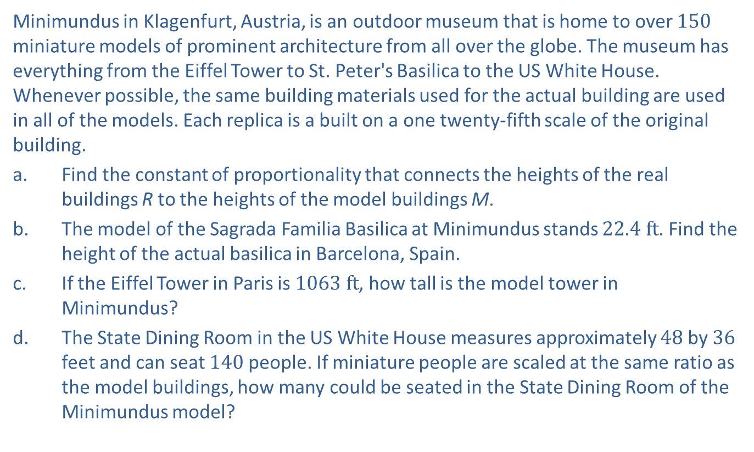
Example 2: Using the Constant of Proportionality—Slide 1
Minimundus in Klagenfurt, Austria, is an outdoor museum that is home to over 150 miniature models of prominent architecture from all over the globe. The museum has everything from the Eiffel Tower to St. Peter's Basilica to the US White House. Whenever possible, the same building materials used for the actual building are used in all of the models. Each replica is a built on a one twenty-fifth scale of the original building.
a. Find the constant of proportionality that connects the heights of the real buildings R to the heights of the model buildings M.
b. ​The model of the Sagrada Familia Basilica at Minimundus stands $22.4 ft$. Find the height of the actual basilica in Barcelona, Spain.
c. ​If the Eiffel Tower in Paris is $1063 ft$, how tall is the model tower in Minimundus?
d. ​The State Dining Room in the US White House measures approximately 48 by 36 feet and can seat 140 people. If miniature people are scaled at the same ratio as the model buildings, how many could be seated in the State Dining Room of the Minimundus model?

Slide 10
Example 2: Using the Constant of Proportionality—Slide 2
Solution
a. As we saw in the previous example, we can use the formula M = kR to set up an equation for the proportionality of the model, where M is the height of the model and R is the height of the actual building. Since the model is built on a one twenty-fifth scale of the original building, we know that M = 1 and R = 25. Substituting these values into the equation and solving for k gives the following.
Therefore, the constant of proportionality for the heights of the actual buildings
to the heights of the model is 25. This means that a real building's height is 25
times the height of its model. And the models are
the size of the real buildings.
So we can use the equivalent equations R = 25M and

Slide 11
Example 2: Using the Constant of Proportionality—Slide 3
b. Now that we know the constant of proportionality, we can easily find the height of the Sagrada Familia Basilica in Barcelona.
We know the real height is 25 times the height of the Minimundus model.
The height of the actual basilica in Barcelona, Spain is 560 feet.

Slide 12

Example 2: Using the Constant of Proportionality—Slide 4
​c. If the Eiffel Tower in Paris is $1063 ft$ tall, we know from the constant of proportionality that the model
So we have the following
equation.
Therefore, the model tower is approximately 42.5 feet tall.

Slide 13
Example 2: Using the Constant of Proportionality—Slide 5
d. ​Because the people are scaled at the same ratio as the model buildings, the miniature State Dining Room would be able to seat the same number of people as the real White House State Dining Room, 140.

Slide 14
Definition: Hooke's Law
The proportional relationship between the force applied to a spring and the length of the spring is given by
F = kx,
where F is the force applied to a spring, x is the displacement of the spring (either stretched or compressed), and k is the spring constant.

Slide 15
Example 3: Using Hooke’s Law—Slide 1
A force of 200 newtons (N) stretches a spring by 4 meters (m).
a. What is the value of the constant of proportionality (the spring constant)?
b. How much force would be needed to stretch the spring 4.5 meters?

Slide 16
Example 3: Using Hooke’s Law—Slide 2
Solution
a. We know the spring constant is the ratio between the force and the distance the spring is stretched. We can use the formula F = kx to set up an equation for the proportionality of the spring, where F is the force applied to the spring and x is the length of the spring.
​

Slide 17
Example 3: Using Hooke’s Law—Slide 3
Therefore, the constant of proportionality is
This tells us is that in order to stretch this spring a distance of 1 meter, a weight or force of 50 newtons is required.
b. In order to stretch the spring 4.5 meters, we can multiply the constant of proportionality that we found in part a. by the length of 4.5 meters.
Therefore, a force of 225 newtons is needed to stretch the
spring 4.5 meters.

Slide 18
Helpful Hint 3
Named after the physicist Isaac Newton, a newton (N) is a unit used to measure force. One newton is equal to the amount of force required to give a mass of 1 kilogram an acceleration of 1 meter per second squared.

Slide 19
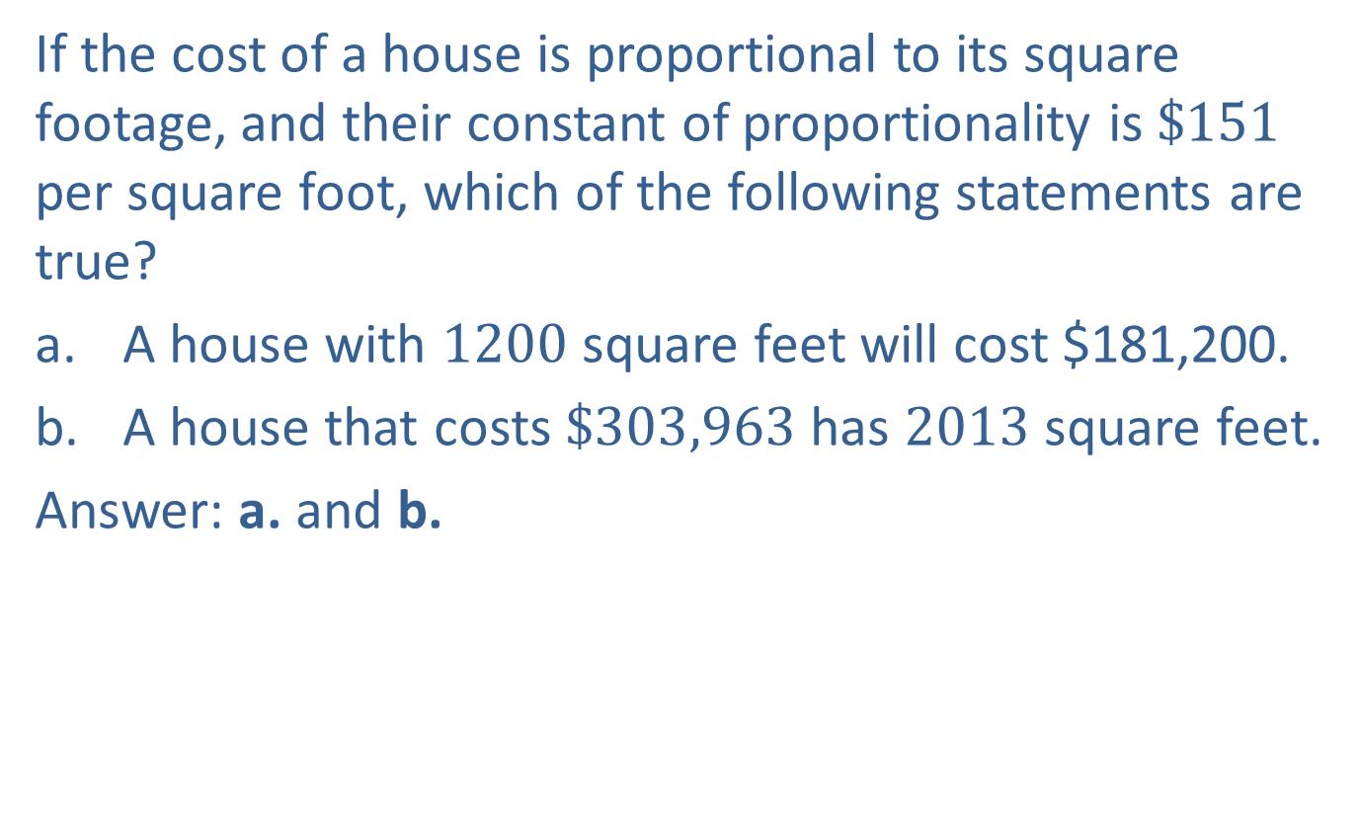
Skill Check 2
If the cost of a house is proportional to its square footage, and their constant of proportionality is $\$151$ per square foot, which of the following statements are true?
a. A house with 1200 square feet will cost $181,200.
b. A house that costs $\$303,963$ has 2013 square feet.
Answer: a. and b.

Slide 20
Example 4: Exploring the Relationship between the Constant of Proportionality and Solving a Proportion—Slide 1
Suppose you want to know how much money you've managed to save in your penny jar, but you don't want to count out the pennies directly. You have the following information.
​25 pennies weigh 2.20 ounces.
​The weight of all the pennies in your jar is 148 ounces.
Use the fact that the number of pennies in your jar is proportional to the weight of those pennies and find out how much you have saved in pennies.

Slide 21
Example 4: Exploring the Relationship between the Constant of Proportionality and Solving a Proportion—Slide 2
Solution
We're going to use two different methods to find the amount of money in the jar—one using the constant of proportionality and one by solving a proportion.
Finding the Constant of Proportionality
In this first method, will use the equation n = kw, where n is the number of pennies and w is the weight of the pennies. Since we know that 25 pennies weigh 2.20 ounces, we can substitute n = 25 and w = 2.20 into the equation and solve for k.

Slide 22
Example 4: Exploring the Relationship between the Constant of Proportionality and Solving a Proportion—Slide 3
In other words, there are approximately 11.364 pennies for every ounce. Notice we can think of this as a rate of pennies per ounce.
Using this constant of proportionality, we can use the equation
We are now ready to substitute the
weight of the pennies for the variable w.

Slide 23
Example 4: Exploring the Relationship between the Constant of Proportionality and Solving a Proportion—Slide 4
This tells us that there are approximately 1682 pennies, or $16.82, in the jar.
Solving a Proportion
Another way to determine the amount of money in the jar is to set up two proportions that we know to be equal to one another.
Since the number of pennies is proportional to the weight of the
pennies, the fraction
is a constant of proportionality.
Thus, it will always be true that corresponding fractions will be equivalent. Once again, we will begin by letting n be the unknown

Slide 24
Example 4: Exploring the Relationship between the Constant of Proportionality and Solving a Proportion—Slide 5
number of pennies in the jar and use the proportion of the number of pennies to the weight of the pennies. We know that 25 pennies weigh 2.20 ounces and that n pennies weigh 148 ounces. Setting these two equivalent fractions equal gives us the following equation.
We want to find the value of n. We do this by multiplying each side of the equation by 148 to find our answer.
This method also tells us there are approximately 1682 pennies, or $16.82, in the jar.

Slide 25
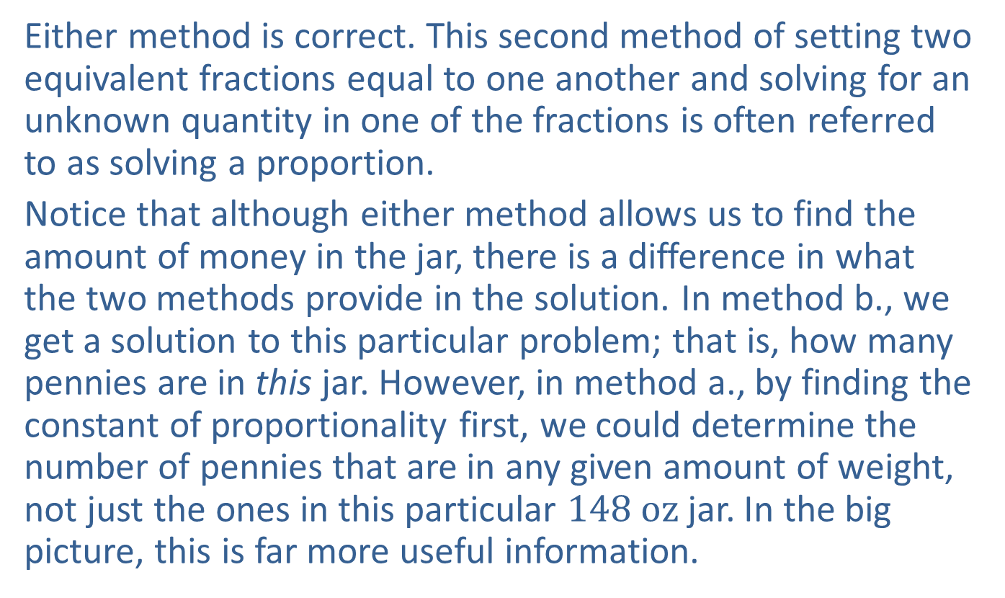
Example 4: Exploring the Relationship between the Constant of Proportionality and Solving a Proportion—Slide 6
Either method is correct. This second method of setting two equivalent fractions equal to one another and solving for an unknown quantity in one of the fractions is often referred to as solving a proportion.
Notice that although either method allows us to find the amount of money in the jar, there is a difference in what the two methods provide in the solution. In method b., we get a solution to this particular problem; that is, how many pennies are in this jar. However, in method a., by finding the constant of proportionality first, we could determine the number of pennies that are in any given amount of weight, not just the ones in this particular $148 oz$ jar. In the big picture, this is far more useful information.

Slide 26
Helpful Hint 4
Setting two equivalent fractions equal to one another and solving for an unknown quantity in one of the fractions is often referred to as solving a proportion.

Slide 27
Skill Check 3
Use the information in Example 4 to find the monetary value of a stack of pennies that weighs 53 ounces.
Answer: $6.02

Slide 28
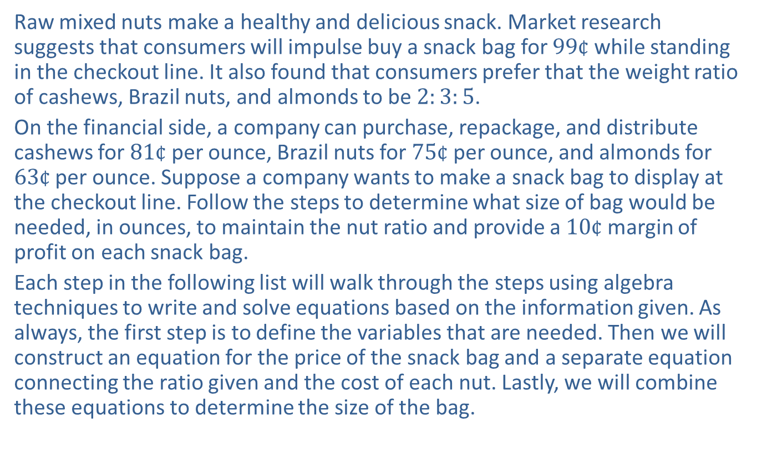
Example 5: Using Proportionality in Business—Slide 1
Raw mixed nuts make a healthy and delicious snack. Market research suggests that consumers will impulse buy a snack bag for $99¢$ while standing in the checkout line. It also found that consumers prefer that the weight ratio of cashews, Brazil nuts, and almonds to be $2:3:5$.
On the financial side, a company can purchase, repackage, and distribute cashews for $81¢$ per ounce, Brazil nuts for $75¢$ per ounce, and almonds for $63¢$ per ounce. Suppose a company wants to make a snack bag to display at the checkout line. Follow the steps to determine what size of bag would be needed, in ounces, to maintain the nut ratio and provide a $10¢$ margin of profit on each snack bag.
Each step in the following list will walk through the steps using algebra techniques to write and solve equations based on the information given. As always, the first step is to define the variables that are needed. Then we will construct an equation for the price of the snack bag and a separate equation connecting the ratio given and the cost of each nut. Lastly, we will combine these equations to determine the size of the bag.

Slide 29
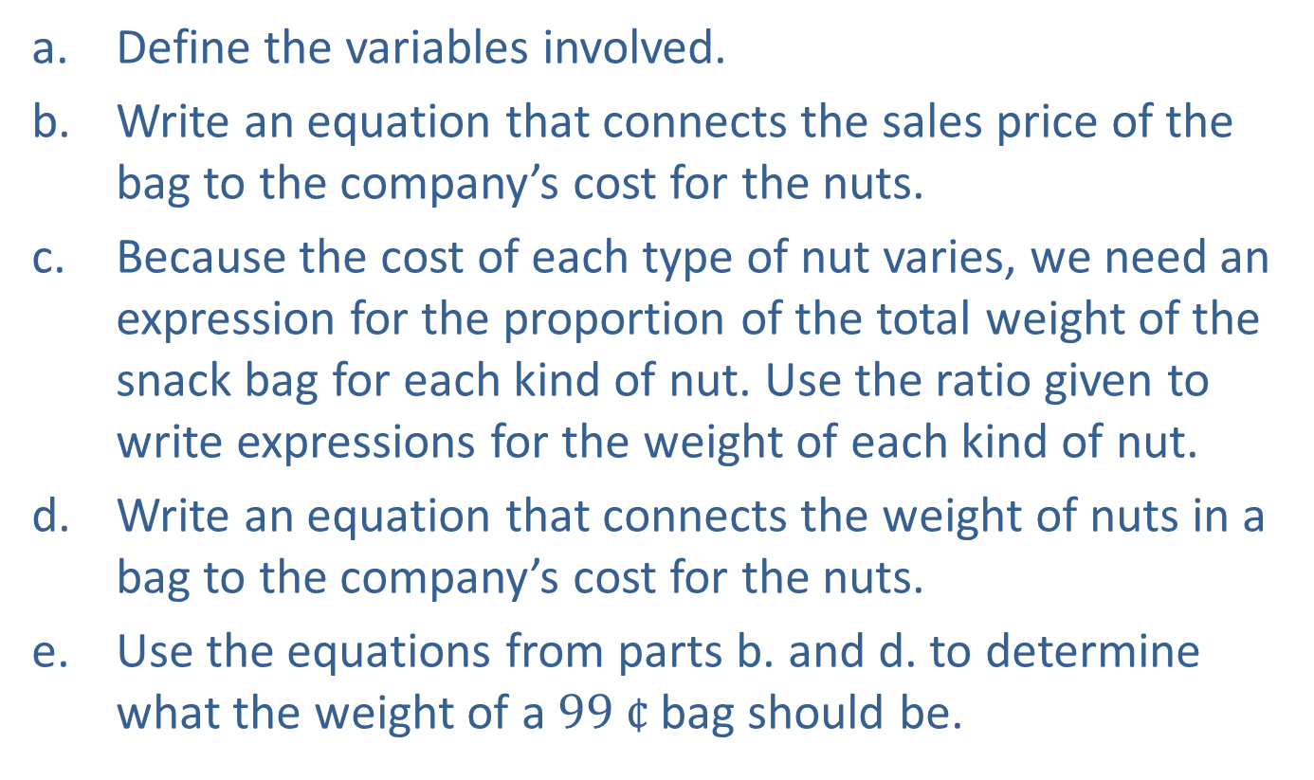
Example 5: Using Proportionality in Business—Slide 2
a. ​Define the variables involved.
b. ​Write an equation that connects the sales price of the bag to the company’s cost for the nuts.
c. ​Because the cost of each type of nut varies, we need an expression for the proportion of the total weight of the snack bag for each kind of nut. Use the ratio given to write expressions for the weight of each kind of nut.
d. Write an equation that connects the weight of nuts in a bag to the company’s cost for the nuts.
e. Use the equations from parts b. and d. to determine what the weight of a $99 ¢$ bag should be.

Slide 30
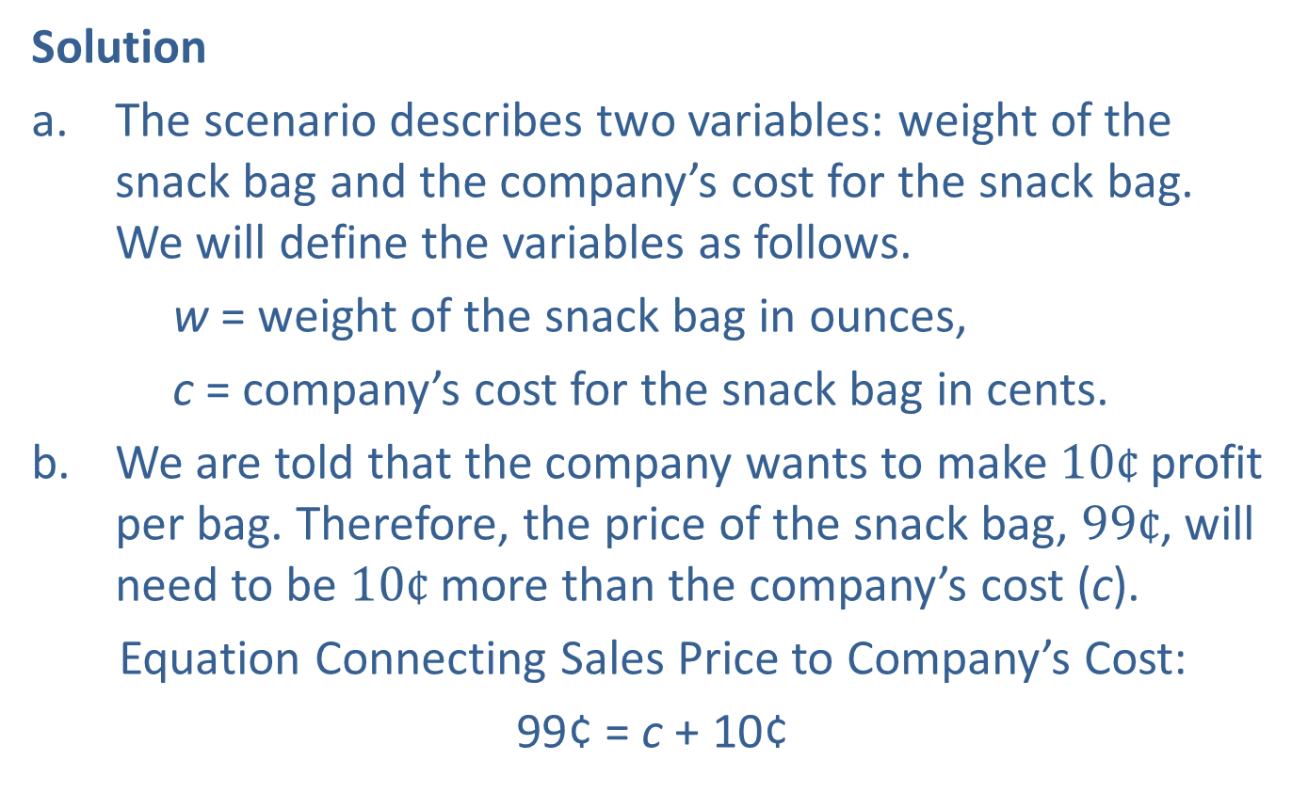
Example 5: Using Proportionality in Business—Slide 3
Solution
The scenario describes two variables: weight of the snack bag and the company’s cost for the snack bag. We will define the variables as follows.
w = weight of the snack bag in ounces,
c = company’s cost for the snack bag in cents.
b. ​We are told that the company wants to make $10¢$ profit per bag. Therefore, the price of the snack bag, $99¢$, will need to be $10¢$ more than the company’s cost (c).
​Equation Connecting Sales Price to Company’s Cost:
99¢ = c + 10¢

Slide 31
Example 5: Using Proportionality in Business—Slide 4
c. First let’s consider what we know from the ratio of weights of the nuts that we were given.
Since a ratio divides a whole into equal parts, we know
the weight of each bag (w) in this case is divided into 2 + 3 + 5 = 10 equal parts. Therefore, each part will have weight of
From there, we can represent the weight of each type of nut in a bag by the number of its parts. We will use Table 1 to help us keep track of the details of each expression.

Slide 32
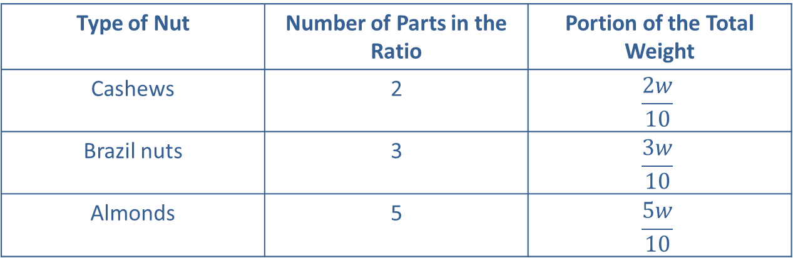
Example 5: Using Proportionality in Business—Slide 5
Table 1: Mixed Nut Bag
Type of Nut | Number of Parts in the Ratio | Portion of the Total Weight
Cashews | 2 | $$\frac{2w}{10}$$
Brazil nuts | 3 | $$\frac{3w}{10}$$
Almonds | 5 | $$\frac{5w}{10}$$
d. For each nut, the company’s cost is computed by multiplying the weight of the nut in the bag, which we found in part c., by its respective cost, which we were given. Once again, we’ll use a table to keep track of the details.

Slide 33
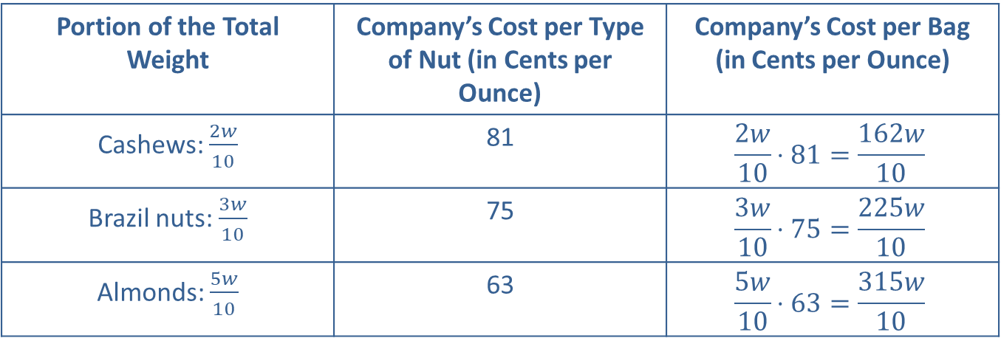
Example 5: Using Proportionality in Business—Slide 6
Table 2: Mixed Nut Bag
Portion of the Total Weight | Company’s Cost per Type of Nut (in Cents per Ounce) | Company’s Cost per Bag (in Cents per Ounce)
Cashews: $\frac{2w}{10}$ | 81 | $$\frac{2w}{10}⋅81=\frac{162w}{10}$$
Brazil nuts: $\frac{3w}{10}$ | 75 | $$\frac{3w}{10}⋅75=\frac{225w}{10}$$
Almonds: $\frac{5w}{10}$ | 63 | $$\frac{5w}{10}⋅63=\frac{315w}{10}$$

Slide 34

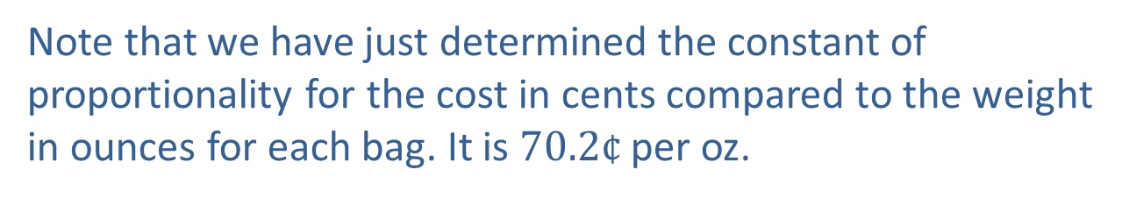
Example 5: Using Proportionality in Business—Slide 7
​The company’s overall cost (c) for nuts in every bag that they produce, no matter what size bag, is the sum of the expressions in the last column of Table 2. So the company’s total cost (in $¢$) for the nuts in any size bag where w represents the weight in ounces is calculated using the following formula.
​Note that we have just determined the constant of proportionality for the cost in cents compared to the weight in ounces for each bag. It is $70.2¢$ per oz.

Slide 35
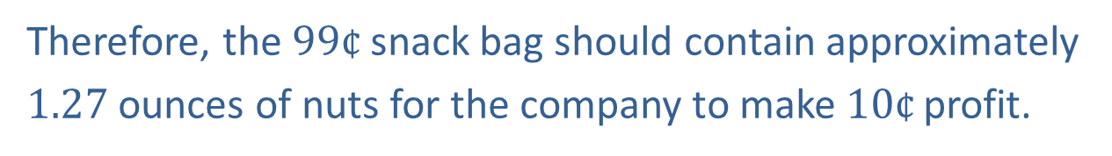
Example 5: Using Proportionality in Business—Slide 8
e. The two equations found in parts b. and d. are 99 = c + 10 and c = 70.2w. Notice that because both equations include the variable c, we can use substitution to eliminate the variable c. We will take the second equation and substitute it into the first one and solve for w.
Therefore, the $99¢$ snack bag should contain approximately
1.27 ounces of nuts for the company to make $10¢$ profit.

Slide 36
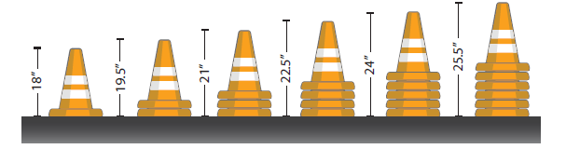
Example 6: Determining Whether Quantities Are Proportional—Slide 1
Consider a stack of traffic caution cones. Is the height of the cones in the stack proportional to the number of cones in the stack?
Figure 4

Slide 37
Example 6: Determining Whether Quantities Are Proportional—Slide 2
Solution
In order to confirm whether these quantities are proportional, we can use any one of the three methods discussed. However, let’s examine all of the methods—pairs of values, a graph, and an equation—so that we can see how each technique could be applied.
Without any values, intuitively we might assume that they are proportional because the height of the stack increases by the same amount each time a cone is added since the cones are all the same height. Consider the following table that gives the varying heights of the stack as more cones are added.

Slide 38
Example 6: Determining Whether Quantities Are Proportional—Slide 3
Table 4: Traffic Cone Stacks
Number of Cones in the Stack | 0 | 1 | 2 | 3 | 4 | 5 | 6
Height of the Stack (inches) | 0 | 18 | 19.5 | 21 | 22.5 | 24 | 25.5
Notice that the number of cones in the stack increases by 1 each time. Similarly, the increase in height is 1.5 inches with each addition, except for the first increase. The first increase is 18 inches. So although the increase is same for all the others, to be proportional, the increase must be the same at all times. From this, we can conclude that the number of cones in a stack and its height are not proportional.

Slide 39
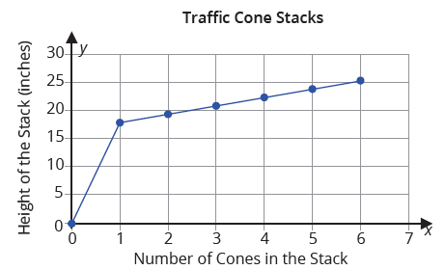
Example 6: Determining Whether Quantities Are Proportional—Slide 4
If we graph the paired values, we can also confirm that they are not proportional.
Figure 5

Slide 40
Example 6: Determining Whether Quantities Are Proportional—Slide 5
Notice that the graph of the paired values is not a straight line, although it does go through the origin.
You might notice that the problem lies with a stack of 0 cones. Suppose we discard the stack with no cones and consider only stacks that have at least one cone in them. Here is the graph without the 0-cone stack along with its equation.

Slide 41
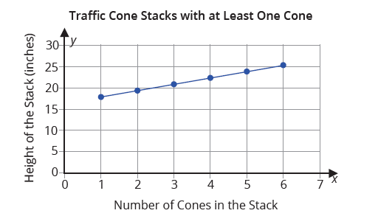
Example 6: Determining Whether Quantities Are Proportional—Slide 6
Figure 6

Slide 42
Example 6: Determining Whether Quantities Are Proportional—Slide 7
Heights of Traffic Cone Stacks:
h = c(1.5) + 16.5
In this equation, h = height in inches of the stack and c = number of cones in the stack.
Two things to note here. First, looking at the graph, if we extend the line, it no longer intersects the origin as it should for proportional relationships. Second, the equation does not adhere to the correct form. The extra 16.5 shatters the form of y = kx necessary for a proportional equation.

