Slide 1
Section 11.1
Statistical Studies

Slide 2
Definition: Statistics
Statistics is the science of gathering, describing, and analyzing data.
or
Statistics is the actual numerical description of sample data.

Slide 3
Procedure: Conducting a Statistical Study
1. ​Design the study.
  a. State the question to be studied.
  b. Determine the population and variables.
  c. ​Determine the type of study: observational or experimental.
2. Collect the data.
3. Organize the data.
4. ​Analyze the data to answer the question.

Slide 4
Helpful Hint 1
The singular form of data is datum.

Slide 5
Definition: Population, Variables, and Data
Population
A population is the particular group of interest in a statistical study.
Variable
A variable is a value or characteristic that changes among members of the population.
Data
Data are the counts, measurements, or observations gathered about a specific variable in a population in order to study it.

Slide 6
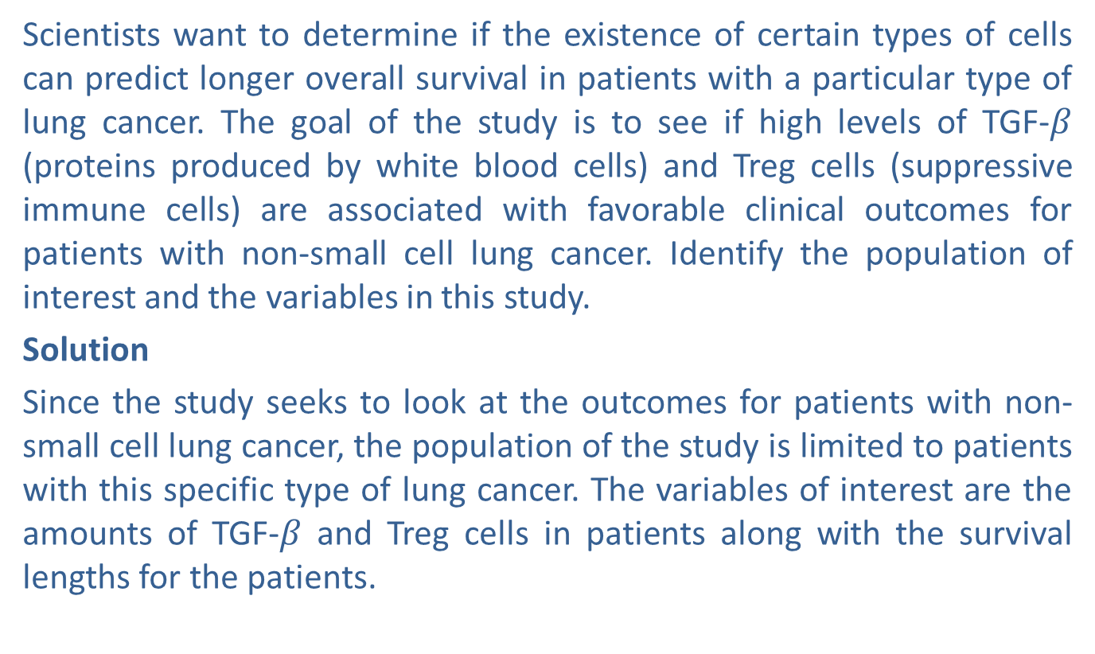
Example 1: Identifying Population and Variables—Slide 1
Scientists want to determine if the existence of certain types of cells can predict longer overall survival in patients with a particular type of lung cancer. The goal of the study is to see if high levels of TGF-$β$ (proteins produced by white blood cells) and Treg cells (suppressive immune cells) are associated with favorable clinical outcomes for patients with non-small cell lung cancer. Identify the population of interest and the variables in this study.
Solution
Since the study seeks to look at the outcomes for patients with non-small cell lung cancer, the population of the study is limited to patients with this specific type of lung cancer. The variables of interest are the amounts of TGF-$β$ and Treg cells in patients along with the survival lengths for the patients.

Slide 7
Skill Check 1
Identify the population of interest and the variables for the following scenario.
Real estate agencies in Kansas City, Missouri, are interested in how the housing market has changed over the past three years. The goal of the study is to determine any change in the average price per square foot for single-family homes as well as the average amount of time these homes stay on the market from listing to closing.
Answer: The population of interest is single-family homes in Kansas City, Missouri. The variables of interest are the price per square foot and listing times.

Slide 8
Fun Fact 1
The United States Census happens once every 10 years, as required by the constitution; the most recent being in 2020. Although statistical data from the census is released as soon as they are available, individual specific records are sealed for 72 years—a number slightly higher than the average female life expectancy of 71.6 years.

Slide 9
Definition: Terms Related to Populations and Subsets
Census
A census is a study involving data obtained from every member of the population.
Parameter
A parameter is the numerical description of a particular population characteristic.
Sample
A sample is a subset of a population from which data are collected in a statistical study.
Sample Statistic
A sample statistic is the numerical description of a particular sample characteristic.

Slide 10
Helpful Hint 2
In set notation, the population is referred to as the universal set and the sample is a subset.

Slide 11
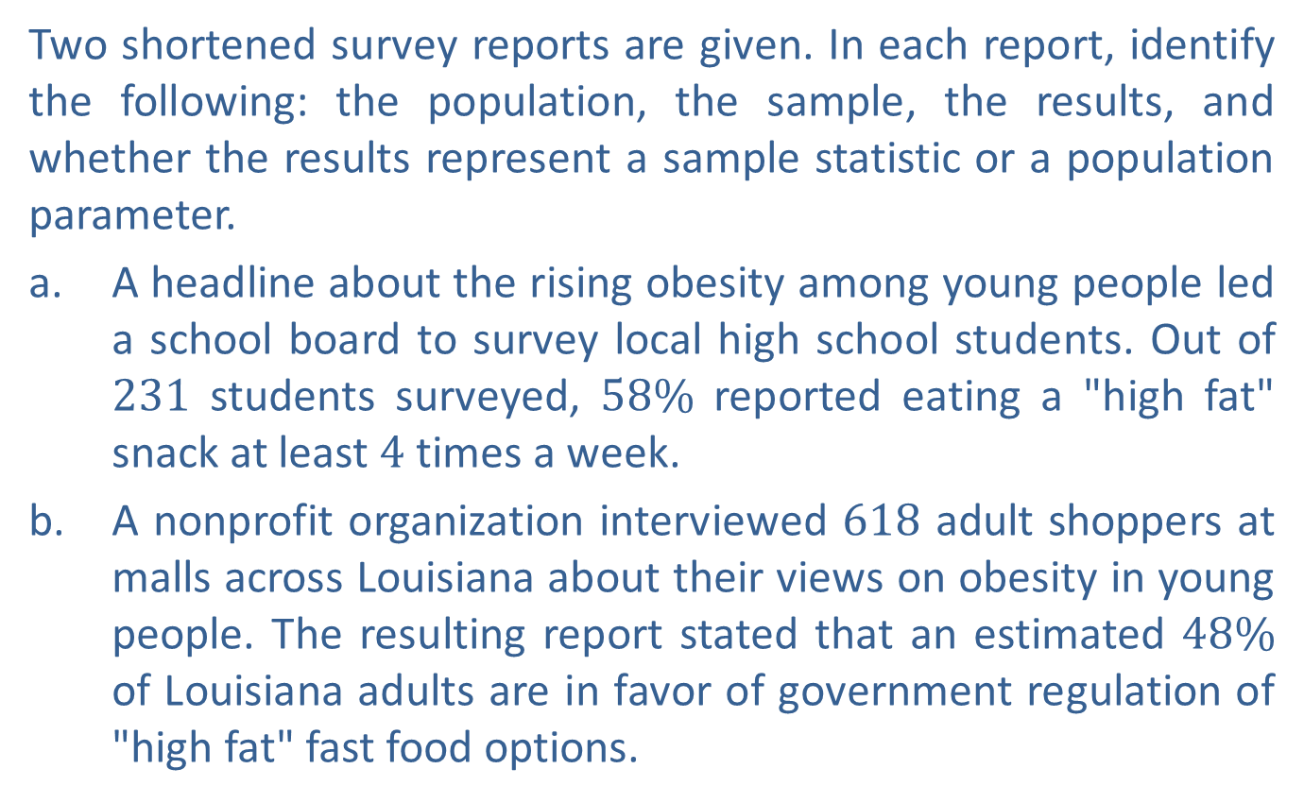
Example 2: Identifying Populations, Samples, Parameters, and Statistics—Slide 1
Two shortened survey reports are given. In each report, identify the following: the population, the sample, the results, and whether the results represent a sample statistic or a population parameter.
a. A headline about the rising obesity among young people led a school board to survey local high school students. Out of 231 students surveyed, $58\%$ reported eating a "high fat" snack at least 4 times a week.
b. A nonprofit organization interviewed 618 adult shoppers at malls across Louisiana about their views on obesity in young people. The resulting report stated that an estimated $48\%$ of Louisiana adults are in favor of government regulation of "high fat" fast food options.

Slide 12
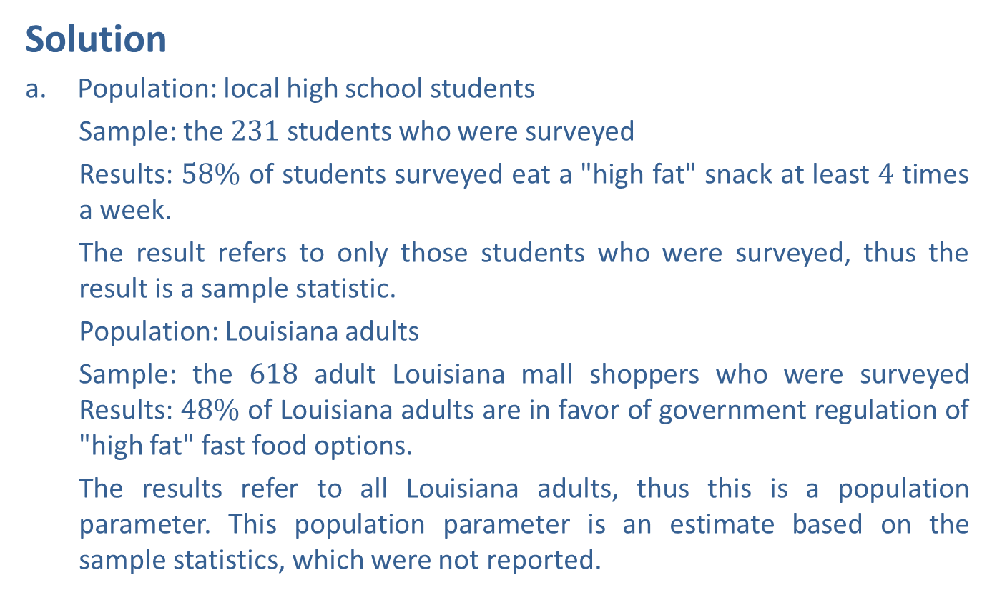
Example 2: Identifying Populations, Samples, Parameters, and Statistics—Slide 2
Solution
a. Population: local high school students
  Sample: the 231 students who were surveyed
  Results: $58\%$ of students surveyed eat a "high fat" snack at least 4 times a week.
  The result refers to only those students who were surveyed, thus the result is a sample statistic.
  ​Population: Louisiana adults
  Sample: the 618 adult Louisiana mall shoppers who were surveyed Results: $48\%$ of Louisiana adults are in favor of government regulation of "high fat" fast food options.
  ​The results refer to all Louisiana adults, thus this is a population parameter. This population parameter is an estimate based on the sample statistics, which were not reported.

Slide 13
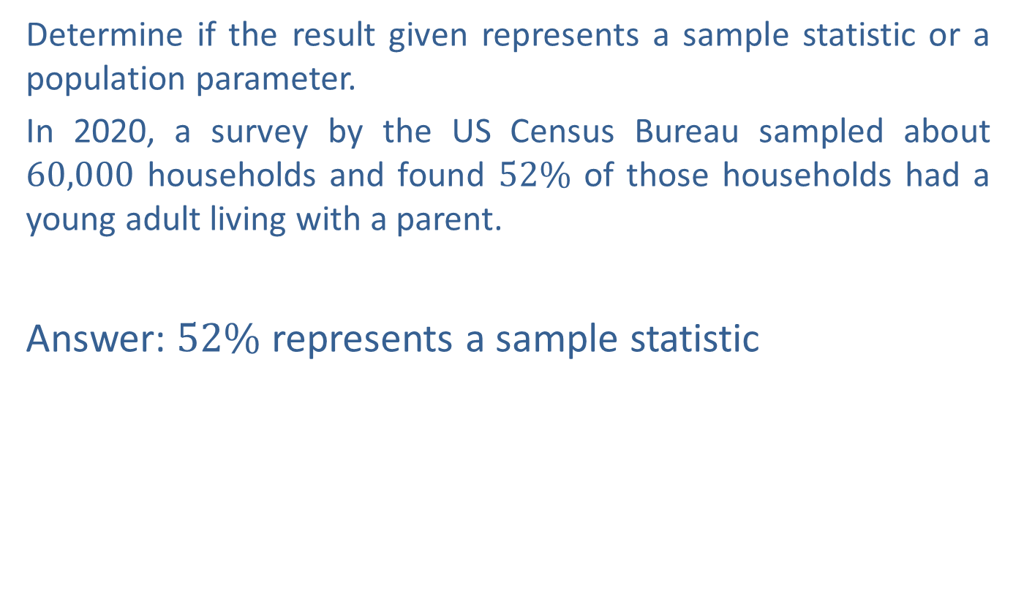
Skill Check 2
Determine if the result given represents a sample statistic or a population parameter.
In 2020, a survey by the US Census Bureau sampled about 60,000 households and found $52\%$ of those households had a young adult living with a parent.
Answer: $52\%$ represents a sample statistic

Slide 14
Definition: Observational Study and Experiment
Observational Study
An observational study observes existing data.
Experiment
An experiment generates data to help identify cause-and-effect relationships.

Slide 15
Example 3: Identifying Observational Studies and Experiments
Given each scenario, which type of study would you conduct: an observational study or an experiment?
a. Researchers wish to determine if a vaccine is effective in preventing the spread of COVID-19.
b. You wish to determine the average salary of college graduates across your state during their first year after graduation.
Solution
a. An experiment would need to be used in order to establish a cause-and-effect relationship between the vaccine and COVID-19 spread prevention.
b. An observational study would be used since you only need to consider existing records of college graduates in your state and determine the average salary.

Slide 16
Definition: Representative Sample and Bias
Representative Sample
A representative sample is one that has the same relevant characteristics as the population and does not favor one group of the population over another.
Bias
A bias is a favoring of a certain outcome in a study.

Slide 17
Definition: Sampling Methods
Random Sampling – Every member of the population has an equal chance of being selected.
Stratified Sampling (Quota Sampling) – A few members from each stratum (or group) are randomly chosen.
Cluster Sampling – All members from a few randomly chosen clusters (or groups) are selected.
Systematic Sampling – Every n ^{th} member of the population is chosen.
Convenience Sampling – The sample is chosen because it is convenient for the researcher.

Slide 18
Example 4: Identifying Sampling
Techniques—Slide 1
Identify the sampling technique used to obtain a sample in each of the following situations.
a. To conduct a survey on collegiate social life, you knock on every 5th dorm room door on campus.
b. ​Student ID numbers are randomly selected from a computer printout for free tickets to the championship game.
c. Fourth grade reading levels across the county were analyzed by the school board by randomly selecting 25 fourth graders from each school in the county district.
d. In order to determine which ice cream flavors would sell best, a grocery store polls shoppers that are in the frozen foods section.
e. ​To determine the average number of cars per household, each household in 4 of the 20 local counties were sent a survey regarding car ownership.

Slide 19
Example 4: Identifying Sampling
Techniques—Slide 2
Solution
a. ​Because the sample is obtained by choosing every n^{th} dorm room, this is systematic sampling. This is a representative sample, as long as students were randomly assigned to dorm rooms and there are no hidden potential biases, like only males live in every n^{th} room.
b. ​Since every member has an equal chance of being selected, this is random sampling.
c. The students were divided into strata based on their schools and then a random sample from each school was chosen. This is stratified sampling.
d. Because of the ease of choosing shoppers right in their own store, this is convenience sampling. In this case, convenience sampling is a viable method for gaining a representative sample since the store would be interested in knowing the thoughts of their customers.
e. ​Cluster sampling was used here because the counties are the natural clusters and all of the households in some of the counties received the surveys.

Slide 20
Fun Fact 2
Even though experiments are used to determine cause and effect, not all cause-and-effect relationships can be established via experiments for ethical reasons. For example, it is important to know if a new medication will cause harm to an unborn baby if taken while a woman is pregnant. However, it would be unethical to perform an experiment on the mother without knowing the possible effects to the child. Therefore, we would have to test the medication through other means.

Slide 21
Definition: Parts of an Experiment
Treatment
A treatment is a certain condition that is applied to a group of subjects in an experiment.
Subjects
Subjects are the people or things being studied in an experiment.
Participants
Subjects in an experiment that consist solely of people are participants.
Response Variable
The response variable is the variable in an experiment that measures any response to the treatment.
Explanatory Variable
The explanatory variable is the variable in an experiment that causes the change in the response variable.

Slide 22
Skill Check 3
Identify the explanatory variable and the response variable in an experiment designed to determine if taking the drug Chantix reduces an adult's urge to smoke.
Answer: Explanatory variable is the drug Chantix and the urge to smoke is the response variable.

Slide 23
Procedure: Principles of Experimental Design
1. ​Randomize the control and treatment groups.
2. Control for outside effects on the response variable.
3. Replicate the experiment a significant number of times to see meaningful patterns.

Slide 24
Definition: Terms Related to Experiments—Slide 1
Control Group
A control group is a group of subjects to which no treatment is applied in an experiment.
Treatment Group
A treatment group is a group of subjects that researchers apply a treatment to in an experiment.
Confounding Variables
Factors other than the treatment that cause an effect on the subjects of an experiment are called confounding variables.
Placebo Effect
The placebo effect is a response to the power of suggestion, rather than the treatment itself, by participants of an experiment.

Slide 25
Definition: Terms Related to Experiments—Slide 2
Placebo
A placebo is a substance that appears identical to the actual treatment but contains no intrinsic beneficial elements.
Single-Blind
In a single-blind experiment, subjects do not know if they are in the control group or the treatment group, but the people interacting with the subjects in the experiment know which group each subject has been placed in.
Double-Blind
In a double-blind experiment, neither the subjects not the people interacting with the subjects know group each subject belongs to.

Slide 26
Helpful Hint 3
Researchers must get approval for an experiment from an Institutional Review Board (IRB) before beginning. The IRB reviews the design of the study to make sure it is appropriate and no unnecessary harm will come to the subjects involved.

Slide 27
Example 5: Identifying Parts of an
Experiment—Slide 1
Consider a statistical study in which researchers want to determine if taking doses of the chemical salicin, found in willow bark, will reduce inflammation in patients. Suppose that the study is focusing only on patients with osteoarthritis, a common chronic joint condition. After study approval, volunteers are randomly assigned to two groups, each having 30 participants. Participants in Group A are administered doses of salicin, and their inflammation is tracked. Participants in Group B are administered doses of saline (which has no active ingredients), and their inflammation is also tracked. The patients are not told which of the two groups they are in; however, the nurses administering the salicin are aware of the group assignments. After a predetermined length of time, the inflammation reported by the separate groups are compared to determine if salicin reduces inflammation for those with osteoarthritis.
a. ​Identify the explanatory and response variables.
b. Identify the treatment in the experiment.

Slide 28
Example 5: Identifying Parts of an
Experiment—Slide 2
c. ​Determine which group is the treatment group and which group is the control group.
d. ​What is the purpose of administering saline to Group B?
e. State whether the experiment is a single-blind or double-blind study. Do you think this is the best choice for this study?

Slide 29
Example 5: Identifying Parts of an
Experiment—Slide 3
Solution
​The explanatory variable is what "explains" the changes in the response variable. Since the researchers are trying to determine if salicin can reduce inflammation, the explanatory variable is salicin and the response variable is the amount of inflammation recorded for each patient.
​The treatment is what is being applied to the group. Thus, the treatment is salicin.
​Group A is the treatment group since they are receiving salicin. Group B is the control group since they did not receive the treatment.

Slide 30
Example 5: Identifying Parts of an
Experiment—Slide 4
​The saline that is administered to Group B is a placebo and is administered to compensate for the placebo effect so that all patients are responding to the same suggestion that they might be receiving the treatment.
​Since only the patients are unaware of the group assignments, this is a single-blind study. Since inflammation is not a subjective measure, this is an appropriate choice for the study.

Slide 31
Skill Check 4
A dentist wants to look at the effects of a new dental material he has patented to be used for fillings. Should the experiment be run as a single-blind or double-blind experiment? Explain your choice.
Answer: Because there is potential researcher bias from the dentist since it is his patent, a double-blind experiment is best.

Slide 32
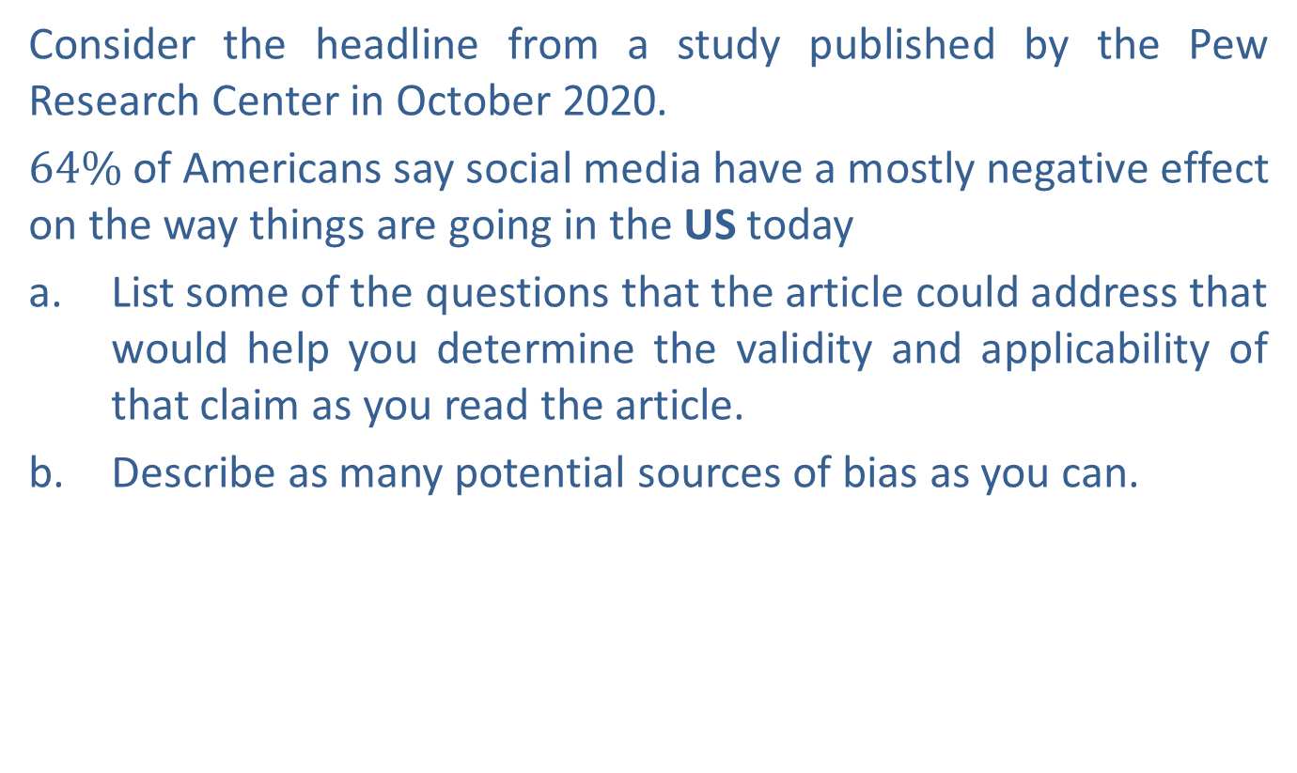
Example 6: Critiquing a Study—Slide 1
Consider the headline from a study published by the Pew Research Center in October 2020.
$64\%$ of Americans say social media have a mostly negative effect on the way things are going in the US today
a. List some of the questions that the article could address that would help you determine the validity and applicability of that claim as you read the article.
b. Describe as many potential sources of bias as you can.

Slide 33
Example 6: Critiquing a Study—Slide 2
Solution
a. There is not a single set of correct questions to ask; however, some possible questions might include the following.
  ​How big was the sample?
  ​What age range was sampled?
  ​How did they measure "negative effect"?
  ​Was "social media" defined?
b. Potential biases might include the following.
  ​Sampling method
  ​Source of the study and their interests in the results
  ​Ill-defined terms
  ​Nonresponses
For more information on the survey, see https://www.pewresearch.org/fact-tank/2020/10/15/64-of-americans-say-social-media-have-a-mostly-negative-effect-on-the-way-things-are-going-in-the-u-
s-today/.

