Slide 1
Lesson 8.1
What is Lifespan Development?

Slide 2
Developmental Psychology
Developmental psychology: scientific study of development across a lifespan
  From conception through childhood, adolescence, adulthood, and death
Viewed as a lifelong process that can be studied scientifically across three domains (Figure 2)
  Physical, cognitive, and psychosocial development

Slide 3
Reflection Question₁
To what extent do you believe that the adult you are today was influenced by the child you were? To what extent is a child fundamentally different from the adult they become?

Slide 4
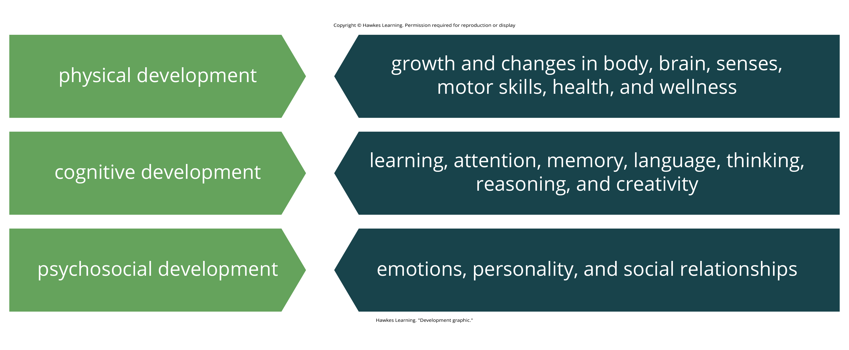
Lesson 8.1 Figure 2
Caption: As we grow, it's not just our physical self that is changing; cognitive and psychosocial processes change as well.

Slide 5
Connect The Concepts: Research Methods In Developmental Psychology
Developmental psychologists use various research methods to understand how individuals change over time.
Naturalistic observations involve observing behavior in natural contexts like playgrounds or homes.
Case studies collect detailed information from one individual to understand physical and psychological changes.
Surveys ask individuals to self-report thoughts, experiences, and beliefs.
Experiments involve control over variables and manipulation of the independent variable.
Experiments allow causal statements about variables important for development.

Slide 6
Normative Approach
This approach asks, "What is normal development?"
  Normative approach: study of development using norms, or average ages, when most children reach specific developmental milestones
It was studied by normative psychologists in the early decades of the 20th century.

Slide 7
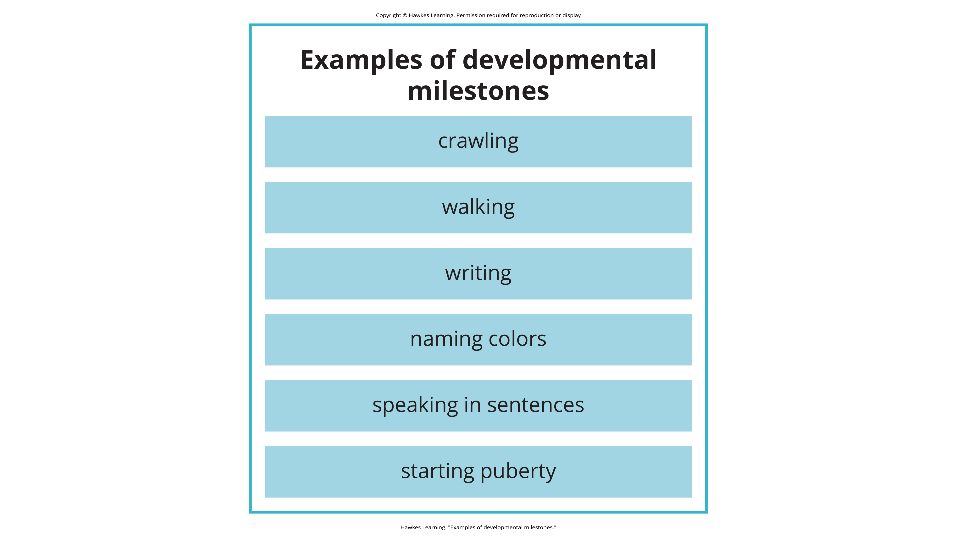
Lesson 8.1 Figure 3
Caption: Generally, children reach certain developmental milestones around the same age.

Slide 8
Developmental Milestones
Children develop at slightly different rates.
We can use age-related averages as general guidelines to compare children with same-age peers to determine the approximate ages they should reach specific normative events called developmental milestones.

Slide 9
Normative Approach Scenario
Imagine two new mothers, Louisa and Kimberly, who are close friends and have children around the same age.
Louisa's daughter is 14 months old, and Kimberly's son is 12 months old.
According to the normative approach, the average age a child starts to walk is 12 months.
At 14 months, Louisa's daughter still isn't walking.
She tells Kimberly she is worried that something might be wrong with her baby.

Slide 10
Reflection Question₂
In the case of Louisa, should she be worried about her daughter? Should she be worried if her daughter is not yet walking by 15 months? 18 months?

Slide 11
Issues In Developmental Psychology
Developmental psychology focuses on how people change.
Questions of change:
  Is the change smooth or uneven (continuous versus discontinuous)?
  Is this pattern of change the same for everyone, or are there many different patterns of change (one course of development versus many courses)?
  How do genetics and environment interact to influence development (nature versus nurture)?

Slide 12
Continuous Development
Continuous development views development as a cumulative process, gradually improving on existing skills (Figure 4).
With this type of development, there is gradual change.
  Example: a child's physical growth (adding inches to their height year by year)

Slide 13
Discontinuous Development
Theorists who view development as discontinuous believe that development takes place in unique stages.
It occurs at specific times or ages.
With this type of development, the change is more sudden.
  Example: an infant's ability to conceive object permanence

Slide 14
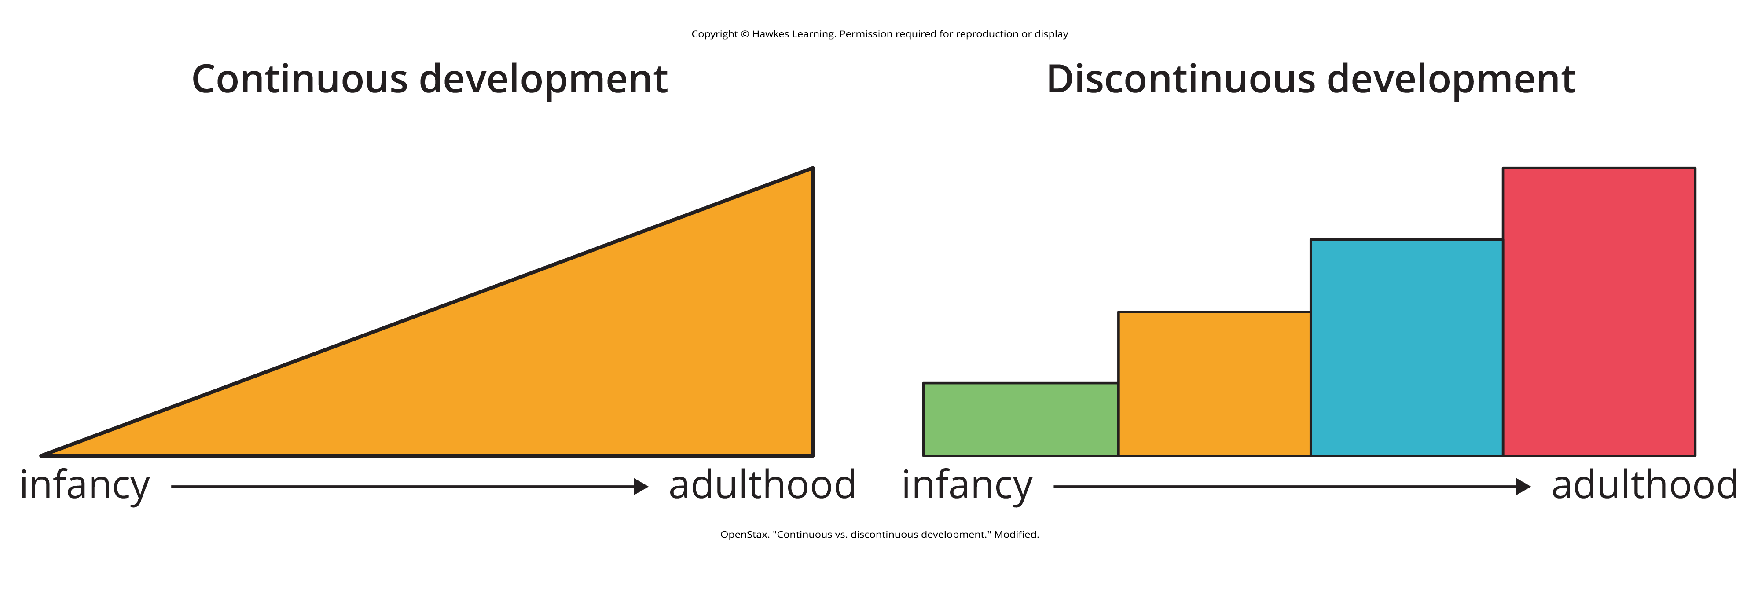
Lesson 8.1 Figure 4
Caption: The concept of continuous development can be visualized as a smooth slope of progression, whereas discontinuous development sees growth in more discrete stages.

Slide 15
Group Activity
Brainstorm three examples of development that are continuous and three examples of development that are discontinuous.
Notes:
Originally an On Your Own

Slide 16
Nature Vs. Nurture
Nature refers to genes and biology.
Nurture refers to environment and culture.
The nature vs. nurture debate seeks to understand how our personalities and traits are the product of our genetic makeup and biological factors.
It also seeks to understand how they are shaped by our environment.
  Including our parents, peers, and culture

Slide 17
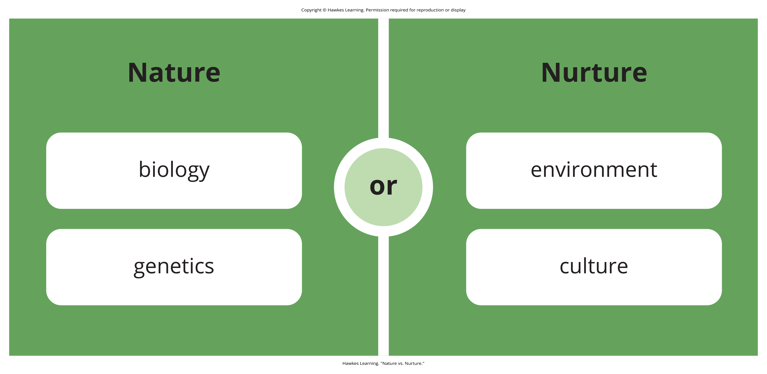
Lesson 8.1 Figure 6
Caption: Nature involves biology and genetics, but nurture involves environment and culture.

Slide 18
Reflection Question₃
Why do children sometimes act like their biological parents? Is it because of genetics or their early childhood environment? How can siblings from the same family be so different?

Slide 19
Summary
Lifespan development explores changes and growth from conception to death, studied by developmental psychologists.
It views development as a lifelong process across three domains: physical, cognitive, and psychosocial.
Theories of development focus on whether it is continuous or discontinuous, follows one course or many, and the nature vs. nurture influence.

Slide 20
End of Hawkes Learning PowerPoint

