Slide 1
Explicit and Implicit Costs, and Accounting and Economic Profit
HAWKES LEARNING

Slide 2

Cost Structure
In less than two decades, Amazon has transformed the way consumers sell, buy, and even read. A major reason for the giant retailer's success is its production model and cost structure, which has enabled Amazon to undercut competitors' prices even when factoring in the cost of shipping.
Notes:
In less than two decades, Amazon has transformed the way consumers sell, buy, and even read. A major reason for the giant retailer's success is its production model and cost structure, which has enabled Amazon to undercut competitors' prices even when factoring in the cost of shipping.

Slide 3
Theory of the Firm
The theory of the firm explains how firms behave.
A firm combines inputs of land, labor, capital, and component materials to produce outputs.
Production is any process or service that creates value, including manufacturing, transportation, distribution, and sales.
Notes:
The theory of the firm explains how firms behave. A firm combines inputs of land, labor, capital, and component materials to produce outputs. Production is any process or service that creates value, including manufacturing, transportation, distribution, and sales.

Slide 4
Production Decisions
Production involves a number of decisions that define a firm's behavior:
What product or products should the firm produce?
How should the firm produce the products?
How much output should the firm produce?
What price should the firm charge for its products?
How much labor should the firm employ?
Notes:
Production involves many important decisions that define a firm's behavior. Just a few of these decisions include what product or products the firm should produce, how the firm should produce these products (in other words, what production process the firm should use), how much output the firm should produce, what price the firm should charge for its products, and how much labor the firm should employ. These decisions depend on the production and cost conditions facing each firm as well as the market structure for the product in question.

Slide 5

Market Structure₁
The answers to production questions depend on the conditions facing each firm and the market structure for the product(s) in question.
Market structure is a multidimensional concept that involves how competitive the industry is.
Notes:
The answers to production questions depend on the conditions facing each firm and the market structure for the product(s) in question. Market structure is a multidimensional concept that involves how competitive the industry is.

Slide 6
Market Structure₂
Market structure is defined by questions such as these:
How much market power does each firm in the industry possess?
How difficult is it for new firms to enter the industry?
How similar is each firm’s product to the products of other firms in the industry?
Do firms compete on the basis of price, advertising, or other product differences?
Notes:
Market structure is defined by questions such as these: How much market power does each firm in the industry possess? How difficult is it for new firms to enter the industry? How similar is each firm’s product to the products of other firms in the industry? Do firms compete on the basis of price, advertising, or other product differences?

Slide 7
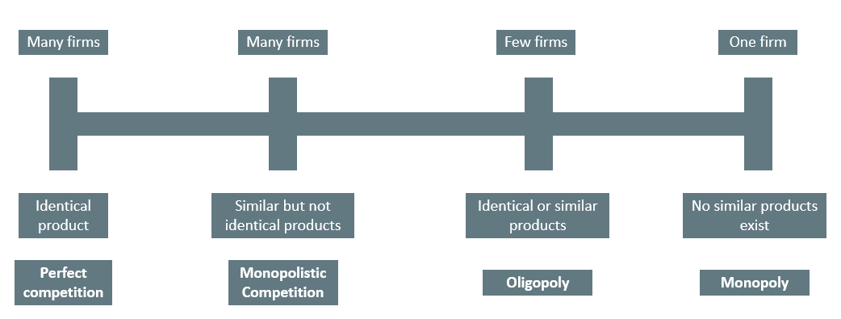
Different Market Structures
Notes:
Firms face different competitive situations. At one extreme—perfect competition—many firms are all trying to sell identical products. At the other extreme—monopoly—only one firm is selling the product, and this firm faces no competition. Monopolistic competition and oligopoly fall between the extremes of perfect competition and monopoly. Monopolistic competition is a situation with many firms selling similar, but not identical, products. Oligopoly is a situation with few firms that sell identical or similar products.

Slide 8

Profit and Revenue
Each business, regardless of size or complexity, tries to earn a profit.
profit = total revenue − total cost
Total revenue is the income the firm generates from selling its products. We calculate it by multiplying the price of the product times the quantity of output sold:
total revenue = price × quantity
Notes:
Each business, regardless of size or complexity, tries to earn a profit. 𝑝𝑟𝑜𝑓𝑖𝑡=𝑡𝑜𝑡𝑎𝑙 𝑟𝑒𝑣𝑒𝑛𝑢𝑒−𝑡𝑜𝑡𝑎𝑙 𝑐𝑜𝑠𝑡. Total revenue is the income the firm generates from selling its products. We calculate it by multiplying the price of the product times the quantity of output sold: 𝑡𝑜𝑡𝑎𝑙 𝑟𝑒𝑣𝑒𝑛𝑢𝑒=𝑝𝑟𝑖𝑐𝑒×𝑞𝑢𝑎𝑛𝑡𝑖𝑡𝑦.

Slide 9
Cost
Total cost is what the firm pays for producing and selling its products.
We can distinguish between two types of cost: explicit and implicit.
Explicit costs are out-of-pocket costs and actual payments, such as wages paid to employees and rent for an office.
Implicit costs are the opportunity costs of using resources the firm already owns, such as depreciation.
Notes:
Total cost is what the firm pays for producing and selling its products. We can distinguish between two types of cost: explicit and implicit. Explicit costs are out-of-pocket costs and actual payments, such as wages paid to employees and rent for an office. Implicit costs are the opportunity costs of using resources the firm already owns, such as depreciation.

Slide 10

Real-World Discussion
Suppose you own your own vinyl album business, and you currently generate revenue of $20,000 per year. To calculate your profit, what else do you need to consider besides your total revenue of $20,000?
Notes:
Suppose you own your own vinyl decal business, and you currently generate revenue of $20,000 per year. To calculate your profit, what else do you need to consider besides your total revenue of $20,000?

Slide 11
Profit
The definitions of cost are important for distinguishing between two conceptions of profit: accounting profit and economic profit.
Accounting profit is a cash concept: total revenue minus explicit costs—the difference between dollars brought in and dollars paid out.
Economic profit is total revenue minus total cost, including both explicit and implicit costs.
Whether or not a business is economically successful depends on its economic profit.
Notes:
The definitions of cost are important for distinguishing between two conceptions of profit: accounting profit and economic profit. Accounting profit is a cash concept: total revenue minus explicit costs—the difference between dollars brought in and dollars paid out. Economic profit is total revenue minus total cost, including both explicit and implicit costs. Whether or not a business is economically successful depends on its economic profit.

Slide 12
On Your Own₁
A firm had a sales revenue of $1,300,000 last year. It spent $450,000 on labor, $50,000 on capital, and $250,000 on materials. The firm's factory sits on land owned by the firm that it could rent for $80,000 per year.
What was the firm's economic profit?
Notes:
A firm had a sales revenue of $1,300,000 last year. It spent $450,000 on labor, $50,000 on capital, and $250,000 on materials. The firm's factory sits on land owned by the firm that it could rent for $80,000 per year.
What was the firm's economic profit?

Slide 13
On Your Own₂
Economic profit is calculated by subtracting total cost from total revenue. Explicit costs are actual payments that the firm makes. Labor, capital, and materials are all explicit costs. Implicit costs are the opportunity costs of using resources that the firm already owns. Using the land the firm owns for its factory is considered an implicit cost since the firm could make money by renting out the land.
Since all four costs are included in total cost, subtract each one from the firm's total revenue.
economic profit = sales revenue − labor − capital − materials − opportunity cost of land
economic profit = $1,300,000 − $450,000 − $50,000 − $250,000 − $80,000
economic profit = $470,000
Notes:
Economic profit is calculated by subtracting total cost from total revenue. Explicit costs are actual payments that the firm makes. Labor, capital, and materials are all explicit costs. Implicit costs are the opportunity costs of using resources that the firm already owns. Using the land the firm owns for its factory is considered an implicit cost since the firm could make money by renting out the land. Since all four costs are included in total cost, subtract each one from the firm's total revenue.
economic profit= sales revenue−labor−capital−materials−opportunity cost of land
economic profit= $1,300,000 − $450,000 − $50,000 − $250,000 − $80,000
economic profit= $470,000

Slide 14
Summary
Privately owned firms are motivated to earn profits.
Profit is the difference between revenue and cost.
While accounting profit considers only explicit costs, economic profit considers both explicit and implicit costs.

Slide 15




HAWKES LEARNING

