Slide 1
Elasticity in Areas Other Than Price
HAWKES LEARNING
Notes:
By the end of this lesson, you will be able to calculate income elasticity of demand, cross-price elasticity of demand, and elasticity in labor and financial capital markets.

Slide 2
Elasticity in Areas Other Than Price₁
The basic idea of elasticity does not just apply to the responsiveness of quantity supplied and demanded to changes in the price of a product.
Quantity demanded depends on income, tastes and preferences, and the prices of related goods, as well as price.
Quantity supplied depends on factors such as the cost of production, as well as price.
Elasticity can be measured for any determinant of quantity supplied and quantity demanded, not just the price.
Notes:
The basic idea of elasticity does not just apply to the responsiveness of quantity supplied and demanded to changes in the price of a product. Quantity demanded depends on income, tastes and preferences, the prices of related goods, and so on, as well as price. Quantity supplied depends on factors such as the cost of production, as well as price. Elasticity can be measured for any determinant of quantity supplied and quantity demanded, not just the price.

Slide 3
Income Elasticity of Demand₁
The income elasticity of demand is the percentage change in quantity demanded divided by the percentage change in income.
For most products, most of the time, the income elasticity of demand is positive.
This pattern is common enough that these goods are referred to as normal goods.
For some goods, an increase in income means that one might purchase less of the good.
When the income elasticity of demand is negative, the good is referred to as an inferior good.
Notes:
The income elasticity of demand is the percentage change in quantity demanded divided by the percentage change in income. For most products, most of the time, the income elasticity of demand is positive. This pattern is common enough that these goods are referred to as normal goods. For some goods, an increase in income means that one might purchase less of the good. When the income elasticity of demand is negative, the good is referred to as an inferior good.

Slide 4

Income Elasticity of Demand₂
If you love pancakes, an increase in your income will increase your demand for pancakes, meaning it is a normal good to you. If you like pancakes, but really prefer expensive croissants, an increase in your income will reduce your demand for pancakes, as you choose to purchase more croissants. This would make pancakes an inferior good to you.
Notes:
If you love pancakes, an increase in your income will increase your demand for pancakes, meaning it is a normal good to you. If you like pancakes, but really prefer expensive croissants, an increase in your income will reduce your demand for pancakes, as you choose to purchase more croissants. This would make pancakes an inferior good to you.

Slide 5
Cross-Price Elasticity of Demand₁
A change in the price of one good can shift the quantity demanded for another good.
If two goods are complements, a drop in the price of one good will lead to an increase in the quantity demanded of the other good.
If two goods are substitutes, a drop in the price of one good will cause people to substitute toward that good.
The term "cross-price" refers to the idea that the price of one good is affecting the quantity demanded of a different good.
Notes:
The income elasticity of demand is the percentage change in quantity demanded divided by the percentage change in income. For most products, most of the time, the income elasticity of demand is positive. This pattern is common enough that these goods are referred to as normal goods. For some goods, an increase in income means that one might purchase less of the good. When the income elasticity of demand is negative, the good is referred to as an inferior good.

Slide 6
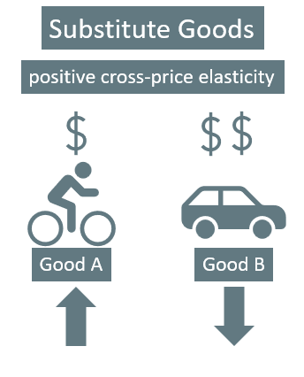
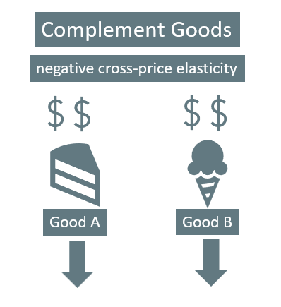
Cross-Price Elasticity of Demand₂
Notes:
Substitute goods have positive cross-price elasticities of demand: if Good A is a substitute for Good B, a higher price for B will mean a greater quantity consumed of A. Complement goods have negative cross-price elasticities: if Good A is a complement for Good B, a higher price for B will mean a lower quantity consumed of A.

Slide 7


Cross-Price Elasticity of Demand₃
In a society where people love to eat peanut butter and jelly sandwiches, while refusing to eat one good without the other, an increase in the price of one of the goods will decrease the demand for the other. This means the cross-price elasticity of demand between peanut butter and jelly is negative, indicating the two goods are complements.
Notes:
In a society where people love to eat peanut butter and jelly sandwiches and refuse to eat one good without the other, an increase in the price of one of the goods will decrease the demand for the other. This means the cross-price elasticity of demand between peanut butter and jelly is negative, indicating the two goods are complements.

Slide 8
Elasticity in Labor and Financial Capital Markets
The concept of elasticity applies to any market, not just markets for goods and services.
The wage elasticity of labor supply refers to the percentage change in hours worked divided by the percentage change in wages.
The elasticity of savings refers to the percentage change in the quantity of savings divided by the percentage change in interest rates.
Notes:
The income elasticity of demand is the percentage change in quantity demanded divided by the percentage change in income. For most products, most of the time, the income elasticity of demand is positive. This pattern is common enough that these goods are referred to as normal goods. For some goods, an increase in income means that one might purchase less of the good. When the income elasticity of demand is negative, the good is referred to as an inferior good.

Slide 9
Summary
Elasticity refers to the change of one variable divided by the percentage change of a related variable that we can apply to many economic connections.
The income elasticity of demand is the percentage change in quantity demanded divided by the percentage change in income.
The cross-price elasticity of demand is the percentage change in the quantity demanded of a good divided by the percentage change in the price of another good.
The wage elasticity of labor supply is the percentage change in the quantity of hours supplied divided by the percentage change in the wage.
The elasticity of savings with respect to interest rates is the percentage change in the quantity of savings divided by the percentage change in interest rates.
Notes:
Elasticity refers to the change of one variable divided by the percentage change of a related variable that we can apply to many economic connections.
The income elasticity of demand is the percentage change in quantity demanded divided by the percentage change in income.
The cross-price elasticity of demand is the percentage change in the quantity demanded of a good divided by the percentage change in the price of another good.
The wage elasticity of labor supply is the percentage change in the quantity of hours supplied divided by the percentage change in the wage.
The elasticity of savings with respect to interest rates is the percentage change in the quantity of savings divided by the percentage change in interest rates.

Slide 10




HAWKES LEARNING

