Slide 1
Demand and Supply in Financial Markets
HAWKES LEARNING
Notes:
By the end of this lesson, you will be able to identify the demanders and suppliers in the financial market; explain how interest rates affect demand and supply; and explain the role of price ceilings and usury laws.

Slide 2
Demand and Supply in Financial Markets₁
The demand and supply model links those who wish to supply financial capital with those who demand financial capital.
Demanders in the financial market are individuals and firms that borrow money.
Suppliers in the financial market are individuals and businesses that save money or make financial investments.
Notes:
The demand and supply model links those who wish to supply financial capital with those who demand financial capital. Demanders in the financial market are individuals and firms that borrow money. Suppliers in the financial market are individuals and businesses that save money or make financial investments.

Slide 3
Who Demands and Who Supplies in Financial Markets?
In financial markets, those who supply financial capital through saving expect to receive a rate of return.
Those who demand financial capital by receiving funds expect to pay a rate of return.
This rate of return can come in a variety of forms, depending on the type of investment.
The simplest example of a rate of return is the interest rate.
Notes:
In any market, the price is what suppliers receive and what demanders pay. In financial markets, those who supply financial capital through saving expect to receive a rate of return, while those who demand financial capital by receiving funds expect to pay a rate of return. This rate of return can come in a variety of forms, depending on the type of investment. The simplest example of a rate of return is the interest rate.

Slide 4
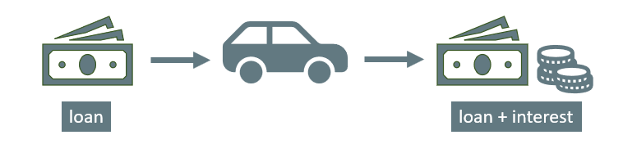
Investments and Savings
When you supply money into a savings account at a bank, you receive interest on your deposit.
The interest the bank pays you as a percent of your deposits is the interest rate.
Similarly, if you demand a loan to buy a car or a computer, you will need to pay interest on the money you borrow.
Notes:
For example, when you supply money into a savings account at a bank, you receive interest on your deposit. The interest the bank pays you as a percent of your deposits is the interest rate. Similarly, if you demand a loan to buy a car, you will need to pay interest on the money you borrow.

Slide 5
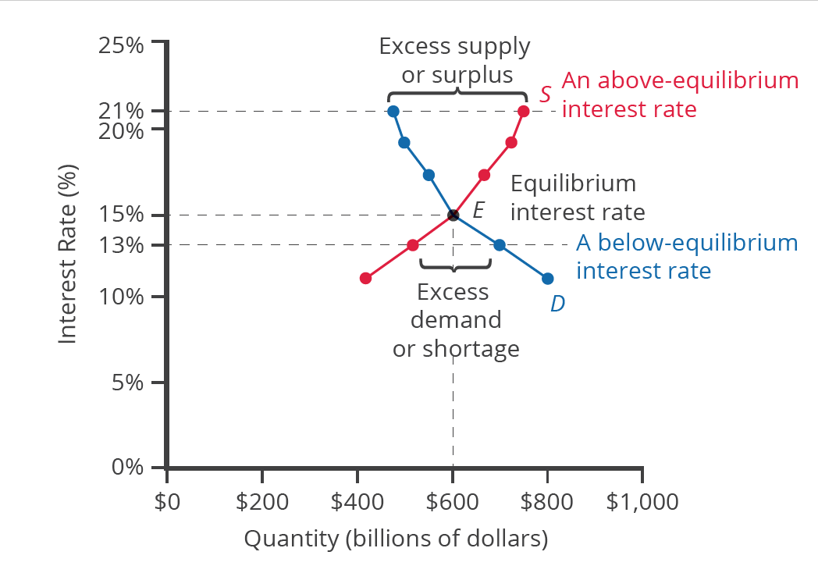
Credit Card Market
In the market for credit cards, the horizontal axis of the financial market shows the quantity of money loaned or borrowed in this market, and the vertical or price axis shows the rate of return, which is measured with an interest rate.
According to the law of demand, a higher rate of return will decrease the quantity demanded, and as the interest rate rises, consumers will reduce the quantity they borrow.
Notes:
In the market for credit cards, the horizontal axis of the financial market shows the quantity of money loaned or borrowed in this market, and the vertical or price axis shows the rate of return, which is measured with an interest rate. According to the law of demand, a higher rate of return will decrease the quantity demanded, and as the interest rate rises, consumers will reduce the quantity they borrow.

Slide 6
Equilibrium in Financial Markets
If the interest rate is above the equilibrium level, an excess supply, or a surplus, of financial capital will arise in this market.
At an above-equilibrium interest rate, firms are eager to supply loans to borrowers, but relatively few people or businesses wish to borrow.
If the interest rate is below the equilibrium, excess demand or a shortage of funds occurs in this market.
In this situation, credit card firms will perceive that there are many eager borrowers and will likely raise interest rates or fees.
Notes:
If the interest rate is above the equilibrium level, an excess supply, or a surplus, of financial capital will arise in this market. At an above-equilibrium interest rate, firms are eager to supply loans to borrowers, but relatively few people or businesses wish to borrow. If the interest rate is below the equilibrium, excess demand or a shortage of funds occurs in this market. In this situation, credit card firms will perceive that there are many eager borrowers and will likely raise interest rates or fees.

Slide 7
Intertemporal Decision-Making₁
Those who supply financial capital face two broad decisions: how much to save and how to divide up their savings.
Participants in financial markets must decide when they prefer to consume goods: now or in the future.
Economists call this intertemporal decision-making because it involves decisions across time.
Unlike a decision about what to buy from the grocery store, people make investment or savings decisions across a period of time.
Notes:
Those who supply financial capital face two broad decisions: how much to save and how to divide up their savings among different forms of financial investments. Participants in financial markets must decide when they prefer to consume goods: now or in the future. Economists call this intertemporal decision-making because it involves decisions across time. Unlike a decision about what to buy from the grocery store, people make investment or savings decisions across a period of time, sometimes a long period.

Slide 8
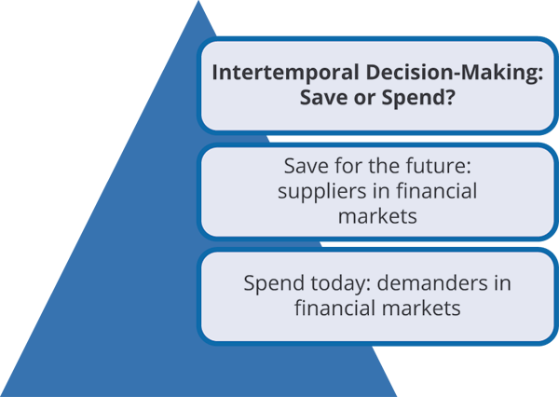
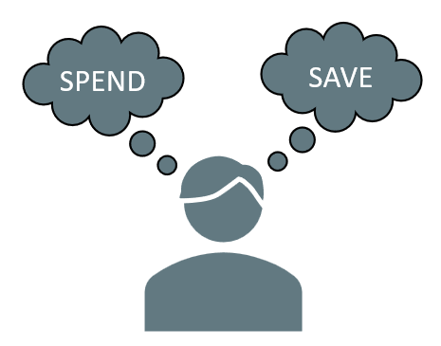
Intertemporal Decision-Making₂

Slide 9
The United States as a Global Borrower
In the global economy, trillions of dollars of financial investment cross national borders every year.
In the early 2000s, foreign investors were investing billions of dollars more per year into the U.S. than U.S. investors were investing abroad.
A reduced inflow of foreign financial investment could impose hardship on U.S. consumers and firms interested in borrowing.
The result could be a significantly lower quantity of financial investment in the U.S., available only at a higher interest rate.
Notes:
In the global economy, trillions of dollars of financial investment cross national borders every year. In the early 2000s, foreign investors were investing billions of dollars more per year into the U.S. than U.S. investors were investing abroad. A reduced inflow of foreign financial investment could impose hardship on U.S. consumers and firms interested in borrowing. The result could be a significantly lower quantity of financial investment in the U.S., available only at a higher interest rate.

Slide 10
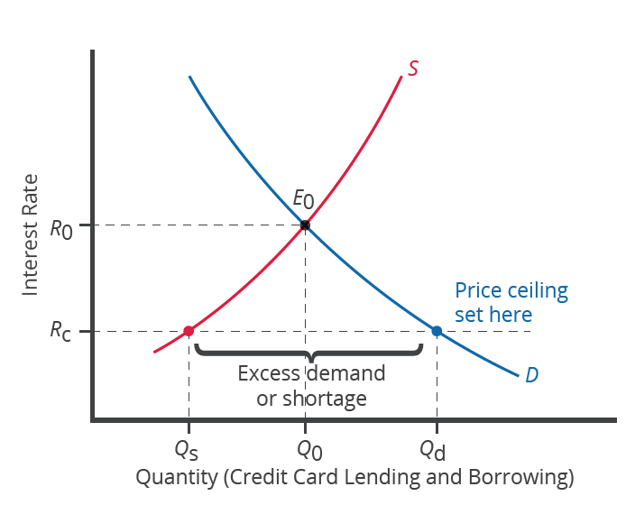
Price Ceilings in Financial Markets: Usury Laws
Usury laws impose an upper limit on the interest rate than lenders can charge.
About 200 million Americans own credit cards, so it is little wonder that political pressures often arise for setting limits on the interest rates or fees that credit card companies charge.
A price ceiling on the interest rate means a number of people who want to have credit cards and are willing to pay the interest rate will find that companies are unwilling to issue cards to them, resulting in a credit shortage.
Notes:
About 200 million Americans own credit cards, so it is little wonder that political pressures often arise for setting limits on the interest rates or fees that credit card companies charge. A price ceiling on the interest rate means a number of people who want to have credit cards and are willing to pay the interest rate will find that companies are unwilling to issue cards to them, resulting in a credit shortage.

Slide 11
Summary
In the demand and supply analysis of financial markets, the "price" is the rate of return or the interest rate received.
We measure the quantity by the money that flows from those who supply financial capital to those who demand it.
Two factors can shift the supply of financial capital to a certain investment: if people want to alter their existing levels of consumption and if the riskiness or return on one investment changes relative to other investments.
Factors that can shift demand for capital include business confidence and consumer confidence in the future—since financial investments received in the present are typically repaid in the future.

Slide 12




HAWKES LEARNING

