Slide 1
Demand and Supply at Work in Labor Markets
HAWKES LEARNING
Notes:
By the end of this lesson, you will be able to predict shifts in the demand and supply curves of the labor market; explain the impact of new technology; and explain price floors in the labor market.

Slide 2
Demand and Supply₁
The theories of supply and demand do not apply just to markets for goods, they also apply to markets like labor and financial services.
In labor markets, job seekers are the suppliers of labor, while firms and other employers who hire labor are the demanders for labor.
In financial markets, any individual or firm who saves contributes to the supply of money, and any who borrows contributes to demand.
Notes:
The theories of supply and demand do not apply just to markets for goods. They apply to any market, even markets for things we may not think of as goods and services like labor and financial services. Labor markets are markets for employees or jobs. Financial services markets are markets for saving or borrowing. In labor markets, job seekers (individuals) are the suppliers of labor, while firms and other employers who hire labor are the demanders for labor. In financial markets, any individual or firm who saves contributes to the supply of money, and any who borrows (person, firm, or government) contributes to the demand for money.

Slide 3
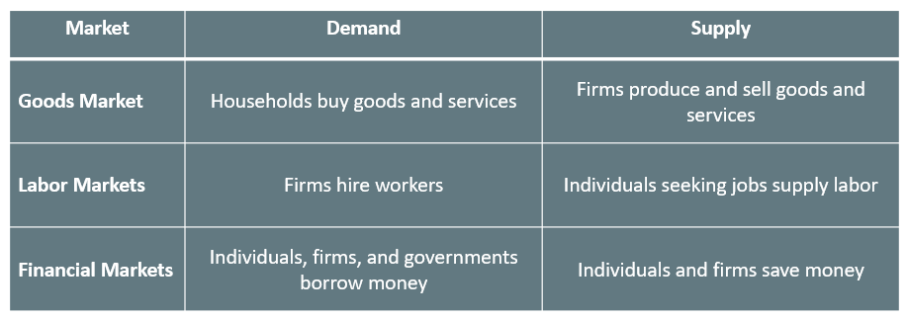
Demand and Supply₂
Notes:
In the goods market, the demanders are the households that buy goods and services, while the suppliers are the firms that produce and sell goods and services. In labor markets, the demanders are the firms that hire workers, while the suppliers are the individuals seeking jobs. In financial markets, the demanders are the individuals, firms, and governments that borrow money, while the suppliers are the individuals and firms that save money.

Slide 4
Labor Demand and Supply
Markets for labor have demand and supply curves, just like markets for goods.
A higher salary or wage—that is, a higher price in the labor market—leads to a decrease in the quantity of labor demanded by employers.
A lower salary or wage leads to an increase in the quantity of labor demanded.
A higher price for labor leads to a higher quantity of labor supplied; a lower price leads to a lower quantity supplied.
Notes:
Markets for labor have demand and supply curves, just like markets for goods. The law of demand applies in labor markets this way: a higher salary or wage—that is, a higher price in the labor market—leads to a decrease in the quantity of labor demanded by employers, while a lower salary or wage leads to an increase in the quantity of labor demanded. The law of supply functions in labor markets, too: a higher price for labor leads to a higher quantity of labor supplied; a lower price leads to a lower quantity supplied.

Slide 5
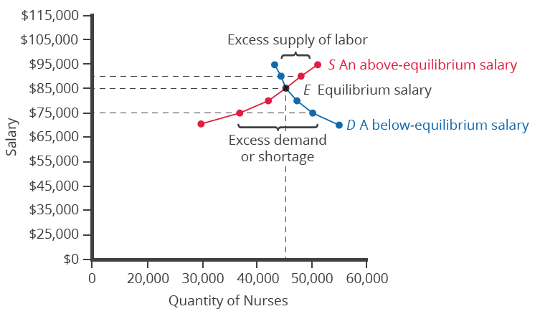
Equilibrium in the Labor Market₁
In 2021, about 42,000 registered nurses worked in the Minneapolis-St. Paul-Bloomington, Minnesota-Wisconsin metropolitan area, according to the BLS.
The demand curve of those employers who want to hire nurses intersects with the supply curve of those who are qualified and willing to work as nurses at an equilibrium salary of $85,000.
Notes:
In 2021, about 42,000 registered nurses worked in the Minneapolis-St. Paul-Bloomington, Minnesota-Wisconsin metropolitan area, according to the BLS. The demand curve of those employers who want to hire nurses intersects with the supply curve of those who are qualified and willing to work as nurses at an equilibrium salary of $85,000.

Slide 6
Equilibrium in the Labor Market₂
At equilibrium in a labor market, the quantity supplied and the quantity demanded are equal.
Every employer who wants to hire at this equilibrium wage can find a willing worker.
Every worker who wants to work at this equilibrium salary can find a job.
When the price of labor is not at the equilibrium, economic incentives tend to move salaries toward the equilibrium.
Notes:
At equilibrium in a labor market, the quantity supplied and the quantity demanded are equal. Every employer who wants to hire at this equilibrium wage can find a willing worker. Every worker who wants to work at this equilibrium salary can find a job. When the price of labor is not at the equilibrium, economic incentives tend to move salaries toward the equilibrium.

Slide 7
Shifts in Labor Demand
Demand for Output
Education and Training
Technology
Number of Companies
Government Regulations
Prices of Other Inputs
Notes:
Labor demand can shift due to any of the following factors: demand for output, education and training, technology, number of companies, government regulations, and prices of other inputs.

Slide 8
Demand for Output
When the demand for the good produced (output) increases, both the output price and profitability increase.
As a result of increased demand for a good, producers demand more labor to ramp up production.
Conversely, decreased demand for the good produced will decrease the demand for labor associated with that good.
Notes:
First, demand for output: when the demand for the good produced (output) increases, both the output price and profitability increase. As a result of increased demand for a good, producers demand more labor to ramp up production. Conversely, decreased demand for the good produced will decrease the demand for labor associated with that good.

Slide 9
Education and Training
A well-trained and educated workforce causes an increase in the demand for that labor by employers.
Increased levels of productivity within the workforce will cause the demand for labor to shift to the right.
If the workforce is not well-trained or educated, employers will not hire from within that labor pool due to high training costs.
A less educated workforce and, therefore, decreased levels of productivity, will shift the demand for labor to the left.
Notes:
A well-trained and educated workforce causes an increase in the demand for that labor by employers. Increased levels of productivity within the workforce will cause the demand for labor to shift to the right. If the workforce is not well-trained or educated, employers will not hire from within that labor pool since they will need to spend a significant amount of time and money training that workforce. Demand for such will shift to the left.

Slide 10
Technology
When technology acts as a substitute, it replaces the need for the number of workers an employer needs to hire.
Technology that acts as a complement to labor will increase the demand for certain types of labor.
More and better technology will increase demand for skilled workers who know how to use technology to enhance workplace productivity.
Those workers who do not adapt to changes in technology will experience a decrease in demand for their labor.
Notes:
Technology changes can act as either substitutes for or complements to labor. When technology acts as a substitute, it replaces the need for the number of workers an employer needs to hire. For example, word processing decreased the number of typists needed in the workplace. This shifted the demand curve for typists to the left. An increase in the availability of certain technologies may increase the demand for labor. Technology that acts as a complement to labor will increase the demand for certain types of labor, resulting in a rightward shift of the demand curve. For example, the increased use of word processing and other software has increased the demand for information technology professionals who can resolve software and hardware issues related to a firm's network. More and better technology will increase demand for skilled workers who know how to use technology to enhance workplace productivity. Those workers who do not adapt to changes in technology will experience a decrease in demand for their labor.

Slide 11


Number of Companies
An increase in the number of companies producing a given product will increase the demand for labor, resulting in a shift to the right.
A decrease in the number of companies producing a given product will decrease the demand for labor, resulting in a shift to the left.

Slide 12
Government Regulations
Complying with government regulations can increase or decrease the demand for labor at any given wage.
In the health care industry, for example, government rules may require that nurses be hired to carry out certain medical procedures.
Untrained health care workers would be prohibited from carrying out these procedures, shifting the demand for these workers to the left.
Notes:
Complying with government regulations can increase or decrease the demand for labor at any given wage. In the health care industry, for example, government rules may require that nurses be hired to carry out certain medical procedures. Untrained health care workers would be prohibited from carrying out these procedures, shifting the demand for these workers to the left.

Slide 13
Prices and Availability of Other Inputs
Labor is not the only input into the production process.
For example, a salesperson at a call center needs a telephone and a computer terminal to enter data and record sales.
If prices of other inputs fall, production will become more profitable, and suppliers will demand more labor to increase production.
The opposite is also true. Higher prices for other inputs lower demand for labor.
Notes:
Last, low prices of other inputs involved in the production price will allow production to be more profitable, and suppliers will demand more labor to increase production. Higher prices for other inputs lower demand for labor as employers will try and cut costs from inputs, including labor.

Slide 14
Labor Supply
Number of Workers
Required Education
Government Policies
Notes:
Labor supply can shift due to any of the following factors: number of workers, required education, and government policies.

Slide 15
Number of Workers
An increased number of workers will cause the supply curve to shift to the right, and vice versa.
An increased number of workers can be due to several factors, such as immigration, increasing population, and changing demographics.
An aging, and therefore retiring, population will decrease the supply of labor.
Another example of changing demographics is more women working outside of the home, which increases the supply of labor.
Notes:
An increased number of workers will cause the supply curve to shift to the right. An increased number of workers can be due to several factors, such as immigration, increasing population, an aging population, and changing demographics. Policies that encourage immigration will increase the supply of labor, and vice versa. Population grows when birth rates exceed death rates. This eventually increases the supply of labor when the former reach working age. An aging, and therefore retiring, population will decrease the supply of labor. Another example of changing demographics is more women working outside of the home, which increases the supply of labor.

Slide 16

Required Education
The more required education, the lower the supply.
For example, there is a lower supply of PhD mathematicians than high school mathematics teachers.
Notes:
Second, since higher education is competitive and expensive, not everyone can attain the same training and skills. The more required education, the lower the supply of eligible workers. For example, there is a lower supply of PhD mathematicians than high school mathematics teachers.

Slide 17
Government Policies
When qualifications for jobs are made tougher, the number of qualified workers will decrease at any given wage.
On the other hand, the government may also subsidize training or even reduce the required level of qualifications.
Government policies that change the relative desirability of working or not, like unemployment and welfare, also affect the labor supply.
All government policies must be carefully designed to minimize any negative labor supply effects.
Notes:
When qualifications for jobs are made tougher, the number of qualified workers will decrease at any given wage. On the other hand, the government may also subsidize training or even reduce the required level of qualifications. Government policies that change the relative desirability of working or not, like unemployment and welfare, also affect the labor supply. All government policies must be carefully designed to minimize any negative labor supply effects.

Slide 18
Technology and Wage Inequality: The Four-Step Process₁
Economic events can change the equilibrium salary (or wage) and quantity of labor.
Consider how the wave of new information technologies, like computer networks, has affected workers in the U.S. economy.
From the perspective of employers who demand labor, these new technologies are often a substitute for low-skill laborers like file clerks.
The same new technologies are a complement to high-skill workers like managers, who can now handle more responsibilities.
Notes:
Economic events can change the equilibrium salary (or wage) and quantity of labor. Consider how the wave of new information technologies, like computer networks, has affected workers in the U.S. economy. From the perspective of employers who demand labor, these new technologies are often a substitute for low-skill laborers like file clerks. The same new technologies are a complement to high-skill workers like managers, who can now handle more responsibilities.

Slide 19
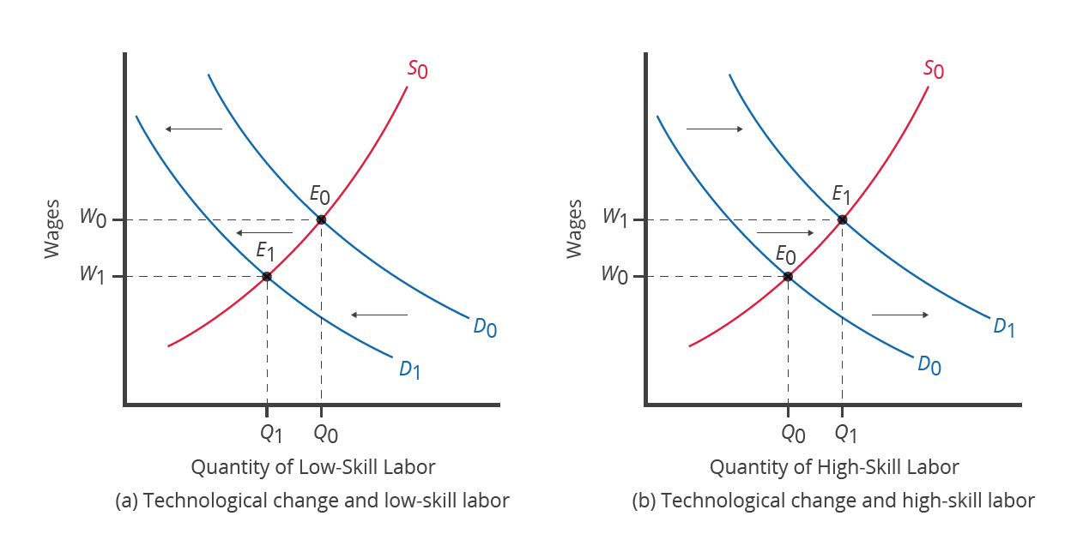
Technology and Wage Inequality: The Four-Step Process₂
The demand for low-skill labor shifts to the left when technology can do the job previously done by these workers. New technologies can also increase the demand for high-skill labor in fields such as information technology and network administration.
Notes:
The demand for low-skill labor shifts to the left when technology can do the job previously done by these workers. New technologies can also increase the demand for high-skill labor in fields such as information technology and network administration.

Slide 20
Price Floors in the Labor Market: Living Wages and Minimum Wages
Price ceilings are rare in labor markets because rules that prevent people from earning income are not politically popular.
The labor market presents some prominent examples of price floors, which are an attempt to increase the wages of low-paid workers.
A minimum wage is a price floor that makes it illegal for an employer to pay employees less than a certain hourly rate.
A living wage is a higher minimum wage that will ensure a reasonable standard of living.
Notes:
Price ceilings are rare in labor markets because rules that prevent people from earning income are not politically popular. The labor market presents some prominent examples of price floors, which are an attempt to increase the wages of low-paid workers. A minimum wage is a price floor that makes it illegal for an employer to pay employees less than a certain hourly rate. A living wage is a higher minimum wage that will ensure a reasonable standard of living.

Slide 21
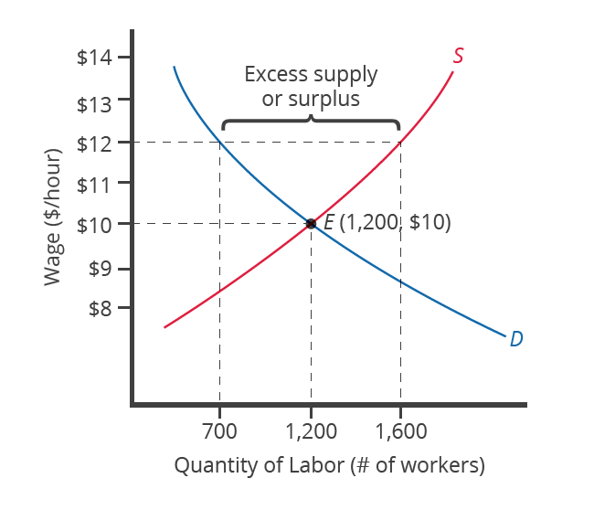
Minimum Wage
At the price floor, the quantity supplied exceeds the quantity demanded, and a surplus of labor exists in this market. For workers who continue to have a job at a higher salary, life has improved. For those who were willing to work at the old wage rate but lost their jobs with the wage increase, life has not improved.
Notes:
At the price floor, the quantity supplied exceeds the quantity demanded, and a surplus of labor exists in this market. For workers who continue to have a job at a higher salary, life has improved. For those who were willing to work at the old wage rate but lost their jobs with the wage increase, life has not improved.

Slide 22
Summary
In the labor market, households are on the supply side of the market, and firms are on the demand side.
In the demand and supply analysis of labor markets, we can measure the price by the annual salary or hourly wage received, and the quantity of labor various ways, like number of workers or the number of hours worked.
Factors that can shift the demand curve for labor include a change in the quantity demanded of the product that the labor produces; a change in the production process that uses more or less labor; and a change in government policy that affects the quantity of labor that firms wish to hire at a given wage.
The main factors that can shift the supply curve for labor are how desirable a job appears to workers relative to the alternatives, government policy that either restricts or encourages the quantity of workers trained for the job, the number of workers in the economy, and required education.

Slide 23




HAWKES LEARNING

