Slide 1
The Benefits of Reducing Barriers to International Trade
HAWKES LEARNING
Notes:
By the end of this lesson, you will be able to explain tariffs as barriers to trade and identify benefits of reducing barriers to international trade.

Slide 2
Tariffs
Tariffs are taxes that governments place on imported goods for a variety of reasons.
Some of these reasons include protecting sensitive industries, humanitarian reasons, and protecting against dumping.
Traditionally, tariffs were used simply as a political tool to protect certain vested economic, social, and cultural interests.
Notes:
Tariffs are taxes that governments place on imported goods for a variety of reasons. Some of these reasons include protecting sensitive industries, humanitarian reasons, and protecting against dumping. Traditionally, tariffs were used simply as a political tool to protect certain vested economic, social, and cultural interests.

Slide 3

WTO
World Trade Organization
committed to lowering barriers to trade
Notes:
The World Trade Organization, WTO, is committed to lowering barriers to trade such as tariffs, to allow consumers to consume a variety of products they want and need. Now, you are able to explain tariffs as barriers to trade and identify benefits of reducing barriers to international trade.

Slide 4
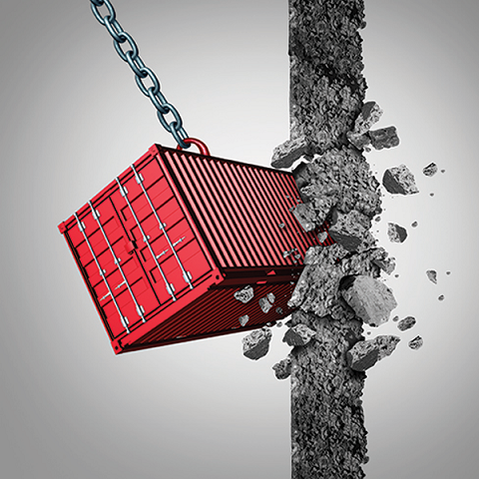
International Trade₁
The economic benefits from reducing barriers to trade are most felt by low-income countries.
Notes:
The economic benefits from reducing barriers to trade are most felt by low-income countries.

Slide 5
International Trade₂
Low-income countries benefit more from trade than high-income countries.
The U.S. economy has less need for international trade because it can already take advantage of internal trade within its economy.
Many smaller national economies around the world have much more limited possibilities for trade inside their countries.
Without international trade, they may have little ability to benefit from comparative advantage, the value chain, or economies of scale.
Notes:
Low-income countries benefit more from trade than high-income countries. The U.S. economy has less need for international trade because it can already take advantage of internal trade within its economy. Many smaller national economies around the world have much more limited possibilities for trade inside their countries. Without international trade, they may have little ability to benefit from comparative advantage, the value chain, or economies of scale.

Slide 6
From Interpersonal to International Trade
We all benefit from living in economies where people and firms can specialize and trade with each other.
If interpersonal, intercommunity, and interstate trade offer economic gains, it should make sense that international trade offers gains, too.
International trade currently involves about $20 trillion worth of goods and services moving around the globe.
Any economic force of that size, even if it confers overall benefits, is certain to cause disruption and controversy.
Notes:
We all benefit from living in economies where people and firms can specialize and trade with each other. If interpersonal, intercommunity, and interstate trade offer economic gains, it should make sense that international trade offers gains, too. International trade currently involves about $20 trillion worth of goods and services moving around the globe. Any economic force of that size, even if it confers overall benefits, is certain to cause disruption and controversy.

Slide 7

On Your Own₁
Suppose you are planning to trade in your old iPhone for a new iPhone that costs $1,150. How would tariffs on goods from China, including iPhones, affect your purchase?
Notes:
Suppose you are planning to trade in your old iPhone for a new iPhone that costs $1,150. How would tariffs on goods from China, including iPhones, affect your purchase?

Slide 8
On Your Own₂
Suppose you are planning to trade in your old iPhone for a new iPhone that costs $1,150. How would tariffs on goods from China, including iPhones, affect your purchase?
Tariffs on goods produced in China would increase the goods’ prices and possibly decrease the quantity available for sale. Tariffs reduce the benefits from trade, such as the ability to split up the value chain (as Apple does with the iPhone). Tariffs also make it harder for producers to achieve economies of scale if demand for their products decreases, which will likely increase their average costs.
Notes:
Suppose you are planning to trade in your old iPhone for a new iPhone that costs $1,150. How would tariffs on goods from China, including iPhones, affect your purchase?
Tariffs on goods produced in China would increase the goods’ prices and possibly decrease the quantity available for sale. Tariffs reduce the benefits from trade, such as the ability to split up the value chain (as Apple does with the iPhone). Tariffs also make it harder for producers to achieve economies of scale if demand for their products decreases, which will likely increase their average costs.

Slide 9
Summary
Tariffs are placed on imported goods as a way of protecting sensitive industries for humanitarian reasons and for protection against dumping.
Traditionally, tariffs were used as a political tool to protect certain vested economic, social, and cultural interests.
The WTO has been, and continues to be, a way for nations to meet and negotiate in order to reduce barriers to trade.
The gains of international trade are very large for smaller countries but are beneficial to all.

Slide 10




HAWKES LEARNING

