Slide 1
The Diversity of Countries and Economies across the World
HAWKES LEARNING

Slide 2
Introduction
Economies across the world are extraordinarily different in composition and performance.
Differences in productivity explain the diversity of average incomes across the world.
Productivity depends on physical and human capital and technology.
Different economic characteristics, institutions, history, and politics impact economic performance.
Notes:
Economies across the world are extraordinarily different in composition and performance. Differences in productivity explain the diversity of average incomes across the world. Productivity depends on physical and human capital and technology. Different economic characteristics, institutions, history, and politics impact economic performance.

Slide 3
The Goals of Different Countries
The goal of most economies is to maintain quality of life.
Quality of life includes low unemployment, price stability, and the ability to trade.
Most countries' goals are similar, but they may use different macroeconomic policies to achieve those goals.
Notes:
The goal of most economies is to maintain quality of life. Quality of life includes low unemployment, price stability, and the ability to trade. Most countries' goals are similar, but they may use different macroeconomic policies to achieve those goals.

Slide 4
Quantifying Economic Diversity
GDP per capita is a useful indicator to quantify the diversity in the standard of living across countries.
Purchasing power parity (PPP) must be considered in order to convert average incomes into comparable units.
PPP takes into account the fact that prices of the same good may be different across countries.
The primary goal for most countries is to not only increase GDP but also GDP per capita, which will raise the overall standard of living.
Notes:
GDP per capita is a useful indicator to quantify the diversity in the standard of living across countries. Purchasing power parity (PPP) must be considered in order to convert average incomes into comparable units. PPP takes into account the fact that prices of the same good may be different across countries. The primary goal for most countries is to not only increase GDP but also GDP per capita, which will raise the overall standard of living.

Slide 5
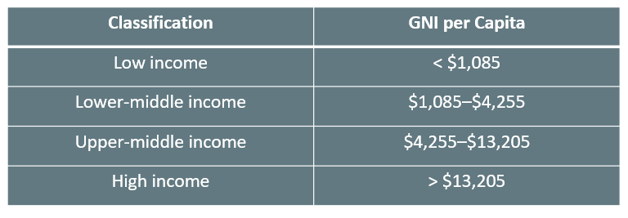
Country Classifications
The World Bank uses gross national income (GNI) per capita to classify countries as low, lower-middle, upper-middle, or high income.
Notes:
The World Bank uses gross national income (GNI) per capita to classify countries as low, lower-middle, upper-middle, or high income.
Low income < $1,085
Lower-middle income $1,085–$4,255
Upper-middle income $4,255– $13,205
High income > $13,205

Slide 6
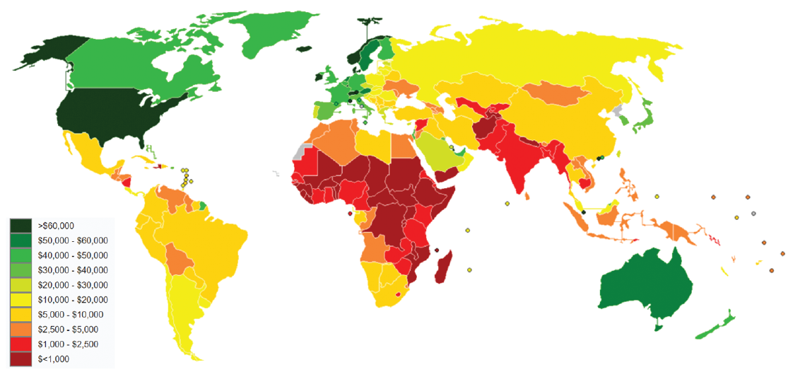
GDP Imbalances₁
This world map shows an overview of GDP per capita by country in 2018. There is a clear imbalance in the GDP across the world.
Notes:
This world map shows an overview of GDP per capita by country in 2018. There is a clear imbalance in the GDP across the world.

Slide 7
GDP Imbalances₂
There is a clear imbalance in GDP levels across the world.
North America, Australia, and western Europe have the highest GDPs.
Large areas of the world, like Africa and South Asia, have much lower GDPs.
North America and the European Union have about 11.5% of the world's population, but they produce close to 48% of the world's GDP.
Notes:
There is a clear imbalance in GDP levels across the world. North America, Australia, and western Europe have the highest GDPs. Large areas of the world, like Africa and South Asia, have much lower GDPs. North America and the European Union have about 11.5% of the world's population, but they produce close to 48% of the world's GDP.

Slide 8
Standard of Living₁
Factors like health, education, human rights, crime and personal safety, and environmental quality are not entirely captured in a GDP per capita calculation.
Many of these factors are correlated with per-capita GDP, but there are exceptions.
No region can claim to have a perfect standard of living; for instance, even high-income regions like Europe and North America still have malnourishment and poverty.
Notes:
Factors like health, education, human rights, crime and personal safety, and environmental quality are not entirely captured in a GDP per capita calculation. Many of these factors are correlated with per-capita GDP, but there are exceptions. No region can claim to have a perfect standard of living; for instance, even high-income regions like Europe and North America still have malnourishment and poverty.

Slide 9
Standard of Living₂
Four additional factors are significant in a wide range of statistical studies:
Geography
Age distribution
Industrial structure
Economic institutions
Notes:
Four additional factors are significant in a wide range of statistical studies: geography, demography, industrial structure, institutions.

Slide 10
Geography
Geographic differences create positive and negative opportunities for trade, health, and the environment.
Some countries have coastlines, while others are completely landlocked.
Some countries have rivers to facilitate commerce, while others have mountains that are barriers to trade.
Some countries have deserts, and some countries have rainforests.
Notes:
Geographic differences create positive and negative opportunities for trade, health, and the environment. Some countries have coastlines, while others are completely landlocked. Some countries have rivers to facilitate commerce, while others have mountains that are barriers to trade. Some countries have deserts, and some countries have rainforests.

Slide 11
Age Distribution
The age distribution of the population will have considerable effects on the standard of living for both the young and the old.
Many high-income countries have a large proportion of elderly citizens.
Most low-income countries have a higher proportion of young workers, but the average age of these countries is expected to increase by 2050.
Notes:
The age distribution of the population will have considerable effects on the standard of living for both the young and the old. Many high-income countries have a large proportion of elderly citizens. Most low-income countries have a higher proportion of young workers, but the average age of these countries is expected to increase by 2050.

Slide 12
Industrial Structure
In high-income countries, only 2% of GDP comes from agriculture.
In middle and low-income countries, 12% of GDP on average comes from agriculture.
Countries have vastly different degrees of urbanization.
Notes:
In high-income countries, only 2% of GDP comes from agriculture. In middle and low-income countries, 12% of GDP on average comes from agriculture. Countries have vastly different degrees of urbanization.

Slide 13
Economic Institutions
Some countries are market-oriented, while others have command economies.
Some economies are far more open to trade than others, with some limiting trade with tariffs and quotas.
Countries have different levels of political stability and religious and social institutions.
Notes:
Some countries are market-oriented, while others have command economies. Some economies are far more open to trade than others, with some limiting trade with tariffs and quotas. Countries have different levels of political stability and religious and social institutions.

Slide 14
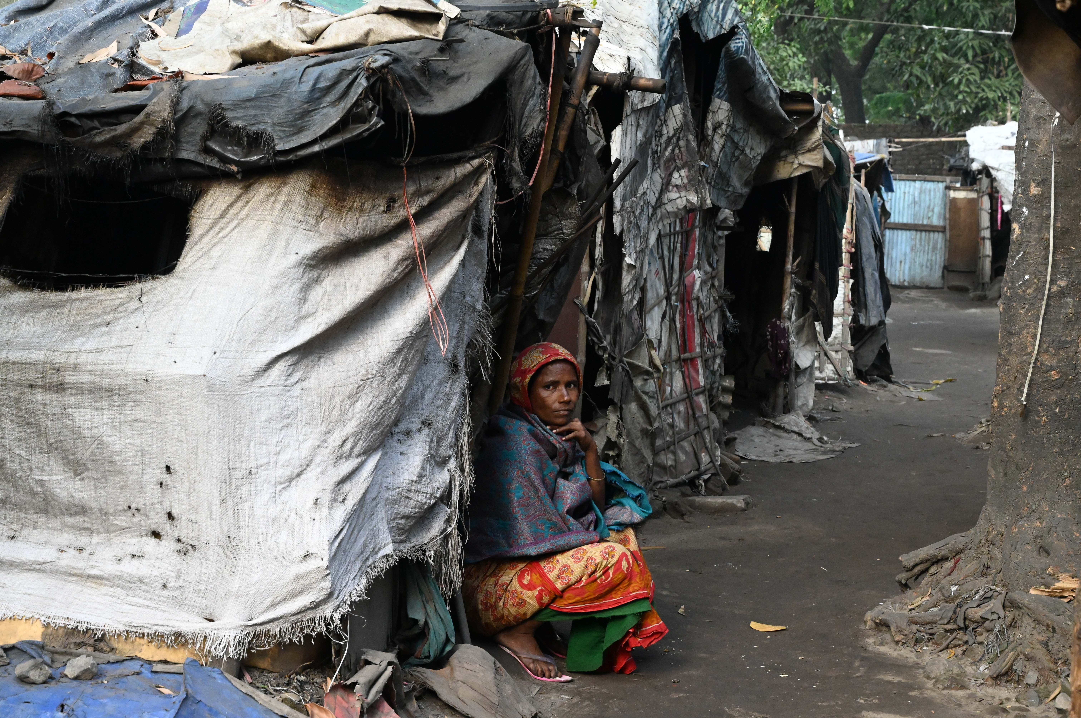
On Your Own
The COVID-19 pandemic affected the entire world, but the outcomes varied widely from country to country. Consider the different factors that comprise standard of living and the data that has emerged on the impact of the pandemic. How would you measure and compare the effect of the pandemic on the standard of living in different countries? Why is that the best measure?
Notes:
The COVID-19 pandemic affected the entire world, but the outcomes varied widely from country to country. Consider the different factors that comprise standard of living and the data that has emerged on the impact of the pandemic. How would you measure and compare the effect of the pandemic on the standard of living in different countries? Why is that the best measure?

Slide 15
Summary
Economies across the world are extraordinarily different in composition and performance.
Macroeconomic policy strives towards low levels of unemployment and inflation, but the ways in which countries reach these goals vary.
Economists analyze countries based on their income per person and rank them as low, lower-middle, upper-middle, or high income.
GDP per capita is a useful indicator for the differences between countries, but geography, demography, industrial structure, and institutions play a part as well.

Slide 16




HAWKES LEARNING

