Slide 1
Taxation
HAWKES LEARNING

Slide 2

Introduction
There are two main categories of taxes:
  Those that the federal government collects
  Those that state and local governments collect
  The amount the government collects in taxes and what taxes are used for varies.
Notes:
There are two main categories of taxes: those that the federal government collects and those that state and local governments collect. The amount the government collects in taxes and what taxes are used for varies.

Slide 3
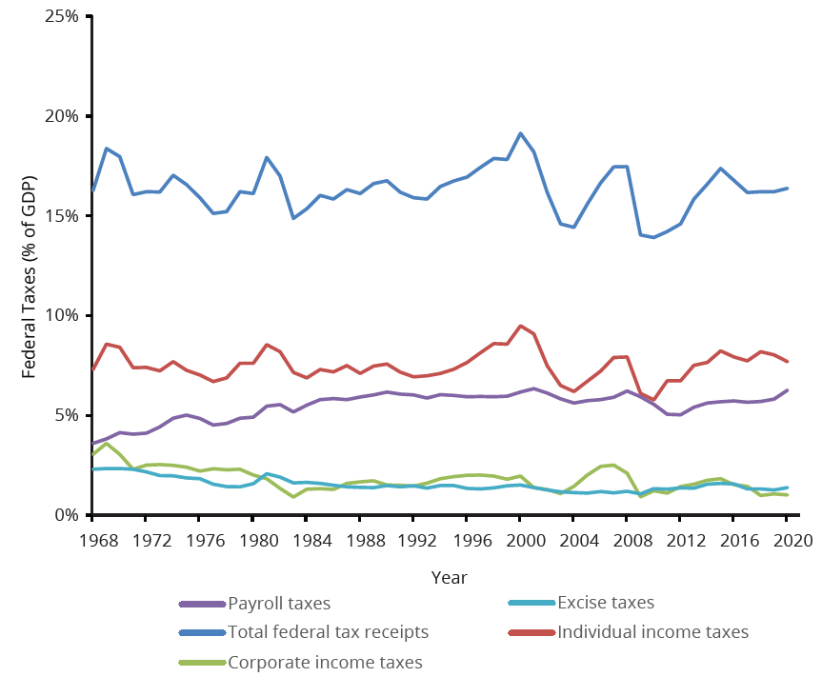
Federal Taxes
This graph shows federal taxes as a percentage of GDP from 1968 to 2020. Federal tax revenues have been about 16%–18% of GDP during most periods in recent decades.
Notes:
This graph shows federal taxes as a percentage of GDP from 1968 to 2020. Federal tax revenues have been about 16%–18% of GDP during most periods in recent decades.

Slide 4
Income and Payroll Taxes
The individual income tax, due every year on April 15, is the largest single source of federal government revenue, but it still represents less than half of federal tax revenue.
The second largest source of federal revenue is the payroll tax (captured in social insurance and retirement receipts), which provides funds for Social Security and Medicare.
Payroll taxes have increased steadily over time.
Together, the personal income tax and the payroll tax accounted for about 83% of federal tax revenues in 2021.
Notes:
The individual income tax, due every year on April 15, is the largest single source of federal government revenue, but it still represents less than half of federal tax revenue. The second largest source of federal revenue is the payroll tax (captured in social insurance and retirement receipts), which provides funds for Social Security and Medicare. Payroll taxes have increased steadily over time. Together, the personal income tax and the payroll tax accounted for about 83% of federal tax revenues in 2021.

Slide 5
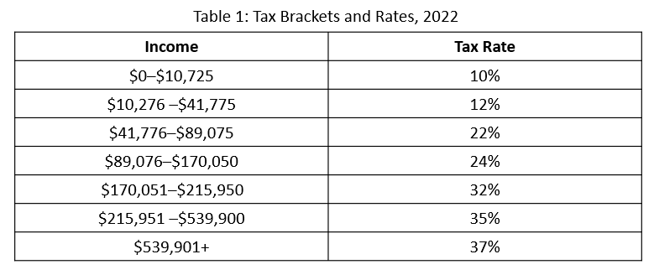
Progressive Taxes
The income tax is a progressive tax, which means that the rate increases as a household's income increases.
The marginal tax rates (the tax due on all yearly income) for a single taxpayer range from 10%–37%, depending on income.
Notes:
The income tax is a progressive tax, which means that the rate increases as a household's income increases. The marginal tax rates (the tax due on all yearly income) for a single taxpayer range from 10%–37%, depending on income.

Slide 6
Social Security and Medicare
The key fact is that the federal income tax is designed so that tax rates increase as income increases, up to a certain level.
The payroll taxes that support Social Security and Medicare are designed in a different way.
The payroll taxes for Social Security are imposed at a rate of 12.4% up to a certain wage limit, set at $147,000 in 2022.
Medicare, on the other hand, pays for elderly health care and is fixed at 2.9%, with no upper ceiling.
Notes:
The key fact is that the federal income tax is designed so that tax rates increase as income increases, up to a certain level. The payroll taxes that support Social Security and Medicare are designed in a different way. The payroll taxes for Social Security are imposed at a rate of 12.4% up to a certain wage limit, set at $147,000 in 2022. Medicare, on the other hand, pays for elderly health care and is fixed at 2.9%, with no upper ceiling.

Slide 7
Proportional and Regressive Taxes
We also call the Medicare payroll tax a proportional tax: a flat percentage of all wages earned.
The Social Security payroll tax is proportional up to the wage limit, but above that level it becomes a regressive tax, meaning that people with higher incomes pay a smaller share of their income in tax.
Notes:
We also call the Medicare payroll tax a proportional tax: a flat percentage of all wages earned. The Social Security payroll tax is proportional up to the wage limit, but above that level it becomes a regressive tax, meaning that people with higher incomes pay a smaller share of their income in tax.

Slide 8
Other Federal Tax Income
The third largest source of federal tax revenue is the corporate income tax.
An excise tax is a tax on a particular good, such as gasoline, tobacco, or alcohol.
Estate and gift taxes are placed on people who pass large amounts of assets to the next generation, either after death or during life as gifts.
Notes:
The third largest source of federal tax revenue is the corporate income tax. An excise tax is a tax on a particular good, such as gasoline, tobacco, or alcohol. Estate and gift taxes are placed on people who pass large amounts of assets to the next generation, either after death or during life as gifts.

Slide 9
State and Local Taxes₁
At the state and local level, taxes have been rising as a share of GDP over the last few decades to match the gradual rise in spending.
The main revenue sources for state and local governments are sales taxes, property taxes, and revenue passed along from the federal government.
Many state and local governments also levy personal and corporate income taxes and impose a wide variety of fees and charges.
Notes:
At the state and local level, taxes have been rising as a share of GDP over the last few decades to match the gradual rise in spending. The main revenue sources for state and local governments are sales taxes, property taxes, and revenue passed along from the federal government. Many state and local governments also levy personal and corporate income taxes and impose a wide variety of fees and charges.

Slide 10
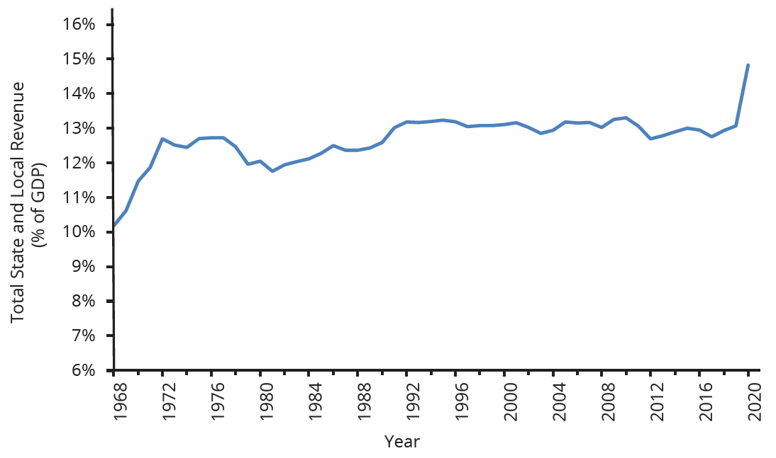
State and Local Taxes₂
State and local tax revenues have increased to match the rise in state and local spending.
Notes:
State and local tax revenues have increased to match the rise in state and local spending.

Slide 11

On Your Own
What has been your experience with paying taxes? How has your job, living situation, and income played a role in what you pay and how?
Notes:
What has been your experience with paying taxes? How has your job, living situation, and income played a role in what you pay and how?

Slide 12
Summary
The two main federal taxes are individual income taxes and payroll taxes that provide funds for Social Security and Medicare.
Other federal taxes include the corporate income tax, excise taxes, and the estate and gift tax.
A progressive tax, like the federal income tax, requires those with higher incomes to pay a higher share of taxes than those with lower incomes.
A proportional tax, like the payroll tax for Medicare, requires everyone to pay the same share of taxes, regardless of income level.
A regressive tax, like the payroll tax (above a certain threshold) that supports Social Security, requires those with higher incomes to pay a lower share than those with lower incomes.

Slide 13




HAWKES LEARNING

