Slide 1
How the Foreign Exchange Market Works
HAWKES LEARNING

Slide 2
Introduction
Most countries have different currencies, but not all.
Sometimes, small economies use the currency of an economically larger neighbor.
For example, Ecuador, El Salvador, and Panama have decided to dollarize and use the U.S. dollar as their currency.
Most of the international economy takes place in a situation of multiple national currencies, in which both people and firms need to convert from one currency to another.
The foreign exchange market is the market in which people or firms use one currency to purchase another currency.
Notes:
Most countries have different currencies, but not all. Sometimes, small economies use the currency of an economically larger neighbor. For example, Ecuador, El Salvador, and Panama have decided to dollarize and use the U.S. dollar as their currency. Most of the international economy takes place in a situation of multiple national currencies, in which both people and firms need to convert from one currency to another. The foreign exchange market is the market in which people or firms use one currency to purchase another currency.

Slide 3
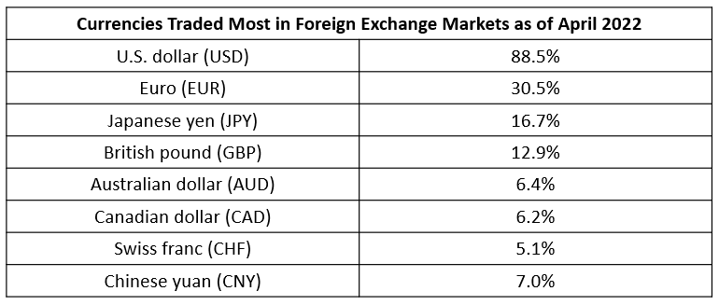
The Extraordinary Size of the Foreign Exchange Markets
A 2022 Bank of International Settlements survey found that $7.5 trillion per day was traded in foreign exchange markets, which makes the foreign exchange market the largest market in the world economy.
Notes:
A 2022 Bank of International Settlements survey found that $7.5 trillion per day was traded in foreign exchange markets, which makes the foreign exchange market the largest market in the world economy.

Slide 4
Demanders and Suppliers of Currency
in Foreign Exchange Markets₁
In foreign exchange markets, demand and supply become closely interrelated because a person or firm who demands one currency must simultaneously supply another currency, and vice versa. To get a sense of this, consider four groups that participate in the market:
  international trading firms
  tourists visiting other countries
  international investors buying ownership of a foreign firm
  international investors making non-ownership investments
Notes:
In foreign exchange markets, demand and supply become closely interrelated because a person or firm who demands one currency must simultaneously supply another currency, and vice versa. To get a sense of this, consider four groups that participate in the market: international trading firms, tourists visiting other countries, international investors buying ownership of a foreign firm, and international investors making non-ownership investments.

Slide 5
Demanders and Suppliers of Currency
in Foreign Exchange Markets₂
For firms that buy and sell in international markets, their costs for workers, suppliers, and investors are measured in the currency of the nation where their production occurs.
Revenues from sales are measured in the currency of the nation where those sales happened.
A Chinese firm exporting abroad will earn some other currency, but will need Chinese yuan to pay the workers, suppliers, and investors in China.
In foreign exchange markets, this firm will be a supplier of U.S. dollars and a demander of Chinese yuan.
International tourists supply their home currency to receive the currency of the country they are visiting.
Notes:
For firms that buy and sell in international markets, their costs for workers, suppliers, and investors are measured in the currency of the nation where their production occurs. Revenues from sales are measured in the currency of the nation where those sales happened. Chinese firm exporting abroad will earn some other currency, but will need Chinese yuan to pay the workers, suppliers, and investors in China. In foreign exchange markets, this firm will be a supplier of U.S. dollars and a demander of Chinese yuan. International tourists supply their home currency to receive the currency of the country they are visiting.

Slide 6
International Financial Investments₁
We often divide financial investments that cross international boundaries and require exchanging currency into two categories.
Foreign direct investment refers to purchasing at least 10% of a firm in another country or starting a new enterprise in another country.
Portfolio investment is a financial investment that does not involve any management responsibility.
Notes:
We often divide financial investments that cross international boundaries and require exchanging currency into two categories. Foreign direct investment refers to purchasing at least 10% of a firm in another country or starting a new enterprise in another country. Portfolio investment is a financial investment that does not involve any management responsibility.

Slide 7
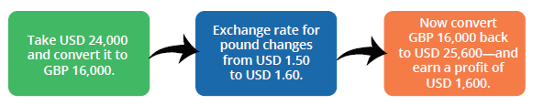
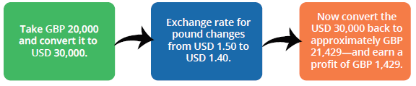
Arbitrage
Businesspeople often link portfolio investment to expectations about how exchange rates will shift, known as arbitrage.
(a) An international investor who expects that, in the future, a British pound will buy USD 1.60 instead of its current exchange rate of USD 1.50 may hope for the following chain of events to occur:
(b) An international investor who expects that, in the future, a British pound will buy only USD 1.40 instead of its current exchange rate of USD 1.50 may hope for the following chain of events to occur:
Notes:
Businesspeople often link portfolio investment to expectations about how exchange rates will shift, known as arbitrage.
An international investor who expects that, in the future, a British pound will buy USD 1.60 instead of its current exchange rate of USD 1.50 may hope for the following chain of events to occur: Take USD 24,000 and convert it to GBP 16,000. Exchange rate increases. Convert GBP back to USD and earn profit.
An international investor who expects that, in the future, a British pound will buy only USD 1.40 instead of its current exchange rate of USD 1.50 may hope for the following chain of events to occur: Take GBP 20,000 and convert it to USD 30,000. Exchange rate decreases. Convert USD back to GBP and earn profit.

Slide 8
Hedging
Many portfolio investment decisions are not as simple as betting that the currency's value will change in a certain direction.
Many investors hedge, which means using a financial transaction to protect themselves against an investment risk.
Specifically, investors can sign a financial contract and pay a fee that guarantees them a certain exchange rate one year from now.
When parties wish to enter financial contracts like hedging, they normally rely on a financial institution or brokerage company.
Notes:
Many portfolio investment decisions are not as simple as betting that the currency's value will change in a certain direction. Many investors hedge, which means using a financial transaction to protect themselves against an investment risk. Specifically, investors can sign a financial contract and pay a fee that guarantees them a certain exchange rate one year from now. When parties wish to enter financial contracts like hedging, they normally rely on a financial institution or brokerage company.

Slide 9
International Financial Investments₂
Both foreign direct investment and portfolio investment involve two parties:
  An investor who supplies domestic currency
  An investor who demands a foreign currency
With portfolio investment, the client purchases less than 10% of a company; portfolio investment often has a short-term focus.
With foreign direct investment, the investor purchases more than 10% of a company and typically assumes some managerial responsibility; foreign direct investment has a more long-term focus.
Notes:
Both foreign direct investment and portfolio investment involve two parties: an investor who supplies domestic currency and an investor who demands a foreign currency. With portfolio investment, the client purchases less than 10% of a company; portfolio investment often has a short-term focus. With foreign direct investment, the investor purchases more than 10% of a company and typically assumes some managerial responsibility; foreign direct investment has a more long-term focus.

Slide 10
Participants in the Exchange Rate Market
The foreign exchange market works through financial institutions, and it operates on several levels.
Most people and firms who are exchanging a substantial quantity of currency go to a bank, and most banks provide foreign exchange.
These banks (and a few other firms), known as dealers, then trade the foreign exchange; this is called the interbank market.
In the world economy, roughly two thousand firms are foreign exchange dealers.
There are less than 100 foreign exchange dealers in the U.S., but the largest twelve or so carry out more than half of the total transactions.
Notes:
The foreign exchange market works through financial institutions, and it operates on several levels. Most people and firms who are exchanging a substantial quantity of currency go to a bank, and most banks provide foreign exchange. These banks (and a few other firms), known as dealers, then trade the foreign exchange; this is called the interbank market. In the world economy, roughly two thousand firms are foreign exchange dealers. There are less than 100 foreign exchange dealers in the U.S., but the largest twelve or so carry out more than half of the total transactions.

Slide 11
Strengthening and Weakening Currency
When a currency's exchange rate rises, so that the currency exchanges for more of other currencies, it's referred to as appreciating or "strengthening."
When a currency's exchange rate falls, so that the currency trades for less of other currencies, it's referred to as depreciating or "weakening."
Exchange rates tend to fluctuate substantially, even between bordering companies such as the United States and Canada.
Appreciating
(Strengthening)
Depreciating
(Weakening)
Notes:
When a currency's exchange rate rises, so that the currency exchanges for more of other currencies, it's referred to as appreciating or "strengthening.“ When a currency's exchange rate falls, so that the currency trades for less of other currencies, it's referred to as depreciating or "weakening.“ Exchange rates tend to fluctuate substantially, even between bordering companies such as the United States and Canada.

Slide 12
Summary
The foreign exchange market is the market in which people or firms use one currency to purchase another currency.
Foreign direct investment refers to purchasing at least 10% of a firm in another country or starting a new enterprise in another country.
Portfolio investment is a financial investment that does not involve any management responsibility.

Slide 13




HAWKES LEARNING

