Slide 1
Demand, Supply, and Efficiency
HAWKES LEARNING
Notes:
By the end of this lesson, you will be able to contrast consumer surplus, producer surplus, and social surplus; explain why price floors and price ceilings can be inefficient; and analyze demand and supply as a social adjustment mechanism.

Slide 2
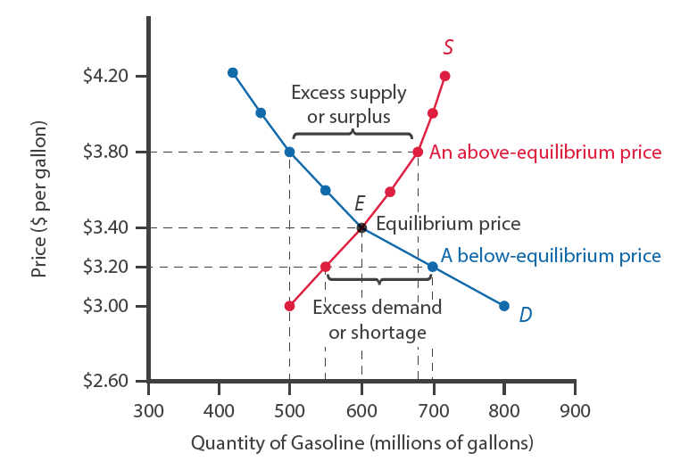
Efficiency
The familiar demand and supply diagram holds within it the concept of economic efficiency.
Efficiency in the demand and supply model has the same basic meaning: the economy is getting as much benefit as possible from its scarce resources, and all the possible gains from trade have been achieved.
Notes:
The familiar demand and supply diagram holds within it the concept of economic efficiency. Efficiency in the demand and supply model has the same basic meaning: the economy is getting as much benefit as possible from its scarce resources, and all the possible gains from trade have been achieved.

Slide 3
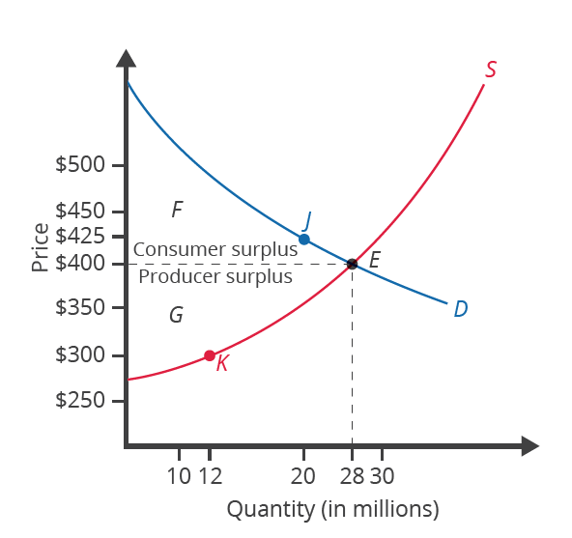
Consumer Surplus
Consumer surplus is the difference between the benefit that the consumer receives and the price that the consumer pays.
The demand curve reflects a consumer's willingness to pay or, in other words, the benefit that consumers expect to receive from consuming a product.
Consumer surplus is represented by the area below the demand curve and above the price.
Notes:
Consumer surplus is the difference between the benefit that the consumer receives and the price that the consumer pays. The demand curve reflects a consumer's willingness to pay or, in other words, the benefit that consumers expect to receive from consuming a product. Consumer surplus is represented by the area below the demand curve and above the price.

Slide 4
Producer Surplus
Producer surplus is the difference between the price a seller actually gets for a product and the minimum price the seller is willing to accept.
The supply curve shows the quantity that sellers are willing to sell at each price.
Producer surplus is represented by the area above the supply curve and below the price.
Notes:
Producer surplus is the difference between the price a seller actually gets for a product and the minimum price the seller is willing to accept. The supply curve shows the quantity that sellers are willing to sell at each price. Producer surplus is represented by the area above the supply curve and below the price.

Slide 5
Social Surplus
Social surplus is the sum of consumer surplus and producer surplus.
Social surplus is also known as economic surplus or total surplus.
Social surplus is larger at equilibrium quantity and price than it would be at any other quantity, demonstrating the economic efficiency of the market equilibrium.
Notes:
Social surplus is the sum of consumer surplus and producer surplus. Social surplus is also known as economic surplus or total surplus. Social surplus is larger at equilibrium quantity and price than it would be at any other quantity, demonstrating the economic efficiency of the market equilibrium.

Slide 6
Inefficiency of Price Floors and Price Ceilings
The imposition of a price control will prevent a market from adjusting to its equilibrium price and quantity, creating an inefficient outcome.
Price floors and price ceilings will transfer some consumer surplus to producers or some producer surplus to consumers.
The loss in social surplus that occurs when the economy produces at an inefficient quantity is called deadweight loss.
Notes:
The imposition of a price control will prevent a market from adjusting to its equilibrium price and quantity, creating an inefficient outcome. Price floors and price ceilings will transfer some consumer surplus to producers or some producer surplus to consumers. The loss in social surplus that occurs when the economy produces at an inefficient quantity is called deadweight loss.

Slide 7
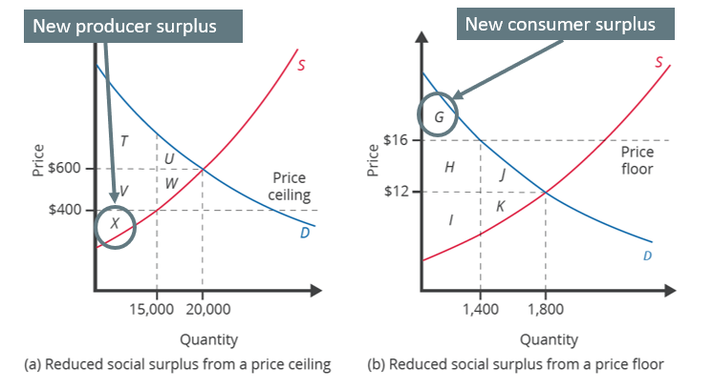
Effect of Price Controls₁
Price ceiling causes shortage
Price floor causes surplus
D > S
S > D
Notes:
A price floor causes a surplus, as quantity supplied exceeds quantity demanded. A price ceiling causes a shortage, as quantity demanded exceeds quantity supplied. A binding price floor reduces consumer surplus, while a binding price ceiling reduces producer surplus.

Slide 8
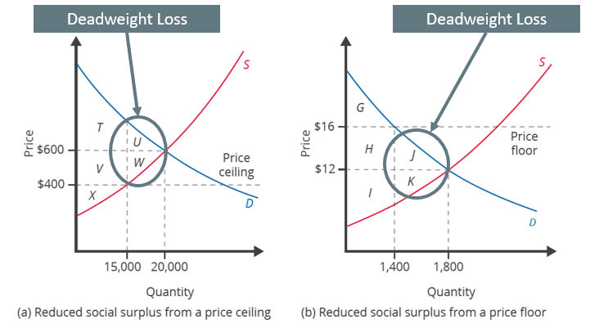
Effect of Price Controls₂
The loss to social surplus resulting from a price control is referred to as deadweight loss, as it benefits neither producers nor consumers.
Notes:
The loss to social surplus resulting from a price control is referred to as deadweight loss, as it benefits neither producers nor consumers.

Slide 9
Summary
Consumer surplus is the gap between the price that consumers are willing to pay, based on their preferences, and the market equilibrium price.
Producer surplus is the gap between the price for which producers are willing to sell a product, based on their costs, and the market equilibrium price.
Social surplus is the sum of consumer surplus and producer surplus.
Total surplus is larger at the equilibrium quantity and price than it will be at any other quantity and price.
Deadweight loss is loss in total surplus that occurs when the economy produces at an inefficient quantity.
Notes:
Consumer surplus is the gap between the price that consumers are willing to pay, based on their preferences, and the market equilibrium price.
Producer surplus is the gap between the price for which producers are willing to sell a product, based on their costs, and the market equilibrium price.
Social surplus is the sum of consumer surplus and producer surplus.
Total surplus is larger at the equilibrium quantity and price than it will be at any other quantity and price.
Deadweight loss is loss in total surplus that occurs when the economy produces at an inefficient quantity.

Slide 10




HAWKES LEARNING

