Slide 1
Shifts in Demand and Supply for Goods and Services
HAWKES LEARNING
Notes:
This lesson will consider the major factors that influence and shift demand and supply.

Slide 2
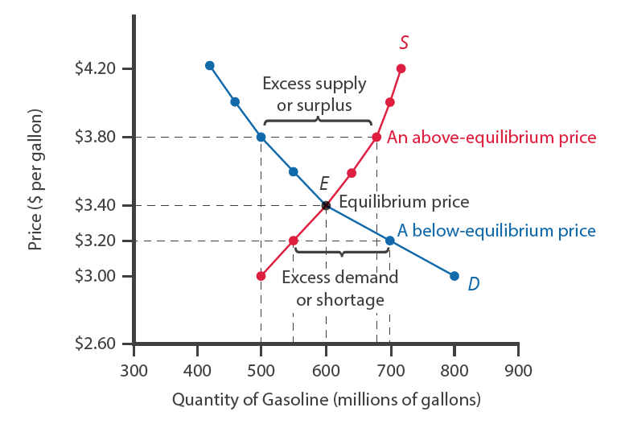
Ceteris Paribus
A demand/supply curve shows the relationship between two variables, assuming ceteris paribus
Ceteris Paribus
"other things being equal"
Notes:
Before discussing the factors that shift demand and supply, we have to ensure that the ceteris paribus rule is in place. A demand curve or a supply curve is a relationship between two, and only two, variables when all other variables are kept constant or equal: ceteris paribus. If all else is not held equal, then the laws of demand and supply will not hold.

Slide 3
Factors That Affect Demand
Demand is defined as the amount of some product a consumer is willing and able to purchase at each price.
Changes in Tastes and Preferences
Changes in Population Composition
Changes in Income
Change in the Price of a Substitute
Change in the Price of a Complement
Changes in Future Expectations
Notes:
Demand is defined as the amount of some product a consumer is willing and able to purchase at each price. When the demand curve shifts left or right, there is a different quantity demanded at any given price. The following six factors can affect demand: changes in income, changes in tastes and preferences, changes in population composition, change in the price of a substitute, change in the price of a complement, and changes in future expectations.

Slide 4
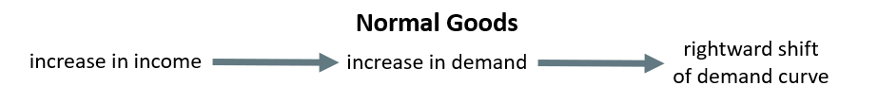
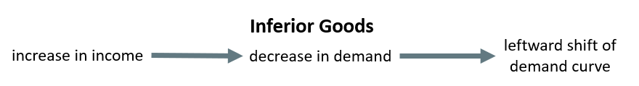
Income
An increase in income increases demand for normal goods and decreases demand for inferior goods.
For example, as incomes rise, many people will buy fewer generic-brand groceries and more name-brand groceries.
Notes:
One would assume that an increase in income would increase demand for all goods. A product that’s demand rises when income rises, and vice versa, is called a normal good. A few exceptions to this pattern do exist. As incomes rise, many people will buy fewer generic-brand groceries and more name-brand groceries. A product that’s demand falls when income rises, and vice versa, is called an inferior good. In other words, when income increases, the demand curve shifts to the left.

Slide 5


Changes in Tastes and Preferences
From 1980 to 2021, per-person consumption of chicken in America increased dramatically, while per-person consumption of beef fell.
Movements in taste change the quantity of a good demanded at every price.
In this case, the demand for chicken would shift rightward, and the demand for beef would shift leftward.
Notes:
From 1980 to 2021, the per-person consumption of chicken by Americans rose from 48 pounds per year to 85 pounds per year, and consumption of beef fell from 77 pounds per year to 54 pounds per year, according to the U.S. Department of Agriculture (USDA). Changes like these are largely due to movements in taste, which change the quantity of a good demanded at every price. That is, they shift the demand curve for that good, right for chicken and left for beef.

Slide 6
Changes in Population Composition
A society with relatively more children will have greater demand for goods and services like tricycles and day care facilities.
A society with relatively more elderly persons has a higher demand for nursing homes and hearing aids.
Changes in the size of the population can affect the demand for housing and many other goods.
Each of these changes in demand is shown as a shift in the demand curve because there is a change in some factor other than price.
Notes:
Population composition can have a large impact on the types of goods demanded. A society with relatively more children will have greater demand for goods and services like tricycles and day care facilities. A society with relatively more elderly persons has a higher demand for nursing homes and hearing aids. Changes in the size of the population can affect the demand for housing and many other goods. Each of these changes in demand is shown as a shift in the demand curve because there is change in some factor other than price.

Slide 7
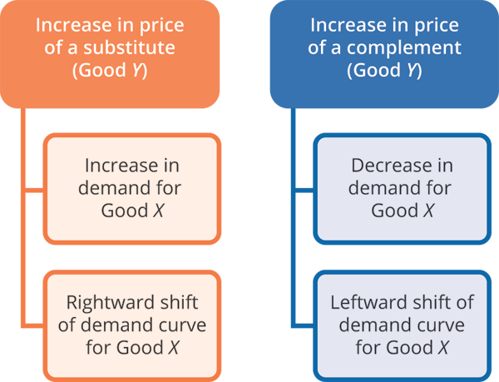
Changes in the Prices of Related Goods
A substitute is a good or service that we can use in place of another good or service.
Complements are goods that are often used together so that consumption of one good tends to enhance consumption of the other.
Notes:
Changes in the prices of related goods, such as substitutes or complements, can also affect the demand for a product. A substitute is a good or service that we can use in place of another good or service, like electronic books and printed books. Complements are goods that are often used together so that consumption of one good tends to enhance consumption of the other, like peanut butter and jelly. If the price of one good increases, the demand for a substitute good will increase as more consumers make the switch. If the price of a good that complements another good increases, the demand for the complement good will decrease, as consumers typically would consume the goods together.

Slide 8

Changes in Future Expectations
An incoming hurricane might increase the demand for flashlights and bottled water.
If people learn that the price of a good like coffee is likely to rise in the future, they may head to the store to stock up on coffee now.
A shift in demand happens when a change in some economic factor causes a different quantity to be demanded at every price.
Notes:
Future expectations can affect demand. For example, if people hear that a hurricane is coming, they may rush to the store to buy flashlight batteries and bottled water. If people learn that the price of a good like coffee is likely to rise in the future, they may head to the store to stock up on coffee now. A shift in demand happens when a change in some economic factor (other than price) causes a different quantity to be demanded at every price.

Slide 9
Factors That Affect Supply
Supply is defined as the amount of some product a producer is willing and able to supply at each price.
Changes in Conditions for Production
Changes in Input Prices
Technological Change
Changes in Regulations, Taxes, etc.
Changes in the Number of Sellers
Notes:
Supply is defined as the amount of some product a producer is willing and able to supply at each price. The following factors can affect supply: changes in conditions for production, changes in input prices, technological change, changes in regulations, taxes, etc., and changes in the number of sellers. Again, we assume ceteris paribus.

Slide 10

Changes in Conditions for Production
Changes in weather and climate will affect the cost of production for many agricultural products.
If natural conditions are favorable, supply will increase, and the curve will shift right.
If conditions are not favorable, supply will be hampered, and the curve will shift left.
Notes:
Changes in weather and climate will affect the cost of production for many agricultural products. If natural conditions are favorable, supply will increase, and the curve will shift right. If conditions are not favorable, supply will be hampered, and the curve will shift left.

Slide 11
How Production Costs Affect Supply₁
A shift in supply means a change in the quantity supplied at every price.
A firm produces goods and services using combinations of labor, materials, and machinery (inputs or factors of production).
When a firm's profits increase, it is more motivated to increase output since the more it produces, the more profit it will earn.
When costs of production fall, a firm will tend to supply a larger quantity at any given price for its output.
Notes:
A shift in supply means a change in the quantity supplied at every price. A firm produces goods and services using combinations of labor, materials, and machinery (inputs or factors of production). When a firm's profits increase, it is more motivated to increase output since the more it produces, the more profit it will earn. When costs of production fall, a firm will tend to supply a larger quantity at any given price for its output.

Slide 12
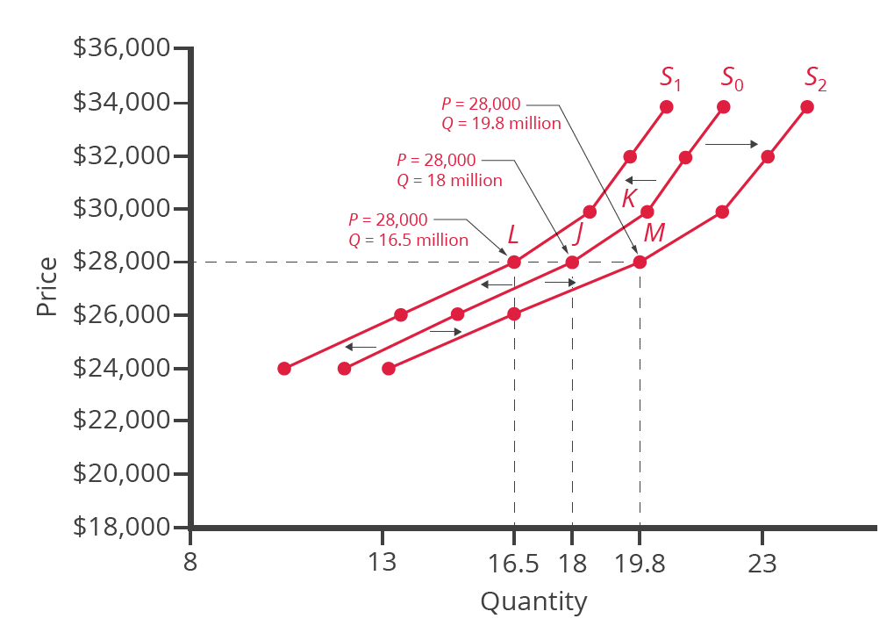
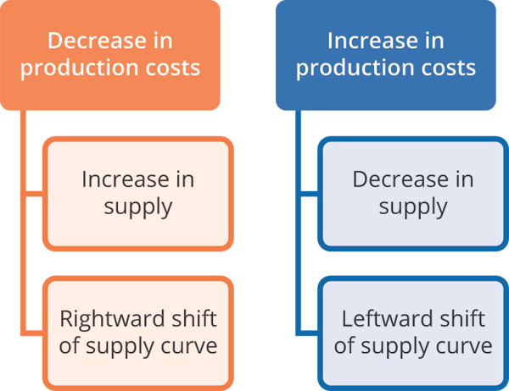
How Production Costs Affect Supply₂
When costs of production fall, a firm will tend to supply a larger quantity at any given price for its output. We can show this with a rightward shift in the supply curve.
Notes:
When costs of production fall, a firm will tend to supply a larger quantity at any given price for its output. We can show this with a rightward shift in the supply curve.

Slide 13

Technological Change
When a firm discovers a new technology that allows the firm to produce at a lower cost, the supply curve will shift to the right as well.
The Green Revolution, focused on breeding improved seeds for basic crops, doubled production per acre in some countries.
Notes:
When a firm discovers a new technology that allows the firm to produce at a lower cost, the supply curve will shift to the right as well. For instance, in the 1960s a major scientific effort, nicknamed the Green Revolution, focused on breeding improved seeds for basic crops like wheat and rice. By the early 1990s, more than two-thirds of the wheat and rice in low-income countries around the world used these Green Revolution seeds—and the harvest was twice as high per acre.

Slide 14
Changes in Regulation, Taxes, Etc.
Government policies can affect the cost of production and the supply curve through taxes, regulations, and subsidies.
Businesses treat taxes as costs, and higher costs decrease supply and shift the supply curve leftward.
Complying with regulations, like requiring firms to spend money to provide a cleaner environment, also shift the supply curve leftward.
Government subsidies reduce the cost of production and increase supply at every given price, shifting the supply curve rightward.
Notes:
Government policies can affect the cost of production and the supply curve through taxes, regulations, and subsidies. Businesses treat taxes as costs, and higher costs decrease supply and shift the supply curve leftward. Complying with regulations, like requiring firms to spend money to provide a cleaner environment, also shift the supply curve leftward. Government subsidies reduce the cost of production and increase supply at every given price, shifting the supply curve rightward.

Slide 15
On Your Own₁
Suppose you are hosting a barbeque at your house this weekend and plan to grill hamburgers and hot dogs. When hamburgers go on sale at the grocery store, you decide to buy more hamburgers. As a result, what happens to the demand for ketchup? At the same time, new hot dog packaging regulations have increased the costs for producers. As a result, what will happen to the supply of hot dogs?
Notes:
Suppose you are hosting a barbeque at your house this weekend and plan to grill hamburgers and hot dogs. When hamburgers go on sale at the grocery store, you decide to buy more hamburgers. As a result, what happens to the demand for ketchup? At the same time, new hot dog packaging regulations have increased the costs for producers. As a result, what will happen to the supply of hot dogs?

Slide 16
On Your Own₂
Suppose you are hosting a barbeque at your house this weekend and plan to grill hamburgers and hot dogs. When hamburgers go on sale at the grocery store, you decide to buy more hamburgers. As a result, what happens to the demand for ketchup? At the same time, new hot dog packaging regulations have increased the costs for producers. As a result, what will happen to the supply of hot dogs?
The sale on hamburgers leads to an increase in the quantity of hamburgers demanded. Since ketchup and hamburgers are complements, the demand for ketchup will increase, shifting its demand to the right. At the same time, the increased packaging costs will decrease the supply of hot dogs, shifting the supply curve to the left.
Notes:
The sale on hamburgers leads to an increase in the quantity of hamburgers demanded. Since ketchup and hamburgers are complements, the demand for ketchup will increase, shifting its demand to the right. At the same time, the increased packaging costs will decrease the supply of hot dogs, shifting the supply curve to the left.

Slide 17
Summary
Economists often use the ceteris paribus or "other things being equal" assumption.
When the demand curve shifts, there is a different quantity demanded at any given price.
Factors that can shift the demand curve for goods and services include changes in income, changes in tastes and preferences, changes in population composition, change in the price of a substitute, change in the price of a complement, and changes in future expectations.
When the supply curve shifts, there is a different quantity supplied at any given price.
Factors that can shift the supply curve for goods and services include changes in conditions for production, changes in input prices, technological changes, changes in regulations, and changes in the number of sellers.
Notes:
Economists often use the ceteris paribus or "other things being equal" assumption.
When the demand curve shifts, there is a different quantity demanded at any given price.
Factors that can shift the demand curve for goods and services include changes in income, changes in tastes and preferences, changes in population composition, change in the price of a substitute, change in the price of a complement, and changes in future expectations.
When the supply curve shifts, there is a different quantity supplied at any given price.
Factors that can shift the supply curve for goods and services include changes in conditions for production, changes in input prices, technological changes, changes in regulations, and changes in the number of sellers.

Slide 18




HAWKES LEARNING

