Slide 1
Pitfalls for Monetary Policy
HAWKES LEARNING

Slide 2
Introduction
In the real world, effective monetary policy faces a number of significant hurdles, and it impacts the economy only after a variable time lag.
Monetary policy involves a chain of events, and it takes time for these changes to filter through the economy.
Due to this chain of events, monetary policy has little effect in the short term; its primary effects are felt perhaps 1 to 3 years in the future.
Central banks should be careful because their actions could create as much or more economic instability as they resolve.
Notes:
In the real world, effective monetary policy faces a number of significant hurdles, and it impacts the economy only after a variable time lag. Monetary policy involves a chain of events, and it takes time for these changes to filter through the economy. Due to this chain of events, monetary policy has little effect in the short term; its primary effects are felt perhaps 1 to 3 years in the future. Central banks should be careful because their actions could create as much or more economic instability as they resolve.

Slide 3
Excess Reserves
Banks are legally required to hold a minimum level of reserves, but no rule prohibits them from holding excess reserves above the limit.
For example, during a recession, banks may be hesitant to lend because they fear that when the economy is contracting, a high proportion of loan applicants are less likely to repay their loans.
If banks prefer to hold excess reserves above the legally required level, the central bank cannot force them to make loans.
The problem of excess reserves does not affect contractionary policy.
Notes:
Banks are legally required to hold a minimum level of reserves, but no rule prohibits them from holding excess reserves above the limit. For example, during a recession, banks may be hesitant to lend because they fear that when the economy is contracting, a high proportion of loan applicants are less likely to repay their loans. If banks prefer to hold excess reserves above the legally required level, the central bank cannot force them to make loans. The problem of excess reserves does not affect contractionary policy.

Slide 4

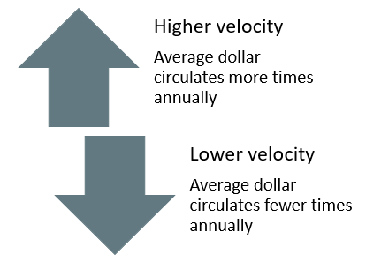
Velocity
Velocity is a term economists use to describe how quickly money circulates through the economy.
Notes:
Velocity is a term economists use to describe how quickly money circulates through the economy. Velocity= nominal GDP/money supply. When velocity is high, the average dollar circulates more times in a year. When velocity is low the average dollar circulate fewer time in a year.

Slide 5
Changes in Velocity
Changes in velocity can cause problems for monetary policy.
money supply × velocity = nominal GDP
nominal GDP = price level (or GDP deflator) × real GDP
money supply × velocity = nominal GDP = price level × real GDP
If velocity is constant over time, a certain percentage rise in the money supply on the left side of the basic quantity equation of money will inevitably lead to the same percentage rise in nominal GDP, although this change could happen through an increase in inflation, an increase in real GDP, or some combination of the two.
Notes:
Changes in velocity can cause problems for monetary policy.
money supply × velocity = nominal GDP
nominal GDP = price level (or GDP deflator) × real GDP
money supply × velocity = nominal GDP = price level × real GDP
If velocity is constant over time, a certain percentage rise in the money supply on the left side of the basic quantity equation of money will inevitably lead to the same percentage rise in nominal GDP, although this change could happen through an increase in inflation, an increase in real GDP, or some combination of the two.

Slide 6
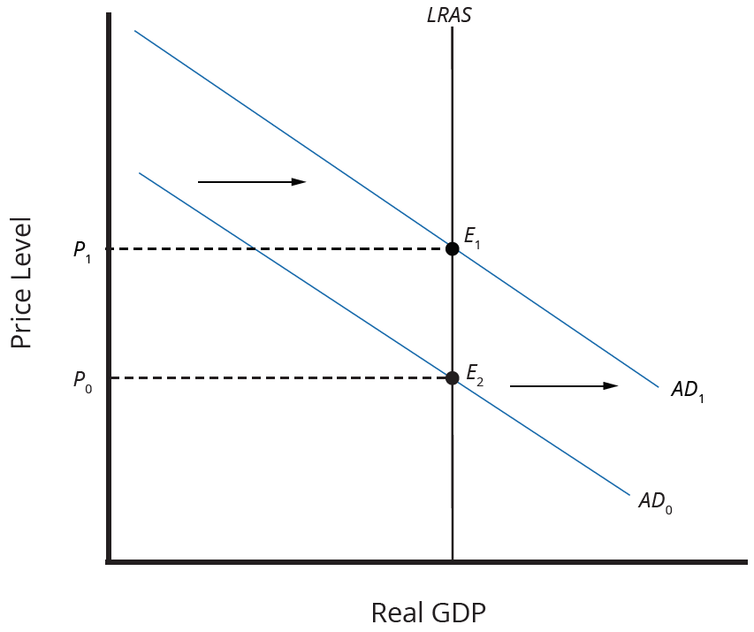
Unemployment and Inflation
If you surveyed central bankers around the world and asked them the primary task of monetary policy, the most popular answer by far would be fighting inflation.
In the neoclassical model, economists determine the level of potential GDP (and the natural rate of unemployment that exists when the economy is producing at potential GDP) by real economic factors.
Expansionary monetary policy that shifts AD rightward only creates an inflationary increase in the price level; it does not alter GDP or unemployment.
Low inflation provides a better climate for a healthy and growing economy.
Notes:
If you surveyed central bankers around the world and asked them the primary task of monetary policy, the most popular answer by far would be fighting inflation. In the neoclassical model, economists determine the level of potential GDP (and the natural rate of unemployment that exists when the economy is producing at potential GDP) by real economic factors. Expansionary monetary policy that shifts AD rightward only creates an inflationary increase in the price level; it does not alter GDP or unemployment. Low inflation provides a better climate for a healthy and growing economy.

Slide 7
Inflation Targeting
Inflation targeting is when the central bank is legally required to focus on keeping inflation low.
According to the International Monetary Fund (IMF), central banks in thirty-eight countries practice inflation targeting.
The U.S. Federal Reserve does not practice inflation targeting but instead takes both unemployment and inflation into account.
Economists have no final consensus on whether a central bank should focus only on inflation or have greater discretion.
Notes:
Inflation targeting is when the central bank is legally required to focus on keeping inflation low. According to the International Monetary Fund (IMF), central banks in thirty-eight countries practice inflation targeting. The U.S. Federal Reserve does not practice inflation targeting but instead takes both unemployment and inflation into account. Economists have no final consensus on whether a central bank should focus only on inflation or have greater discretion.

Slide 8
Asset Bubbles and Leverage Cycles
If the central bank focuses on inflation and unemployment, it may overlook other looming economic problems.
If the economy, or a specific market, reaches unsustainable levels, the subsequent drop-off in price could lead to recession.
Some economists worry about a leverage cycle, where leverage is a term financial economists use to mean "borrowing."
In good economic times, banks are eager to lend, and people are eager to borrow; in bad economic times, the opposite is true.
The central bank should not just look at economic growth, inflation, and unemployment rates but also asset prices and leverage cycles.
Notes:
If the central bank focuses on inflation and unemployment, it may overlook other looming economic problems. If the economy, or a specific market, reaches unsustainable levels, the subsequent drop-off in price could lead to recession. Some economists worry about a leverage cycle, where leverage is a term financial economists use to mean "borrowing.“ In good economic times, banks are eager to lend, and people are eager to borrow; in bad economic times, the opposite is true. The central bank should not just look at economic growth, inflation, and unemployment rates but also asset prices and leverage cycles.

Slide 9
Summary
Monetary policy is imprecise for several reasons:
  The effects occur only after long- and variable-time lags.
  If banks decide to hold excess reserves, monetary policy cannot force them to lend.
  Velocity may shift in unpredictable ways.
  The basic quantity equation of money is MV=PQ, where M is the money supply, V is the velocity of money, P is the price level, and Q is the real output of the economy.
  Some central banks, like the European Central Bank, practice inflation targeting, which means that the only goal of the central bank is to keep inflation within a low target range.
  Other central banks, such as the U.S. Federal Reserve, are free to focus on either reducing inflation or stimulating an economy that is in recession, whichever goal seems most important at the time.

Slide 10




HAWKES LEARNING

