Slide 1
Monetary Policy and Economic Outcomes
HAWKES LEARNING

Slide 2
Monetary Policy
Expansionary monetary policy, also called loose monetary policy, lowers interest rates and stimulates borrowing.
Contractionary monetary policy, also called tight monetary policy, raises interest rates and reduces borrowing in the economy.
Notes:
Expansionary monetary policy, also called loose monetary policy, lowers interest rates and stimulates borrowing. Contractionary monetary policy, also called tight monetary policy, raises interest rates and reduces borrowing in the economy.

Slide 3
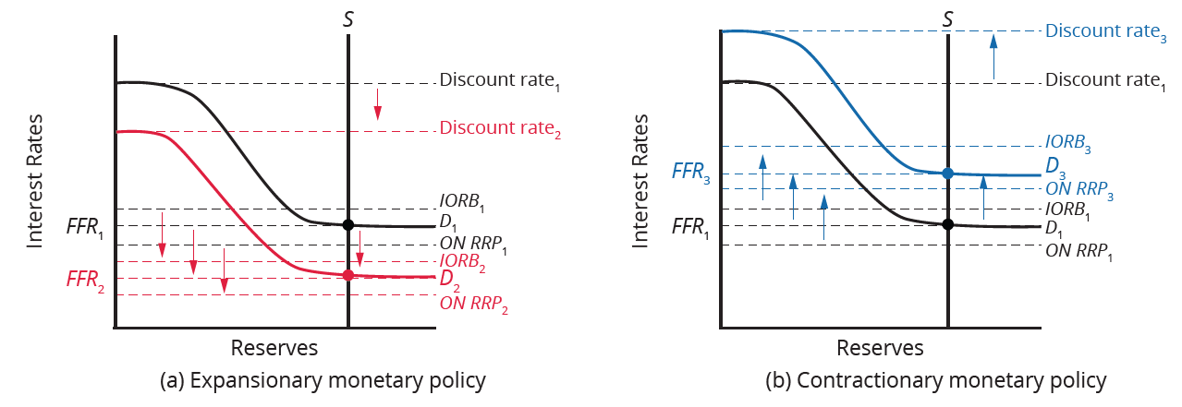
The Effect of Monetary Policy on Interest Rates
The Fed conducts expansionary monetary policy by lowering its administered rates. This causes the demand curve to shift down and intersect the supply curve at a lower federal funds rate.
The Fed conducts contractionary monetary policy by raising its administered rates. This causes the demand curve to shift up and intersect the supply curve at a higher federal funds rate.
Notes:
The Fed conducts expansionary monetary policy by lowering its administered rates. This causes the demand curve to shift down and intersect the supply curve at a lower federal funds rate.
The Fed conducts contractionary monetary policy by raising its administered rates. This causes the demand curve to shift up and intersect the supply curve at a higher federal funds rate.

Slide 4
Federal Funds Rate
Recall that the specific interest rate the Fed targets is the federal funds rate (FFR).
The central bank changes its administered rates.
  The discount rate sets a ceiling that the FFR will not rise above.
  The overnight reverse repurchase (ON RRP) rate sets a floor that the FFR will not go below.
  The interest rate on reserves balances (IORB) is near the FFR and stays near it due to arbitrage.
The Fed sets these three rates to target its goal FFR.
Notes:
Recall that the specific interest rate the Fed targets is the federal funds rate (FFR).
The central bank changes its administered rates.
The discount rate sets a ceiling that the FFR will not rise above.
The overnight reverse repurchase (ON RRP) rate sets a floor that the FFR will not go below.
The interest rate on reserves balances (IORB) is near the FFR and stays near it due to arbitrage.
The Fed sets these three rates to target its goal FFR.

Slide 5
The Effect of Monetary Policy on Aggregate Demand
Contractionary (tight) monetary policy will reduce investment and consumption due to higher interest rates and a reduced quantity of loanable funds.
Expansionary (loose) monetary policy will increase business investment and consumption (consumer borrowing) due to lower interest rates and a higher quantity of loanable funds.
Notes:
Contractionary (tight) monetary policy will reduce investment and consumption due to higher interest rates and a reduced quantity of loanable funds. Expansionary (loose) monetary policy will increase business investment and consumption (consumer borrowing) due to lower interest rates and a higher quantity of loanable funds.

Slide 6
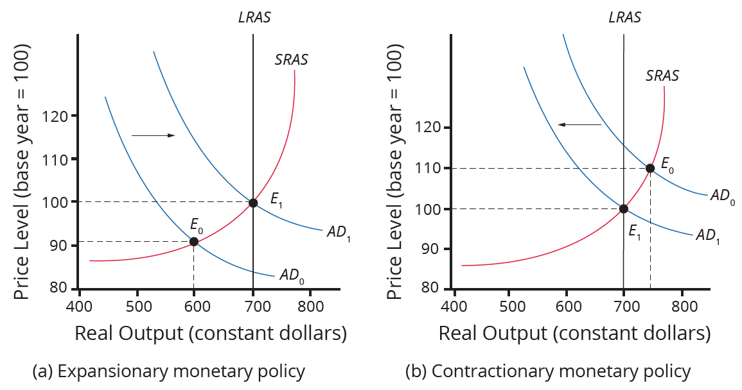
Countercyclical Monetary Policy₁
If the economy is suffering a recession and high unemployment, with output below potential GDP, expansionary monetary policy can help the economy return to potential GDP.
If the economy is producing at a quantity of output above its potential GDP, contractionary monetary policy can reduce the inflationary pressures for a rising price level.
Notes:
If the economy is suffering a recession and high unemployment, with output below potential gross domestic product (GDP), expansionary monetary policy can help the economy return to potential GDP. if an economy is producing at a quantity of output above its potential GDP, contractionary monetary policy can reduce the inflationary pressures for a rising price level.

Slide 7
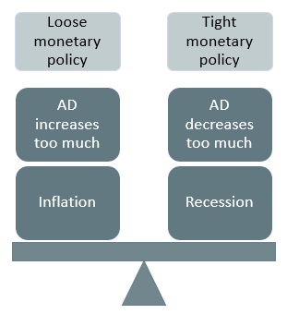
Countercyclical Monetary Policy₂
Monetary policy should be countercyclical: it should counterbalance the business cycles of economic downturns and upswings. Of course, countercyclical policy comes with the risk of overreaction. Loose monetary policy may increase AD too much and trigger inflation, while tight monetary policy may decrease AD too much and trigger a recession.
Notes:
Monetary policy should be countercyclical: it should counterbalance the business cycles of economic downturns and upswings. Of course, countercyclical policy comes with the risk of overreaction. Loose monetary policy may increase AD too much and trigger inflation, while tight monetary policy may decrease AD too much and trigger a recession.

Slide 8
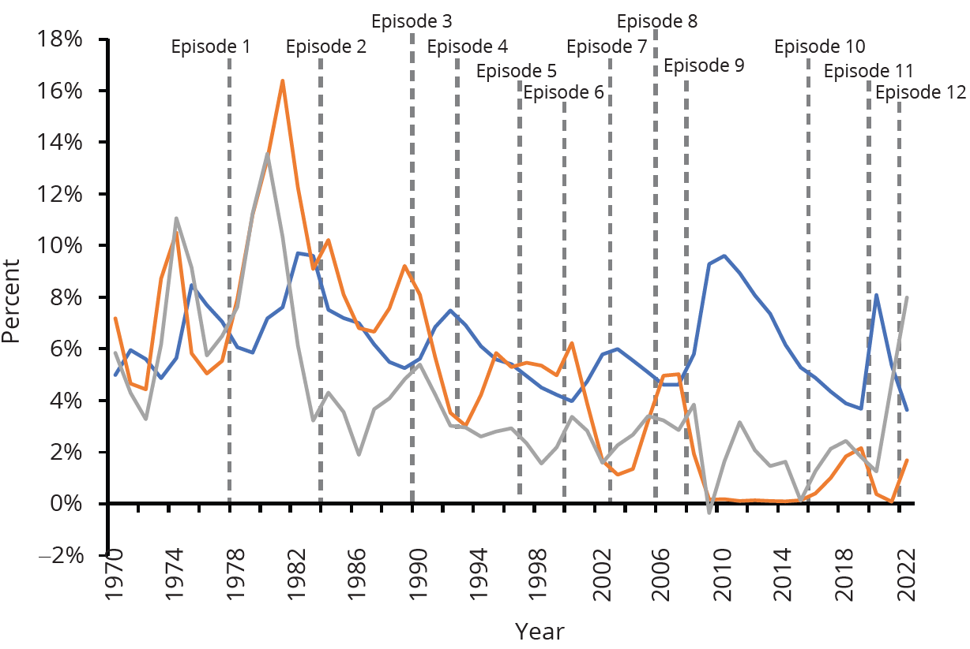
Federal Reserve Actions in Recent Decades
In recent decades, the Federal Reserve has typically reacted to higher inflation with contractionary monetary policy and a higher interest rate and reacted to higher unemployment with expansionary monetary policy and a lower interest rate.
Notes:
In recent decades, the Federal Reserve has typically reacted to higher inflation with contractionary monetary policy and a higher interest rate and reacted to higher unemployment with expansionary monetary policy and a lower interest rate.

Slide 9
On Your Own₁
Imagine you are the main decision maker for your country's central bank. Now, suppose your country is facing inflationary pressures and is producing over potential GDP. Which type of monetary policy would you decide to implement in the economy? Describe the effect the policy would have on the economy's interest rates, price levels, and components of aggregate demand.
Notes:
Imagine you are the main decision maker for your country's central bank. Now, suppose your country is facing inflationary pressures and is producing over potential GDP. Which type of monetary policy would you decide to implement in the economy? Describe the effect the policy would have on the economy’s interest rates, price levels, and components of aggregate demand.

Slide 10
On Your Own₂
Imagine you are the main decision maker for your country's central bank. Now, suppose your country is facing inflationary pressures and is producing over potential GDP. Which type of monetary policy would you decide to implement in the economy? Describe the effect the policy would have on the economy's interest rates, price levels, and components of aggregate demand.
An economy facing inflationary pressures would prefer contractionary (tight) monetary policy. Contractionary monetary policy is implemented to decrease the money supply in the economy. A decreased money supply would raise the interest rates in the economy, which would decrease the desire for businesses to borrow money from the banks. Also, higher interest rates would decrease consumption in the economy because the overall demand for big-ticket items, such as cars or homes, would decline. These declines in consumption and investment in the economy would cause a decrease in overall price levels and real GDP.
Notes:
Imagine you are the main decision maker for your country's central bank. Now, suppose your country is facing inflationary pressures and is producing over potential GDP. Which type of monetary policy would you decide to implement in the economy? Describe the effect the policy would have on the economy’s interest rates, price levels, and components of aggregate demand.
An economy facing inflationary pressures would prefer contractionary (tight) monetary policy. Contractionary monetary policy is implemented to decrease the money supply in the economy. A decreased money supply would raise the interest rates in the economy, which would decrease the desire for businesses to borrow money from the banks. Also, higher interest rates would decrease consumption in the economy because the overall demand for big-ticket items, such as cars or homes, would decline. These declines in consumption and investment in the economy would cause a decrease in overall price levels and real GDP.

Slide 11
Quantitative Easing
The most powerful and commonly used of the three traditional tools of monetary policy—open market operations—works by expanding or contracting the money supply in a way that influences the interest rate.
In late 2008, as the U.S. economy struggled with recession, the Federal Reserve had already reduced the interest rate to near-zero.
With the recession still ongoing, the Fed decided to adopt an innovative and nontraditional policy known as quantitative easing (QE).
To stimulate AD by making credit available, central banks purchased long-term (rather than short-term) Treasury bonds and private mortgage-backed securities, neither of which the Fed had purchased before.
Notes:
The most powerful and commonly used of the three traditional tools of monetary policy—open market operations—works by expanding or contracting the money supply in a way that influences the interest rate. In late 2008, as the U.S. economy struggled with recession, the Federal Reserve had already reduced the interest rate to near-zero. With the recession still ongoing, the Fed decided to adopt an innovative and nontraditional policy known as quantitative easing (QE). To stimulate AD by making credit available, central banks purchased long-term (rather than short-term) Treasury bonds and private mortgage-backed securities, neither of which the Fed had purchased before.

Slide 12
Summary
Expansionary (loose) monetary policy raises the quantity of money and credit above what it otherwise would have been and reduces interest rates, boosting AD and thus countering recession.
Contractionary (tight) monetary policy reduces the quantity of money and credit below what it otherwise would have been and raises interest rates, seeking to hold down inflation.
During the 2008 to 2009 recession, central banks around the world also used quantitative easing (QE) to expand the supply of credit.

Slide 13




HAWKES LEARNING

