Slide 1
How a Central Bank Executes Monetary Policy
HAWKES LEARNING

Slide 2

Introduction
The Federal Reserve's most important function is to conduct the nation's monetary policy.
Article I, Section 8 of the U.S. Constitution gives Congress the power "to coin money" and "regulate the value thereof."
Historically, central banks have used three traditional tools to implement monetary policy in the economy:
These tools are most effective when the economy is operating in a limited reserves scenario.
Notes:
The Federal Reserve's most important function is to conduct the nation's monetary policy. Article I, Section 8 of the U.S. Constitution gives Congress the power "to coin money" and "regulate the value thereof." Historically, central banks have used three traditional tools to implement monetary policy in the economy: open market operations, changing reserve requirements, and altering the discount rate. These tools are most effective when the economy is operating in a limited reserves scenario.

Slide 3
Open Market Operations₁
When there are limited reserves in an economy, the most common monetary policy tool is open market operations.
These take place when the central bank sells or buys U.S. Treasury bonds in order to influence the quantity of bank reserves and interest rates.
The specific interest rate targeted in open market operations is the federal funds rate.
The federal funds rate is the interest rate that commercial banks charge when making overnight loans to other banks.
Notes:
When there are limited reserves in an economy, the most common monetary policy tool is open market operations. Takes place when the central bank sells or buys U.S. Treasury bonds in order to influence the quantity of bank reserves and interest rates. The specific interest rate targeted in open market operations is the federal funds rate. The federal funds rate is the interest rate that commercial banks charge when making overnight loans to other banks.

Slide 4
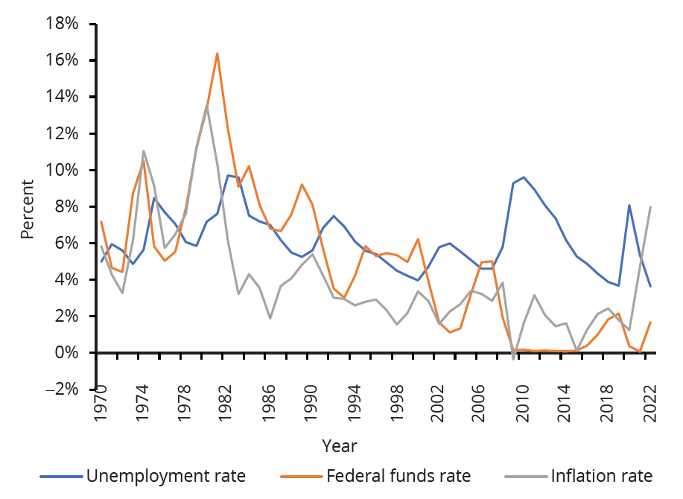
Federal Funds Rate
The federal funds rate is a very short-term interest rate, but it reflects credit conditions in financial markets very well.
Notes:
The federal funds rate often correlates with the unemployment rate and the inflation rate.

Slide 5
The Federal Open Market Committee
The Federal Open Market Committee (FOMC) makes the decisions regarding open market operations.
The FOMC is comprised of seven members of the Federal Reserve's Board of Governors.
The FOMC tries to act by consensus; however, the Federal Reserve's chair has traditionally played a powerful role in defining and shaping that consensus.
Over the last few decades, open market operations have been the most commonly used tool of monetary policy for the Fed and central banks.
Notes:
The Federal Open Market Committee (FOMC) makes the decisions regarding open market operations. The FOMC is comprised of seven members of the Federal Reserve's Board of Governors. The FOMC tries to act by consensus; however, the Federal Reserve's chair has traditionally played a powerful role in defining and shaping that consensus. Over the last few decades, open market operations have been the most commonly used tool of monetary policy for the Fed and central banks.

Slide 6
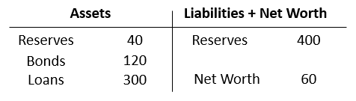
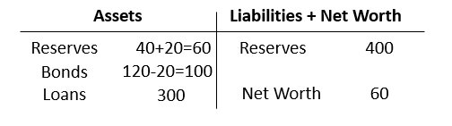
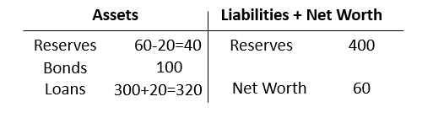
Open Market Operations₂
Table 1: The Original Balance Sheet
Table 2: The Central Bank Buys Bonds
Table 3: The Bank Makes Additional Loans
Notes:
To understand how open market operations affect the money supply, consider Eastern Bank's T-account balance sheet in Tables 1–3. Table 1 shows that Eastern Bank starts with $460 million in assets, divided among reserves, bonds, and loans, and $400 million in liabilities in the form of deposits, with a net worth of $60 million. When the central bank purchases $20 million in bonds from Eastern Bank, the bond holdings of Eastern Bank fall by $20 million, and the bank’s reserves rise by $20 million, as Table 2 shows.

Slide 7

Money Creation₁
Where did the Federal Reserve get the $20 million it used to purchase the bonds? A central bank has the power to create money. In practical terms, the Federal Reserve would write a check to Eastern Bank. In truth, the Federal Reserve created the money out of thin air (or with a computer).
Notes:
Where did the Federal Reserve get the $20 million it used to purchase the bonds? A central bank has the power to create money. In practical terms, the Federal Reserve would write a check to Eastern Bank. In truth, the Federal Reserve created the money out of thin air (or with a computer).

Slide 8


Money Creation₂
First, the Federal Reserve buys government bonds from a bank.
The bank’s excess reserves increase, and the bank uses those reserves to make new loans.
New lending creates deposits for other banks, generating more loans.
Notes:
First, the Federal Reserve buys government bonds from a bank. The bank’s excess reserves increase, and the bank uses those reserves to make new loans. New lending creates deposits for other banks, generating more loans.

Slide 9
Money Deletion
Open market operations can also reduce the quantity of money and loans in an economy.
At any given time, a bank is receiving payments on loans that it made previously and also making new loans.
A decrease in the quantity of loans also means fewer deposits in other banks and other banks reducing their lending.
Notes:
Open market operations can also reduce the quantity of money and loans in an economy. At any given time, a bank is receiving payments on loans that it made previously and also making new loans. A decrease in the quantity of loans also means fewer deposits in other banks and other banks reducing their lending.

Slide 10
Changing Reserve Requirements
A second method of conducting monetary policy is for the central bank to raise or lower the reserve requirement, which is the percentage of each bank's deposits that it is legally required to hold as cash or on deposit with the central bank.
If banks are required to hold a greater amount in reserves, they have less money available to lend out.
If banks are allowed to hold a smaller amount in reserves, they will have a greater amount of money available to lend out.
Notes:
A second method of conducting monetary policy is for the central bank to raise or lower the reserve requirement, which is the percentage of each bank's deposits that it is legally required to hold as cash or on deposit with the central bank. If banks are required to hold a greater amount in reserves, they have less money available to lend out. If banks are allowed to hold a smaller amount in reserves, they will have a greater amount of money available to lend out.

Slide 11
Changing the Discount Rate
The Federal Reserve was founded in the aftermath of the Panic of 1907, when many banks failed as a result of bank runs.
In the event of a run, sound banks (banks that are not bankrupt) can borrow as much cash as they need from the Fed's discount window.
The interest rate that banks pay for such loans is called the discount rate because the bank makes loans against its outstanding loans "at a discount" of their face value.
The third traditional method for conducting monetary policy is to raise or lower the discount rate.
If the central bank raises the discount rate, commercial banks will reduce their borrowing of reserves from the Fed and instead call in loans to replace those reserves.
Notes:
The Federal Reserve was founded in the aftermath of the Panic of 1907, when many banks failed as a result of bank runs. In the event of a run, sound banks (banks that are not bankrupt) can borrow as much cash as they need from the Fed's discount window. The interest rate that banks pay for such loans is called the discount rate because the bank makes loans against its outstanding loans "at a discount" of their face value. The third traditional method for conducting monetary policy is to raise or lower the discount rate. If the central bank raises the discount rate, commercial banks will reduce their borrowing of reserves from the Fed and instead call in loans to replace those reserves.

Slide 12
On Your Own₁
Indicate whether the following monetary policy actions would increase or decrease the money supply.
The Federal Reserve sells government bonds to banks.
Increases the money supply
Decreases the money supply
The Federal Reserve raises the required reserve ratio.
Increases the money supply
Decreases the money supply
The Federal Reserve reduces the discount rate.
Increases the money supply
Decreases the money supply

Slide 13
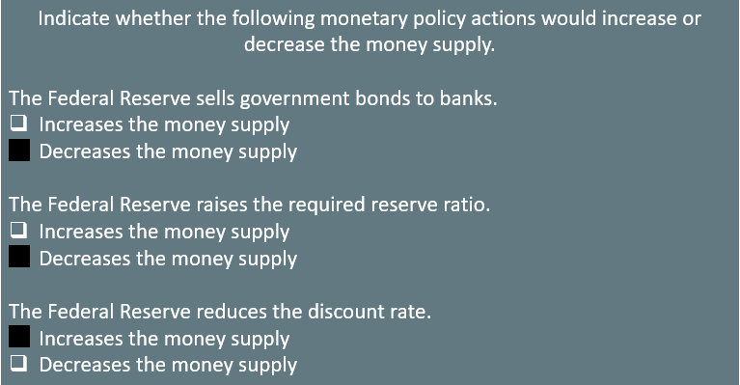
On Your Own₂

Slide 14

Ample Reserves Policy₁
During the Great Recession, open market operations with limited reserves did not provide enough stimulus for economic recovery.
The Fed began using a new tool: paying interest on reserves balances that banks hold at the Fed. This resulted in ample reserves.
The Fed uses four tools to conduct monetary policy when there are ample reserves in the economy:
IORB is the Fed’s primary tool.
Notes:
During the Great Recession, open market operations with limited reserves did not provide enough stimulus for economic recovery. The Fed began using a new tool: paying interest on reserves balances that banks hold at the Fed. This resulted in ample reserves.
The Fed uses four tools to conduct monetary policy when there are ample reserves in the economy: interest rates on reserves balances (IORB), overnight reverse repurchase (ON RRP) rates, discount rates, and open market operations.
IORB is the Fed’s primary tool.

Slide 15
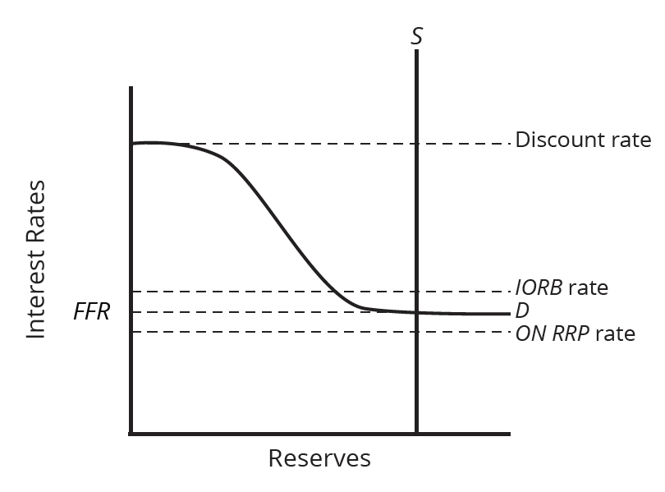
Ample Reserves Policy₂
In an ample reserves scenario, the Fed administers rates to determine the federal funds rate (FFR) instead of it being determined by the demand and supply of reserves in the federal funds market.
The three rates the Fed administers are the discount rate, the interest on reserves balances (IORB), and the overnight reverse repurchase (ON RRP) rate.
Notes:
In an ample reserves scenario, the Fed administers rates to determine the federal funds rate (FFR) instead of it being determined by the demand and supply of reserves in the federal funds market.
The three rates the Fed administers are the discount rate, the interest on reserves balances (IORB), and the overnight reverse repurchase (ON RRP) rate.

Slide 16
Summary
Prior to the Great Recession, the economy was in a limited reserves scenario, and the Fed used three tools to conduct monetary policy: open market operations, reserve requirements, and discount rates.
During the Great Recession, the Fed began using a new tool, paying interest on reserves balances, which resulted in ample reserves.
In an ample reserves scenario, the Fed shifts the demand for reserves by changing its administered rates: the discount rate, the interest rate on reserve balances, and the overnight reverse repurchase rate.
Limited reserves policy works through changing the supply of reserves, while ample reserves policy works through changing the demand for reserves by changing administered interest rates. The Fed will use open market operations to shift the supply curve if it needs to increase reserves in order to stay in an ample reserves framework.

Slide 17




HAWKES LEARNING

