Slide 1
The Federal Reserve Banking System and Central Banks
HAWKES LEARNING

Slide 2
Introduction
When the interlocking system of money, loans, and banks works well, economic transactions occur smoothly in goods and labor markets, and savers are connected with borrowers.
If the money and banking system does not operate smoothly, the economy can either fall into recession or suffer prolonged inflation.
The government of every country has public policies that support the system of money, loans, and banking; however, these policies do not always work perfectly.
Notes:
When the interlocking system of money, loans, and banks works well, economic transactions occur smoothly in goods and labor markets, and savers are connected with borrowers. If the money and banking system does not operate smoothly, the economy can either fall into recession or suffer prolonged inflation. The government of every country has public policies that support the system of money, loans, and banking; however, these policies do not always work perfectly.

Slide 3
Federal Reserve
The central bank is responsible for conducting monetary policy and ensuring that a nation's financial system operates smoothly.
Some prominent central banks around the world include the European Central Bank, the Bank of Japan, and the Bank of England.
In the United States, we call the central bank the Federal Reserve, often abbreviated as "the Fed."
The Federal Reserve was founded in 1913 under President Woodrow Wilson.
Notes:
The central bank is responsible for conducting monetary policy and ensuring that a nation's financial system operates smoothly. Some prominent central banks around the world include the European Central Bank, the Bank of Japan, and the Bank of England. In the United States, we call the central bank the Federal Reserve, often abbreviated as "the Fed.“The Federal Reserve was founded in 1913 under President Woodrow Wilson.

Slide 4
Structure and Organization of the Federal Reserve
The Federal Reserve is semi-decentralized, mixing government appointees with representation from private-sector banks.
The Fed is run by a Board of Governors, consisting of seven members appointed by the president and confirmed by the Senate.
Appointments are for fourteen-year terms, which are arranged so that one term expires January 31 of every even-numbered year.
The purpose of the long and staggered terms is to insulate the Board of Governors as much as possible from political pressure so that governors can make policy decisions based only on their economic merits.
Notes:
The Federal Reserve is semi-decentralized, mixing government appointees with representation from private-sector banks. It is run by a Board of Governors, consisting of seven members appointed by the president and confirmed by the Senate. Appointments are for fourteen-year terms, which are arranged so that one term expires January 31 of every even-numbered year. The purpose of the long and staggered terms is to insulate the Board of Governors as much as possible from political pressure so that governors can make policy decisions based only on their economic merits.

Slide 5
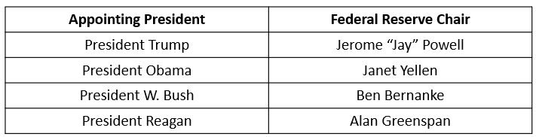
The Chair
One member of the Board of Governors is designated as the chair. The Fed chair is first among equals on the Board of Governors. While he or she has only one vote, the chair controls the agenda and is the Fed's public voice, so he or she has more power and influence than you might expect.
Table 1: Fed Chairs and the Appointing U.S. President
Notes:
One member of the Board of Governors is designated as the chair. The Fed chair is first among equals on the Board of Governors. While he or she has only one vote, the chair controls the agenda and is the Fed's public voice, so he or she has more power and influence than you might expect.

Slide 6
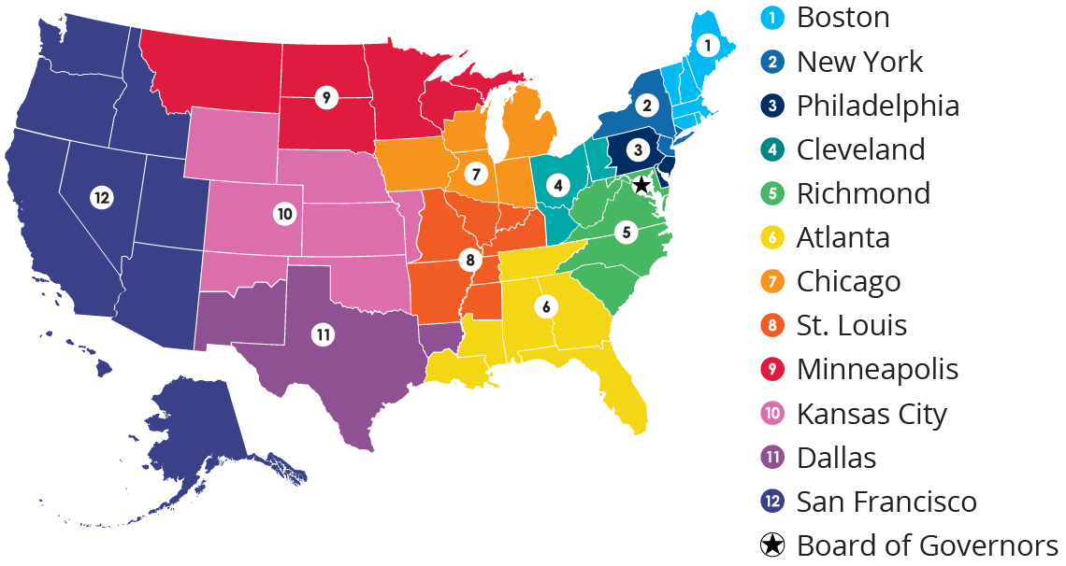
Federal Reserve Banks
There are 12 regional banks that support the commercial banks and general economy in their districts.
Notes:
There are 12 regional banks that support the commercial banks and general economy in their districts.

Slide 7
On Your Own
Using a dollar bill and the map from the lesson, determine the Federal Reserve District bank that printed the dollar bill.
Notes:
Using a dollar bill and the map from the lesson, determine the Federal Reserve District bank that printed the dollar bill.

Slide 8
Federal Reserve Responsibilities
The Federal Reserve, like most central banks, is designed to perform three important functions:
1. Conduct monetary policy
2. Promote stability of the financial system
3. Provide banking services to commercial banks and other depository institutions and to the federal government
The first two functions are so important that we will discuss them in their own lessons. The third function is discussed here.
Notes:
The Federal Reserve, like most central banks, is designed to perform three important functions:
Conduct monetary policy
Promote stability of the financial system
Provide banking services to commercial banks and other depository institutions and to the federal government
The first two functions are so important that we will discuss them in their own lessons. The third function is discussed here.

Slide 9
Federal Reserve Banking Services
The Federal Reserve provides many of the same services to banks that banks provide to customers.
All commercial banks have an account at the Fed, where they deposit reserves.
The Fed is responsible for check processing.
The Federal Reserve also ensures that enough currency and coins are circulating through the financial system to meet public demands.
Finally, the Fed is responsible for assuring that banks are in compliance with a wide variety of consumer protection laws.
Notes:
The Federal Reserve provides many of the same services to banks that banks provide to customers. All commercial banks have an account at the Fed, where they deposit reserves. The Fed is responsible for check processing. The Federal Reserve also ensures that enough currency and coins are circulating through the financial system to meet public demands. Finally, the Fed is responsible for assuring that banks are in compliance with a wide variety of consumer protection laws.

Slide 10
Summary
The central bank is responsible for conducting monetary policy and ensuring that a nation's financial system operates smoothly.
In the United States, we call the central bank the Federal Reserve, often abbreviated as "the Fed."
The Federal Reserve Board of Governors consists of seven members, each serving a fourteen-year nonrenewable term.
The Federal Reserve, like most central banks, is designed to perform three important functions: conduct monetary policy, promote stability of the financial system, and provide banking services to commercial banks and other depository institutions and to the federal government.

Slide 11




HAWKES LEARNING

