Slide 1
How Banks Create Money
HAWKES LEARNING

Slide 2

Introduction
Banks and money are intertwined. Most money is not just in the form of bank accounts; the banking system can literally create money through the process of making loans.
Notes:
Banks and money are intertwined. Most money is not just in the form of bank accounts; the banking system can literally create money through the process of making loans.

Slide 3
Money Creation by a Single Bank₁
1. Singleton Bank has $10 million in deposits and no loans, so all $10 million is in reserves.
2. Federal Reserve has a reserve requirement of 10%, so Singleton must keep $1 million in reserves and can loan the rest (to earn interest payments).
3. Singleton loans $9 million to Rico’s Auto Supply, so the bank now has $10 million in deposits, $1 million in reserves, and $9 million in loans (the loan is an asset because it will generate interest income).
4. Rico deposits the loan into an account at First National Bank, whose deposits and reserves now rise by $9 million.
Notes:
Singleton Bank has $10 million in deposits and no loans, so all $10 million is in reserves. Federal Reserve has a reserve requirement of 10%, so Singleton must keep $1 million in reserves and can loan the rest (to earn interest payments). Singleton loans $9 million to Rico’s Auto Supply, so the bank now has $10 million in deposits, $1 million in reserves and $9 million in assets (the loan is an asset because it will generate interest income). Rico deposits the loan into an account at First National Bank, whose deposits and reserves now rise by $9 million.

Slide 4
Money Creation by a Single Bank₂
Making loans that are deposited into a demand deposit account increases the M1 money supply.
The money supply is now $19 million: $10 million in deposits in Singleton Bank and $9 million in deposits at First National.
In this example so far, bank lending has expanded the money supply by $9 million.
Notes:
Making loans that are deposited into a demand deposit account increases the M1 money supply. The money supply is now $19 million: $10 million in deposits in Singleton Bank and $9 million in deposits at First National. In this example so far, bank lending has expanded the money supply by $9 million.

Slide 5
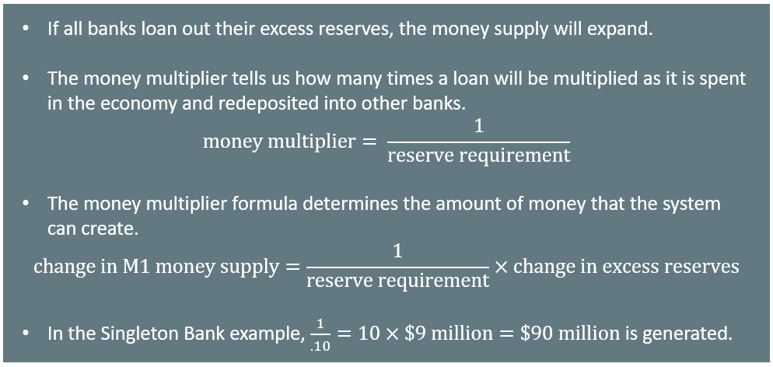
The Money Multiplier and a Multibank System
Notes:
If all banks loan out their excess reserves, the money supply will expand. The money multiplier tells us how many times a loan will be multiplied as it is spent in the economy and redeposited into other banks. Money multiplier = 1/reserve requirement
The money multiplier formula determines the amount of money that the system can create. Change in money supply= 1/reserve requirement*change in excess reserves. In the Singleton Bank example, 1/.10 = 10 x $9 million = $90 million is generated.

Slide 6

On Your Own₁
If the reserve requirement is 20%, and the banking system has $1,000 in deposits and reserves, by how much can the money supply change?
Notes:
If the reserve requirement is 20%, and the banking system has $1,000 in deposits and reserves, by how much can the money supply change?

Slide 7
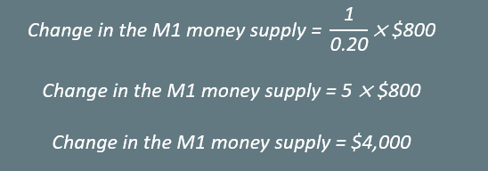
On Your Own₂
If the reserve requirement is 20%, and the banking system has $1,000 in deposits and reserves, by how much can the money supply change?
For deposits of $1,000, with a 20% reserve requirement, $200 are required reserves, and $800 are excess reserves.
Notes:
If the reserve requirement is 20%, and the banking system has $1,000 in deposits and reserves, by how much can the money supply change?
For deposits of $1,000, with a 20% reserve requirement, $200 are required reserves, and $800 are excess reserves. The change in the M1 money supply is $4,000.

Slide 8
Cautions about the Money Multiplier
The money multiplier will depend on the proportion of reserves that the Federal Reserve Bank requires banks to hold.
During recessions, banks are likely to hold a higher proportion of reserves because they fear that customers are less likely to repay loans.
The process of how banks create money shows that the quantity of money in an economy is closely linked to the quantity of lending or credit in the economy.
The money multiplier depends on people redepositing the money that they receive in the banking system.
Notes:
The money multiplier will depend on the proportion of reserves that the Federal Reserve Bank requires banks to hold. During recessions, banks are likely to hold a higher proportion of reserves because they fear that customers are less likely to repay loans. The process of how banks create money shows that the quantity of money in an economy is closely linked to the quantity of lending or credit in the economy. The money multiplier depends on people redepositing the money that they receive in the banking system.

Slide 9
Mattress Savings
Low-income countries have what economists sometimes refer to as "mattress savings," or money that people are hiding in their homes because they do not trust banks. When mattress savings in an economy are substantial, banks cannot lend those funds, and the money multiplier cannot operate as effectively.
Notes:
Low-income countries have what economists sometimes refer to as "mattress savings," or money that people are hiding in their homes because they do not trust banks. When mattress savings in an economy are substantial, banks cannot lend those funds, and the money multiplier cannot operate as effectively.

Slide 10
Money and Banks: Benefits and Dangers
Benefits
Dangers
If banks aren’t working well, there will be a decline in transactions.
When banks are under financial stress, loans become less available.
Money helps modern economies function.
Banking makes money more effective.
vs.

Slide 11
Summary
We define the money multiplier as the quantity of money that the banking system can generate from each $1 of bank reserves.
The formula for calculating the multiplier is: 1∕reserve requirement
The reserve requirement is the fraction of deposits that the bank must hold as reserves.
The quantity of money in an economy and the quantity of credit for loans are inextricably intertwined.
The network of banks making loans, people making deposits, and banks making more loans creates much of the money in an economy.

Slide 12




HAWKES LEARNING

