Slide 1
Measuring Money: Currency, M1, and M2
HAWKES LEARNING

Slide 2
Liquidity
Rather than trying to state a single way of measuring money, economists offer broader definitions of money based on liquidity.
Liquidity refers to how quickly you can use a financial asset to buy a good or service.
Cash is extremely liquid while money in a savings account is less liquid, since a savings account is more difficult to immediately access.
Notes:
Rather than trying to state a single way of measuring money, economists offer broader definitions of money based on liquidity. Liquidity refers to how quickly you can use a financial asset to buy a good or service. Cash is extremely liquid while money in a savings account is less liquid, since a savings account is more difficult to immediately access.

Slide 3
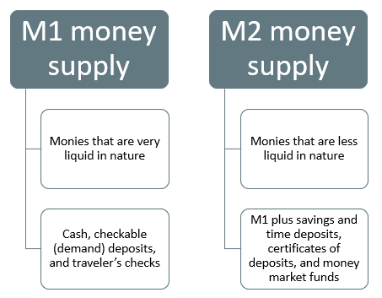
Money Supply
The Federal Reserve Bank, which is the central bank of the United States, is a bank regulator that is responsible for monetary policy and defines money according to its liquidity. There are two definitions of money: M1 money supply and M2 money supply.
Notes:
The Federal Reserve Bank, which is the central bank of the United States, is a bank regulator that is responsible for monetary policy and defines money according to its liquidity. There are two definitions of money: M1 money supply and M2 money supply.

Slide 4
M1 Money Supply
M1 money supply includes coins and currency in circulation: coins and bills that circulate in an economy that the U.S. Treasury does not hold at the Federal Reserve Bank or in vaults.
Closely related to currency are checkable deposits (also known as demand deposits), which are the amounts held in checking accounts.
Together, these items comprise the definition of money known as M1, which the Federal Reserve System measures daily.
Notes:
M1 money supply includes coins and currency in circulation: coins and bills that circulate in an economy that the U.S. Treasury does not hold at the Federal Reserve Bank or in vaults. Closely related to currency are checkable deposits (also known as demand deposits), which are the amounts held in checking accounts. Together, these items comprise the definition of money known as M1, which the Federal Reserve System measures daily.

Slide 5
M2 Money Supply
M2 is a broader definition of money; it includes everything in M1 as well as other types of deposits.
M2 includes savings deposits in banks.
Many financial institutions offer a chance to invest in money market funds, where they pool the deposits of investors and safely invest them.
Another ingredient of M2 are the relatively small certificates of deposit (CDs) or time deposits, which are accounts that the depositor has committed to leaving in the bank for a certain period of time.
Notes:
M2 is a broader definition of money; it includes everything in M1 as well as other types of deposits. M2 includes savings deposits in banks. Many financial institutions offer a chance to invest in money market funds, where they pool the deposits of investors and safely invest them. Another ingredient of M2 are the relatively small certificates of deposit (CDs) or time deposits, which are accounts that the depositor has committed to leaving in the bank for a certain period of time.

Slide 6
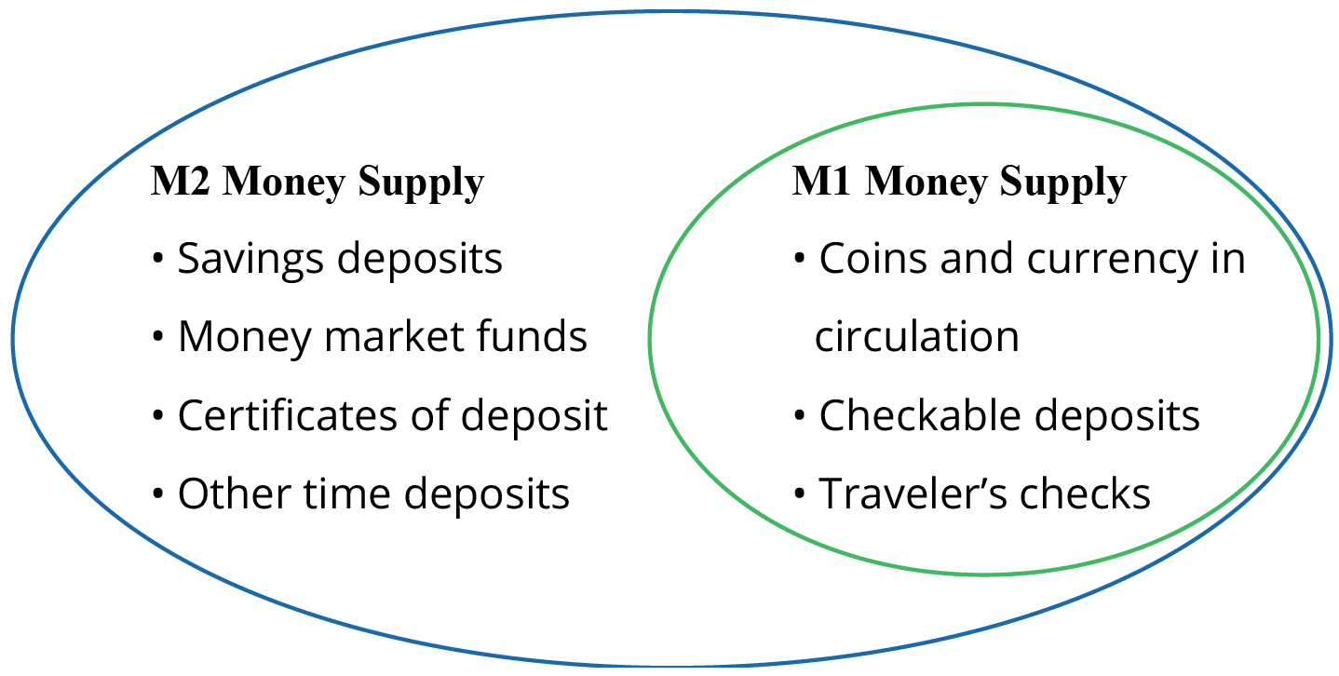
M1 and M2 Money Supply₁
In short, all the M2 types of deposits are money that require a greater effort to access and spend than M1.
Notes:
In short, all the M2 types of deposits are money that require a greater effort to access and spend than M1.

Slide 7
M1 and M2 Money Supply₂
The lines separating M1 and M2 can become a little blurry.
For example, some businesses will not accept personal checks for large amounts but will accept traveler's checks or cash.
Changes in banking practices and technology have made the savings accounts in M2 more similar to the checking accounts in M1.
As with many other economic terms and statistics, the important point is to know the strengths and limitations of the various definitions.
Notes:
The lines separating M1 and M2 can become a little blurry. For example, some businesses will not accept personal checks for large amounts but will accept traveler's checks or cash. Changes in banking practices and technology have made the savings accounts in M2 more similar to the checking accounts in M1. As with many other economic terms and statistics, the important point is to know the strengths and limitations of the various definitions.

Slide 8
Plastic Money₁
A debit card, like a check, is an instruction to the user's bank to transfer money directly and immediately from your bank account to the seller.
Although you can make a purchase with a credit card, the financial institution does not consider it money but rather a short-term loan from the credit card company to you.
With a smart card, you can store a certain value of money on a card and then use the card to make purchases.
Notes:
A debit card, like a check, is an instruction to the user's bank to transfer money directly and immediately from your bank account to the seller. Although you can make a purchase with a credit card, the financial institution does not consider it money but rather a short-term loan from the credit card company to you. With a smart card, you can store a certain value of money on a card and then use the card to make purchases.

Slide 9

Plastic Money₂
Suppose that you receive a $100 Amazon gift card. Does this represent a $100 increase in the M1 money supply? Explain your answer.
Notes:
Suppose that you receive a $100 Amazon gift card. Does this represent a $100 increase in the M1 money supply? Explain your answer.

Slide 10
Plastic Money₃
Suppose that you receive a $100 Amazon gift card. Does this represent a $100 increase in the M1 money supply? Explain your answer.
The gift card itself is not part of the money supply, but the $100 that purchased the card is part of the M1 money supply. The gift card, unlike currency, checkable deposits, or traveler’s checks, cannot be used to purchase any goods or services except those offered by Amazon.
Notes:
Suppose that you receive a $100 Amazon gift card. Does this represent a $100 increase in the M1 money supply? Explain your answer.
The gift card itself is not part of the money supply, but the $100 that purchased the card is part of the M1 money supply. The gift card, unlike currency, checkable deposits, or traveler’s checks, cannot be used to purchase any goods or services except those offered by Amazon.

Slide 11
Summary
M1 includes currency in circulation and money in checking accounts accessible by checks and debit and credit cards.
M2 includes all of M1, plus savings deposits, time deposits, and money market funds.
The Federal Reserve System is responsible for tracking the amounts of M1 and M2 and releasing information frequently.

Slide 12




HAWKES LEARNING

