Slide 1
Balancing Keynesian and Neoclassical Models
HAWKES LEARNING

Slide 2

Introduction
Finding the balance between Keynesian and neoclassical models can prove difficult.
Both approaches have their own strengths and weaknesses.
Notes:
Finding the balance between Keynesian and Neoclassical models can prove difficult. Both approaches have their own strengths and weaknesses.

Slide 3
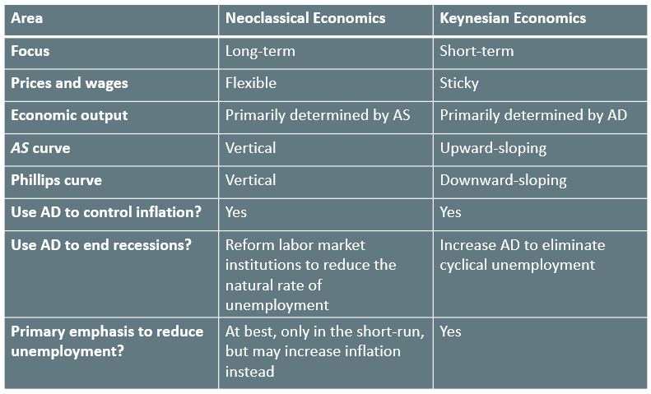
Balancing the Models₁

Slide 4

Group Activity
Discuss the implications of the term neoclassical Keynesian. Is this possible? Why or why not?
Notes:
Discuss the implications of the term neoclassical Keynesian. Is this possible? Why or why not?

Slide 5
Balancing the Models₂
Keynesian Model
Neoclassical Model
AD is the cause of business cycles and rigid wages/prices
Risks overlooking long-term economic growth and natural unemployment
AS focused: analyzes the determinants of output and employment
Not effective at explaining short-term fluctuations and recessions
&
Notes:
The Keynesian model states that AD is the cause of business cycles and rigid wages/prices. It risks overlooking long-term economic growth and natural unemployment. The Neoclassical model is AS focused and analyzes the determinants of output and employment. It is not effective at explaining short-term fluctuations and recessions.

Slide 6
Dual Approach
"At short-time scales, I think, something sort of ‘Keynesian’ is a good approximation, and surely better than anything straight ‘neoclassical.’ At very long-time scales, the interesting questions are best studied in a neoclassical framework, and attention to the Keynesian side of things would be a minor distraction. At the five- to ten-year time scale, we have to piece things together as best we can and look for a hybrid model that will do the job." —Robert Solow, Economics Nobel laureate

Slide 7
Summary
The Keynesian perspective sees changes in AD as the cause of business cycle fluctuations.
Neoclassical economists believe that long-term productivity growth determines the potential GDP level and that the economy typically will return to full employment after a change in AD.
While Keynesians tend to advocate an acceptable tradeoff between inflation and unemployment when counteracting a recession, neoclassical economists argue that no such tradeoff exists.

Slide 8




HAWKES LEARNING

