Slide 1
The Phillips Curve
HAWKES LEARNING

Slide 2
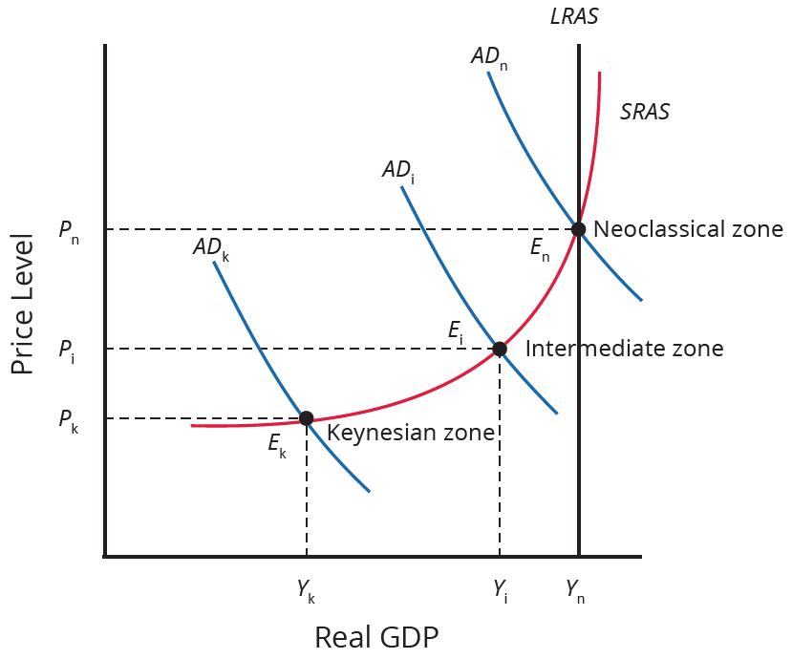
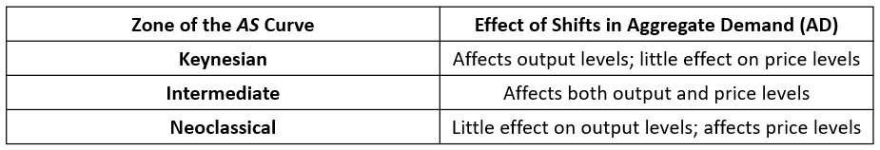
Introduction
The simplified AD/AS model is consistent with Keynes’ original model.
In the real-world, an AS curve is more curved than the right angle presented previously.
The real-world AS curve goes from flat to curved to very steep, leading to the concept of the Phillips curve.
Notes:
The simplified AD/AS model is consistent with Keynes’ original model. In the real-world, an AS curve is more curved than the right angle presented previously. The real-world AS curve goes from flat to curved to very steep, leading to the concept of the Phillips curve.

Slide 3
The Phillips Curve₁
Keynesian theory implies that inflationary pressures are low during a recession but higher when the level of output is near or even beyond potential GDP.
In the 1950s, London School of Economics economist, A.W. Phillips, studied the Keynesian school of thought and developed a theory.
Phillips found that a tradeoff between unemployment and inflation does indeed exist.
The curve that shows this tradeoff became known as the Phillips curve.
Notes:
Keynesian economics focuses on explaining why recessions occur and how to best minimize their effects. Aggregate demand is not always high enough to incentivize firms to higher workers and reach full employment. The economy adjusts very slowly to changes in aggregate demand due to sticky wages and prices.

Slide 4
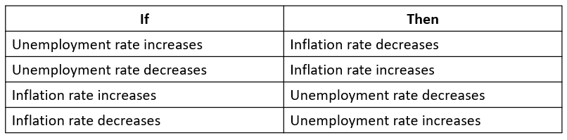
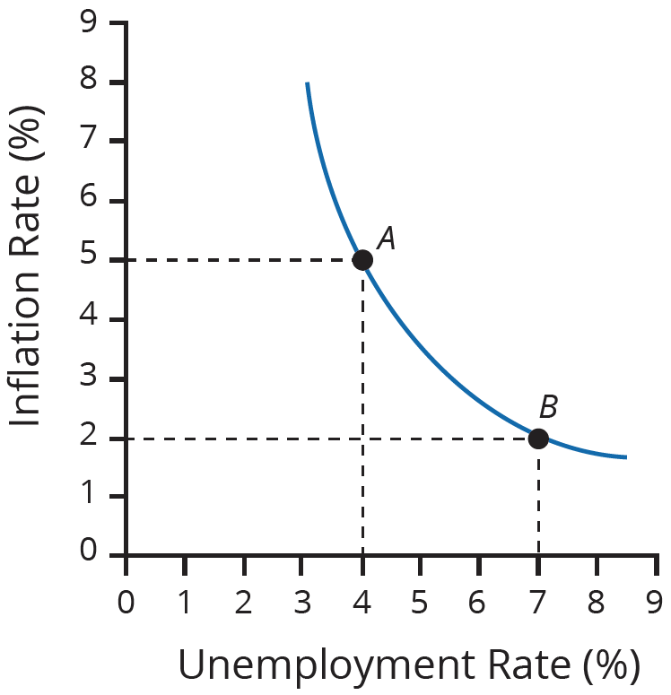
The Phillips Curve₂
Notes:
The Phillips curve illustrates the following: if the unemployment rate increases, the inflation rate decreases. If the inflation rate increases, the unemployment rate decreases.

Slide 5
The Instability of the Phillips Curve
During the 1960s, the Phillips curve represented real-world economies very well and was an effective menu for monetary and fiscal policy.
The relationship between unemployment and inflation depicted in the Phillips curve does not always hold true.
The U.S. experienced stagflation, high unemployment and high inflation, during the 1970s and 1980s.
Economists conclude that two factors can cause the Phillips curve to shift: one being supply shifts and the other being people's expectations about inflation.
Notes:
During the 1960s, the Phillips curve represented real-world economies very well and was an effective menu for monetary and fiscal policy. The relationship between unemployment and inflation depicted in the Phillips curve does not always hold true. The U.S. experienced stagflation, high unemployment and high inflation, during the 1970s and 1980s. Economists conclude that two factors can cause the Phillips curve to shift: one being supply shifts and the other being people's expectations about inflation.

Slide 6

On Your Own₁
Explain what would likely happen to the Phillips curve and the aggregate supply curve if the use of alternative energy sources, such as wind and solar, substantially reduced the cost of energy.
Notes:
Explain what would likely happen to the Phillips curve and the aggregate supply curve if the use of alternative energy sources, such as wind and solar, substantially reduced the cost of energy.

Slide 7
On Your Own₂
Explain what would likely happen to the Phillips curve and the aggregate supply curve if the use of alternative energy sources, such as wind and solar, substantially reduced the cost of energy.
If energy costs decrease, the Phillips curve would shift down, showing lower rates of inflation associated with given unemployment levels. The aggregate supply curve would shift right, showing a higher level of real GDP associated with each possible price level.
Notes:
Explain what would likely happen to the Phillips curve and the aggregate supply curve if the use of alternative energy sources, such as wind and solar, substantially reduced the cost of energy.
If energy costs decrease, the Phillips curve would shift down, showing lower rates of inflation associated with given unemployment levels. The aggregate supply curve would shift right, showing a higher level of real GDP associated with each possible price level.

Slide 8
Summary
The Phillips curve shows the tradeoff between unemployment and inflation.
From a Keynesian viewpoint, the Phillips curve should slope down so that higher unemployment means lower inflation and vice versa.
A downward-sloping Phillips curve is a short-term relationship that may shift after a few years.

Slide 9




HAWKES LEARNING

