Slide 1
Keynes' Law and Say's Law in the AD/AS Model
HAWKES LEARNING

Slide 2
Introduction
In the last two centuries, macroeconomists have often divided into two groups.
Some argue that supply is the most important determinant of the size of the macroeconomy, while demand just tags along.
Others argue that demand is the most important factor in the size of the macroeconomy, while supply just tags along.
Notes:
In the last two centuries, macroeconomists have often divided into two groups. Some argue that supply is the most important determinant of the size of the macroeconomy, while demand just tags along. Others argue that demand is the most important factor in the size of the macroeconomy, while supply just tags along.

Slide 3
Macroeconomic Schools of Thought
Supply Side
Demand Side
Supply dictates size of macroeconomy
Say’s Law: Supply creates its own demand
Demand dictates size of the macroeconomy
Keynes’ Law: Demand creates its own supply
&
Notes:
Those who advocate that supply creates its own demand subscribe to Say’s Law.
Those who advocate that demand creates its own supply subscribe to Keynes’ Law.

Slide 4
Say’s Law
Based on the work of French economist Jean-Baptiste Say.
The notion that “supply creates its own demand” provides a useful summary of Say’s general point of view.
A given value of supply creates an equivalent value of demand somewhere else in the economy.
Say was a classical economist, while modern day subscribers to his viewpoints are called neoclassical economists.
Notes:
Based on the work of French economist Jean-Baptiste Say. The notion that “supply creates its own demand” provides a useful summary of Say’s general point of view. A given value of supply creates an equivalent value of demand somewhere else in the economy. Say was a classical economist, while modern day subscribers to his viewpoints are called neoclassical economists.

Slide 5
Say’s Law Drawbacks
If supply always creates exactly enough demand, it is hard to understand why recessions and high unemployment should ever occur.
Economic failures during recessions are not counterbalanced by an equivalent number of successes.
In the short run, recessions occur when many firms face a lack of demand for their products, regardless of supply.
Say’s Law is a good approximation in the long run.
Notes:
If supply always creates exactly enough demand, it is hard to understand why recessions and high unemployment should ever occur. Economic failures during recessions are not counterbalanced by an equivalent number of successes. In the short run, recessions occur when many firms face a lack of demand for their products, regardless of supply. Say’s Law is a good approximation in the long run.

Slide 6
Keynes’ Law
Based on the work of British economist John Maynard Keynes
States that demand creates its own supply
During the Great Depression, unemployment surpassed 20%, and many factories closed even though the workers and machinery were still available.
Keynes argued that recessions result from lack of demand, disincentivizing firms’ production of goods and services.
Notes:
Based on the work of British economist John Maynard Keynes. States that demand creates its own supply. During the Great Depression, unemployment surpassed 20%, and many factories closed even though the workers and machinery were still available. Keynes argued that recessions result from lack of demand, disincentivizing firms’ production of goods and services.

Slide 7
Keynes’ Law Drawbacks
If demand was the only factor for economic growth, the government could easily control the size of the economy.
Economies face limits on what they can produce based on the factors of production.
Limits on what an economy can supply do not disappear because of an increase in demand.
Notes:
If demand was the only factor for economic growth, the government could easily control the size of the economy. Economies face limits on what they can produce based on the factors of production. Limits on what an economy can supply do not disappear because of an increase in demand.

Slide 8
On Your Own₁
Determine whether each of the following statements is true or false.
The focus of Say’s law is the long run.
      True
    False
The focus of Keynes’ law is the long run.
  True
False
Notes:
President Trump strongly suggested that the Federal Reserve should lower interest rates even though the economy was operating very close to potential GDP. What impact would a decrease in interest rates have on the macroeconomic goals of low unemployment and low inflation?

Slide 9
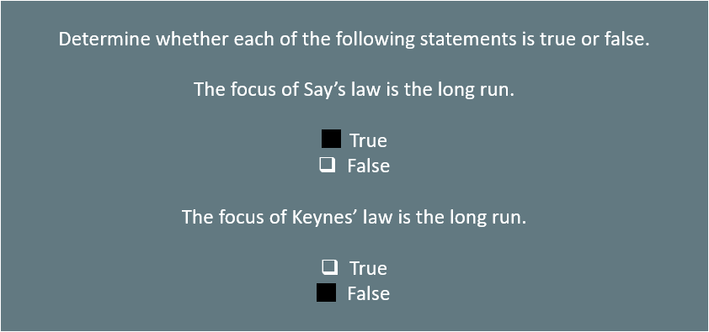
On Your Own₂
Notes:
President Trump strongly suggested that the Federal Reserve should lower interest rates even though the economy was operating very close to potential GDP. What impact would a decrease in interest rates have on the macroeconomic goals of low unemployment and low inflation?

Slide 10
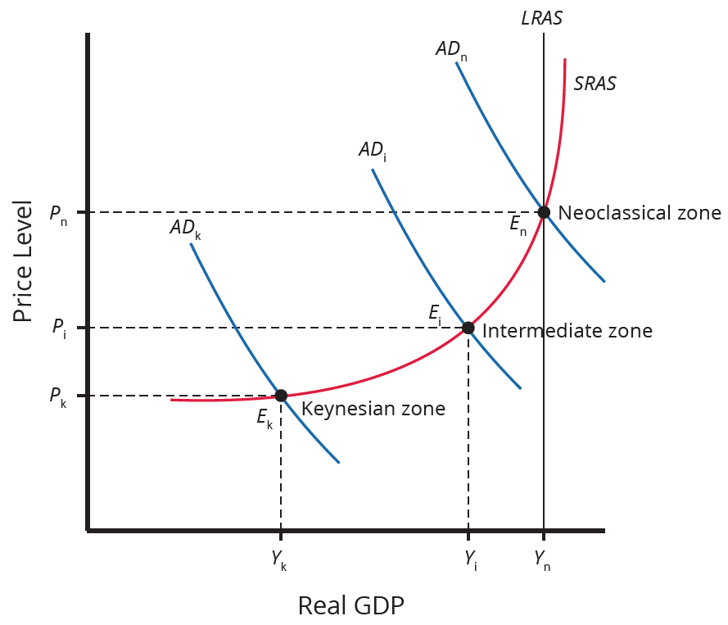
Zones in AD/AS Model
We can use the AD/AS model to illustrate Say's law and Keynes' law. Consider the SRAS curve's three zones below: the Keynesian zone, the neoclassical zone, and the intermediate zone.
Notes:
We can use the AD/AS model to illustrate Say's law and Keynes' law. Consider the SRAS curve's three zones below: the Keynesian zone, the neoclassical zone, and the intermediate zone.

Slide 11
Keynesian Zone
Equilibrium GDP is far below potential GDP.
Economy is in a recession.
Cyclical unemployment is high.
Aggregate demand shifts impact output level but have little impact on price level.
Inflationary pressures are not a concern.
Represents the short run
Notes:
Equilibrium GDP far below potential GDP
Economy is in a recession
Cyclical unemployment high
Aggregate demand shifts impact output level, little impact on price level
Inflationary pressures not a concern
Represents short-run

Slide 12
Intermediate Zone
A shift in AD to the right has the following effects:
Output moves closer to potential GDP.
Unemployment is reduced.
The price level is higher.
There is upward pressure on inflation.
A shift in AD to the left has the following effects:
Output moves further from potential GDP.
Unemployment increases.
The price level is lower.
There is downward pressure on inflation.
Notes:
A shift in the aggregate demand curve to the right causes: output to move closer to GDP, reduction in unemployment, increase in price level, and upward pressure on inflation.
A shift in the aggregate demand curve to the left causes: output to move further from GDP, increase in unemployment, decrease in price level, and downward pressure on inflation.

Slide 13
Neoclassical Zone
Equilibrium GDP is near full potential.
Cyclical unemployment is low.
Shifts of aggregate demand have little effect on the level of unemployment.
Shifts of aggregate demand create pressures to change the price level.
Represents the long run
Notes:
Equilibrium GDP near full potential
Cyclical unemployment low
Shifts of aggregate demand have little effect on the level of unemployment
Shifts of aggregate demand create pressures to change the price level
Represents long run

Slide 14

On Your Own₃
Before the pandemic, President Trump strongly suggested that the Federal Reserve should lower interest rates even though the economy was operating very close to potential GDP. What impact would a decrease in interest rates have on the macroeconomic goals of low unemployment and low inflation?
Notes:
President Trump strongly suggested that the Federal Reserve should lower interest rates even though the economy was operating very close to potential GDP. What impact would a decrease in interest rates have on the macroeconomic goals of low unemployment and low inflation?

Slide 15
On Your Own₄
Before the pandemic, President Trump strongly suggested that the Federal Reserve should lower interest rates even though the economy was operating very close to potential GDP. What impact would a decrease in interest rates have on the macroeconomic goals of low unemployment and low inflation?
A decrease in interest rates usually increases the consumption and investment components of aggregate demand. With the economy near potential GDP (the neoclassical zone), increases in aggregate demand will have little or no effect on output and employment but will increase inflation.
Notes:
President Trump strongly suggested that the Federal Reserve should lower interest rates even though the economy was operating very close to potential GDP. What impact would a decrease in interest rates have on the macroeconomic goals of low unemployment and low inflation?
A decrease in interest rates usually increases the consumption and investment components of aggregate demand. With the economy near potential GDP (the neoclassical zone), increases in aggregate demand will have little or no effect on output and employment but will increase inflation.

Slide 16
Summary
Neoclassical economists emphasize Say’s Law, which states that supply creates its own demand.
Keynesian economists emphasize Keynes’ Law, which states that demand creates its own supply.
A balanced perspective including aspects from both laws represents real world economic growth well.
The AD/AS model can be used to incorporate both laws by dividing the SRAS curve into three distinct zones.

Slide 17




HAWKES LEARNING

