Slide 1
The National Saving and Investment Identity
HAWKES LEARNING

Slide 2
Introduction
The close connection between trade balances and international flows of savings and investments leads to a macroeconomic analysis. This approach views trade balances—and their associated flows of financial capital—in the context of the overall levels of savings and financial investment in the economy.
With a group of classmates, discuss the difference between a trade deficit and a government budget deficit. Is one more desirable than the other?
Notes:
The close connection between trade balances and international flows of savings and investments leads to a macroeconomic analysis. This approach views trade balances—and their associated flows of financial capital—in the context of the overall levels of savings and financial investment in the economy. With a group of classmates, discuss the difference between a trade deficit and a government budget deficit. Is one more desirable than the other?

Slide 3
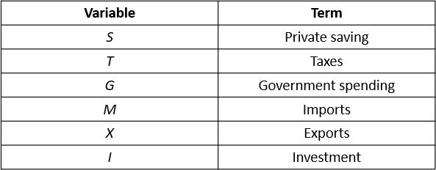
Understanding the Determinants of the Trade and Current Account Balances₁
The national saving and investment identity states that the quantity of financial capital supplied must equal the quantity demanded.
supply of financial capital = demand for financial capital
S + (M − X) = I + (G − T)
Notes:
The national saving and investment identity states that the quantity of financial capital supplied must equal the quantity demanded. This identity provides a useful way to understand the determinants of the trade and current account balances.

Slide 4
Main Sources of Supply and Demand of Financial Capital
Supply:
Demand:
1. Savings by individuals and firms (S)
2. Inflow of financial capital from foreign investors, which is equal to the trade deficit: imports − exports (M − X)
1. Private sector investment (I)
2. Government borrowing, which occurs when government spending (G) is higher than the taxes collected (T)
&
supply of financial capital = demand for financial capital
S + (M − X) = I + (G − T)

Slide 5
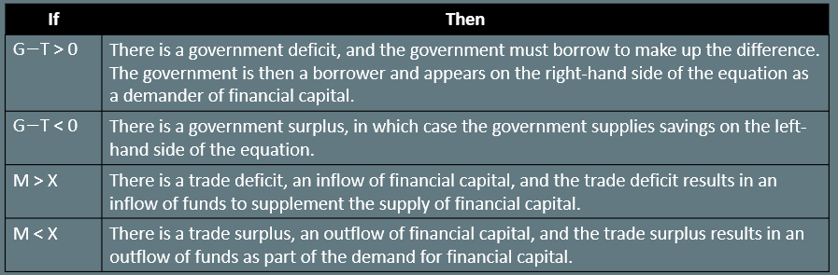
Understanding the Determinants of the Trade and Current Account Balances₂
For the macroeconomy, the quantity of financial capital supplied always equals the quantity demanded.
Certain components of the national saving and investment identity can switch between the supply side and the demand side.

Slide 6
Understanding the Determinants of the Trade and Current Account Balances₃
Domestic saving will always appear as part of the supply of financial capital.
Domestic investment will always appear as part of the demand for financial capital.
The government and trade balance elements of the equation can move back and forth as either suppliers or demanders of financial capital, depending on whether government budgets and the trade balance are in surplus or deficit.
Notes:
Domestic saving will always appear as part of the supply of financial capital. Domestic investment will always appear as part of the demand for financial capital. The government and trade balance elements of the equation can move back and forth as either suppliers or demanders of financial capital, depending on whether government budgets and the trade balance are in surplus or deficit.

Slide 7
Domestic Saving and Investment Determine the Trade Balance₁
A nation’s own levels of domestic saving and investment determine its trade balance.
trade deficit = domestic investment − private domestic saving − government borrowing
(M − X) = I − S − (T − G)
In this case, domestic investment is higher than domestic saving, including both private and government saving.
The only way that domestic investment can exceed domestic saving is if capital is flowing into a country from abroad.
Notes:
A nation’s own levels of domestic saving and investment determine its trade balance. Trade deficit = domestic investment − private domestic saving − government borrowing = (M−X) = I−S − (T−G). In this case, domestic investment is higher than domestic saving, including both private and government saving. The only way that domestic investment can exceed domestic saving is if capital is flowing into a country from abroad.

Slide 8
Domestic Saving and Investment Determine the Trade Balance₂
For a trade surplus, the national saving and investment identity can be rewritten.
trade surplus = private domestic saving + public saving − domestic investment
(X − M) = S + (T − G) − I
In this case, domestic saving (both private and public) is higher than domestic investment.
The extra financial capital will be invested abroad.
Notes:
For a trade surplus, the national saving and investment identity can be rewritten. Trade surplus (X−M) = private domestic saving + public saving − domestic investment = S+(T−G) −I. In this case, domestic saving (both private and public) is higher than domestic investment. The extra financial capital will be invested abroad.

Slide 9
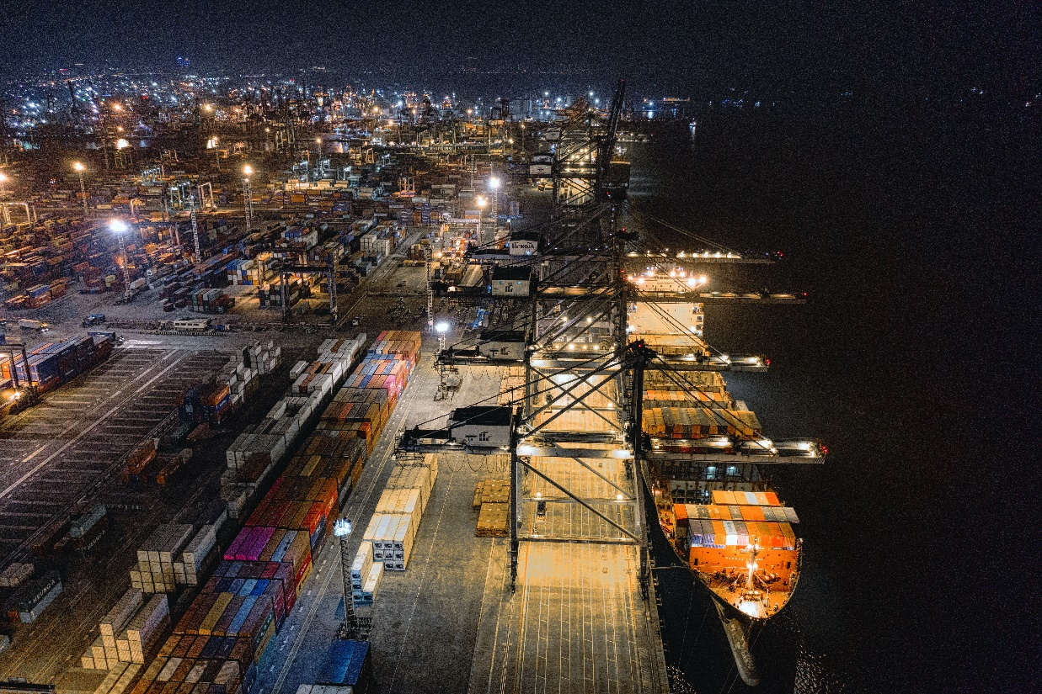
Domestic Saving and Investment Determine the Trade Balance₃
This connection, between the trade balance and domestic saving and investment, explains why economists view the trade balance as a fundamentally macroeconomic phenomenon.
Notes:
This connection, between the trade balance and domestic saving and investment, explains why economists view the trade balance as a fundamentally macroeconomic phenomenon.

Slide 10
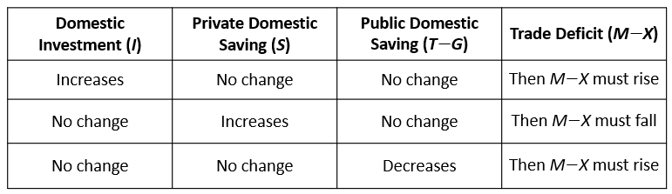
Examining Trade Balances One Factor at a Time
The national saving and investment identity also provides a framework for thinking about what will cause trade deficits to rise or fall.
Notes:
The national saving and investment identity also provides a framework for thinking about what will cause trade deficits to rise or fall.

Slide 11
Short-Term Movements in the Business Cycle and the Trade Balance
In the short run, trade imbalances can be affected by whether an economy is in a recession or on the upswing.
A recession makes a trade deficit smaller or a trade surplus larger, and economic growth makes a trade deficit larger or a trade surplus smaller.
When the trade deficit rises, it necessarily means a greater net inflow of foreign financial capital.
Reduced private saving could offset the inflow of financial capital, leaving domestic investment and public saving unchanged.
The inflow could result in higher domestic investment, leaving private and public saving unchanged.
Notes:
In the short run, trade imbalances can be affected by whether an economy is in a recession or on the upswing. A recession makes trade deficit smaller or trade surplus larger, and economic growth makes trade deficit larger or trade surplus smaller. When the trade deficit rises, it necessarily means a greater net inflow of foreign financial capital. Reduced private saving could offset the inflow of financial capital, leaving domestic investment and public saving unchanged. The inflow could result in higher domestic investment, leaving private and public saving unchanged.

Slide 12
On Your Own₁
Suppose an economy has a budget deficit of $155 billion, savings of $300 billion, and domestic investments of $165 billion. According to the national saving and investment identity, what is the current account balance?
Notes:
Suppose an economy has a budget deficit of $155 billion, savings of $300 billion, and domestic investments of $165 billion. According to the national saving and investment identity, what is the current account balance?

Slide 13
On Your Own₂
Suppose an economy has a budget deficit of $155 billion, savings of $300 billion, and domestic investments of $165 billion. According to the national saving and investment identity, what is the current account balance?
S + (M − X) = I + (G − T)
Substitute the values for S = $300, I = $165, and (G − T) = $155, and solve for (M − X).
$300 + (M − X) = $165 + $155
(M − X) = $165 + $155 − $300
(M − X) = $20
Notes:
Suppose an economy has a budget deficit of $155 billion, savings of $300 billion, and domestic investments of $165 billion. According to the national saving and investment identity, what is the current account balance?
S+(M−X)=I+(G−T)
Substitute the values for S=$300, I=$165, and (G-T)=$155, and solve for (M-X).
$300+(M-X)=$165+$155
(M-X)=$165+$155-$300
(M-X)=$20

Slide 14
Summary
The national saving and investment identity is based on the relationship that the total quantity of financial capital supplied from all sources must equal the total quantity of financial capital demanded from all sources.
S = private savings, T = taxes, G = government spending, M = imports, X = exports, I = investment
In the formula for an economy with a current account deficit and budget deficit:
supply of financial capital = demand for financial capital
S + (M − X) = I + (G − T)
A recession tends to increase the trade balance (meaning a higher trade surplus or lower trade deficit), while economic boom tends to decrease the trade balance (meaning a lower trade surplus or a larger trade deficit).

Slide 15




HAWKES LEARNING

