Slide 1
Measuring Trade Balances
HAWKES LEARNING

Slide 2
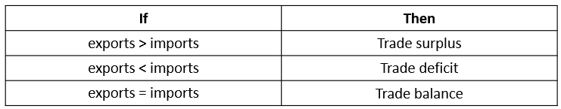
Trade Balances₁
Trade balance: the difference between a nation’s dollar value of its exports (what its producers sell abroad) and its dollar value of imports (the foreign-made products and services that households and businesses purchase)—also known as net exports
Countries can have surpluses or deficits for long periods of time. (Example: Germany has had large trade surpluses in recent decades, and the U.S. has had large trade deficits in recent decades.)
Notes:
Trade balance: the difference between a nation’s dollar value of its exports (what its producers sell abroad) and its dollar value of imports (the foreign-made products and services that households and businesses purchase)—also known as net exports
Countries can have surpluses or deficits for long periods of time. (Example: Germany has had large trade surpluses in recent decades, and the U.S. has had large trade deficits in recent decades.)

Slide 3
Trade Balances₂
A series of financial crises triggered by unbalanced trade can lead economies into deep recessions.
These crises begin with large trade deficits.
At some point, foreign investors become pessimistic about the economy and move their money to other countries.
The economy then drops into deep recession, with real gross domestic product (GDP) often falling 10% or more in a single year.
Notes:
A series of financial crises triggered by unbalanced trade can lead economies into deep recessions. These crises begin with large trade deficits. At some point, foreign investors become pessimistic about the economy and move their money to other countries. The economy then drops into deep recession, with real gross domestic product (GDP) often falling 10% or more in a single year.

Slide 4
Measuring Trade Balances₁
Merchandise Trade Balance
Current Account Balance
&
Measures trade of physical goods
A common measurement a few decades ago, but the global economy has changed
More modern measurements now include trade of services
Broader measure than merchandise trade balance
Includes other international flows of income and foreign aid
Notes:
Merchandise Trade Balance: measures trade of physical goods, was a common measurement a few decades ago, but the global economy has changed. More modern measurements now include trade of services.
Current Account Balance: Broader measure than merchandise trade balance, includes other international flows of income and foreign aid.

Slide 5
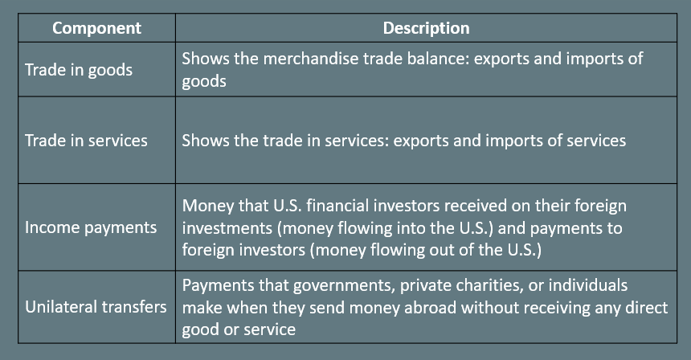
Components of the U.S. Current Account Balance
Notes:
Trade in goods- shows the merchandise trade balance: exports and imports of goods
Trade in services- shows the trade in services: exports and imports of services
Income payments- Money that U.S. financial investors received on their foreign investments (money flowing into the U.S.) and payments to foreign investors (money flowing out of the U.S.)
Unilateral transfers- Payments that governments, private charities, or individuals make when they send money abroad without receiving any direct good or service

Slide 6
Unilateral Transfers
Unilateral transfers are one-way payments that governments, private entities, or individuals make that they send abroad.
With unilateral transfers, nothing is received in return.
Some examples include U.S. economic or military assistance for other countries and spending abroad by charities to address poverty.
For the U.S. economy, unilateral transfers are almost always negative.
Notes:
Unilateral transfers are one-way payments that governments, private entities, or individuals make that they send abroad. With unilateral transfers, nothing is received in return. Some examples include U.S. economic or military assistance for other countries and spending abroad by charities to address poverty. For the U.S. economy, unilateral transfers are almost always negative.

Slide 7
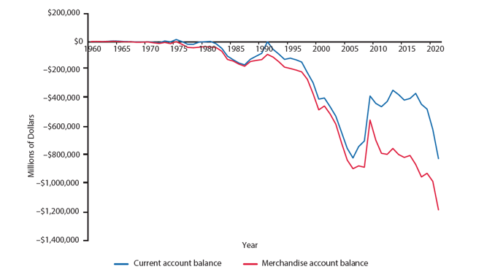
Trade Balances in Historical and International Context₁
If the lines are above $0, the U.S. was running a positive merchandise trade balance and current account balance. If the lines fall below $0, the U.S. was running a merchandise trade deficit and a deficit in its current account balance.
Notes:
If the lines are above $0, the U.S. was running a positive merchandise trade balance and current account balance. If the lines fall below $0, the U.S. was running a merchandise trade deficit and a deficit in its current account balance.

Slide 8
Trade Balances in Historical and International Context₂
From the 1960s into the 1970s, the U.S. economy had mostly small trade surpluses.
Starting in the 1980s, the merchandise trade deficit increased rapidly, and in the 1990s, the current account trade deficit increased.
While the U.S. economy has consistently run trade deficits in recent years, many European nations have consistently run trade surpluses.
Notes:
From the 1960s into the 1970s, the U.S. economy had mostly small trade surpluses. Starting in the 1980s, the merchandise trade deficit increased rapidly, and in the 1990s, the current account trade deficit increased. While the U.S. economy has consistently run trade deficits in recent years, many European nations have consistently run trade surpluses.

Slide 9
Summary
The trade balance measures the gap between a country's exports and imports.
In most high-income economies, goods compose less than half of a country's total production, while services compose more than half.
The last two decades have seen a surge in international trade of services; however, most global trade still takes the form of goods rather than services.
The current account balance includes the trade in goods, services, and money flowing into and out of a country from investments and unilateral transfers.

Slide 10




HAWKES LEARNING

