Slide 1
The Confusion over Inflation
HAWKES LEARNING

Slide 2

Introduction
Robert Shiller, one of 2013's Nobel Prize winners in economics, carried out several surveys of attitudes toward inflation during the 1990s. One of his questions asked, "Do you agree that preventing high inflation is an important national priority, as important as preventing drug abuse or deterioration in the quality of our schools?"
U.S. population: 52% answered "fully agree"
Professional economists: 18% answered "fully agree"
U.S. population: 4% answered "completely disagree"
Professional economists: 18% answered "completely disagree"
Notes:
Robert Shiller, one of 2013's Nobel Prize winners in economics, carried out several surveys of attitudes toward inflation during the 1990s. One of his questions asked, "Do you agree that preventing high inflation is an important national priority, as important as preventing drug abuse or deterioration in the quality of our schools?“ Of the U.S. population as a whole, 52% answered "fully agree," and just 4% answered "completely disagree." However, among professional economists, 18% answered "fully agree," and 18% answered "completely disagree."

Slide 3
Unintended Redistribution of Purchasing Power₁
Inflation can cause redistributions of purchasing power that hurt some and help others.
People who are hurt by inflation include those who are holding considerable cash, like in a safety deposit box.
When inflation happens, the buying power of cash diminishes.
People tend to suffer from inflation if they have financial assets invested in such a way that the nominal return does not keep up.
Notes:
Inflation can cause redistributions of purchasing power that hurt some and help others. People who are hurt by inflation include those who are holding considerable cash, like in a safety deposit box. When inflation happens, the buying power of cash diminishes. People tend to suffer from inflation if they have financial assets invested in such a way that the nominal return does not keep up.

Slide 4
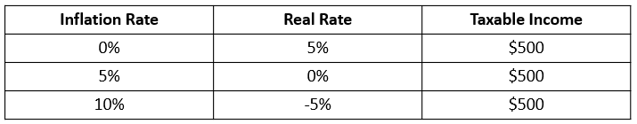
Real Interest Rate
If a person has money in a bank account that pays 4% interest, but inflation rises to 5%, the real rate of return for the money invested in that bank account is negative 1%. The real interest rate is the nominal interest rate minus the inflation rate.
nominal interest rate − inflation rate = real interest rate
Notes:
If a person has money in a bank account that pays 4% interest, but inflation rises to 5%, the real rate of return for the money invested in that bank account is negative 1%. The real interest rate is the nominal interest rate minus the inflation rate. nominal interest rate−inflation rate=real interest rate. The problem of an attractive nominal interest rate transforming into an ugly real interest rate can be worsened by taxes. The U.S. income tax is charged on the nominal interest received in dollar terms, without an adjustment for inflation. Thus, the government taxes a person who invests $10,000 and receives a 5% nominal rate of interest on the $500 received, whether the inflation rate is 0%, 5%, or 10%.

Slide 5

On Your Own₁
Suppose that a bank wants to receive a real interest rate of at least 5% on the loans it makes next year. If the bank research department forecasts inflation of 2% next year, what nominal interest rate should the bank charge?
Notes:
Suppose that a bank wants to receive a real interest rate of at least 5% on the loans it makes next year. If the bank research department forecasts inflation of 2% next year, what nominal interest rate should the bank charge?

Slide 6
On Your Own₂
Suppose that a bank wants to receive a real interest rate of at least 5% on the loans it makes next year. If the bank research department forecasts inflation of 2% next year, what nominal interest rate should the bank charge?
nominal interest rate − inflation rate = real interest rate
nominal interest rate = real interest rate + inflation rate
= 5% + 2%
= 7%
Notes:
Suppose that a bank wants to receive a real interest rate of at least 5% on the loans it makes next year. If the bank research department forecasts inflation of 2% next year, what nominal interest rate should the bank charge?
nominal interest rate - inflation rate = real interest rate
nominal interest rate = real interest rate + inflation rate
= 5% + 2%
= 7%

Slide 7
Unintended Redistribution of Purchasing Power₂
The unintended redistributions of buying power that inflation causes may have a broader effect on society.
When inflation causes a retiree to suffer and a borrower to benefit, it challenges the belief that these outcomes were deserved in some way.
One of the reasons the general public dislikes inflation is a sense that it makes economic rewards and penalties more arbitrary.
Inflation is often perceived as unfair or even dangerous.
Notes:
The unintended redistributions of buying power that inflation causes may have a broader effect on society. When inflation causes a retiree to suffer and a borrower to benefit, it challenges the belief that these outcomes were deserved in some way. One of the reasons the general public dislikes inflation is a sense that it makes economic rewards and penalties more arbitrary. Inflation is often perceived as unfair or even dangerous.

Slide 8
Blurred Price Signals₁
Prices are the messengers in a market economy, conveying information about conditions of demand and supply.
Inflation interferes with price signals, and if the interference is strong, it is hard to tell what is happening.
When the levels and changes of prices become uncertain, firms and individuals find it harder to react to economic signals.
Notes:
Prices are the messengers in a market economy, conveying information about conditions of demand and supply. Inflation interferes with price signals, and if the interference is strong, it is hard to tell what is happening. When the levels and changes of prices become uncertain, firms and individuals find it harder to react to economic signals.

Slide 9

Real World Example
In Israel, inflation accelerated to an annual rate of 500% in 1985. Some stores stopped posting prices directly on items because they would have had to change them every few days to reflect inflation. Instead, a shopper just took items from a shelf and went to the checkout register to find out the price that day.
Notes:
In Israel, inflation accelerated to an annual rate of 500% in 1985. Some stores stopped posting prices directly on items because they would have had to change them every few days to reflect inflation. Instead, a shopper just took items from a shelf and went to the checkout register to find out the price that day.

Slide 10
Blurred Price Signals₂
High and variable inflation makes markets adjust slower to equilibrium for two main reasons:
On the demand side, higher prices may be a signal to consumers that they should shop for lower-priced substitutes, whose prices may not have been affected by inflation yet.
On the supply side, producers might interpret higher prices as a signal to produce more of the good, especially if the inputs used to produce the good haven't been affected by inflation.
&
Notes:
High and variable inflation makes markets adjust slower to equilibrium for two main reasons:
On the demand side, higher prices may be a signal to consumers that they should shop for lower-priced substitutes, whose prices may not have been affected by inflation yet. On the supply side, producers might interpret higher prices as a signal to produce more of the good, especially if the inputs used to produce the good haven't been affected by inflation.

Slide 11
Difficulties in Long-Term Planning₁
Inflation can make long-term planning difficult, especially for the following groups:
People planning for retirement, especially if their pension is a fixed nominal payment each month
Firms that hold too much cash, which will lose purchasing power when inflation occurs
Firms that concentrate on trying to profit from inflation and not on increasing productivity and quality of their products
Notes:
Inflation can make long-term planning difficult, especially for the following groups:
People planning for retirement, especially if their pension is a fixed nominal payment each month
Firms that hold too much cash, which will lose purchasing power when inflation occurs
Firms that concentrate on trying to profit from inflation and not on increasing productivity and quality of their products

Slide 12
Difficulties in Long-Term Planning₂
Economists disagree about whether low rates of inflation reduce productivity.
Some evidence shows moderate inflation doesn’t prevent the economy from growing at a healthy pace.
In the early 1970s, however, when the U.S. inflation rate rose to 10% per year, production slowed until the inflation rate slowed in the 1980s.
Notes:
Economists disagree about whether low rates of inflation reduce productivity. Some evidence shows moderate inflation doesn’t prevent the economy from growing at a healthy pace. In the early 1970s, however, when the U.S. inflation rate rose to 10% per year, production slowed until the inflation rate slowed in the 1980s.

Slide 13
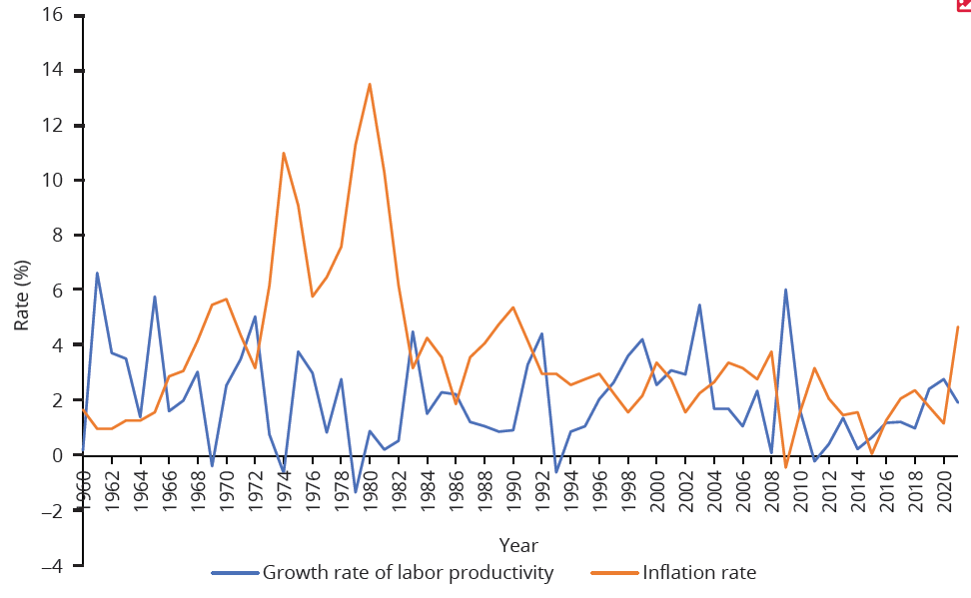
Difficulties in Long-Term Planning₃
Over the last several decades in the United States, there have been times when rising inflation rates have been closely followed by lower productivity rates and lower inflation rates have corresponded to increasing productivity rates. As the graph shows, however, this correlation does not always exist.
Notes:
Over the last several decades in the United States, there have been times when rising inflation rates have been closely followed by lower productivity rates and lower inflation rates have corresponded to increasing productivity rates. As the graph shows, however, this correlation does not always exist.

Slide 14
Any Benefits of Inflation?
The impact of inflation will differ considerably according to whether it is moving slowly, jogging along, or racing to the point of hyperinflation.
Hyperinflation can rip apart an economy and a society, but an annual inflation rate of 2% to 4% is a long way from a national crisis.
Economists sometimes argue that moderate inflation may help the economy by making wages in labor markets more flexible.
A little inflation could nibble away at real wages and thus help them decline if necessary.
Notes:
The impact of inflation will differ considerably according to whether it is moving slowly, jogging along, or racing to the point of hyperinflation. Hyperinflation can rip apart an economy and a society, but an annual inflation rate of 2 to 4% is a long way from a national crisis. Economists sometimes argue that moderate inflation may help the economy by making wages in labor markets more flexible. A little inflation could nibble away at real wages and thus help them decline if necessary.

Slide 15
Summary
Unexpected inflation will tend to hurt those who receive money, in terms of wages and interest payments, that does not rise with inflation.
Inflation can help those who owe money because they can pay in less valuable, inflated dollars.
Low rates of inflation have relatively little economic impact over the short term, while over the medium and long term, even low rates of inflation can complicate future planning.
High rates of inflation can muddle price signals in the short term, prevent market forces from operating efficiently, and vastly complicate long-term savings and investment decisions.

Slide 16




HAWKES LEARNING

