Slide 1
How to Measure Changes in the Cost of Living
HAWKES LEARNING

Slide 2
Consumer Price Index
The most commonly cited measure of inflation in the United States is the consumer price index (CPI).
CPI is based on the prices in a fixed basket of goods and services that represents the purchases of an average family of four.
Though CPI is an effective measure of inflation, it does have its drawbacks.
Notes:
The most commonly cited measure of inflation in the United States is the consumer price index (CPI). CPI is based on the prices in a fixed basket of goods and services that represents the purchases of an average family of four. Though CPI is an effective measure of inflation, it does has its drawbacks.

Slide 3
Consumer Price Index Drawbacks
The change in the total cost of buying a fixed basket of goods and services over time is not the same as the change in the cost of living.
Unless consumers buy the exact same basket of goods every year, the fixed basket of goods approach in CPI may be misleading.
Two main biases arise when using CPI: the substitution bias and the quality/new goods bias.
Notes:
The change in the total cost of buying a fixed basket of goods and services over time is not the same as the change in the cost of living. Unless consumers buy the exact same basket of goods every year, the fixed basket of goods approach in CPI may be misleading. Two main biases arise when using CPI: the substitution bias and the quality/new goods bias

Slide 4

On Your Own
Consider your basket of goods as a student. How would a basket of goods and services purchased by a typical college student differ from the basket purchased by an older, retired person? Why would the difference be important?
Notes:
Consider your basket of goods as a student. How would a basket of goods and services purchased by a typical college student differ from the basket purchased by an older, retired person? Why would the difference be important?

Slide 5
Biases
Substitution Bias
Quality/New Goods Bias
Consumers will substitute away from goods whose relative prices have risen.
If the price of apples rises, consumers will purchase a substitute, like bananas or oranges.
CPI does not reflect the quality gained from new products (e.g., cell phones).
CPI does not reflect quality improvements in products, only the subsequent increase in price (e.g., cereal).
&
Notes:
Substitution Bias: Consumers will substitute away from goods whose relative prices have risen. If the price of apples rises, consumers will purchase a substitute, like bananas or oranges.
Quality/New Goods Bias: CPI does not reflect the quality gained from new products (e.g., cell phones). CPI does not reflect quality improvements in products, only the subsequent increase in price (e.g., cereal).

Slide 6
Core Inflation Index
The core inflation index is CPI without the volatile economic variables.
The core inflation index is more appropriate to use in the aftermath of natural disasters, such as hurricanes.
The CPI in the aftermath of Hurricane Katrina would have inaccurately registered an increase in the cost of living to all households.
Notes:
The core inflation index is CPI without the volatile economic variables. The core inflation index is more appropriate to use in the aftermath of natural disasters, such as hurricanes. The CPI in the aftermath of Hurricane Katrina would have inaccurately registered an increase in the cost of living to all households.

Slide 7
Real World Example₁
Give an example of a situation where the change in an economic variable would affect the CPI but not the core inflation index.
Notes:
Give an example of a situation where the change in an economic variable would affect the CPI but not the core inflation index.

Slide 8
Real World Example₂
Give an example of a situation where the change in an economic variable would affect the CPI but not the core inflation index.
Any situation where changes in the prices of key components of the CPI are temporary would cause a change in the CPI but not the core inflation index. If a sudden snowstorm closed highways for several days, truckers would not be able to deliver fresh fruits and vegetables to grocery stores. The prices of fresh fruits and vegetables would increase temporarily until shipping resumed. The CPI would reflect the temporary price increase, but the core inflation index would not.
Notes:
Give an example of a situation where the change in an economic variable would affect the CPI but not the core inflation index.
Any situation where changes in the prices of key components of the CPI are temporary would cause a change in the CPI but not the core inflation index. If a sudden snowstorm closed highways for several days, truckers would not be able to deliver fresh fruits and vegetables to grocery stores. The prices of fresh fruits and vegetables would increase temporarily until shipping resumed. The CPI would reflect the temporary price increase, but the core inflation index would not.

Slide 9
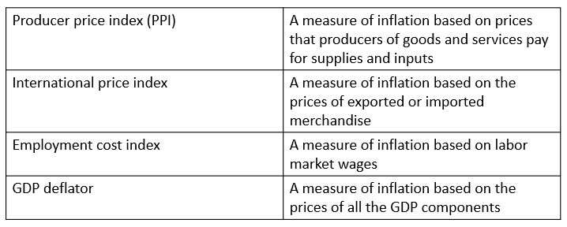
Other Economic Indices

Slide 10
Summary
The substitution bias: when a fixed basket of goods does not allow for buying more of what becomes relatively less expensive and less of what becomes relatively more expensive
The quality/new goods bias: when a fixed basket cannot account for improvements in quality and the advent of new goods
The most commonly cited measure of inflation is the consumer price index (CPI), which is based on a basket of goods representing what the typical consumer buys.

Slide 11




HAWKES LEARNING

