Slide 1
Tracking Inflation
HAWKES LEARNING

Slide 2
Introduction
This chapter begins by showing how to combine prices of individual goods and services to create a measure of overall inflation.
It discusses the historical and recent experience of inflation, both in the United States and in other countries around the world.
Inflation has consequences for people and firms in their roles as lenders and borrowers, wage earners, taxpayers, and consumers.
Notes:
This chapter begins by showing how to combine prices of individual goods and services to create a measure of overall inflation. It discusses the historical and recent experience of inflation, both in the United States and in other countries around the world. Inflation has consequences for people and firms in their roles as lenders and borrowers, wage earners, taxpayers, and consumers.

Slide 3
Inflation₁
The primary reason for price level increases over time is inflation.
The power of inflation does not only affect goods and services but also wages and income levels.
To determine inflation, economists combine a variety of prices into a single price level.
The inflation rate is simply the percentage change in the price level; applying the concept, however, involves some practical difficulties.
Notes:
The primary reason for price level increases over time is inflation. The power of inflation does not only affect goods and services but also wages and income levels. To determine inflation, economists combine a variety of prices into a single price level. The inflation rate is simply the percentage change in the price level. Applying the concept, however, involves some practical difficulties.

Slide 4
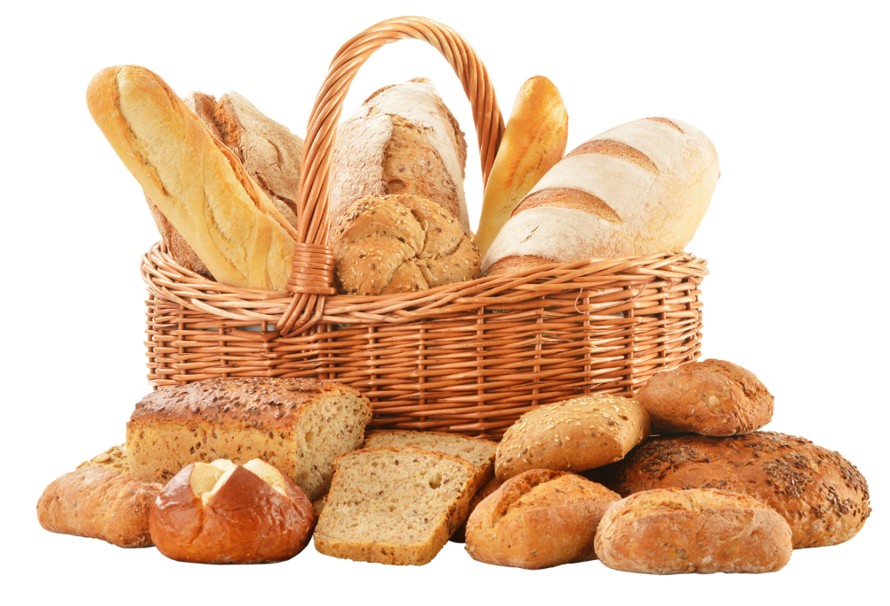
Inflation₂
Hyperinflation is an extreme form of inflation. This occurred in Zimbabwe between 2008 and 2009. In November 2008, Zimbabwe had an inflation rate of 79.6 billion percent. In contrast, in 2014, the United States had an average annual rate of inflation of 1.6%. At one point, a loaf of bread cost 550 million Zimbabwean dollars.
Notes:
Hyperinflation is an extreme form of inflation. This occurred in Zimbabwe between 2008 and 2009. In November 2008, Zimbabwe had an inflation rate of 79.6 billion percent. In contrast, in 2014, the United States had an average annual rate of inflation of 1.6%. At one point, a loaf of bread cost 550 million Zimbabwean dollars.

Slide 5
The Price of a Basket of Goods
To calculate the price level in the economy, economists begin with the concept of a basket of goods and services.
A basket of goods and services consists of the different items that individuals, businesses, or organizations typically buy.
The next step is to look at how the prices of those items change over time.
Changes in the prices of goods on which people spend a larger share of their incomes will matter more than changes in the prices of goods on which people spend a smaller share of their incomes.
Notes:
To calculate the price level in the economy, economists begin with the concept of a basket of goods and services. A basket of goods and services consists of the different items that individuals, businesses, or organizations typically buy. The next step is to look at how the prices of those items change over time. Changes in the prices of goods on which people spend a larger share of their incomes will matter more than changes in the prices of goods on which people spend a smaller share of their incomes.

Slide 6

Index Numbers₁
Keeping calculations in dollar amounts can get messy, so economists use index numbers.
An index number is a unit-free number rather than a dollar amount.
Economists arbitrarily choose one year to be the “base year.”
The base year, by definition, has an index number equal to 100.
Notes:
Keeping calculations in dollar amounts can get messy, so economists use index numbers.
Index number = a unit-free number, used instead of a dollar amount
How to convert dollar amounts to index numbers:
Economists arbitrarily choose one year to be the “base year”
Index number = total spending in a year/total spending in base year * 100

Slide 7
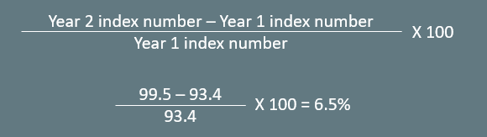
Index Numbers₂
Index numbers can be used to calculate inflation. Given that the index number is 99.5 in Year 2 and 93.4 in Year 1, the inflation rate from Year 1 to Year 2 would be calculated as follows:

Slide 8

On Your Own₁
If the index number is 114 this year and 120 next year, find the rate of inflation.

Slide 9
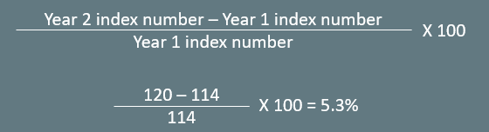
On Your Own₂
If the index number is 114 this year and 120 next year, find the rate of inflation.

Slide 10
Why Use Index Numbers?
If you glance at two index numbers like 107 and 110, you know that the rate of inflation between the two years is about 3%.
Most people find it difficult to glance at numbers like $19,493.62 and $20,040.17 and know they represent a change of about 3%.
Index numbers are much easier to interpret than nominal values.
Any base year that we choose for the index numbers will result in the same inflation rate.
Notes:
If you glance at two index numbers like 107 and 110, you know that the rate of inflation between the two years is about 3%. Most people find it difficult to glance at numbers like $19,493.62 and $20,040.17 and know they represent a change of about 3%. Index numbers are much easier to interpret than nominal values. Any base year that we choose for the index numbers will result in the same inflation rate.

Slide 11
Summary
Economists measure the price level by using a basket of goods and services and calculating how the total cost of buying that basket of goods will increase over time.
Economists often express the price level in terms of index numbers, which transform the cost of buying the basket of goods and services into a series of numbers in the same proportion to each other but with an arbitrary base year of 100.
We measure the inflation rate as the percentage change between price levels or index numbers over time.

Slide 12




HAWKES LEARNING

