Slide 1
What Causes Changes in Unemployment over the Long Run
HAWKES LEARNING

Slide 2
Introduction
Cyclical unemployment explains why unemployment rises during a recession and falls during an economic expansion, but what explains the level of unemployment that remains even in good economic times?
Why is the unemployment rate never zero?
Why does some level of unemployment persist even when economies are growing strongly?
Why are unemployment rates continually higher in certain economies, through good economic years and bad?
Notes:
Cyclical unemployment explains why unemployment rises during a recession and falls during an economic expansion, but what explains the level of unemployment that remains even in good economic times? Why is the unemployment rate never zero? Why does some level of unemployment persist even when economies are growing strongly? Why are unemployment rates continually higher in certain economies, through good economic years and bad?

Slide 3
Natural Rate of Unemployment
The remaining level of unemployment that occurs even when the economy is healthy is called the natural rate of unemployment.
The natural rate of unemployment is not "natural" in the sense that it is a physical or unchanging law of nature.
It results from a combination of economic, social, and political factors, assuming the economy is neither booming nor in a recession.
The natural rate of unemployment is caused by several factors: frictional unemployment, structural unemployment, and public policy.
Notes:
The remaining level of unemployment that occurs even when the economy is healthy is called the natural rate of unemployment. The natural rate of unemployment is not "natural" in the sense that it is a physical or unchanging law of nature. Results from a combination of economic, social, and political factors, assuming the economy is neither booming nor in a recession. The natural rate of unemployment is caused by several factors: frictional unemployment, structural unemployment, and public policy.

Slide 4
Frictional Unemployment₁
It takes time to discover new jobs, interview and determine if the new job is a good match, and relocate to be in the proximity of the new job.
Economists call the unemployment that occurs in the meantime, as workers move between jobs, frictional unemployment.
Frictional unemployment is not inherently a bad thing.
People must find the job for which they are best suited, not just take the first one offered.
Notes:
It takes time to discover new jobs, interview and determine if the new job is a good match, and relocate to be in the proximity of the new job. Economists call the unemployment that occurs in the meantime, as workers move between jobs, frictional unemployment. Frictional unemployment is not inherently a bad thing. People must find the job for which they are best suited, not just take the first one offered.

Slide 5
Frictional Unemployment₂
Depends on ease of communication about job prospects, willingness of people to relocate, and demographics of the labor force
Ease of communication: level of frictional unemployment will depend on how easy it is for workers to learn about alternative jobs
Willingness to relocate: how willing people are to move to new areas to find jobs, which in turn may depend on history and culture
Demographics: workers under 25 try out new options often and have higher frictional unemployment; workers aged 25 to 54 want a steadier job and income
Notes:
Depends on ease of communication about job prospects, willingness of people to relocate, and demographics of the labor force
Ease of communication: level of frictional unemployment will depend on how easy it is for workers to learn about alternative jobs
Willingness to relocate: how willing people are to move to new areas to find jobs, which in turn may depend on history and culture
Demographics: workers under 25 try out new options often and have higher frictional unemployment; workers aged 25 to 54 want a steadier job and income

Slide 6
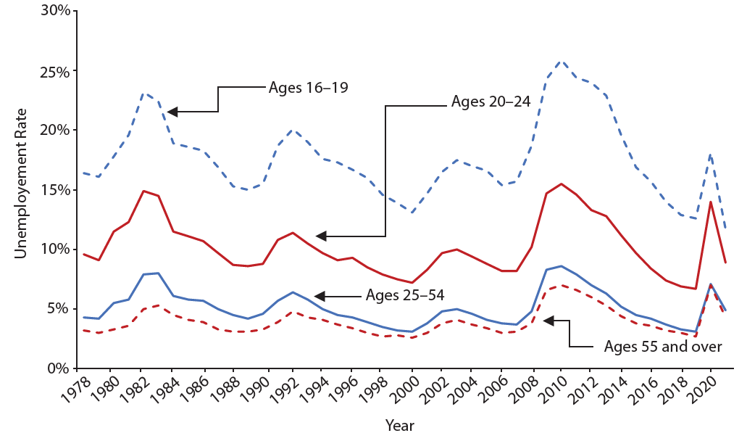
Unemployment by Age
Unemployment rates are highest for the very young and become lower with age.
Notes:
Unemployment rates are highest for the very young and become lower with age.

Slide 7
Structural Unemployment
Another factor that influences the natural rate of unemployment is the amount of structural unemployment.
The structurally unemployed don't have jobs because they lack skills valued by the labor market.
Some people worry that technology causes structural unemployment.
In the past, new technology has put low-skilled employees out of work, but at the same time, it creates demand for high-skilled workers.
Notes:
Another factor that influences the natural rate of unemployment is the amount of structural unemployment. The structurally unemployed don't have jobs because they lack skills valued by the labor market. Some people worry that technology causes structural unemployment. In the past, new technology has put low-skilled employees out of work, at the same time, it creates demand for high-skilled workers.

Slide 8
On Your Own₁
Determine whether the following situations are examples of frictional or structural unemployment.
Fatima, who is a certified public accountant (CPA), left her old job as an accountant for a large company when her family moved to a large city in another state. She is currently interviewing with several companies for an accounting position.
Frictional unemployment
Structural unemployment
Jason lost his job at an automobile manufacturing plant when the company installed robots to replace workers on the assembly line. All of the company’s competitors have also replaced workers with robots.
Frictional unemployment
Structural unemployment

Slide 9
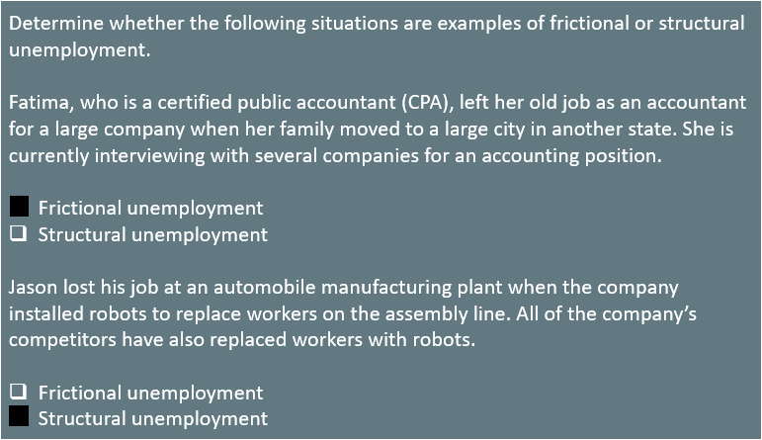
On Your Own₂

Slide 10
Natural Unemployment and Potential Real GDP₁
The natural unemployment rate is related to two other concepts:
Full Employment
Potential Real GDP
Operating above potential GDP is only possible for a short time.
Notes:
The natural unemployment rate is related to two other important concepts:
Full employment
Potential real gross domestic product (GDP)
Operating above potential GDP is only possible for a short time since it is analogous to all workers working overtime.

Slide 11
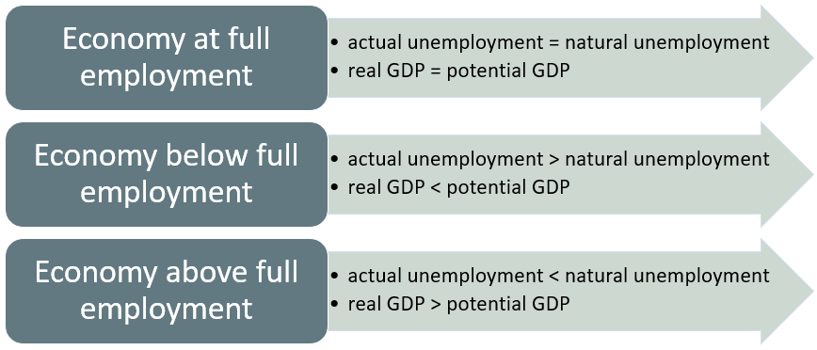
Natural Unemployment and Potential Real GDP₂
Notes:
The natural unemployment rate is related to two other important concepts:
Full employment
Potential real gross domestic product (GDP)
Operating above potential GDP is only possible for a short time since it is analogous to all workers working overtime.

Slide 12
Productivity Shifts and the Natural Rate of Unemployment₁
Over time, productivity determines the level of wages in an economy.
Adjustments of wages to productivity levels don’t happen quickly or smoothly.
If productivity unexpectedly changes, it can affect the natural rate of unemployment.
When productivity is unexpectedly lower, levels of unemployment tend to be higher.
When productivity is unexpectedly higher, levels of unemployment tend to be lower.
Over time, wages adjust to reflect productivity levels.
Notes:
Over time, productivity determines level of wages in an economy. Adjustments of wages to productivity levels don’t happen quickly or smoothly. If productivity unexpectedly changes, it can affect the natural rate of unemployment. When productivity is unexpectedly lower, levels of unemployment tend to be higher. When productivity is unexpectedly higher, levels of unemployment tend to be lower. Over time, wages adjust to reflect productivity levels.

Slide 13
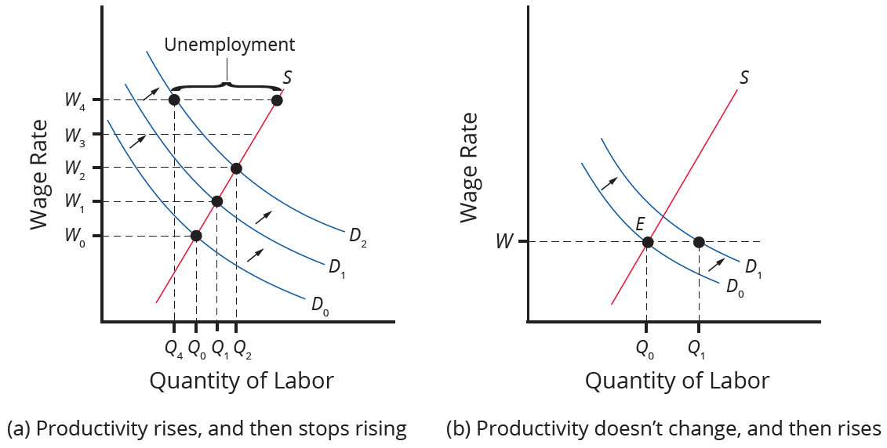
Productivity Shifts and the Natural Rate of Unemployment₂
Productivity rises, which increases the demand for labor. Employers and workers become used to the pattern of wage increases. Then, productivity suddenly stops increasing. However, the expectations of employers and workers for wage increases do not shift immediately, so wages keep rising as before. However, the demand for labor has not increased, so at wage W₄, unemployment exists where the quantity supplied of labor exceeds the quantity demanded.
Notes:
Productivity rises, which increases the demand for labor. Employers and workers become used to the pattern of wage increases. Then, productivity suddenly stops increasing. However, the expectations of employers and workers for wage increases do not shift immediately, so wages keep rising as before.

Slide 14
Productivity Shifts and the Natural Rate of Unemployment₃
The rate of productivity increase has been zero for a time, so employers and workers have come to accept the equilibrium wage level (W). Then, productivity increases unexpectedly, shifting demand for labor from D ₀ to D ₁. At wage W, this means that the quantity demanded of labor exceeds the quantity supplied, and with job offers plentiful, the unemployment rate will be low.
Notes:
Productivity rises, which increases the demand for labor. Employers and workers become used to the pattern of wage increases. Then, productivity suddenly stops increasing. However, the expectations of employers and workers for wage increases do not shift immediately, so wages keep rising as before.

Slide 15
Public Policy and the Natural Rate of Unemployment
Supply-side public policies to assist the unemployed can affect how eager people are to find work.
Demand-side policies, like government rules and unions, can affect willingness to hire workers.
Examples:
If bureaucratic rules make it hard to start a business or expand, businesses will be discouraged from hiring.
If government rules make it difficult to fire/lay off workers, businesses may not hire more than necessary.
Mandated high minimum wages may discourage businesses from hiring low-skilled workers.
Government rules that support unions, which could push wages up, could discourage businesses from hiring those workers.

Slide 16
The Natural Rate of Unemployment in Recent Years
The underlying economic, social, and political factors that determine the natural rate of unemployment can change over time.
For example, the internet, the growth of the temporary worker industry, and the aging of the baby boomer generation have all affected the natural rate of unemployment.
The growth of the temporary worker industry has probably also helped reduce the natural rate of unemployment.
The natural rate of unemployment was, on average, lower in the 1990s and the early 2000s than in the 1980s.
Notes:
The underlying economic, social, and political factors that determine the natural rate of unemployment can change over time. For example, the internet, the growth of the temporary worker industry, and the aging of the baby boomer generation in the 1990s. The growth of the temporary worker industry has probably also helped reduce the natural rate of unemployment. The natural rate of unemployment was, on average, lower in the 1990s and the early 2000s than in the 1980s.

Slide 17
The Natural Rate of Unemployment in Europe
By the standards of other high-income economies, the natural rate of unemployment in the U.S. economy appears relatively low.
Many European economies have had unemployment rates hovering near 10%, or even higher, since the 1970s.
Many European countries have generous welfare and unemployment benefits that impose additional costs on firms when they hire workers.
When companies know that it will be difficult to fire or lay off workers, they also become hesitant about hiring in the first place.
Notes:
By the standards of other high-income economies, the natural rate of unemployment in the U.S. economy appears relatively low. Many European economies have had unemployment rates hovering near 10%, or even higher, since the 1970s. Many European countries have generous welfare and unemployment benefits that impose additional costs on firms when they hire workers. When companies know that it will be difficult to fire or lay off workers, they also become hesitant about hiring in the first place.

Slide 18
Preview of Policies to Fight Unemployment
When a government enacts policies, it must examine the effects on the information and incentives that employees or employers receive.
Governments can rethink the design of unemployment assistance programs and protections so they will not unduly discourage the supply of labor.
Governments can reassess rules for businesses starting up or expanding to not unduly discourage the demand for labor.
Governments should not repeal all laws affecting labor markets, but tradeoffs should be considered when enacting such laws.
Notes:
When a government enacts policies, it must examine the effects on the information and incentives that employees or employers receive. Government can rethink design of unemployment assistance programs and protections to not unduly discourage supply of labor. Government can reassess rules for businesses starting up or expanding to not unduly discourage demand for labor. Governments should not repeal all laws affecting labor markets, but tradeoffs should be considered when enacting such laws.

Slide 19

Real World Example
Have you or someone you know experienced unemployment due to one of the reasons identified in this lesson? If so, describe what happened. If not, come up with a likely scenario in which you feel unemployment is justified and another one in which you feel it is unfair to the employee.

Slide 20
Summary
The natural rate of unemployment is the rate of unemployment that the economic, social, and political forces in the economy would cause even when the economy is not in a recession.
These factors include the frictional unemployment that occurs when people choose to change jobs or are put out of work for a time by the shifts of a dynamic and changing economy.
They also include any laws concerning conditions of hiring and firing that have the undesired side effect of discouraging job formation.
They also include structural unemployment, which occurs when demand shifts permanently away from a certain type of job skill.

Slide 21




HAWKES LEARNING

