Slide 1
Economic Convergence
HAWKES LEARNING

Slide 2
Introduction
Convergence is the pattern in which economies with low per capita incomes grow faster than economies with high per capita incomes.
From 2010 to 2019, gross domestic product (GDP) increased by an average rate of 2% per year in the high-income countries of the world.
Economic growth in some lower-income countries has exceeded the average of the world's high-income economies, so these countries may eventually converge with the high-income countries.
Notes:
Convergence is the pattern in which economies with low per capita incomes grow faster than economies with high per capita incomes. From 2010 to 2019, gross domestic product (GDP) increased by an average rate of 2% per year in the high-income countries of the world. Economic growth in some lower-income countries has exceeded the average of the world's high-income economies, so these countries may eventually converge with the high-income countries.

Slide 3
Arguments Favoring Convergence
Arguments suggest that low-income countries might have an advantage in achieving greater productivity and economic growth in the future.
Diminishing marginal returns: marginal gains from increasing human and physical capital will decrease as the stock of capital increases.
"The advantages of backwardness": relatively old technologies benefit low-income countries compared to high-income countries, who must invent new technologies to receive a benefit.
Benefits of a higher standard of living through growth: when people in low-income countries begin to enjoy better living standards through growth, they are more likely to build and support market-friendly institutions that foster further growth.
Notes:
Arguments suggest that low-income countries might have an advantage in achieving greater productivity and economic growth in the future. Diminishing marginal returns: marginal gains from increasing human and physical capital will decrease as the stock of capital increases. "The advantages of backwardness": relatively old technologies benefit low-income countries compared to high-income countries, who must invent new technologies to receive a benefit. Benefits of a higher standard of living through growth: when people in low-income countries begin to enjoy better living standards through growth, they are more likely to build and support market-friendly institutions that foster further growth.

Slide 4
Arguments That Convergence Is Neither Inevitable nor Likely
Technology may not be subject to diminishing returns.
It may not be easier for low-income countries to adapt existing technology than it is for high-income countries to invent new technology.
If an economy's growth depended only on the deepening of human capital and physical capital, we would expect that economy's growth rate to slow down over the long run because of diminishing marginal returns.
Notes:
Technology may not be subject to diminishing returns. It may not be easier for low-income countries to adapt existing technology than it is for high-income countries to invent new technology.

Slide 5
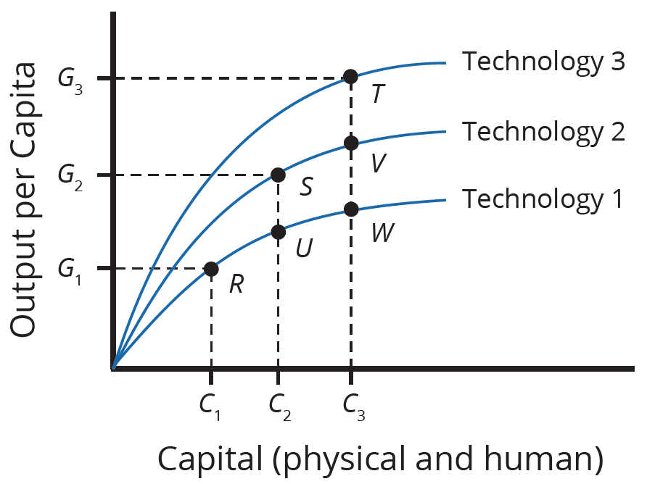
Production Function
Developing new technology can provide a way for an economy to sidestep the diminishing marginal returns of capital deepening.
Along the Technology 1 production function, if capital increases from C₁ to C₂ to C₃, the economy moves from R to U to W.
Output increases, but by smaller and smaller amounts, which demonstrates diminishing returns.
With better technology (Technology 2), a higher level of output is possible at each level of capital.
If technology and capital increase at the same time, it is possible to avoid diminishing returns, shown by increases in output from R to S to T.
Notes:
Developing new technology can provide a way for an economy to sidestep the diminishing marginal returns of capital deepening. Along the Technology 1 production function, if capital increases from C1 to C2 to C3, the economy moves from R to U to W. Output increases, but by smaller and smaller amounts, which demonstrates diminishing returns. With better technology (Technology 2), a higher level of output is possible at each level of capital. If technology and capital increase at the same time, it is possible to avoid diminishing returns, shown by increases in output from R to S to T.

Slide 6
The Slowness of Convergence₁
Although economic convergence between high-income countries and the rest of the world seems possible and likely, it will proceed slowly.
The slowness of convergence illustrates that small differences in annual rates of economic growth become huge differences over time.
Even in an optimistic scenario, it will take decades for the low-income countries of the world to catch up significantly.
Notes:
Although economic convergence between high-income countries and the rest of the world seems possible and likely, it will proceed slowly. The slowness of convergence illustrates that small differences in annual rates of economic growth become huge differences over time. Even in an optimistic scenario, it will take decades for the low-income countries of the world to catch up significantly.

Slide 7

The Slowness of Convergence₂
Consider, for example, a country that starts off with a GDP per capita of $40,000, which would roughly represent a typical high-income country today, and another country that starts out at $4,000, which is roughly the level in low-income but not impoverished countries like Indonesia, Guatemala, or Egypt. Say that the rich country chugs along at a 2% annual growth rate of GDP per capita, while the poorer country grows at the aggressive rate of 7% per year. These are the results after thirty years:
Notes:
Consider, for example, a country that starts off with a GDP per capita of $40,000, which would roughly represent a typical high-income country today, and another country that starts out at $4,000, which is roughly the level in low-income but not impoverished countries like Indonesia, Guatemala, or Egypt.
GDP per capita in the rich country = $40,000(1+0.02)30 = $72,455
GDP per capita in the poor country = $4,000(1+0.07)30 = $30,449

Slide 8

On Your Own₁
Suppose that Trevor and Lucia each find a $100 bill on the sidewalk as they are walking into work. Trevor’s income is $20,000 per year, and Lucia’s income is $200,000 per year. How much does each person benefit from finding the $100? How is this an example of the diminishing returns that occur in human and physical capital?
Notes:
Suppose that Trevor and Lucia each find a $100 bill on the sidewalk as they are walking into work. Trevor’s income is $20,000 per year, and Lucia’s income is $200,000 per year. How much does each person benefit from finding the $100? How is this an example of the diminishing returns that occur in human and physical capital?

Slide 9
On Your Own₂
Suppose that Trevor and Lucia each find a $100 bill on the sidewalk as they are walking into work. Trevor’s income is $20,000 per year, and Lucia’s income is $200,000 per year. How much does each person benefit from finding the $100? How is this an example of the diminishing returns that occur in human and physical capital?
Since Trevor’s income is ten times less than Lucia’s, the marginal benefit of $100 is greater for Trevor than for Lucia. In the same way, a high-income country with a large stock of human and physical capital will receive a smaller benefit from a $1 million investment in capital than a low-income country starting with a relatively small stock of capital.
Notes:
Suppose that Trevor and Lucia each find a $100 bill on the sidewalk as they are walking into work. Trevor’s income is $20,000 per year, and Lucia’s income is $200,000 per year. How much does each person benefit from finding the $100? How is this an example of the diminishing returns that occur in human and physical capital?
Since Trevor’s income is ten times less than Lucia’s, the marginal benefit of $100 is greater for Trevor than for Lucia. In the same way, a high-income country with a large stock of human and physical capital will receive a smaller benefit from a $1 million investment in capital than a low-income country starting with a relatively small stock of capital.

Slide 10
Summary
Convergence is the process of countries with lower GDP levels per capita catching up to countries with higher GDP levels per capita.
Convergence can occur even when high- and low-income countries increase investment in physical and human capital with the objective of growing GDP.
In higher-income countries, a level of investment equal to that of the low-income country is not likely to have as big an effect because the more developed country most likely already has high levels of capital investment.
Higher-income countries are more likely to have diminishing returns to their investments and must continually invent new technologies.
Continuous technological innovation can counterbalance diminishing returns to investments in human and physical capital.

Slide 11




HAWKES LEARNING

