Slide 1
Components of
Economic Growth
HAWKES LEARNING

Slide 2

Introduction
Small differences of a few percentage points in the annual rate of economic growth make an enormous difference in GDP per capita.
In this lesson, we discuss some of the components of economic growth, including physical capital, human capital, and technology.
Notes:
Small differences of a few percentage points in the annual rate of economic growth make an enormous difference in GDP per capita. In this lesson, we discuss some of the components of economic growth, including physical capital, human capital, and technology.

Slide 3
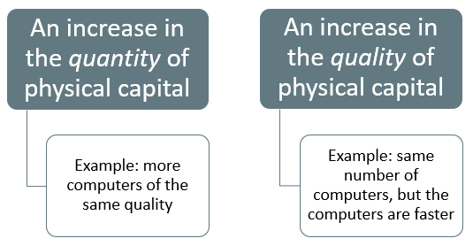
Physical Capital
Physical capital includes the factories and equipment that firms use, as well as things like roads (also called infrastructure).
More physical capital implies more output.
Notes:
Physical capital includes the factories and equipment that firms use, as well as things like roads (also called infrastructure). More physical capital implies more output.

Slide 4
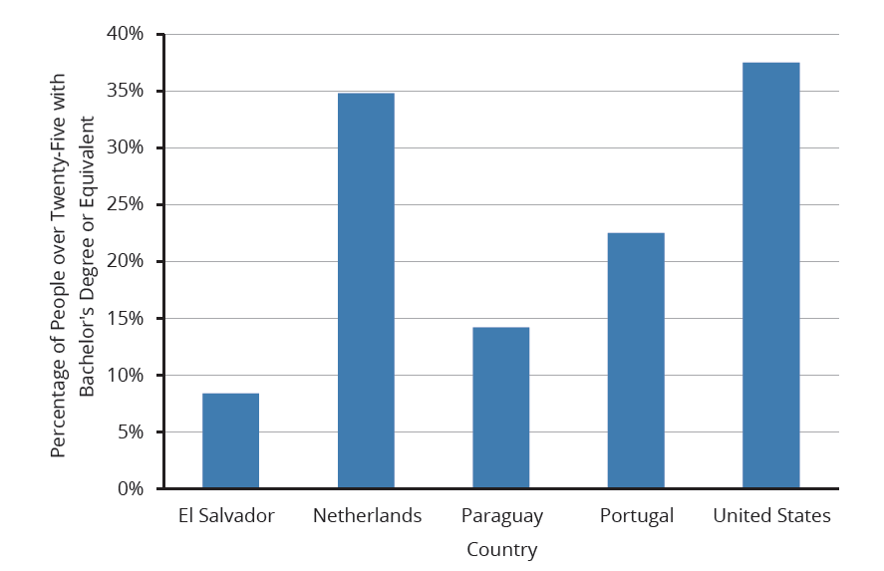
Human Capital
Human capital refers to the skills and knowledge that make workers productive.
Human capital and physical capital accumulation are similar: in both cases, investment now pays off in higher productivity in the future.
Notes:
Human capital refers to the skills and knowledge that make workers productive. Human capital and physical capital accumulation are similar: in both cases, investment now pays off in higher productivity in the future. An example of investing in human capital is investing in education. This chart compares the percentage of the populations in El Salvador, the Netherlands, Paraguay, Portugal, and the United States in 2020 that is above the age of twenty-five and has a bachelor's degree or equivalent.

Slide 5
Technology
Technology is the combination of invention and innovation.
When most people think of new technology, the invention of products like the laser or the smartphone come to mind.
Technology, as economists use the term, however, includes still more.
In short, technology comprises all the advances that make existing machines produce more and at higher quality, as well as altogether new products.
Notes:
Technology is the combination of invention and innovation. When most people think of new technology, the invention of products like the laser or the smartphone. Technology, as economists use the term, however, includes still more. In short, technology comprises all the advances that make existing machines produce more and at higher quality, and new products.

Slide 6
GDP per Capita₁
GDP per capita is useful to understanding economic growth and standard of living.
GDP per capita makes it easier to compare countries with different population sizes.
Notes:
GDP per capita is useful to understanding economic growth and standard of living. GDP per capita makes it easier to compare countries with different population sizes.

Slide 7
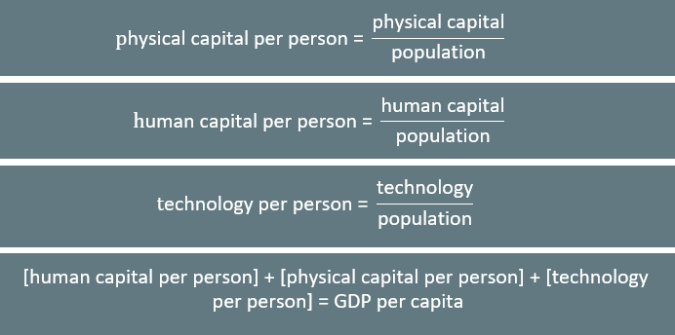
GDP per Capita₂
Notes:
$$\text{Physical} \text{capital} \text{per} \text{person}\text{ = }\frac{\text{physical} \text{capital}}{\text{population}}$$
$$\text{Human} \text{capital} \text{per} \text{person}\text{ = }\frac{\text{human} \text{capital}}{\text{population}}$$
$$\text{Technology} \text{per} \text{person}\text{ = }\frac{\text{technology}}{\text{population}}$$
$$\text{[}\text{human} \text{capital} \text{per} \text{person}\text{]+[}\text{physical} \text{capital} \text{per} \text{person}\text{]+[}\text{technology} \text{per} \text{person}\text{]=}\text{GDP} \text{per} \text{capita}$$

Slide 8

On Your Own₁
If the U.S. government provided free college for all students who qualified, how would this affect GDP and the standard of living?
Notes:
If the U.S. government provided free college for all students who qualified, how would this affect GDP and the standard of living?

Slide 9
On Your Own₂
If the U.S. government provided free college for all students who qualified, how would this affect GDP and the standard of living?
If the government provided free college for all qualifying students, this would increase human capital and likely increase GDP per capita, leading to a higher standard of living in the U.S.
Notes:
If the U.S. government provided free college for all students who qualified, how would this affect GDP and the standard of living?
If the government provided free college for all qualifying students, this would increase human capital and likely increase GDP per capita, leading to a higher standard of living in the U.S.

Slide 10
Capital Deepening₁
Capital deepening is when society increases the level of capital per person.
The idea of capital deepening can apply both to additional human capital per worker and to additional physical capital per worker.
The idea of human capital deepening also applies to the years of experience that workers have.
The average experience level of U.S. workers has not changed much in recent decades.
Notes:
Capital deepening is when society increases the level of capital per person. The idea of capital deepening can apply both to additional human capital per worker and to additional physical capital per worker. The idea of human capital deepening also applies to the years of experience that workers have. The average experience level of U.S. workers has not changed much in recent decades.

Slide 11
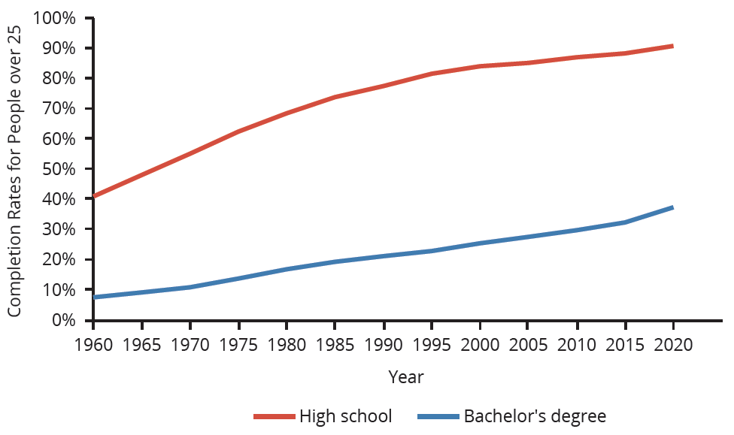
Capital Deepening₂
Rising levels of education for persons twenty-five and older show the deepening of human capital in the U.S. economy. As of 2020, 38% of U.S. adults have completed a four-year college degree. There is clearly room for additional deepening of human capital to occur.
Notes:
Rising levels of education for persons twenty-five and older show the deepening of human capital in the U.S. economy. As of 2020, 38% of U.S. adults have completed a four-year college degree. There is clearly room for additional deepening of human capital to occur.

Slide 12
Growth Accounting
Growth accounting studies determine the extent to which physical and human capital deepening and technology have contributed to growth.
The usual approach uses an aggregate production function to estimate how human and physical capital contribute to per capita growth.
The part of growth that is unexplained by measured inputs, called the residual, is then attributed to growth in technology.
Notes:
Growth accounting studies determine the extent to which physical and human capital deepening and technology have contributed to growth. The usual approach uses an aggregate production function to estimate how human and physical capital contribute to per capita growth. The part of growth that is unexplained by measured inputs, called the residual, is then attributed to growth in technology.

Slide 13
A Healthy Climate for Economic Growth
Both the type of market economy and a legal system that governs and sustains property and contractual rights are important contributors to a healthy economic climate.
A healthy economic climate usually involves market orientation at the microeconomic, individual, or firm decision-making level.
Markets that allow personal and business rewards and incentives for increasing human and physical capital encourage economic growth.
The government's role is to correct when markets fail to properly allocate capital or technology.
Notes:
The type of market economy and legal system that governs property and contractual rights are important to a healthy economic climate. A healthy economic climate usually involves market orientation at the microeconomic, individual, or firm decision-making level. Markets that allow personal and business rewards and incentives for increasing human and physical capital encourage economic growth. The government's role is to correct when markets fail to properly allocate capital or technology.

Slide 14
Summary
Over long periods of time, seemingly small differences of a few percentage points in the annual rate of economic growth make an enormous difference in GDP per capita.
Capital deepening refers to an increase in the amount of capital per worker, either human capital per worker (in the form of higher education or skills) or physical capital per worker.
Technology, in its economic meaning, refers broadly to all new methods of production, which include major scientific inventions but also small inventions and even better forms of management or other types of institutions.
A healthy climate for growth in GDP per capita consists of improvements in human capital, physical capital, and technology in a market-oriented environment with supportive public policies and institutions.

Slide 15




HAWKES LEARNING

