Slide 1
Labor Productivity and Economic Growth
HAWKES LEARNING

Slide 2
Introduction
Sustained, long-term economic growth comes from increases in worker productivity, which essentially means how well we do things.
Labor productivity is the value that each employed person creates per unit of his or her input.
More productivity essentially means you can do more in the same amount of time.
Notes:
Sustained, long-term economic growth comes from increases in worker productivity, which essentially means how well we do things. Labor productivity is the value that each employed person creates per unit of his or her input. More productivity essentially means you can do more in the same amount of time.

Slide 3
Labor Productivity
The first determinant of labor productivity is human capital.
The higher the average level of education in an economy, the higher the accumulated human capital and the higher the labor productivity.
The second factor that determines labor productivity is technological change.
Technological change is a combination of invention—advances in knowledge—and innovation—putting those advances to use.
The third factor that determines labor productivity is economies of scale, which are cost advantages that industries obtain due to size.
Notes:
The first determinant of labor productivity is human capital. The higher the average level of education in an economy, the higher the accumulated human capital and the higher the labor productivity. The second factor that determines labor productivity is technological change. Technological change is a combination of invention—advances in knowledge—and innovation—putting those advances to use. The third factor that determines labor productivity is economies of scale, which are cost advantages that industries obtain due to size.

Slide 4
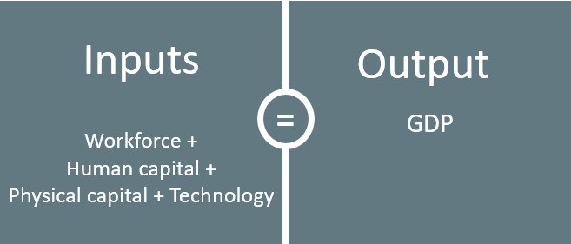
Aggregate Production Function
In macroeconomics, the connection between inputs and outputs for the entire economy is called an aggregate production function.
Notes:
In macroeconomics, the connection between inputs and outputs for the entire economy is called an aggregate production function.

Slide 5
Measuring Productivity
An economy's rate of productivity growth is closely linked to the growth rate of its GDP per capita, although the two are not identical.
If the percentage of the population with jobs in an economy increases, GDP per capita will increase, but productivity may not be affected.
Over the long term, the only way that GDP per capita can grow continually is if the productivity of the average worker rises.
A common measure of U.S. productivity per worker is the dollar value per hour that the worker contributes to the employer's output.
Notes:
An economy's rate of productivity growth is closely linked to the growth rate of its GDP per capita, although the two are not identical. If the percentage of the population with jobs in an economy increases, GDP per capita will increase, but productivity may not be affected. Over the long term, the only way that GDP per capita can grow continually is if the productivity of the average worker rises. A common measure of U.S. productivity per worker is the dollar value per hour that the worker contributes to the employer's output.

Slide 6
The "New Economy" Controversy
A controversy has been brewing among economists about the resurgence of U.S. productivity in the second half of the 1990s.
One school of thought argues that the U.S. had developed a "new economy" based on the technological advancements of the 1990s.
The most optimistic proponents argue that it would generate higher average productivity growth for decades to come.
The pessimists argue that even several years of stronger productivity growth does not prove higher productivity will last for the long term.
Notes:
A controversy has been brewing among economists about the resurgence of U.S. productivity in the second half of the 1990s. One school of thought argues that the U.S. had developed a "new economy“ based on the technological advancements of the 1990s. The most optimistic proponents argue that it would generate higher average productivity growth for decades to come. The pessimists argue that even several years of stronger productivity growth does not prove higher productivity will last for the long term.

Slide 7
The Power of Sustained Economic Growth
Even small changes in the rate of growth, when compounded over long periods of time, make an enormous difference in the standard of living.
An economy that starts with a GDP per capita of 100 and grows at 3% per year will reach a GDP per capita of 209 after twenty-five years.
Notes:
Even small changes in the rate of growth, when compounded over long periods of time, make an enormous difference in the standard of living. Future GDP per capita =
Current GDP per capita × (1+growth rate of GDP per capita) ^{years}. An economy that starts with a GDP per capita of 100 and grows at 3% per year will reach a GDP per capita of 209 after twenty-five years. Future GDP per capita = 100 × (1.03) ²⁵ = 209

Slide 8

On Your Own₁
Lakeisha has been working for four years at her job, where she is paid $50,000 annually, which is the same amount she was paid four years ago when she began. She learned from company records that her productivity has increased 3% each year of her employment. How can Lakeisha use this information to justify a raise?
Notes:
Lakeisha has been working for four years at her job, where she is paid $50,000 annually, which is the same amount she was paid four years ago when she began. She learned from company records that her productivity has increased 3% each year of her employment. How can Lakeisha use this information to justify a raise?

Slide 9
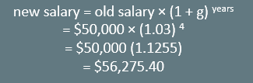
On Your Own₂
Lakeisha has been working for four years at her job, where she is paid $50,000 annually, which is the same amount she was paid four years ago when she began. She learned from company records that her productivity has increased 3% each year of her employment. How can Lakeisha use this information to justify a raise?
Since wages are based on the value of the workers’ contributions to output, which is productivity, and Lakeisha’s productivity has increased by 3% each year, her wage should reflect that. Her new salary based on her productivity should be this:
Notes:
Lakeisha has been working for four years at her job, where she is paid $50,000 annually, which is the same amount she was paid four years ago when she began. She learned from company records that her productivity has increased 3% each year of her employment. How can Lakeisha use this information to justify a raise? Since wages are based on the value of the workers’ contributions to output, which is productivity, and Lakeisha’s productivity has increased by 3% each year, her wage should reflect that. Her new salary based on her productivity should be this:
new salary = old salary × (1 + g) years
= $50,000 × (1.03) 4
= $50,000 (1.1255)
= $56,275.40

Slide 10
Summary
We can measure productivity as the level of GDP per worker or GDP per hour worked.
The rate of productivity growth is the primary determinant of an economy's rate of long-term economic growth and higher wages.
The aggregate production function specifies how certain inputs in the economy—like human capital, physical capital, and technology—lead to the output measured as GDP per capita.

Slide 11




HAWKES LEARNING

