Slide 1
Comparing GDP among Countries
HAWKES LEARNING

Slide 2
Introduction
It is common to use gross domestic product (GDP) as a measure of a nation's economic welfare or standard of living.
However, when comparing the GDPs of different nations, two issues immediately arise.
First, we measure a country's GDP in its own currency.
A second issue is that countries have different populations.
Notes:
It is common to use gross domestic product (GDP) as a measure of a nation's economic welfare or standard of living. However, when comparing the GDPs of different nations, two issues immediately arise. First, we measure a country's GDP in its own currency. A second issue is that countries have different populations.

Slide 3
Comparing Countries
For instance, the U.S. has a much larger economy than Mexico or Canada, but it also has three times as many people as Mexico and nine times as many people as Canada.
Comparing GDP requires converting to a common currency.
Comparing standards of living requires dividing GDP by population.
Notes:
For instance, the U.S. has a much larger economy than Mexico or Canada, but it also has three times as many people as Mexico and nine times as many people as Canada. Comparing GDP requires converting to a common currency. Comparing standards of living requires dividing GDP by population.

Slide 4

Exchange Rates₁
To compare the GDPs of countries with different currencies, it is necessary to convert to a "common denominator" using an exchange rate, which is the value of one currency in terms of another currency.
Exchange rates are expressed either as the units of Country A's currency that need to be traded for a single unit of Country B's currency (for example, Japanese yen per British pound) or as the inverse (British pounds per Japanese yen).
Notes:
To compare the GDPs of countries with different currencies, it is necessary to convert to a “common denominator” using an exchange rate, which is the value of one currency in terms of another currency. Exchange rates are expressed either as the units of Country A’s currency that need to be traded for a single unit of Country B’s currency (for example, Japanese yen per British pound) or as the inverse (British pounds per Japanese yen).

Slide 5
Exchange Rates₂
We can use two types of exchange rates for this purpose: market exchange rates and purchasing power parity equivalent exchange rates.
PPP-equivalent exchange rates provide a longer-run measure of the exchange rate.
Economists typically use PPP-equivalent exchange rates for GDP comparisons across countries.
Notes:
We can use two types of exchange rates for this purpose: market exchange rates and purchasing power parity equivalent exchange rates. PPP-equivalent exchange rates provide a longer-run measure of the exchange rate. Economists typically use PPP-equivalent exchange rates for GDP comparisons across countries.

Slide 6


GDP Per Capita
GDP per capita is a better measure than GDP because it takes into account both total GDP and population size.
Notes:
"GDP per capita = " "GDP" /"Population"
GDP per capita is a better measure than GDP because it takes into account both total GDP and population size.

Slide 7
On Your Own₁
Countries with the largest populations always have the largest GDPs.
True
False
In order to make valid comparisons to measure the standard of living in different countries, GDP should be adjusted by the country’s population.
True
False

Slide 8
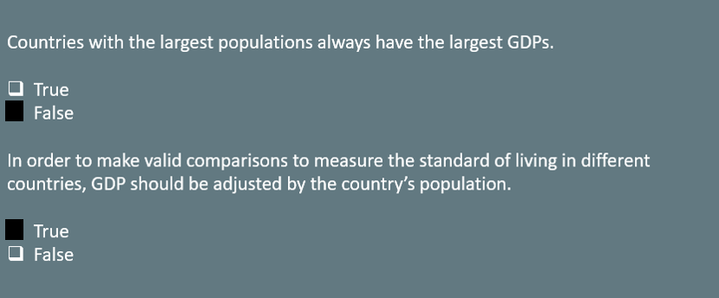
On Your Own₂

Slide 9

Real World Example
Visit the BEA’s website (hawkes.biz/beagdp) and choose GDP by state to find the GDP of your state in 2022. Use Google to find your state’s population; then, calculate the GDP per capita in your state. How does your state’s GDP per capita compare with the 2022 U.S. GDP per capita, which was $76,028?
Notes:
Visit the BEA’s website (hawkes.biz/beagdp) and choose GDP by state to find the GDP of your state in 2022. Use Google to find your state’s population; then, calculate the GDP per capita in your state. How does your state’s GDP per capita compare with the 2022 U.S. GDP per capita, which was $76,028?

Slide 10
Summary
Since GDP is measured in a country's currency, we need to convert it to a common currency to compare different countries' GDPs.
One method uses the exchange rate, which is the price of one country's currency in terms of another country’s.
Once we express the GDPs in a common currency, we can compare each country's GDP per capita by dividing GDP by population.
Countries with large populations often have large GDPs, but GDP alone can be a misleading indicator of a nation's wealth.
A better measure is GDP per capita.

Slide 11




HAWKES LEARNING

