Slide 1
Measuring the Size of the Economy: Gross Domestic Product
HAWKES LEARNING

Slide 2
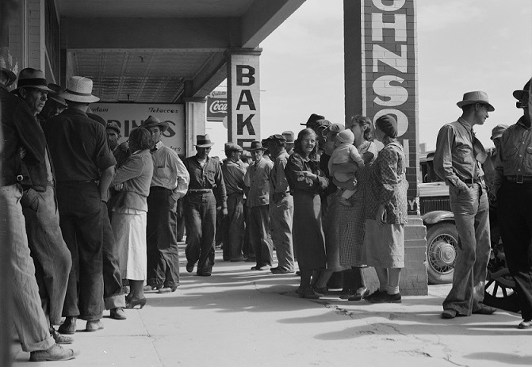
Introduction
People waited in line for relief checks during the Great Depression. During times like this, when many people have trouble making ends meet, it's easy to assess the condition of an economy. It can be more difficult to assess an economy at other times, such as when some people are doing well and others are not.
Notes:
People waited in line for relief checks during the Great Depression. During times like this, when many people have trouble making ends meet, it's easy to assess the condition of an economy. It can be more difficult to assess an economy at other times, such as when some people are doing well and others are not.

Slide 3
What Is Macroeconomics?
Macroeconomics focuses on the economy as a whole and how whole economies interact.
The macroeconomy is a measure of how a country is performing and includes all production and consumption within every market.
There are three macroeconomic goals for every country: economic growth, low unemployment, and low inflation.
Notes:
Macroeconomics focuses on the economy as a whole and how whole economies interact. The macroeconomy is a measure of how a country is performing and includes all production and consumption within every market. There are three macroeconomic goals for every country: economic growth, low unemployment, and low inflation.

Slide 4
Three Macroeconomic Goals
Economic growth: Economic growth determines the standard of living in a country, measured by the change in GDP adjusted for inflation.
3% or more is good.
Low unemployment: Unemployment is the percentage of the labor force without a job.
5% or less is good.
Low inflation: Inflation is the overall increase in the level of prices in an economy. Inflation is measured by the Consumer Price Index (CPI).
The Federal Reserve maintains an inflation rate goal of around 2%.
Notes:
Economic growth: Economic growth determines the standard of living in a country, measured by the change in GDP adjusted for inflation.
3% or more is good. Low unemployment: Unemployment is the percentage of the labor force without a job. 5% or less is good.
Low inflation: Inflation is the overall increase in the level of prices in an economy. Inflation is measured by the Consumer Price Index (CPI).
The Federal Reserve maintains an inflation rate goal of around 2%.

Slide 5
Frameworks
The principal tools that economists use are theories and models.
In microeconomics, we use the theories of supply and demand.
In macroeconomics, we use the theories of aggregate demand (AD) and aggregate supply (AS).
We will review two perspectives on macroeconomics: neoclassical and Keynesian.
Notes:
The principal tools that economists use are theories and models. In microeconomics, we use the theories of supply and demand. In macroeconomics, we use the theories of aggregate demand (AD) and aggregate supply (AS). We will review two perspectives on macroeconomics: neoclassical and Keynesian.

Slide 6
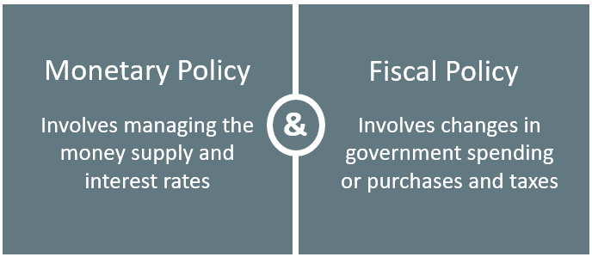
Policy Tools
National governments have two tools for influencing the macroeconomy:

Slide 7
Measuring the Economy with Gross Domestic Product
Macroeconomics requires measuring data and observing trends, patterns, and changes.
The first step in macroeconomics is measuring the overall economy.
Economists typically measure the size of a nation’s overall economy by its gross domestic product (GDP), which is the value of all final goods and services produced within a country in a given year.
Notes:
Macroeconomics requires measuring data and observing trends, patterns, and changes. The first step in macroeconomics is measuring the overall economy. Economists typically measure the size of a nation’s overall economy by its gross domestic product (GDP), which is the value of all final goods and services produced within a country in a given year.

Slide 8
Three Ways to Measure GDP
1. By demand (what consumers purchase)
2. By supply (what a country produces)
3. The national income approach
Notes:
There are three ways to measure GDP: by demand, by supply, and the national income approach.

Slide 9
Measuring GDP by Demand
Investment
(business spending)
Consumption
(consumer spending)
Government spending on goods & services
Spending on net exports (exports−imports)
Notes:
Who buys (demands) all this production? We can divide demand into four main parts: Consumer spending (consumption), Business spending (investment), Government spending on goods and services, Spending on net exports (exports minus imports)

Slide 10
Consumption
Consumption expenditure by households is the largest component of GDP, accounting for about two-thirds in any year.
This tells us that consumers' spending decisions are a major driver of the economy.
Consumer spending does not fluctuate much and has only increased modestly over time.
Notes:
Consumption expenditure by households is the largest component of GDP, accounting for about two-thirds in any year. This tells us that consumers' spending decisions are a major driver of the economy. Consumer spending does not fluctuate much and has only increased modestly over time.

Slide 11
Investment
Investment expenditure refers to purchases of buildings and equipment, primarily by businesses.
Investment demand is far smaller than consumption demand, typically accounting for only about 15% to 18% of GDP.
Investment fluctuates more noticeably than consumption.
Notes:
Investment expenditure refers to purchases of buildings and equipment, primarily by businesses. Investment demand is far smaller than consumption demand, typically accounting for only about 15% to 18% of GDP. Investment fluctuates more noticeably than consumption.

Slide 12
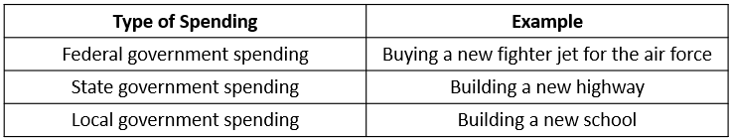
Government Spending
Government expenditure in the United States is close to 20% of GDP.
The only part of government spending counted in demand is government purchases of goods or services produced in the economy.
Notes:
Government expenditure in the United States is close to 20% of GDP. The only part of government spending counted in demand is government purchases of goods or services produced in the economy.

Slide 13
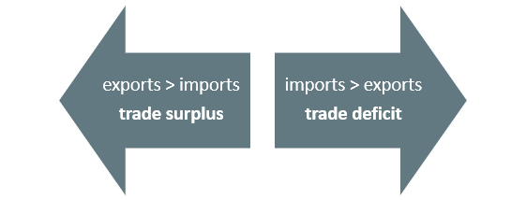
Exports and Imports
Exports are domestically produced goods that a country sells abroad.
Imports are goods produced in other countries that residents of this country purchase.
We call the gap between exports and imports the trade balance.
Notes:
Exports are domestically produced goods that a country sells abroad. Imports are goods produced in other countries that residents of this country purchase. We call the gap between exports and imports the trade balance. When a country’s exports are greater than its imports, there is a trade surplus. When exports are less than imports, there is a trade deficit.

Slide 14
Measuring GDP by Supply
Durable Goods
Nondurable Goods
Services
Structures
Inventories

Slide 15
Measuring GDP by the National Income Approach
Businesses use revenue to pay their bills, including wages, rent, and profit to the entrepreneur.
Adding up all the income produced in a year is another way to measure GDP.
The total value of a nation’s output is equal to the total value of its income.
Notes:
Businesses use revenue to pay their bills, including wages, rent, and profit to the entrepreneur. Adding up all the income produced in a year is another way to measure GDP. The total value of a nation’s output is equal to the total value of its income.

Slide 16
The Problem of Double Counting
GDP is the value of all final goods and services, those that have reached the furthest stage of production, produced within a year.
Double counting is counting output more than once as it travels through production.
To avoid double counting, statisticians only count the value of final goods and services, not intermediate goods (goods that go into producing other goods).
Notes:
GDP is the value of all final goods and services, those that have reached the furthest stage of production, produced within a year. Double counting is counting output more than once as it travels through production. To avoid double counting, statisticians only count the value of final goods, not intermediate goods.

Slide 17
Other Ways to Measure the Economy
Gross National Product (GNP):
Measures what a country’s citizens and firms produce, regardless of whether it was produced domestically or internationally
Net National Product (NNP):
GNP minus how much physical capital depreciates due to aging over the course of a year
Can be divided into national income (all incomes to business & people) and personal income (only income to people)
Notes:
Gross National Product (GNP):
Measures what a country’s citizens and firms produce, regardless of whether it was produced domestically or internationally
Net National Product (NNP):
GNP minus how much physical capital depreciates due to aging over the course of a year
Can be divided into national income (all incomes to business & people) and personal income (only income to people)

Slide 18

Real World Example₁
President Trump imposed tariffs (taxes) on many goods that the U.S. imports from China. Explain how this is likely to affect GDP (1) if China does not reciprocate with tariffs on U.S. goods exported to China and (2) if China imposes tariffs on U.S. goods exported to China.
Notes:
President Trump imposed tariffs (taxes) on many goods that the U.S. imports from China. Explain how this is likely to affect GDP (1) if China does not reciprocate with tariffs on U.S. goods exported to China and (2) if China imposes tariffs on U.S. goods exported to China.

Slide 19
Real World Example₂
President Trump imposed tariffs (taxes) on many goods that the U.S. imports from China. Explain how this is likely to affect GDP (1) if China does not reciprocate with tariffs on U.S. goods exported to China and (2) if China imposes tariffs on U.S. goods exported to China.
(1) If China does not respond by imposing its own tariffs on U.S. goods, U.S. exports would not be affected, but U.S. imports from China would likely decrease. The decrease in imports with exports remaining constant would increase net exports and increase GDP.
(2) However, China has already responded with tariffs on U.S. goods sold in China, which will decrease U.S. exports. If the decrease in U.S. exports is larger than the decrease in U.S. imports, net exports will decrease, causing GDP to decrease.
Notes:
President Trump imposed tariffs (taxes) on many goods that the U.S. imports from China. Explain how this is likely to affect GDP (1) if China does not reciprocate with tariffs on U.S. goods exported to China and (2) if China imposes tariffs on U.S. goods exported to China.
If China does not respond by imposing its own tariffs on U.S. goods, U.S. exports would not be affected, but U.S. imports from China would likely decrease. The decrease in imports with exports remaining constant would increase net exports and increase GDP.
However, China has already responded with tariffs on U.S. goods sold in China, which will decrease U.S. exports. If the decrease in U.S. exports is larger than the decrease in U.S. imports, net exports will decrease, causing GDP to decrease.

Slide 20
Summary
Economists generally express the size of a nation's economy as its gross domestic product (GDP), which measures the value of the output of all goods and services produced within the country in a year.
Economists measure GDP by taking the quantities of all goods and services produced, multiplying them by their prices, and summing the total.
We can divide demand into the following categories: consumption, investment, government spending, exports and imports.
We can divide what is produced in the economy into the following categories: durable goods, nondurable goods, services, structures, and change in inventories.

Slide 21




HAWKES LEARNING

