Slide 1
Confronting Objections to the Economic Approach
HAWKES LEARNING

Slide 2

Economic Approach
Do individuals and societies always make decisions based on the most rational economic choices, or are there other motivating factors to decision making?
Notes:
Do individuals and societies always make decisions based on the most rational economic choices, or are there other motivating factors to decision making?

Slide 3
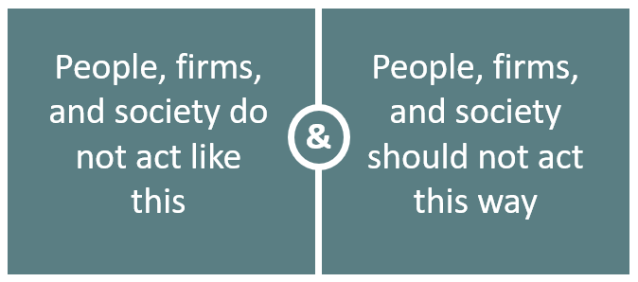
Two Common Objections
Notes:
This lesson will consider two common objections to the economic approach. The first objection is, “People don’t actually act how the economic approach assumes.” The second objection is, “Even if people do act this way, they shouldn’t.”

Slide 4
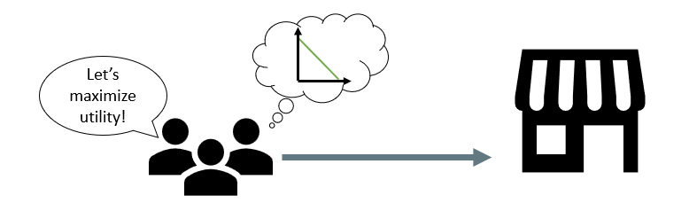
People Do Not Act This Way₁
The ways in which people and societies operate do not look like neat budget constraints or smooth production possibilities frontiers.
Despite this, people and societies generally attempt to maximize utility with their decisions.
Notes:
The first objection states that people, firms, and society don’t act consistently with the assumptions of the economic approach. The economic approach to decision-making seems to require more information than most individuals possess and more careful decision-making than most individuals display. For instance, it’s highly unlikely that you and your friends draw a budget constraint and talk about maximizing utility before going shopping. When governments make decisions, it is unlikely that they draw a budget constraint to find allocative efficiency. Despite this, people and societies generally attempt to maximize utility with their decisions.

Slide 5

People Do Not Act This Way₂
Notes:
People who go grocery shopping try to get what they want for the least amount of money possible. While they do not need to use a budget constraint to make their purchasing decisions, they still balance costs and utility. In other words, they’re making economic decisions. The economic approach makes it easier to analyze and understand decisions like these by using specific words, terms, and ideas.

Slide 6
People Should Not Act This Way
The economic approach portrays people as self-interested, and sometimes these self-interested behaviors are not moral.
Economics seeks to describe economic behavior as it actually exists, not as a form of moral instruction.
Personal choice and freedom are forms of self-interested behavior, which can lead to positive social results.
People may set aside self-interest in the non-economic areas of their lives.
Notes:
The second objection states that people should not act the way that they do. The economic approach portrays people as self-interested. For some critics of this approach, even if self-interest is an accurate description of how people behave, these behaviors are not moral. Instead, the critics argue that people should be taught to care more deeply about others. Economists' answers to the concern that acting in one's self-interest may not be moral is that economics seeks to describe economic behavior, not to provide moral instruction. Personal choice and freedom are forms of self-interested behavior, and self-interested behavior can lead to positive social results. People may set aside self-interest in the non-economic areas of their lives.

Slide 7
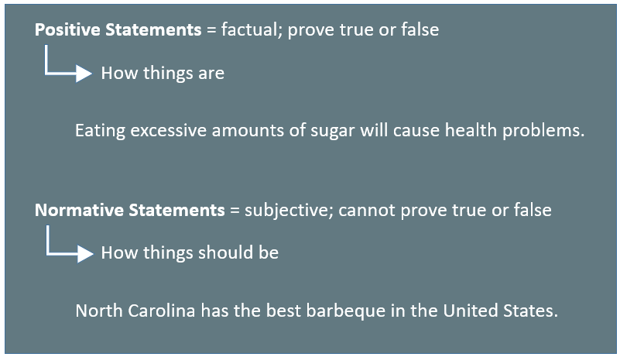
Positive and Normative Statements
Notes:
Positive statements are factual; they can be proven true or false. Here’s an example of a positive statement: “Eating excessive amounts of sugar will cause health problems.” In contrast, normative statements are subjective; they cannot be proven true or false. Here’s an example of a normative statement: ”North Carolina has the best barbeque in the United States.” Basically, positive statements describe how things are; normative statements describe how things should be. The economic approach attempts to use only positive, factual statements to describe how people, firms, and society make decisions.

Slide 8
On Your Own₁
Indicate whether the following statements are positive or normative:
The unemployment rate is 4%.
Positive/Normative
An unemployment rate of 4% is too high.
Positive/Normative
The government should provide health care for all citizens.
Positive/Normative
Notes:
Indicate whether the following statements are positive or normative:
The unemployment rate is 4%.
An unemployment rate of 4% is too high.
The government should provide health care for all citizens.

Slide 9
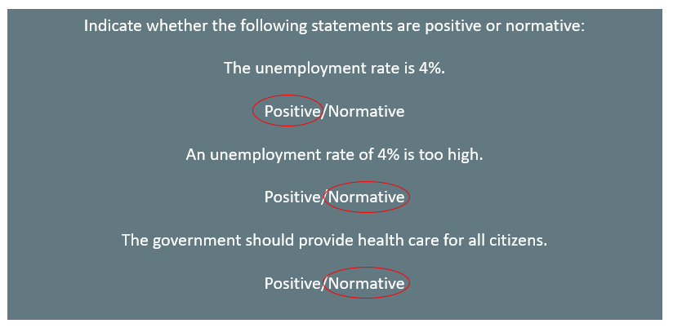
On Your Own₂
Notes:
Recall that positive statements are factual and normative statements are subjective. The statement, “The unemployment rate is 4%,” is a positive statement. The statement, “An unemployment rate of 4% is too high,” is a normative statement. The statement, “The government should provide health care for all citizens,” is a normative statement.

Slide 10
Personal Choice and Freedom
self-interested
profit-seeking
personal choice
freedom
Notes:
“Self-interested behavior” and “profit-seeking” can also be called “personal choice” and “freedom.” Some people choose to spend most of their money on themselves; others may give most of their money to charity or spend it on their friends and family. Some people prefer to work for a large company; others want to start their own business. People’s freedom to make their own economic choices is worth respecting.

Slide 11
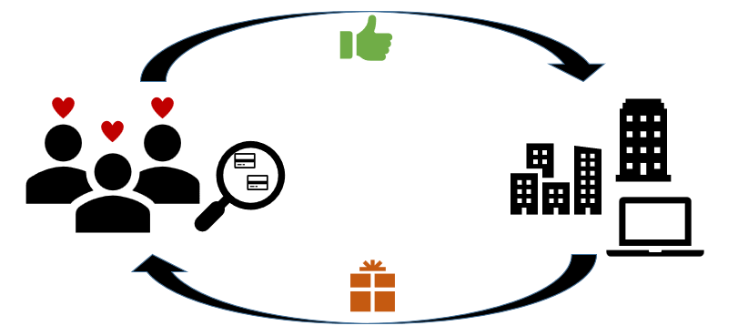
Positive Social Results
self-interested behavior
positive social results
Notes:
Self-interested behavior can actually lead to positive social results. For example, consumers who look for the best deals will (often unintentionally) encourage businesses to offer goods and services that meet their needs.

Slide 12
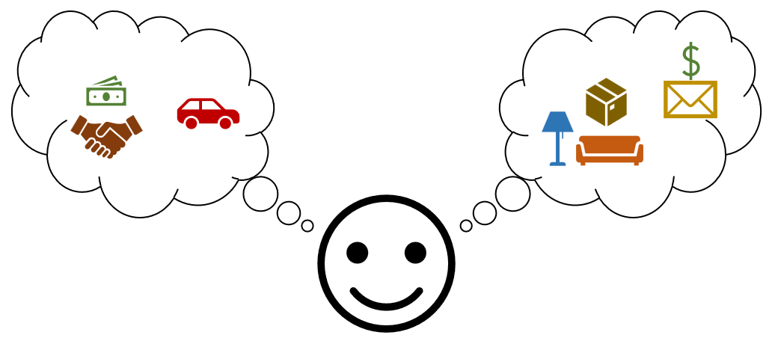
Self-Interest vs. Selfishness
Notes:
Most people are not completely self-interested all the time. For instance, you might be thinking mostly about yourself if you ask for a raise or negotiate the purchase of a car. However, you might shift your focus to others when you help a friend move or donate money to charity. Self-interest is a reasonable starting point for analyzing many economic decisions, but it doesn’t have to imply that people are 100% selfish all the time.

Slide 13

Real-World Discussion
There are several ways in which you apply the economic way of thinking without realizing it. For instance, when you go to the store, you try to maximize your utility while being mindful of staying within your budget.
What is another way that you apply the economic way of thinking?
Notes:
There are several ways in which you apply the economic way of thinking without realizing it. For instance, when you go to the store, you try to maximize your utility while being mindful of staying within your budget. What is another way that you apply the economic way of thinking?

Slide 14
Summary
The economic way of thinking provides a useful approach to understanding human behavior.
Positive statements describe the world as it is, and normative statements describe how the world should be.
People often act in their own self-interest, but this is not always an inherently bad thing for society.
The analysis of economics is rooted in a positive analysis of how people, firms, and governments actually behave, not how they should behave.
Notes:
The economic way of thinking provides a useful approach to understanding human behavior.
Positive statements describe the world as it is, and normative statements describe how the world should be.
People often act in their own self-interest, but this is not always an inherently bad thing for society.
The analysis of economics is rooted in a positive analysis of how people, firms, and governments actually behave, not how they should behave.

Slide 15




HAWKES LEARNING

