Slide 1
How Households Supply Financial Capital
HAWKES LEARNING
Notes:
By the end of this lesson, you will be able to show the relationship between savers, banks, and borrowers; calculate bond yield; contrast bonds, stocks, mutual funds, and assets; and explain the tradeoffs between return and risk.

Slide 2


Household Savings
Mechanisms for Household Savings:
Analyze Investments by These Factors:
Deposits in bank accounts
Rate of return
Risk
Bonds
Stocks
Money market mutual funds
Liquidity
Stock & bond mutual funds
Housing & other tangible assets
Notes:
We can divide the mechanisms for savings available to households into several categories: deposits in bank accounts; bonds; stocks; money market mutual funds; stock and bond mutual funds; and housing and other tangible assets like owning gold. We need to analyze each of these investments in terms of three factors: the expected rate of return it will pay; the risk that the return will be much lower or higher than expected; and the investment's liquidity, which refers to how easily one can exchange money or financial assets for a good or service.

Slide 3
Expected Rate of Return, Risk, and Actual Rate of Return
The expected rate of return refers to how much a project or investment is expected to return to the investor.
Rate of return can be measured in future interest payments, capital gains, or increased profitability; often expressed as a percentage rate.
Risk measures the uncertainty of that project's profitability.
The actual rate of return refers to the total rate of return at the end of a time period.
Notes:
The expected rate of return refers to how much a project or investment is expected to return to the investor. Rate of return can be measured in future interest payments, capital gains, or increased profitability; often expressed as a percentage rate. Risk measures the uncertainty of that project's profitability. The actual rate of return refers to the total rate of return at the end of a time period.

Slide 4

Risk
Default risk: the risk that the borrower fails to pay back the bond or loan
Interest rate risk: the danger that you might buy a long-term bond at a lower interest rate right before market rates suddenly rise, causing you to lose out on the increase
Notes:
Risk measures the uncertainty of that project’s profitability. There are several types of risk. Default risk is the risk that the borrower fails to pay back the bond or loan. Interest rate risk is the danger that you might buy a long-term bond at a lower interest rate right before market rates suddenly rise, causing you to lose out on the increase. A high-risk investment is one for which a wide range of potential payoffs is reasonably probable. A high-risk investment will have actual returns that are much higher than the expected rate of return in some months or years and much lower in other months or years. A low-risk investment may have actual returns that are fairly close to its expected rate of return year after year.

Slide 5
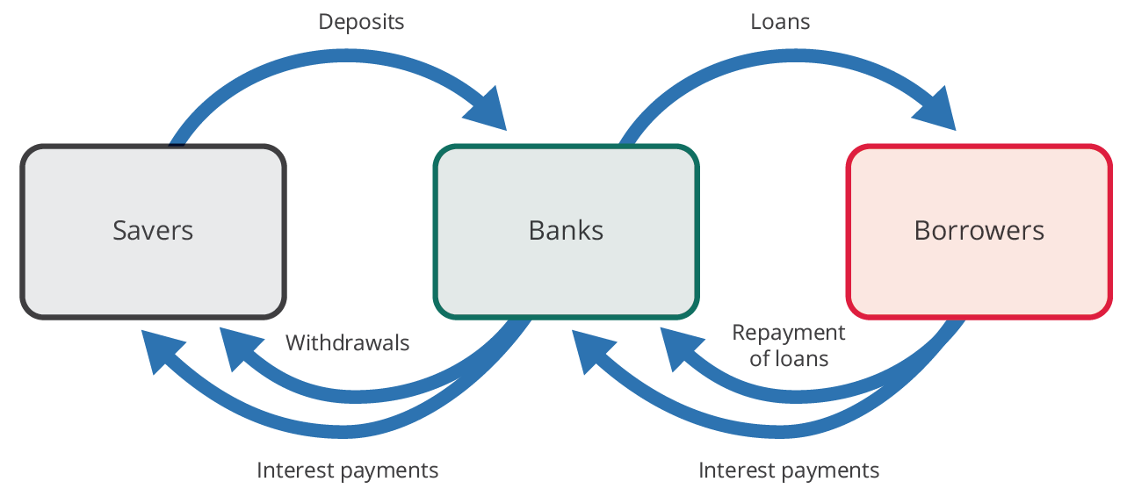
Bank Accounts₁
In financial capital markets, banks are an example of a financial intermediary: an institution that operates between a saver who deposits funds in a bank and a borrower who receives a loan from that bank.
When a bank serves as a financial intermediary, the saver and the borrower never meet.
Notes:
An intermediary is one who stands between two other parties. For example, a person who arranges a blind date between two other people is one kind of intermediary. In financial capital markets, banks are an example of a financial intermediary: an institution that operates between a saver who deposits funds in a bank and a borrower who receives a loan from that bank. When a bank serves as a financial intermediary, unlike the situation with a couple on a blind date, the saver and the borrower never meet.

Slide 6


Bank Accounts₂
Bank Accounts
Checking Accounts
Savings Accounts
Certificates of Deposits
Notes:
Banks offer a range of accounts to serve different needs. This includes checking accounts, savings accounts, and certificates of deposit. A checking account typically pays little or no interest, but it facilitates transactions by giving easy access to liquid money. A savings account typically pays some interest rate, but money is less liquid. With a CD, you agree to deposit a certain amount of money, often measured in thousands of dollars, in the account for a stated period of time, typically ranging from a few months to several years. In exchange, the bank agrees to pay a higher interest rate than for a regular savings account.

Slide 7
Bonds₁
Bonds vary in the rates of return that they offer, according to the riskiness of the borrower.
An interest rate can be divided into three components:
Compensation for delaying consumption
An adjustment for an inflationary rise in the overall level of prices
A risk premium that takes the borrower's riskiness into account
Notes:
Bonds vary in the rates of return that they offer, according to the riskiness of the borrower. An interest rate can be divided into three components:
compensation for delaying consumption
an adjustment for an inflationary rise in the overall level of prices
a risk premium that takes the borrower's riskiness into account

Slide 8
Bonds₂
Bonds that offer high interest rates to compensate for their relatively high chance of default are called high-yield bonds or junk bonds.
Bond Key Terms
Face Value
Interest Rate
Maturity Date
Bond Yield
Notes:
We call bonds that offer high interest rates to compensate for their relatively high chance of default ”high-yield bonds” or ”junk bonds.” In financial terms, a bond has several parts. A bond is basically an “I owe you” note that an investor receives in exchange for capital (money).

Slide 9


Face Value
the amount the borrower agrees to pay the investor at maturity
Notes:
The bond has a face value. This is the amount the borrower agrees to pay the investor at maturity.

Slide 10

Coupon or Interest Rate
%
usually semi-annual but can be paid at different times throughout the year
Notes:
The bond has a coupon rate or interest rate, which is usually semi-annual but can be paid at different times throughout the year.

Slide 11

Maturity Date
when the borrower will pay back bond face value as well as the last interest payment
Notes:
The bond has a maturity date: when the borrower will pay back its face value as well as its last interest payment. Combining the bond’s face value, interest rate, maturity date, and market interest rates allows a buyer to compute a bond’s present value, which is the most that a buyer would be willing to pay for a given bond.

Slide 12


Bond Yield
measures the rate of return a bond is expected to pay over time
Notes:
The bond yield measures the rate of return a bond is expected to pay over time. Investors can buy bonds when they are issued, and they can buy and sell them during their lifetimes.

Slide 13
On Your Own₁
A bond with a maturity date one year from now has a face value of $10,000 and a coupon rate of 4%. Interest rates have increased in the market, changing the bond's price to $9,454.54. For an investor purchasing the bond today, what is the bond yield?
Notes:
A bond with a maturity date one year from now has a face value of $10,000 and a coupon rate of 4%. Interest rates have increased in the market, changing the bond's price to $9454.54. For an investor purchasing the bond today, what is the bond yield?

Slide 14
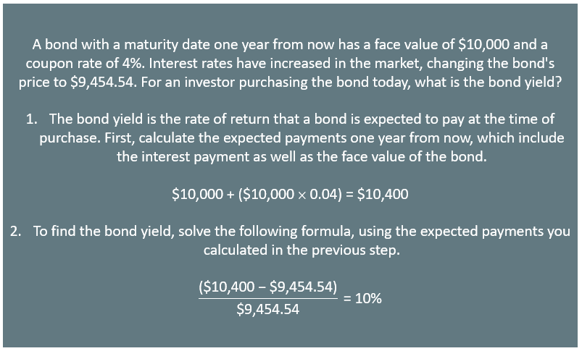
On Your Own₂

Slide 15
Stocks
The rate of return on a financial investment in a share of stock can come in two forms: as a dividend and as a capital gain.
There are different ways to measure the overall performance of the stock market, based on averaging different subsets of stock prices.
A popular stock market measure is the Dow Jones Industrial Average, which is based on 30 large U.S. companies' stock prices.
Another stock market performance gauge, the Standard & Poor's 500, follows the stock prices of the 500 largest U.S. companies.
Notes:
The rate of return on a financial investment in a share of stock can come in two forms: as dividends and capital gain. There are different ways to measure the overall performance of the stock market, based on averaging different subsets of stock prices. A popular stock market measure is the Dow Jones Industrial Average, which is based on 30 large U.S. companies' stock prices. Another stock market performance gauge, the Standard & Poor's 500, follows the stock prices of the 500 largest U.S. companies.

Slide 16
Mutual Funds
Buying stocks or bonds issued by a single company is always somewhat risky.
Companies offer mutual funds, which consist of a variety of stocks or bonds from different companies.
We call a mutual fund that seeks only to mimic the market's overall performance an index fund.
Diversification can offset some of the risks of individual stocks rising or falling.
Notes:
Buying stocks or bonds issued by a single company is always somewhat risky. Companies offer mutual funds, which consist of a variety of stocks or bonds from different companies. We call a mutual fund that seeks only to mimic the market's overall performance an index fund. Diversification can offset some of the risks of individual stocks rising or falling.

Slide 17
Housing and Other Tangible Assets
Households can also seek a rate of return by purchasing tangible assets, especially housing.
An owner's equity in a house is the monetary value the owner would have after selling the house and repaying any outstanding bank loans.
Other tangible assets include precious metals, commodities, and collectibles.
Notes:
Households can also seek a rate of return by purchasing tangible assets, especially housing. An owner's equity in a house is the monetary value the owner would have after selling the house and repaying any outstanding bank loans. Other tangible assets include precious metals, commodities, and collectibles.

Slide 18

Real World Example₁
When you graduate from college and begin your first job, you decide to save 10% of your income each month. In which of the financial assets are you likely to invest? Why? How would your choice change many years later as you approach retirement? Why?
Notes:
When you graduate from college and begin your first job, you decide to save 10% of your income each month. In which of the financial assets are you likely to invest? Why? How would your choice change many years later as you approach retirement? Why?

Slide 19
Real World Example₂
When you graduate from college and begin your first job, you decide to save 10% of your income each month. In which of the financial assets are you likely to invest? Why? How would your choice change many years later as you approach retirement? Why?
When a young worker is just starting out with many years to work, they would most likely be willing to accept moderate or possibly high risk in order to receive a high rate of return. Young workers would probably buy mutual funds to take advantage of diversification or possibly buy individual stocks since over a long period of time, the average return on stocks is consistently higher even though in any one year, there may be losses. Most older workers will be willing to accept a lower return, probably buying
bonds or even CDs, to avoid risk.
Notes:
When a young worker is just starting out with many years to work, they would most likely be willing to accept moderate or possibly high risk in order to receive a high rate of return. Young workers would probably buy mutual funds to take advantage of diversification or possibly buy individual stocks since over a long period of time, the average return on stocks is consistently higher even though in any one year, there may be losses. Most older workers will be willing to accept a lower return, probably buying bonds or even CDs, to avoid risk.

Slide 20
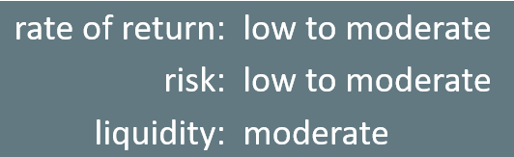
Return, Risk, Liquidity: Bonds
Bonds
Notes:
The bottom line for bonds: rate of return: low to moderate, depending on the borrower's risk. Risk: low to moderate, depending on whether interest rates in the economy change substantially after the bond is issued. Liquidity: moderate because the investor needs to sell the bond before the investor regains the cash.

Slide 21
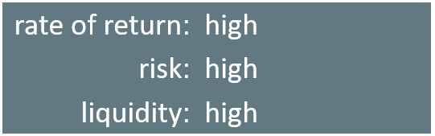
Return, Risk, Liquidity: Stocks
Stocks
Notes:
The bottom line on investing in stocks is that the rate of return over time will be high, but the risks are also high, especially in the short run. Liquidity is also high since one can sell stock in publicly held companies readily for spendable money.

Slide 22
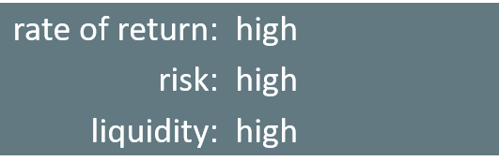
Return, Risk, Liquidity: Mutual Funds
Mutual Funds
Notes:
The bottom line on investing in mutual funds is that the rate of return over time will be high. The risks are also high, but the risks and returns for an individual mutual fund will be lower than those for an individual stock. As with stocks, liquidity is also high, provided the mutual fund or stock index fund is readily traded.

Slide 23
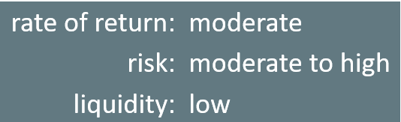
Return, Risk, Liquidity: Tangible Assets
Tangible Assets
Notes:
The bottom line on investing in tangible assets: rate of return is moderate, especially if you can receive nonfinancial benefits from them. Risk is moderate for housing or high for collectibles. Liquidity is low because it often takes considerable time and energy to sell a house and turn your capital gain into cash.

Slide 24
Summary
We can categorize all investments according to three key characteristics: average expected return, degree of risk, and liquidity.
Banks and their products, as well as tangible assets, offer a variety of investment choices for consumers, all with varying degrees of risk, liquidity, and return.
A typical bond promises the financial investor a series of payments over time, based on the interest rate at the time the financial institution issues the bond and when the borrower repays it.
Investing in any individual firm is somewhat risky, so investors are wise to practice diversification, which means investing in a range of companies.
We can also regard housing and other tangible assets as forms of financial investment, which pay a rate of return in the form of capital gains.

Slide 25




HAWKES LEARNING

