Slide 1
Insurance and Imperfect Information
HAWKES LEARNING
Notes:
Insurance is used every day, and we’ll explore how it works and what goes into the decisions of insurance company in this lesson titled “Insurance and Imperfect Information.”

Slide 2

Insurance and Imperfect Information₁
Insurance provides an individual or business with protection from the economic effects of an unexpected event.
Notes:
Insurance provides an individual or business with protection from the economic effects of an unexpected event.

Slide 3
Introduction
Insurance is a method that households and firms use to prevent any single event from having a significant detrimental financial effect.
Generally, households or firms with insurance make regular payments, called premiums.
The insurance company prices these premiums based on the probability of certain events occurring among a pool of people.
Members of the group who then suffer a specified bad experience receive payments from this pool of money.
Notes:
Insurance is a method that households and firms use to prevent any single event from having a significant detrimental financial effect. Generally, households or firms with insurance make regular payments, called premiums. The insurance company prices these premiums based on the probability of certain events occurring among a pool of people. Members of the group who then suffer a specified bad experience receive payments from this pool of money.

Slide 4
Imperfect Information
All insurance involves imperfect information.
We cannot predict future events with certainty.
Adverse events occur due to a combination of people’s characteristics and choices, which make the risks higher or lower, and the good or bad luck of circumstances.
Notes:
All insurance involves imperfect information because there’s no way to see into the future. Who will get ill or be in a car accident or be robbed is impossible to predict with 100 percent accuracy.
We cannot predict future events with certainty. Adverse events occur due to a combination of people’s characteristics and choices, which make the risks higher or lower, and the good or bad luck of circumstances.

Slide 5
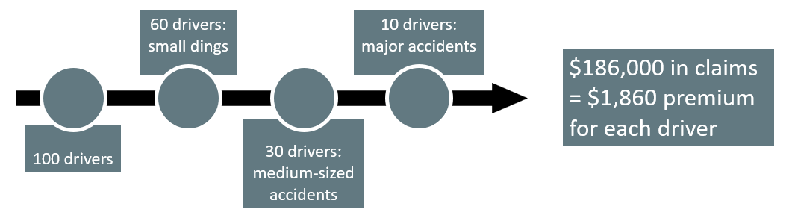
How Insurance Works
Since insurance companies have such a large number of clients, they are able to negotiate with health care and other service providers for lower rates than the individual would be able to get. This both increases the benefit to consumers of becoming insured and saves the insurance company money when it must pay claims.
Notes:
Now, for the math. Let’s say a car insurance company has 100 drivers and in one year most of them will have small dings, a few will have medium-sized accidents and a small amount will have major accidents. The company doesn’t know which driver will have which incident, so they’ll divide the total cost of the accidents, $186,000, by the number of drivers, 100, and charge each driver a premium of $1,860. The benefit to customers is that insurance companies are large, so they’re able to negotiate with health care providers for lower rates. This also means the insurance companies save themselves money.
Since insurance companies have such a large number of clients, they are able to negotiate with health care and other service providers for lower rates than the individual would be able to get. This both increases the benefit to consumers of becoming insured and saves the insurance company money when it must pay claims.

Slide 6
How Insurance Companies Make Money
Money In:
Premiums from customers
Investment income
Insurance Company
Money Out:
Payments to customers
Expenses
Profits or losses
Money flows into an insurance company through premiums and investments and out through the payment of claims and operating expenses.
Notes:
Insurance companies receive income from insurance premiums and investment income. The companies derive income from investing the funds that insurance companies received in the past but did not pay out as insurance claims in prior years. The insurance company receives a rate of return from investing these funds or reserves. The companies typically invest in fairly safe, liquid (easy to convert into cash) investments, as the insurance companies need to be able to readily access these funds when a major disaster strikes.

Slide 7
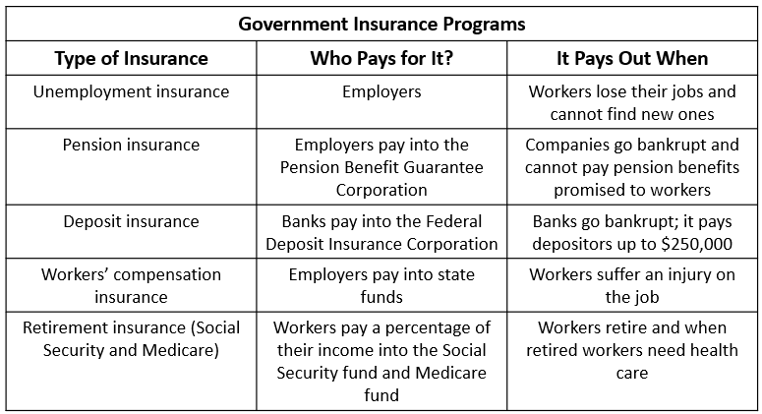
Government and Social Insurance
Federal and state governments run a number of insurance programs.

Slide 8
Risk Groups
To make insurance fair, customers are often divided into risk groups, where the people in the group share roughly the same risks of something bad happening.
Low-risk group pays lower premium.
High-risk group pays higher premium.
If someone is generally safe and has one major accident, which group should they be in?
Notes:
To make insurance fair, customers are often divided into risk groups, where the people in the group share roughly the same risks of something bad happening. So, people who are in a low-risk group may pay a lower premium, and people in a high-risk group may pay a higher premium. But, if someone is generally safe and has one major accident, which group should they be in?

Slide 9

Actuarially Fair
When the premiums paid equal the amount an average person in that risk group would collect in the payout of claims, the level of insurance is said to be “actuarially fair.”
Notes:
Insurance companies work to make groups “actuarially fair”, which is when the premiums paid equal the amount an average person in that risk group would collect in the payout of claims.

Slide 10
Moral Hazard Problem
Moral hazard refers to the case when people with insurance engage in riskier behavior than they would if they did not have insurance.
Ways to Reduce Effects
Discounts on premiums for safety measures
Requiring customer to pay share of the costs
Monitoring behavior
Notes:
Insurance can lead to the Moral Hazard Problem, when people may engage in riskier behavior because they have insurance than they would without it. Insurance companies want to combat this to save themselves money. There are a few ways to reduce its effect, like monitoring behavior and offering premium discounts for safety.

Slide 11
Ways Customers Pay
Deductibles:
the amount the policyholder pays before insurance starts paying
Copayments:
the policyholder pays a small amount, and the insurance company pays the rest
Coinsurance:
the insurance company pays a certain percentage, and the policyholder pays the rest
Notes:
Companies can also require the insured to pay a portion of the bill, through deductibles (the out-of-pocket expense paid before insurance kicks in), copayments (a flat fee the insured must pay before receiving services) and coinsurance (where the insured is required to pay a percentage of costs).

Slide 12
Incentives of Health Care Providers
Fee-for-service:
health care providers are paid for the services they provide and are paid more if they provide more services
HMOs:
health care providers are paid a fixed amount per person, which gives the provider the incentive to limit the quantity of care
Notes:
Fee-for-service is what you would expect: companies pay doctors and providers for services, and the more services, the more they pay. But in Health Maintenance Organizations, or HMOs, providers are reimbursed a fixed amount per person, so it limits the quantity of care. Most insurance plans today are a mix of the two.

Slide 13
Adverse Selection Problem
Adverse selection refers to the problem in which insurance buyers have more information about whether they are high-risk or low-risk than the insurance company does.
Buyers who are high-risk tend to want to buy more insurance without letting the insurance company know about their higher risk.
For example, someone purchasing health insurance probably knows more about their family's health history than an insurer can find out.
Notes:
Adverse selection refers to the problem in which insurance buyers have more information about their risk than the insurance company. Buyers who are high-risk tend to want to buy more insurance without letting the insurance company know about their higher risk. For example, someone purchasing health insurance probably knows more about their family's health history than an insurer can find out.

Slide 14
U.S. Health Care in an International Context
The U.S. is the only high-income country where private firms pay and provide for most health insurance.
The U.S. spends more per capita on health care than any other industrialized country.
Outcomes measured by life expectancy and child mortality are worse than in other high-income countries.
The U.S. health care system provides high-quality care with relatively short waiting times for treatment.
Other countries have more equal access, but quality may be lower and waiting times longer than in the U.S.
Notes:
When we compare the United States to other countries with similar incomes, we can see that it’s mostly private company providers, and the quality of care is higher in the U.S. But, it costs more than other countries.

Slide 15
Government Regulation of Insurance₁
The U.S. insurance industry is primarily regulated at the state level.
The National Association of Insurance Commissioners brings together these state regulators to exchange information and strategies.
The state insurance regulators attempt to keep the price of insurance low and ensure that everyone has insurance.
If premiums are set low for all policyholders, the premiums collected may not be enough to cover all the claims.
If premiums are set too low, insurance companies will lose money and withdraw from the insurance markets in that state.
Notes:
Insurance requires regulation, and here in the U.S., that happens mostly at the state level through the National Association of Insurance Commissioners. Their goal is keep premiums low and make sure everyone has insurance. But if premiums get too low, insurance companies won’t have enough money to pay claims, and if they lose enough money, they’ll leave that state, decreasing choice for insurance customers.

Slide 16
Government Regulation of Insurance₂
In some industries, the U.S. government has decided free markets will not provide insurance at an affordable price, so the government pays for it directly.
Another common government intervention in insurance markets is to require that everyone buy certain kinds of insurance.
Medicaid
Medicare
States require car insurance
Mortgage companies require homeowner's insurance
Notes:
Sometimes, the U.S. steps in for customers who need insurance at an affordable price, like with Medicaid and Medicare. Sometimes, governments require insurance, eliminating the worry over adverse selection, like with states that require car insurance and mortgage holders that require homeowner’s insurance.

Slide 17
The Patient Protection and Affordable Care Act
In March of 2010, President Obama signed into law the Patient Protection and Affordable Care Act (PPACA).
The goal of the act is to bring the United States closer to universal coverage.
Prior to the ACA, more than 32 million Americans were uninsured.
People who are uninsured tend to use emergency rooms for treatment, which has contributed significantly to rising costs.
Notes:
In March of 2010, President Obama signed into law the Patient Protection and Affordable Care Act (PPACA). The goal of the act is to bring the United States closer to universal coverage. Prior to the ACA, more than 32 million Americans were uninsured. People who are uninsured tend to use emergency rooms for treatment, which has contributed significantly to rising costs.

Slide 18
On Your Own
This lesson discusses the tradeoff between quality of care and equal access at low costs. Which do you consider to be more important, a high quality of care provided or more equal access and lower costs? Why?
Notes:
This lesson discusses the tradeoff between quality of care and equal access and low costs. Which do you consider to be more important, a high quality of care provided or more equal access and lower costs? Why?

Slide 19
Summary
The fundamental law of insurance is that what the average person pays in over time cannot be less than what the average person gets out.
Many insurance policies have deductibles, copayments, or coinsurance.
In a fee-for-service health financing system, medical care providers receive reimbursement according to the cost of services they provide.
An alternative method of organizing health care is through health maintenance organizations (HMOs), where medical care providers receive reimbursement according to the number of patients they handle, and it is up to the providers to allocate resources between patients who receive more or fewer health care services.
Adverse selection arises in insurance markets when insurance buyers know more about the risks they face than the insurance company.

Slide 20




HAWKES LEARNING

