Slide 1
Income Inequality: Measurements and Causes
HAWKES LEARNING
Notes:
Income Inequality: Measurement and Causes. By the end of this lesson, you will be able to measure the distribution and inequality of income, calculate and graph a Lorenz curve, and understand the demand and supply of high-skilled labor.

Slide 2
Income Inequality
Poverty levels can be subjective based on the overall income levels of a country.
Typically, a government measures poverty based on a percentage of the median income.
Income inequality, however, has to do with the distribution of that income in terms of which group receives the most or least income.
Income inequality involves comparing those with high incomes, middle incomes, and low incomes, not just looking at those below or near the poverty line.
Notes:
Poverty levels can be subjective based on the overall income levels of a country. Typically, a government measures poverty based on a percentage of the median income. Income inequality, however, has to do with the distribution of that income in terms of which group receives the most or least income. Income inequality involves comparing those with high incomes, middle incomes, and low incomes, not just looking at those below or near the poverty line.

Slide 3
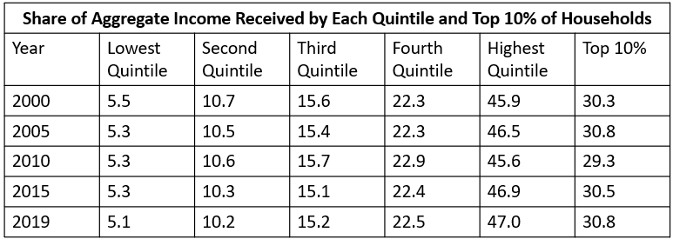
Measuring Income Distribution by Quintiles
A common way of measuring income inequality is to rank all households by income from lowest to highest and then divide all households into five groups with equal numbers of people, known as quintiles.
Notes:
A common way of measuring income inequality is to rank all households by income from lowest to highest and then divide all households into five groups with equal numbers of people, known as quintiles.

Slide 4
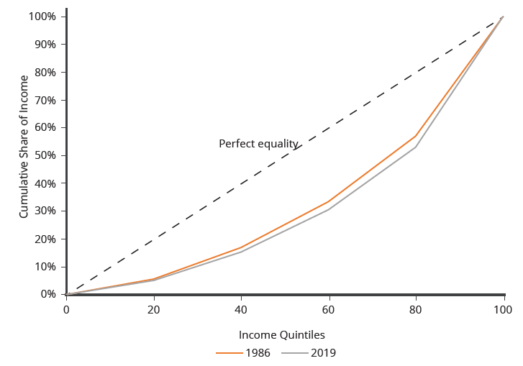
Lorenz Curve
The Lorenz curve shows the cumulative share of population on the horizontal axis and the cumulative percentage of total income received on the vertical axis.
Every Lorenz curve diagram begins with a line sloping up at a 45-degree angle.
The income distribution in 1986 was closer to the perfect equality line than the income distribution in 2019; that is, the U.S. income distribution became more unequal over time.
Notes:
The Lorenz curve shows the cumulative share of population on the horizontal axis and the cumulative percentage of total income received on the vertical axis. Every Lorenz curve diagram begins with a line sloping up at a 45-degree angle. The income distribution in 1986 was closer to the perfect equality line than the income distribution in 2019; that is, the U.S. income distribution became more unequal over time

Slide 5
Causes of Growing Inequality: The Changing Composition of American Households
In 1970, 41% of married women were in the labor force, but by 2020, 57.4% of married women were in the labor force.
One result of this trend is that more households have two earners.
Moreover, it has become more common for one high earner to marry another high earner.
Now, mothers with high-powered careers are often returning to work while their children are quite young.
This pattern of households with two high earners tends to increase the proportion of high-earning households.
Notes:
In 1970, 41% of married women were in the labor force, but by 2015, 56.7% of married women were in the labor force. One result of this trend is that more households have two earners. Moreover, it has become more common for one high earner to marry another high earner. Now, mothers with high-powered careers are often returning to work while their children are quite young. This pattern of households with two high earners tends to increase the proportion of high-earning households.

Slide 6
Causes of Growing Inequality: A Shift in the Distribution of Wages₁
Another factor behind the rise in U.S. income inequality is that earnings have become less equal since the late 1970s.
In particular, the earnings of high-skilled labor relative to low-skilled labor have increased.
Winner-take-all labor markets result from changes in technology, which have increased global demand for “stars,” like doctors or actors.
The winner-take-all theory argues that the salary gap between the median and the top 1% is not due to educational differences.
Notes:
Another factor behind the rise in U.S. income inequality is that earnings have become less equal since the late 1970s. In particular, the earnings of high-skilled labor relative to low-skilled labor have increased. Winner-take-all labor markets result from changes in technology, which have increased global demand for "stars,“ like doctors or actors. The winner-take-all theory argues that the salary gap between the median and the top 1 percent is not due to educational differences.

Slide 7
Causes of Growing Inequality: A Shift in the Distribution of Wages₂
We can view the market for high-skilled labor as a race between forces of supply and demand.
Increased education and training
Increases in the highly skilled labor supply
Wages should be relatively lower
Technological advancement and globalization
Increases in the demand for highly skilled labor
Wages should be relatively higher
We can view the greater inequality of wages as a sign that demand for skilled labor is increasing faster than supply. The combination of forces in the high-skilled and low-skilled labor markets leads to increased income disparity.
Notes:
We can view the market for high-skilled labor as a race between forces of supply and demand. Additional education and on-the-job training will tend to increase the high-skilled labor supply and to hold down its relative wage. Conversely, new technology and other economic trends, like globalization, tend to increase the demand for high-skilled labor and push up its relative wage. We can view the greater inequality of wages as a sign that demand for skilled labor is increasing faster than supply. Alternatively, if the supply of lower-skilled workers exceeds the demand, average wages in the lower quintiles of the income distribution will decrease. The combination of forces in the high-skilled and low-skilled labor markets leads to increased income disparity

Slide 8
On Your Own₁
Suppose that you finish undergraduate school with a business major, and then you go on to graduate school and earn an MBA. Within a few years, you are earning $120,000 as an executive at a small software company. You marry a lawyer who is earning $150,000 annually. Do you and your spouse contribute to the growing income inequality in the U.S? Why or why not?
Notes:
Suppose that you finish undergraduate school with a business major, and then you go on to graduate school and earn an MBA. Within a few years, you are earning $120,000 as an executive at a small software company. You marry a lawyer who is earning $150,000 annually. Do you and your spouse contribute to the growing income inequality in the U.S? Why or why not?

Slide 9
On Your Own₂
Suppose that you finish undergraduate school with a business major, and then you go on to graduate school and earn an MBA. Within a few years, you are earning $120,000 as an executive at a small software company. You marry a lawyer who is earning $150,000 annually. Do you and your spouse contribute to the growing income inequality in the U.S? Why or why not?
One of the factors contributing to growing income inequality is that now, unlike 30 or 40 years ago, many households have two professionals with high incomes. In the past, generally one spouse was the high-income earner and the other spouse had a lower paying profession or stayed out of the labor force to manage the household and raise the family.
Notes:
Suppose that you finish undergraduate school with a business major, and then you go on to graduate school and earn an MBA. Within a few years, you are earning $120,000 as an executive at a small software company. You marry a lawyer who is earning $150,000 annually. Do you and your spouse contribute to the growing income inequality in the U.S? Why or why not? One of the factors contributing to growing income inequality is that now, unlike 30 or 40 years ago, many households have two professionals with high incomes. In the past, generally one spouse was the high-income earner and the other spouse had a lower paying profession or stayed out of the labor force to manage the household and raise the family.

Slide 10
Summary
Measuring inequality involves making comparisons across the entire distribution of income, not just the poor.
One way of doing this is to divide the population into groups, like quintiles, and then calculate what share of income each group receives.
An alternative approach is to draw Lorenz curves, which compare the cumulative income actually received to a perfectly equal distribution of income.
Income inequality in the United States increased substantially from the late 1970s and early 1980s into the 2000s.
The two most common explanations that economists cite are changes in household structures that have led to more two-earner couples and single-parent families and the effect of new information and communications technology on wages.

Slide 11




HAWKES LEARNING

