Slide 1
The Safety Net
HAWKES LEARNING
Notes:
The Safety Net. By the end of this lesson, you will be able to identify the goals of antipoverty government programs that comprise the safety net and discuss their complexities and why they can be controversial.

Slide 2
The Safety Net₁
The U.S. government has implemented a number of programs to assist those below the poverty line and those who have incomes just above the poverty line, whom we refer to as the near-poor. Such programs are called the safety net, to recognize that they offer some protection for those who find themselves without jobs or income.
SNAP (1964)
Medicaid (1965)
EITC (1975)
TANF (1996)
Notes:
The U.S. government has implemented a number of programs to assist those below the poverty line and those who have incomes just above the poverty line, whom we refer to as the near-poor. Such programs are called the safety net, to recognize that they offer some protection for those who find themselves without jobs or income.

Slide 3
Temporary Assistance for Needy Families₁
From the Great Depression until 1996, the United States' most visible antipoverty program was Aid to Families with Dependent Children (AFDC).
AFDC provided cash payments to mothers with children who were below the poverty line.
In 1996, Congress passed and President Bill Clinton signed into law the Personal Responsibility and Work Opportunity Reconciliation Act.
The new law replaced AFDC with Temporary Assistance for Needy Families (TANF).
Notes:
From the Great Depression until 1996, the United States' most visible antipoverty program was Aid to Families with Dependent Children (AFDC), which provided cash payments to mothers with children who were below the poverty line. Many just called this program "welfare." In 1996, Congress passed and President Bill Clinton signed into law the Personal Responsibility and Work Opportunity Reconciliation Act, more commonly called the "welfare reform act." The new law replaced AFDC with Temporary Assistance for Needy Families (TANF).

Slide 4
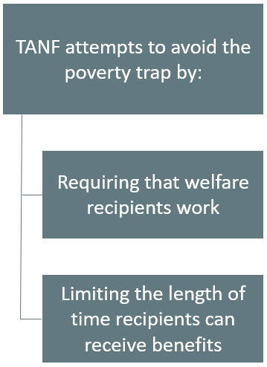
Temporary Assistance for Needy Families₂
Notes:
Under TANF, however, the federal government gives a fixed amount of money to each state. The state can then use the money for almost any program with an antipoverty component: for example, the state might use the money to give cash to poor families, or reduce teenage pregnancy, or even raise the high school graduation rate. However, the federal government imposed two key requirements. First, if states are to keep receiving the TANF grants, they must impose work requirements so that most of those receiving TANF benefits are working (or attending school). Second, no one can receive TANF benefits with federal money for more than a total of five years over his or her lifetime. The old AFDC program had no such work requirements or time limits.

Slide 5
The Earned Income Tax Credit (EITC)₁
The Earned Income Tax Credit (EITC), first passed in 1975, is a method of assisting the working poor through the tax system.
The EITC is one of the largest assistance programs for low-income groups.
The amount of the tax break increases with the amount of income earned, up to a point.
The EITC is popular with economists because of the way it effectively increases the payment received for work.
Notes:
The earned income tax credit (EITC), first passed in 1975, is a method of assisting the working poor through the tax system. The EITC is one of the largest assistance programs for low-income groups. The amount of the tax break increases with the amount of income earned, up to a point. The EITC is popular with economists because of the way it effectively increases the payment received for work.

Slide 6
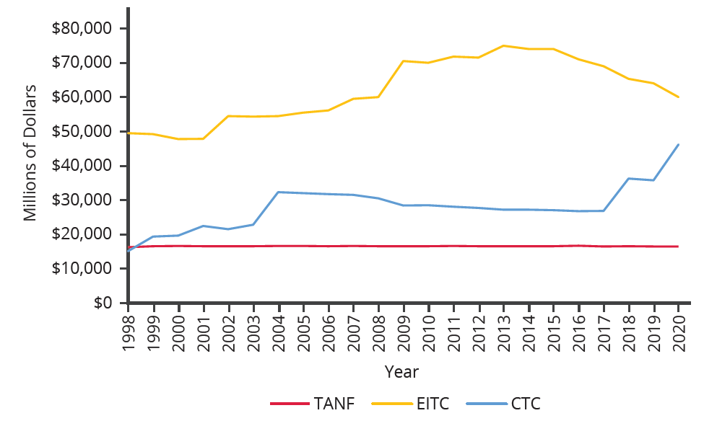
The Earned Income Tax Credit (EITC)₂
EITC increased from more than $45 billion in 2000 to over $60 billion by 2020, far exceeding 2020 outlays in the CTC (Child Tax Credits) and TANF of over $46 billion and $16 billion, respectively.
Notes:
EITC increased from more than $45 billion in 2000 to over $60 billion by 2020, far exceeding 2020 outlays in the CTC (Child Tax Credits) and TANF of over $46 billion and $16 billion, respectively.

Slide 7
Supplemental Nutrition Assistance Program (SNAP)
Often called "food stamps," Supplemental Nutrition Assistance Program (SNAP) is a federally funded program, started in 1964.
With SNAP, each month eligible people receive a card like a debit card that they can use to buy food.
The amount of food aid for which a household is eligible varies by income, number of children, and other factors.
If 30% of a household’s net income is not enough to purchase a nutritionally adequate diet, those households are eligible for SNAP.
Notes:
Often called "food stamps," Supplemental Nutrition Assistance Program (SNAP) is a federally funded program, started in 1964. With SNAP, each month eligible people receive a card like a debit card that they can use to buy food. The amount of food aid for which a household is eligible varies by income, number of children, and other factors. If 30% of a household’s net income is not enough to purchase a nutritionally adequate diet, those households are eligible for SNAP.

Slide 8
SNAP and the Poverty Trap
For every $100 earned, the government assumes a family can spend $30 more for food and thus reduces its eligibility for food aid by $30.
While not a complete disincentive to work, combined with how other programs reduce benefits as income increases, it adds to the problem.
SNAP does try to address the poverty trap with its own set of work requirements and time limits.
Notes:
For every $100 earned, the government assumes a family can spend $30 more for food and thus reduces its eligibility for food aid by $30. While not a complete disincentive to work, combined with how other programs reduce benefits as income increases, it adds to the problem. SNAP does try to address the poverty trap with its own set of work requirements and time limits.

Slide 9
On Your Own₁
Explain how SNAP can be used as a method of transferring income to the working poor when it is for food. Why does the program use a debit card?
Notes:
Explain how SNAP can be used as a method of transferring income to the working poor when it is for food. Why does the program use a debit card?

Slide 10
On Your Own₂
Explain how SNAP can be used as a method of transferring income to the working poor when it is for food. Why does the program use a debit card?
SNAP is the modern-day version of food stamps and is a debit card received monthly that is preloaded with funds that can only be spent on food. The intent of this program using a debit card is an attempt to reduce spending on other forms of consumption that are not the intended use (food) of the program. Given the restriction of using the debit card for food, if recipients budgeted other income for food expenses, they could now allocate that money to other consumption since they now have the SNAP debit card supplement for food. This enables transferring income to the working poor.
Notes:
SNAP is the modern-day version of food stamps and is a debit card received monthly that is preloaded with funds that can only be spent on food. The intent of this program using a debit card is an attempt to reduce spending on other forms of consumption that are not the intended use (food) of the program. Given the restriction of using the debit card for food, if recipients budgeted other income for food expenses, they could now allocate that money to other consumption since they now have the SNAP debit card supplement for food. This enables transferring income to the working poor.

Slide 11
Other Income Security Programs
The federal government deploys a range of income security programs that it funds through departments such as:
Health and Human Services
Agriculture
Housing and Urban Development (HUD)
Collectively, these three departments provided an estimated $110.8 billion of aid in 2017 through programs such as supplemental feeding programs for women and children, subsidized housing, and energy assistance.
Notes:
The federal government deploys a range of income security programs that it funds through departments such as: Health and Human Services, Agriculture, and Housing and Urban Development.

Slide 12
Medicaid₁
Congress created Medicaid in 1965.
Medicaid is a joint health insurance program between states and the federal government.
It provides medical insurance for certain low-income people, with a focus on families with children, the elderly, and the disabled.
The program ensures that participants receive a basic level of benefits, but the program differs from state to state.
Notes:
Congress created Medicaid in 1965. Medicaid is a joint health insurance program between states and the federal government. It provides medical insurance for certain low-income people, with a focus on families with children, the elderly, and the disabled. The program ensures that participants receive a basic level of benefits, but the program differs from state to state.

Slide 13
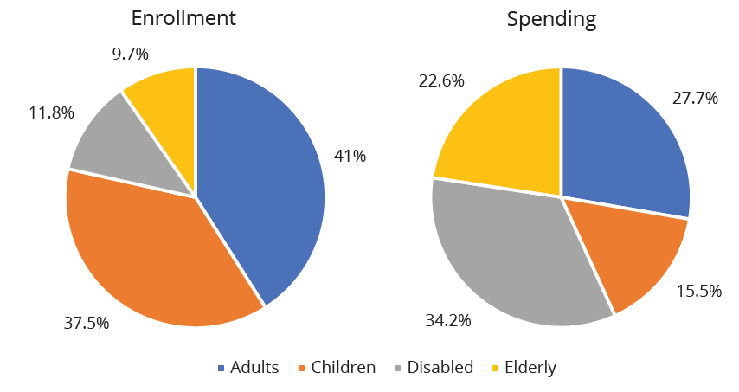
Medicaid₂
Notes:
Part (a) shows the Medicaid enrollment by different populations, with adults comprising the largest percentage at 41%, followed by children at 37.5%, and the disabled at 11.8%. Part (b) shows that Medicaid spending is principally for the disabled, followed by adults. Although children are the second largest population that Medicaid covers, expenditures on children are only at 15.5%.

Slide 14
Summary
We call the group of government programs that assist the poor the safety net.
In the United States, prominent safety net programs include Temporary Assistance to Needy Families (TANF), the Supplemental Nutrition Assistance Program (SNAP), the earned income tax credit (EITC), and Medicaid.

Slide 15




HAWKES LEARNING

