Slide 1
Market Power on the Supply Side of Labor Markets
HAWKES LEARNING

Slide 2
Introduction
A labor union is an organization of workers that negotiates with employers over wages and working conditions.
Labor unions seek to change the power balance between employers and workers by requiring employers to deal with workers collectively.
A labor union operates like a monopoly in a labor market.
Economists sometimes call negotiations between unions and firms collective bargaining.
Notes:
A labor union is an organization of workers that negotiates with employers over wages and working conditions. Labor unions seek to change the power balance between employers and workers by requiring employers to deal with workers collectively. A labor union operates like a monopoly in a labor market. Economists sometimes call negotiations between unions and firms collective bargaining.

Slide 3
Pros and Cons of Labor Unions
Pros (for workers)
Higher wages
Better working conditions
More job security
Cons
Higher cost of labor to firms
Higher costs to consumers
Perhaps less hiring
Notes:
There are both pros and cons to labor unions. The pros of labor unions accrue to the workers that are members of labor unions through the enhanced negotiating power the threat of a strike or work stoppage generates for unions. These are higher wages, better working conditions and more job security. The cons from labor unions include the higher cost of labor to firms, higher costs to consumers and also the possibility of less hiring by firms in response to both the higher wages generated by labor unions and also the increased difficulty firms have in firing workers that are labor union members.

Slide 4
Real-World Example₁
Suppose you own a firm that is currently more labor intensive than capital intensive, but labor and capital can be substituted for each other in your industry. If your industry becomes unionized, what can you do to avoid some of the negative impacts of a union?
Notes:
Suppose you own a firm that is currently more labor intensive than capital intensive, but labor and capital can be substituted for each other in your industry. If your industry becomes unionized, what can you do to avoid some of the negative impacts of a union?

Slide 5
Real-World Example₂
Suppose you own a firm that is currently more labor intensive than capital intensive, but labor and capital can be substituted for each other in your industry. If your industry becomes unionized, what can you do to avoid some of the negative impacts of a union?
To avoid having issues with higher costs of production (due to higher wages) following the decision to unionize, you could substitute more capital for labor in the production process.
Notes:
Suppose you own a firm that is currently more labor intensive than capital intensive, but labor and capital can be substituted for each other in your industry. If your industry becomes unionized, what can you do to avoid some of the negative impacts of a union?
To avoid having issues with higher costs of production (due to higher wages) following the decision to unionize, you could substitute more capital for labor in the production process.

Slide 6
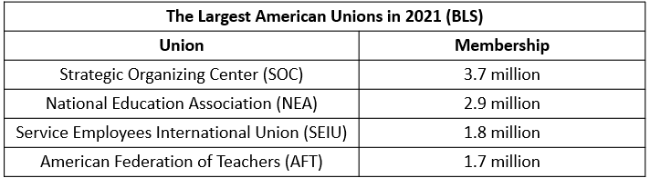
Largest Labor Unions in 2021
Notes:
Here is a table showing the four largest labor unions in the United States in 2021. The Strategic Organizing Center is the largest union with 3.7 million members. The National Education Association, which is a union for teachers, is the second largest union with 2.9 million members. The Service Employees International Union is the third largest union with 1.8 million members. They represent service workers ranging from janitors to home health care workers to child care workers. You can look up each of these unions on the web if you are interested to see who they represent and the issues they are fighting for.

Slide 7
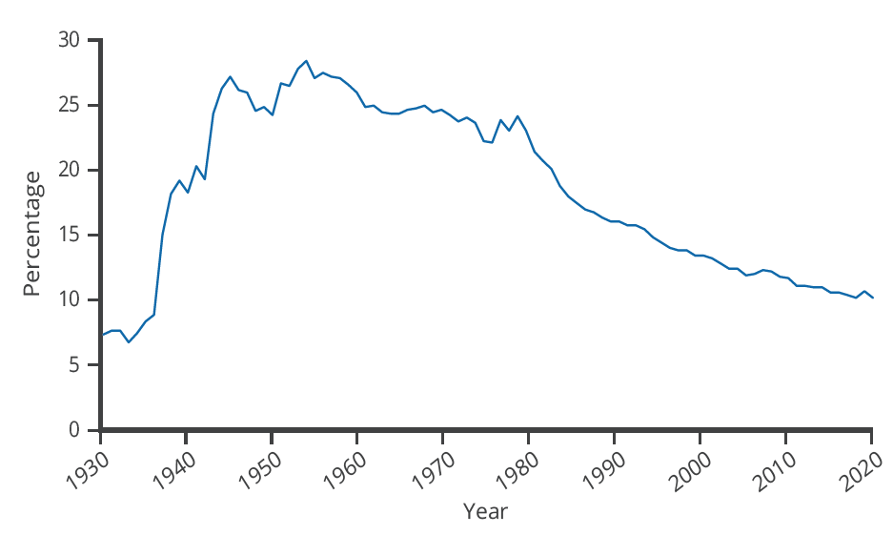
Union Membership Over Time
The share of wage and salary workers who belong to unions rose sharply in the 1930s and 1940s but has tailed off since then to around 10.3% today.
Notes:
Here is a graph showing the trend in union membership over time. Union membership increased rapidly in the 1930’s in response to legislation introduced as part of the New Deal during the Great Depression, but since the 1960’s union membership has steadily declining.

Slide 8
Higher Wages for Union Workers
Because a union is the sole supplier of labor, it can act like a monopoly and ask for whatever wage rate it can obtain for its workers.
If employers need workers, they must meet the union's wage demand.
The union can threaten that workers will strike unless firms agree to the wages they demand.
Notes:
Because a union is the sole supplier of labor, it can act like a monopoly and ask for whatever wage rate it can obtain for its workers. If employers need workers, they must meet the union's wage demand. The union can threaten that unless firms agree to the wages they demand, the workers will strike.

Slide 9
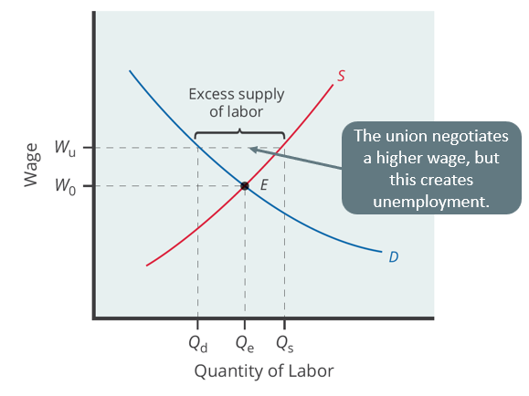
Negotiating Higher Wages
Without a union, the equilibrium at E would have involved the wage W _{e} and the quantity of labor Q _{e}.
The union is able to use its bargaining power to raise the wage to W _{u}.
The result is an excess supply of labor for union jobs.
Notes:
Without a union, the equilibrium at E would have involved the wage We and the quantity of labor Qe. However, the union is able to use its bargaining power to raise the wage to Wu. The result is an excess supply of labor for union jobs. That is, a quantity of labor supplied, Qs, is greater than firms' quantity demanded for labor, Qd.

Slide 10
Why Union Workers Might Have Higher Productivity than Non-Union Workers
Reason 1:
Higher wages may induce workers to work harder.
Reason 2:
Union workers tend to stay on the job longer.
  This increases experience and reduces hiring and training costs.
Reason 3:
In response to higher wages, firms often choose more capital-intensive production techniques.
  More capital boosts worker productivity.
  However, unions sometimes oppose the adoption of labor-saving technology.
Notes:
Let’s now address the question of whether union workers are more productive than non-union workers. There are three reasons why this might be the case. The first reason is that the higher wage negotiated by the union may induce workers to work harder. Higher than market clearing wages are often called efficiency wages for this reason.

Slide 11

Why Has Union Membership Declined?₁
Economists list three main reasons for the decline in union membership since the 1960s.
Notes:
Now let’s address the question of why union membership has declined since the 1950’s. Economist give three main reasons for this.

Slide 12
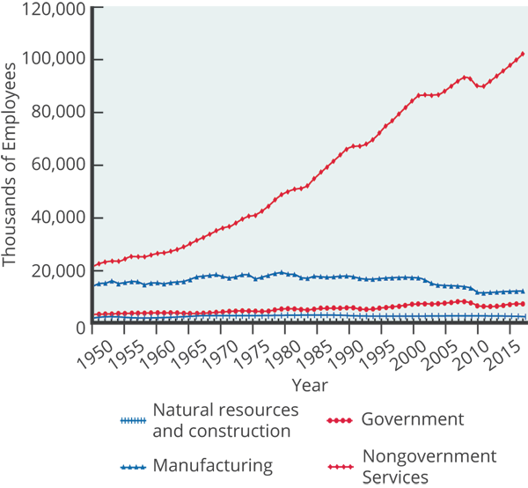
Why Has Union Membership Declined?₂
Reason 1: The shift from manufacturing to service industries.
Notes:
The first reason for the decline in union membership is the shift away from manufacturing jobs, which are more heavily unionized, to service jobs that are often not represented by unions. Here is graph showing the job trends in the United States since 1950. The y-axis shows the level of employment measured in thousands of employees, so you can see the rapid increase in the number of service sector jobs from about 22 million workers in 1950 to over 100 million workers in 2017. You can also see the slow decline in manufacturing jobs from 19 million in the 1970’s to 17 million in 2017.

Slide 13
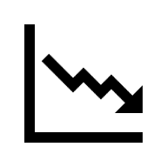

Why Has Union Membership Declined?₃
Reason 2: Globalization and increased competition from foreign products have reduced union bargaining power.
Notes:
The second reason union membership has declined is because globalization and increased competition from foreign products have reduced union bargaining power.

Slide 14

Auto Industry Example
Starting in the 1960s, U.S. car makers faced increased competition from Europe and Japan.
As sales of imports rose, U.S. car sales fell.
Membership in the United Auto Workers union fell from 975,000 in 1985 to 400,000 by 2022.
Notes:
Starting in the 1960’s US car makers faced increased competition from Europe and Japan. As sales of imports rose, U.S. car sales fell. Membership in the United Auto Workers union fell from 975,000 in 1985 to 400,000 in 2022 as the decline in car sales lead to layoffs by U.S. auto companies.

Slide 15

Why Has Union Membership Declined?₄
Reason 3: Workplace protection laws now in place have reduced the need for unions to negotiate on behalf of workers for these better working conditions.
Notes:
The third reason for the decline in union membership is because workplace protection laws now in place reduced the need for unions to negotiate on behalf of workers for these better working conditions.

Slide 16
International Union Membership
The U.S. is near the bottom of international rankings in percentage of workers whose wages are determined by union bargaining.
U.S. laws are, perhaps, less friendly to the formation of unions than such laws in other countries.
The close connection between union membership and a friendly legal environment is apparent in the history of U.S. unions.
The National Labor-Management Relations Act of 1935 specified that workers had a right to organize unions.
Notes:
The U.S. is near the bottom of international rankings in percentage of workers whose wages are determined by union bargaining. U.S. laws are, perhaps, less friendly to the formation of unions than such laws in other countries. The close connection between union membership and a friendly legal environment is apparent in the history of U.S. unions. The National Labor-Management Relations Act of 1935 specified that workers had a right to organize unions.

Slide 17
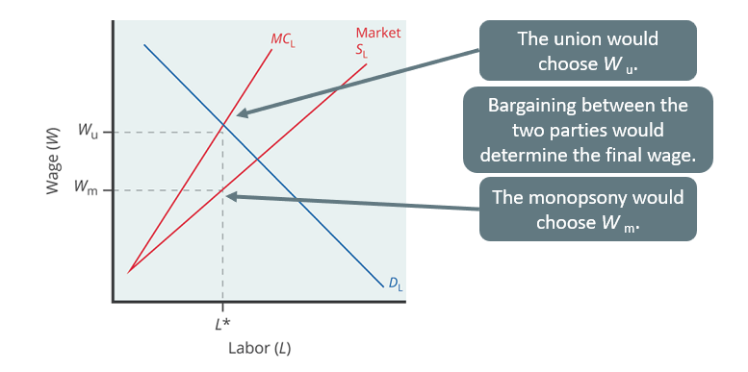
Bilateral Monopoly
A bilateral monopoly occurs when there is market power on both sides of the labor market.
Notes:
Now let’s take a look at a special case known as bilateral monopoly. A bilateral monopoly occurs when there is market power on both sides of the labor market. So, this is a battle between a monopsony on the labor demand side vs. a union on the labor supply side. Employment, L*, will be lower in a bilateral monopoly than in a competitive labor market, but the equilibrium wage is indeterminate, somewhere in the range between Wu (what the union would choose) and Wm (what the monopsony would choose).

Slide 18
Summary
A labor union is an organization of workers that negotiates as a group with employers over compensation and work conditions.
Union workers in the United States are paid more on average than other workers with comparable education and experience.
American union membership has been falling for decades: some possible reasons include the shift of jobs to service industries, greater competition from globalization, the passage of worker-friendly legislation, and U.S. laws that are less favorable to organizing unions.
A bilateral monopoly is a labor market with a union on the supply side and a monopsony on the demand side.
Since both sides have monopoly power, the equilibrium level of employment will be lower than that for a competitive labor market, but the equilibrium wage could be higher or lower depending on which side negotiates better.

Slide 19




HAWKES LEARNING

