Slide 1
The Theory of Labor Markets
HAWKES LEARNING

Slide 2

The Theory of Labor Markets₁
In the U.S., income is based on one's value to an employer, which depends in part on education.
Notes:
In the U.S., income is based on one's value to an employer, which depends in part on education.

Slide 3
Introduction
In a market economy like the United States, income comes from ownership of the means of production: resources or assets.
Income is a function of the quantity of each resource one owns and the value society places on those resources.
Each factor payment, like wages for labor and interest for financial capital, is determined in their respective factor markets.
This lesson will focus on labor markets, but other factor markets operate similarly.
Notes:
In a market economy like the United States, income comes from ownership of the means of production: resources or assets. Income is a function of the quantity of each resource one owns and the value society places on those resources. Each factor payment, like wages for labor and interest for financial capital, is determined in their respective factor markets. This lesson will focus on labor markets, but other factor markets operate similarly.

Slide 4
What is the Labor Market?
The labor market is the term that economists use for all the different markets for labor.
There is no single labor market; rather, there is a different market for every different type of labor.
Labor differs by type of work (e.g., retail vs. research science), skill level (entry or more experienced), and location (local, regional, etc.).
While each labor market is different, they all tend to operate in similar ways.
Notes:
The labor market is the term that economists use for all the different markets for labor. There is no single labor market; rather, there is a different market for every different type of labor. Labor differs by type of work (e.g. retail sales vs. scientist), skill level (entry level or more experienced), and location (local, regional, etc.). While each labor market is different, they all tend to operate in similar ways.

Slide 5
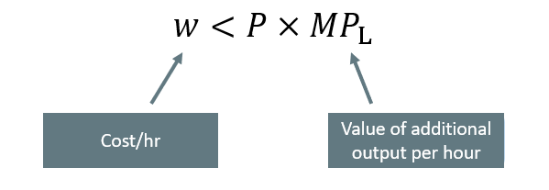
First Rule of Labor Markets
To maximize profit, a firm should never pay more in wages and benefits than the value of the worker’s marginal productivity to the firm.
Notes:
If a firm wants to maximize profits, it should follow the first rule of labor markets. To maximize profits, firms should never pay more in wages and benefits than the value of the worker’s marginal productivity to the firm. Algebraically, this can be represented as w (wage) has to be less than the price of the product the firm is selling times the marginal product of labor (MPL). The price times the MPL gives the value of the marginal product of labor. Remember, the marginal product of labor is the additional output a worker produces. If you multiply that output by its price, you get the value of that additional output. The value of the additional output must be less than the cost of hiring the worker, which again is w.

Slide 6
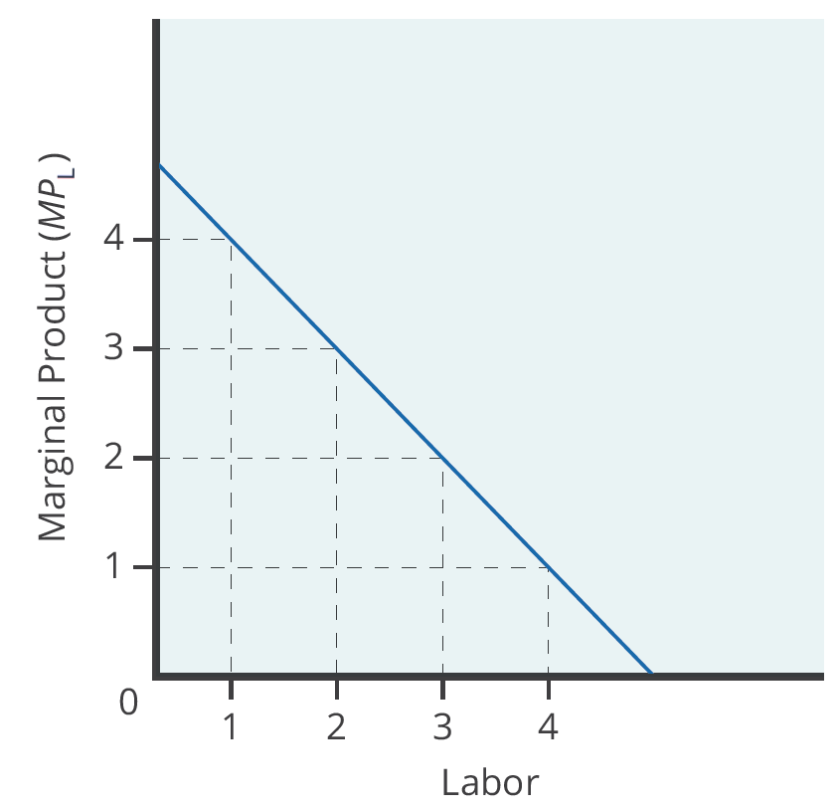
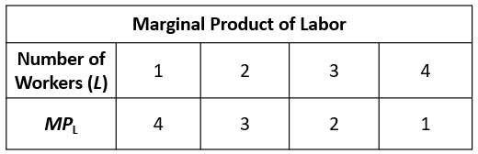

Marginal Product of Labor
Since employers often hire labor by the hour, marginal product of labor is the additional output the firm produces by adding one more worker hour to the production process.
Notes:
Since employers often hire labor by the hour, marginal product is the additional output the firm produces by adding one more worker hour to the production process. Demand for labor is represented in the equation D_{L} = MP_{L} × P.

Slide 7
Labor Demand
On what does the value of each worker's marginal product depend? If we assume that the employer sells its output in a perfectly competitive market, the value of each worker's output will be the market price of the product.
Notes:
On what does the value of each worker's marginal product depend? If we assume that the employer sells its output in a perfectly competitive market, the value of each worker's output will be the market price of the product. Thus,
Demand for Labor=MP_{L}×P=Value of the Marginal Product of Labor

Slide 8
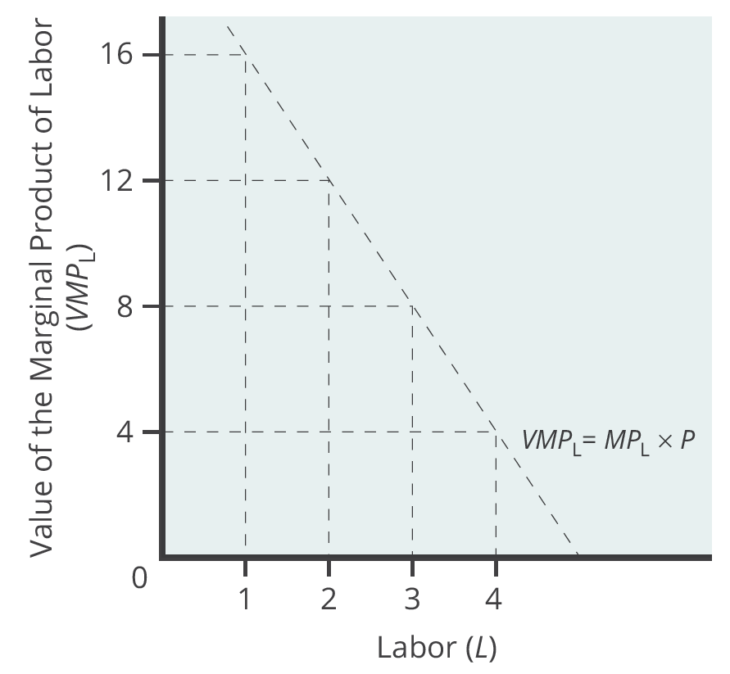
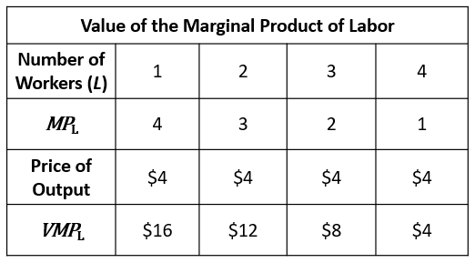
Value of the Marginal Product of Labor
Notes:
For firms operating in a competitive output market, the value of additional output sold is the price the firms receive for the output. Since MPL declines with additional labor employed, the value of the marginal product declines as employment increases.

Slide 9
Real-World Example₁
Suppose you are working for a firm that sells its output for $10. Suppose that your marginal product of labor is 7. When the firm hires the next person after you, their marginal product of labor is 5. What is the value of the marginal product of labor for you? What is it for the next person hired?
Notes:
Suppose you are working for a firm that sells its output for $10. Suppose that your marginal product of labor is 7. When the firm hires the next person after you, their marginal product of labor is 5. What is the value of the marginal product of labor for you? What is it for the next person hired?

Slide 10
Real-World Example₂
Suppose you are working for a firm that sells its output for $10. Suppose that your marginal product of labor is 7. When the firm hires the next person after you, their marginal product of labor is 5. What is the value of the marginal product of labor for you? What is it for the next person hired?
The value of the marginal product of labor is the marginal product of labor multiplied by the price of the output. So, your VMP_{L} would be 7 × $10 = $70. The VMP_{L} for the next person hired would be 5 × $10 = $50.
Notes:
Suppose you are working for a firm that sells its output for $10. Suppose that your marginal product of labor is 7. When the firm hires the next person after you, their marginal product of labor is 5. What is the value of the marginal product of labor for you? What is it for the next person hired?
The value of the marginal product of labor is the marginal product of labor multiplied by the price of the output. So, your VMP_{L} would be 7 x $10 = $70. The VMP_{L} for the next person hired would be 5 x $10 = $50.

Slide 11

Demand for Labor in Perfectly Competitive Output Markets₁
A perfectly competitive labor market is one where firms can hire all the labor they wish at the going market wage.
Graphically, this means that firms face a horizontal supply curve for labor.
Notes:
A perfectly competitive labor market is one where firms can hire all the labor they wish at the going market wage. Graphically, this means that firms face a horizontal supply curve for labor. Given the market wage, profit-maximizing firms hire workers up to the point where: $W_{mkt}={VMP}_{L}$.

Slide 12
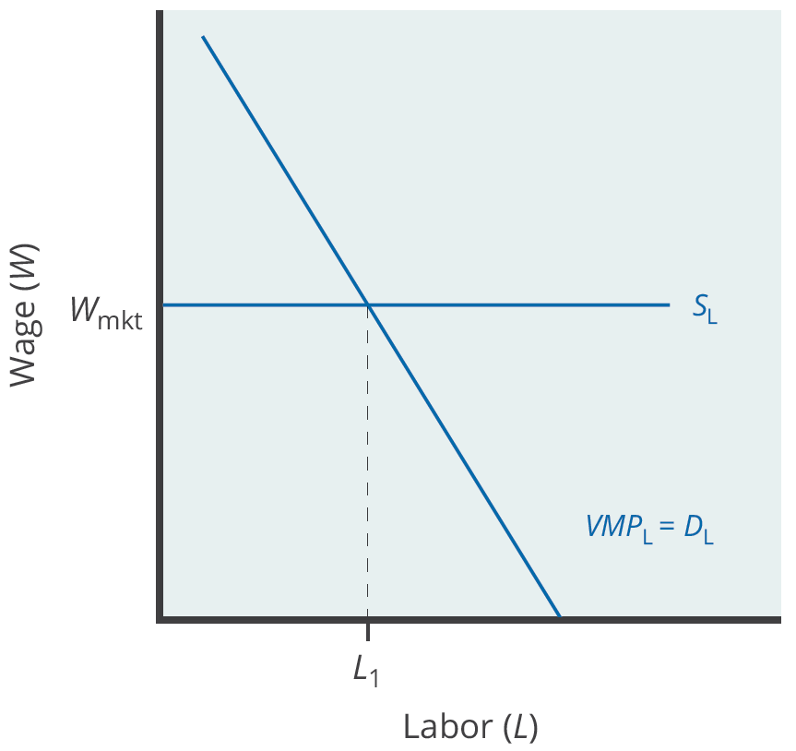
Demand for Labor in Perfectly Competitive Output Markets₂
In a perfectly competitive labor market, firms can hire all the labor they want at the going market wage. Therefore, they hire workers up to the point L₁, where the going market wage equals the value of the marginal product of labor.
Notes:
In a perfectly competitive labor market, firms can hire all the labor they want at the going market wage. Therefore, they hire workers up to the point L1, where the going market wage equals the value of the marginal product of labor.

Slide 13
Labor Demand in Imperfectly Competitive Output Markets₁
If the employer does not sell its output in a perfectly competitive industry, it faces a downward-sloping demand curve for output.
This is true if the firm is a monopoly, but it's also true if the firm is an oligopoly or monopolistically competitive.
In this situation, the value of a worker's marginal product is the marginal revenue, not the price.
Thus, the demand for labor is the marginal product times the marginal revenue.
Notes:
If the employer does not sell its output in a perfectly competitive industry, it faces a downward-sloping demand curve for output. This is true if the firm is a monopoly, but it's also true if the firm is an oligopoly or monopolistically competitive. In this situation, the value of a worker's marginal product is the marginal revenue, not the price. Thus, the demand for labor is the marginal product times the marginal revenue.

Slide 14
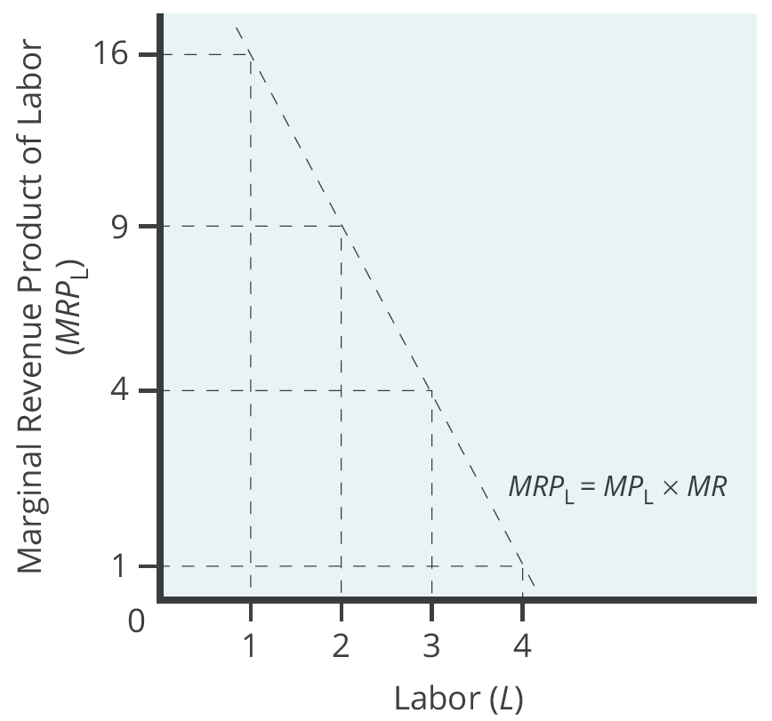
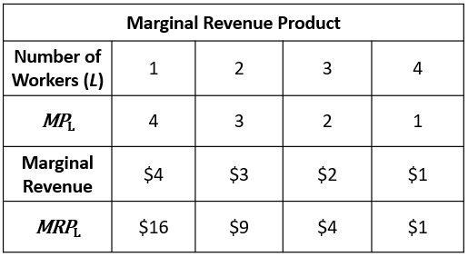
Labor Demand in Imperfectly Competitive Output Markets₂
Notes:
For firms with some market power in their output market, the value of additional output sold is the firm's marginal revenue. Since MPL declines with additional labor employed, and MR declines with additional output sold, the firm's marginal revenue declines as employment increases.

Slide 15
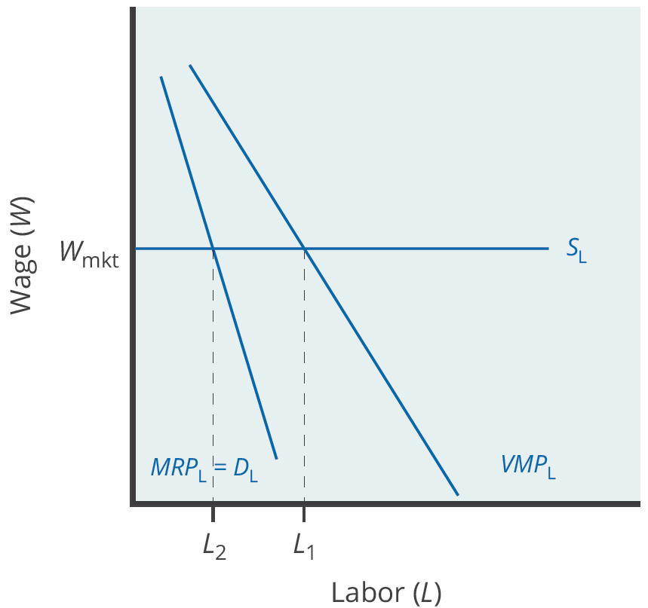
Labor Demand in Imperfectly Competitive Output Markets₃
For firms with market power in their output market, they choose the number of workers, L₂, where the going market wage equals the firm's marginal revenue product. Employment will be lower in an imperfectly competitive industry than in a perfectly competitive industry.
Notes:
For firms with market power in their output market, they choose the number of workers, L2, where the going market wage equals the firm's marginal revenue product. Note that since marginal revenue is less than price, the demand for labor for a firm that has market power in its output market is less than the demand for labor ( L1) for a perfectly competitive firm. As a result, employment will be lower in an imperfectly competitive industry than in a perfectly competitive industry.

Slide 16
On Your Own₁
Choose the answer that accurately completes the following sentences.
The market demand for labor is the [blank] of all firms’ demands for labor.
☐ vertical sum
☐ horizontal sum
☐ supply minus the sum
☐ none of the above
The supply of labor curve is [blank].
☐ an upward-sloping function of the wage rate
☐ a downward-sloping function of the interest rate
☐ an upward-sloping function of the interest rate
☐ a downward-sloping function of the wage rate

Slide 17
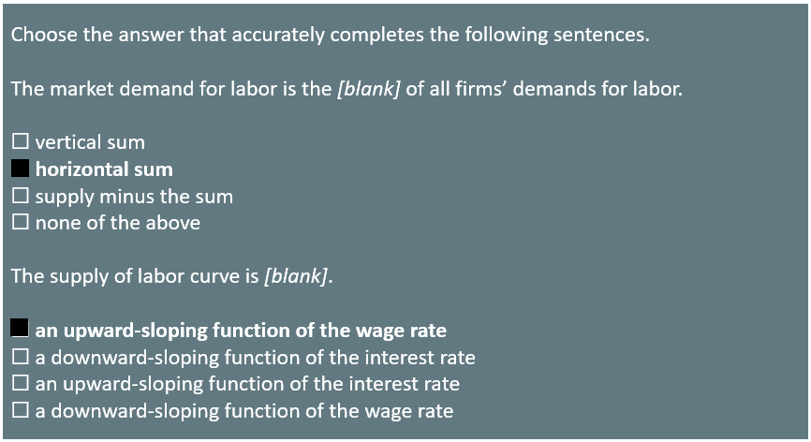
On Your Own₂

Slide 18
Summary
A firm demands labor because of the value of the labor's marginal productivity.
For a firm operating in a perfectly competitive output market, this will be the value of the marginal product, which we define as the marginal product of labor multiplied by the firm's output price.
For a firm that is not perfectly competitive, the appropriate concept is the marginal revenue product, which we define as the marginal product of labor multiplied by the firm's marginal revenue.
Profit-maximizing firms employ labor up to the point where the market wage is equal to the firm's demand for labor.
In a competitive labor market, we determine market wage through the interaction between the market supply and market demand for labor.

Slide 19




HAWKES LEARNING

