Slide 1
Policies to Reduce Pollution
HAWKES LEARNING

Slide 2
Command-and-Control Regulation₁
Command-and-control regulation includes laws that specify allowable quantities of pollution.
This regulation may detail which pollution-control technologies companies may use.
In effect, command-and-control regulation requires that firms increase their costs by installing anti-pollution equipment.
Firms are required to account for the social costs of pollution in deciding how much output to produce.
Notes:
Command-and-control regulation includes laws that specify allowable quantities of pollution. This regulation may detail which pollution-control technologies companies may use. In effect, command-and-control regulation requires that firms increase their costs by installing anti-pollution equipment. Firms are required to account for the social costs of pollution in deciding how much output to produce.

Slide 3
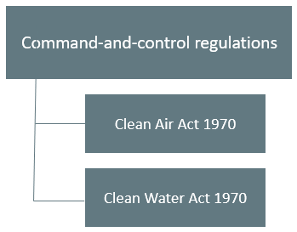
Command-and-Control Regulation₂
Command-and-control regulation has been highly successful in protecting and cleaning up the U.S. environment.
In 1970, the Federal government created the Environmental Protection Agency (EPA) to oversee all environmental laws.
Notes:
Command-and-control regulation has been highly successful in protecting and cleaning up the U.S. environment. In 1970, the Federal government created the Environmental Protection Agency (EPA) to oversee all environmental laws. These laws include the Clean Air Act and the Clean Water Act of 1970.

Slide 4
Difficulties With Command-and-Control Regulation
Economists have pointed out three difficulties with command-and-control environmental regulation.
Command-and-control regulation offers no incentive to reduce pollution below the standard set by law.
Command-and-control regulation is inflexible because it applies the same standard of pollution reduction to all polluters.
Legislators and EPA analysts write the regulations, so they are subject to compromises in the political process that may weaken the impact.
Notes:
Economists have pointed out three difficulties with command-and-control environmental regulation. Command-and-control regulation offers no incentive to reduce pollution below the standard set by law. Command-and-control regulation is inflexible because it applies the same standard of pollution reduction to all polluters. Legislators and EPA analysts write the regulations, so they are subject to compromises in the political process that may weaken the impact.

Slide 5
Real-World Discussion₁
Suppose you are in a polluting industry, and you are a relatively new, small firm in that industry. How might command-and-control regulation be problematic for you compared to a larger, more established firm?
Notes:
Suppose you are in a polluting industry, and you are a relatively new, small firm in that industry. How might command-and-control regulation be problematic for you compared to a larger, more established firm?

Slide 6
Real-World Discussion₂
Suppose you are in a polluting industry, and you are a relatively new, small firm in that industry. How might command-and-control regulation be problematic for you compared to a larger, more established firm?
It is likely that a new, small entrant in a market would face higher costs from command-and-control regulation than a more established, larger firm. The one-size-fits-all approach of this type of regulation applies the same standard to all firms in the industry. It is possible that this regulation could increase costs for your small firm to the extent that it is hard to compete or cost-prohibitive to comply with the regulation.
Notes:
Suppose you are in a polluting industry, and you are a relatively new, small firm in that industry. How might command-and-control regulation be problematic for you compared to a larger, more established firm?
It is likely that a new, small entrant in a market would face higher costs from command-and-control regulation than a more established, larger firm. The one-size-fits-all approach of this type of regulation applies the same standard to all firms in the industry. It is possible that this regulation could increase costs for your small firm to the extent that it is hard to compete or cost-prohibitive to comply with the regulation.

Slide 7
Market-Oriented Environmental Tools
Market-oriented environmental policies create incentives to allow firms some flexibility in reducing pollution.
There are three main categories of market-oriented approaches to pollution control.
Pollution charges
Marketable permits
Better-defined property rights
Notes:
Market-oriented environmental policies create incentives to allow firms some flexibility in reducing pollution. There are three main categories of market-oriented approaches to pollution control: pollution charges, marketable permits, and better-defined property rights.

Slide 8
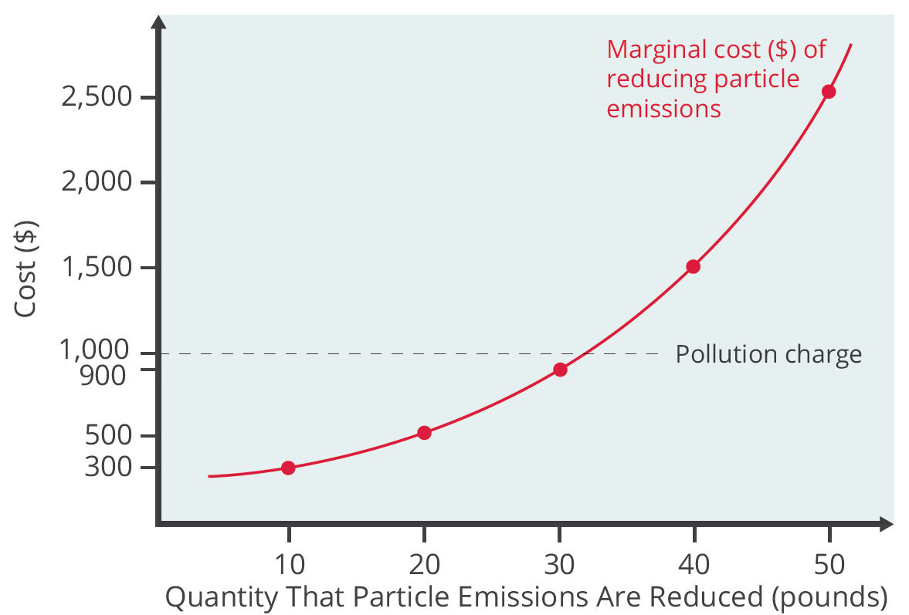
Pollution Charges₁
Pollution charges are taxes imposed on the quantity of pollution that a firm emits.
They give firms an incentive to reduce pollution as long as the marginal cost is less than the tax.
The marginal cost of pollution reduction, like most marginal cost curves, increases with output, at least in the short run.
Notes:
Pollution charges are taxes imposed on the quantity of pollution that a firm emits. Gives firms an incentive to reduce pollution as long as the marginal cost is less than the tax. The marginal cost of pollution reduction, like most marginal cost curves, increases with output, at least in the short run.

Slide 9
Pollution Charges₂
A firm has no incentive to reduce pollutants beyond the point of the pollution tax because this would be more costly than the tax.
Notes:
A firm has no incentive to reduce pollutants beyond the point of the pollution tax because this would be more costly than the tax.

Slide 10
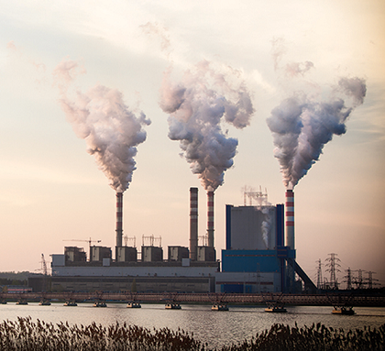
Marketable Permits₁
In order to limit the amount of pollution emitted into the environment, governments can give companies marketable permits that allow a certain amount of pollution.
Notes:
A city or state government may set up a marketable permit program (e.g. cap-and-trade). State and local governments determine the overall level of pollution they will allow. The government divides permits allowing the determined level of pollution among firms. Firms may buy and sell the permits.

Slide 11
Marketable Permits₂
A city or state government may set up a marketable permit program (e.g., cap-and-trade).
State and local governments determine the overall level of pollution they will allow.
The government divides permits allowing the determined level of pollution among firms.
Firms may buy and sell the permits.
Notes:
A city or state government may set up a marketable permit program (e.g. cap-and-trade). State and local governments determine the overall level of pollution they will allow. The government divides permits allowing the determined level of pollution among firms. Firms may buy and sell the permits.

Slide 12
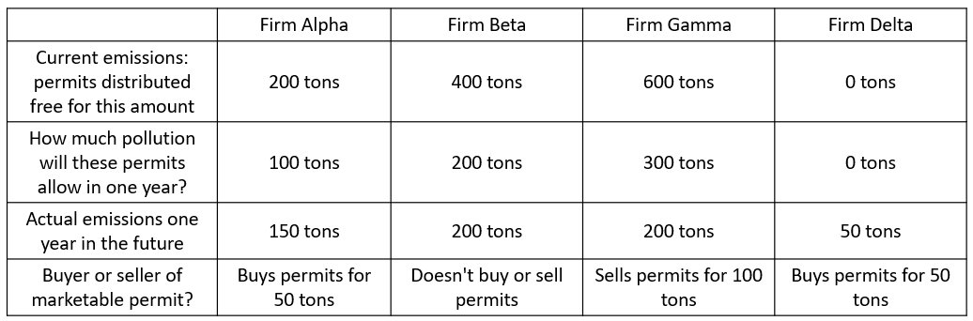
Marketable Permits₃
Firms will buy and sell permits. For example, Alpha can reduce its pollution at a relatively low cost to 150 tons, but it still has 50 tons of pollution above its permitted amount. Alpha will buy permits from Gamma for the 50 tons over its 100-ton limit.
Notes:
Firms will buy and sell permits. For example, Alpha can reduce its pollution at a relatively low cost to 150 tons, but it still has 50 tons of pollution above its permitted amount. Alpha will buy permits from Gamma for the 50 tons over its 100-ton limit.

Slide 13
Better-Defined Property Rights
Property rights are the legal rights of ownership on which others are not allowed to infringe without paying compensation.
The property rights approach is highly relevant in cases involving endangered species, for example.
The U.S. government's endangered species list includes about 1,000 plants and animals, and about 90% live on privately owned land.
The protection of these endangered species requires careful thinking about incentives and property rights.
Notes:
Property rights are the legal rights of ownership on which others are not allowed to infringe without paying compensation. The property rights approach is highly relevant in cases involving endangered species, for example. The U.S. government's endangered species list includes about 1,000 plants and animals, and about 90% live on privately owned land. The protection of these endangered species requires careful thinking about incentives and property rights.

Slide 14
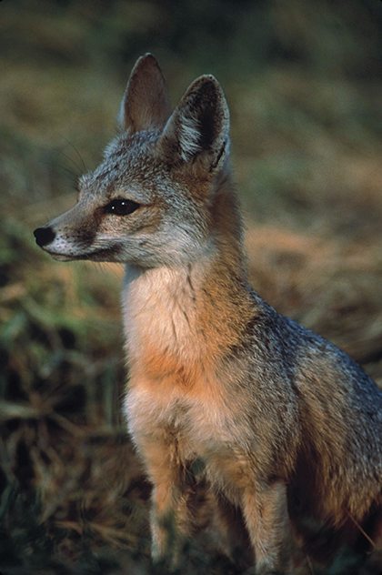
Property Rights
The protection of endangered species on privately owned land has created unintended incentives for landowners.
Notes:
The protection of endangered species on privately owned land has created unintended incentives for landowners.

Slide 15
Applying Market-Oriented Environmental Tools
Specific policy tools will work better in some situations than in others.
For example, marketable permits work best when a few dozen or few hundred parties are highly interested in trading.
For cases in which many users emit small amounts of pollution and have no interest in trading, pollution charges offer a better choice.
Alternatively, the government could combine marketable permits with a pollution tax on any emissions not covered by a permit.
Notes:
Specific policy tools will work better in some situations than in others. For example, marketable permits work best when a few dozen or few hundred parties are highly interested in trading. For cases in which many users emit small amounts of pollution and have no interest in trading, pollution charges offer a better choice. Alternatively, the government could combine marketable permits with a pollution tax on any emissions not covered by a permit.

Slide 16
On Your Own₁
Property rights are the [blank] rights of [blank] on which others are not allowed to infringe without paying compensation.
☐ legal; households
☐ ownership; firms
☐ firms’; ownership
☐ legal; ownership
Environmental law built on [blank] and [blank] tends to be more effective than the command and-control approach.
☐ property rights; flexibility
☐ incentives; property rights
☐ incentives; flexibility

Slide 17
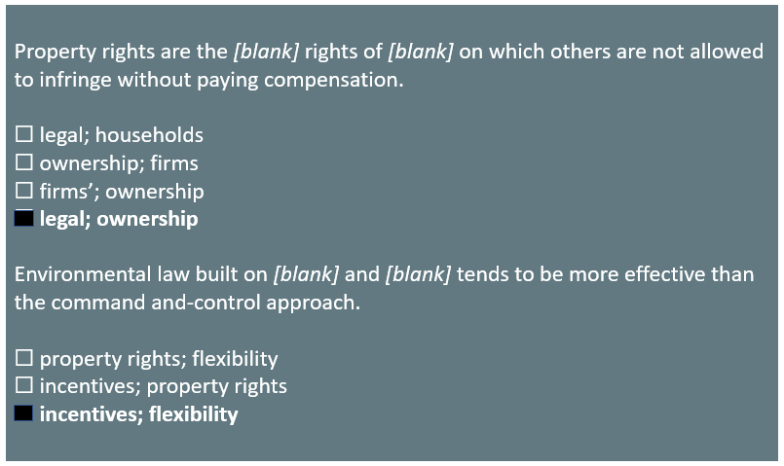
On Your Own₂

Slide 18
Summary
Command-and-control regulation sets specific limits for pollution emissions and/or specific pollution-control technologies that firms must use.
Although such regulations have helped protect the environment, they have three shortcomings: they provide no incentive for going beyond the limits they set; they offer limited flexibility on where and how to reduce pollution; and they often have politically motivated loopholes.
Examples of market-oriented environmental policies include pollution charges, marketable permits, and better-defined property rights.
Market-oriented environmental policies include taxes, markets, and property rights so that those who impose negative externalities must face the social cost.

Slide 19




HAWKES LEARNING

