Slide 1
The Economics of Pollution
HAWKES LEARNING

Slide 2
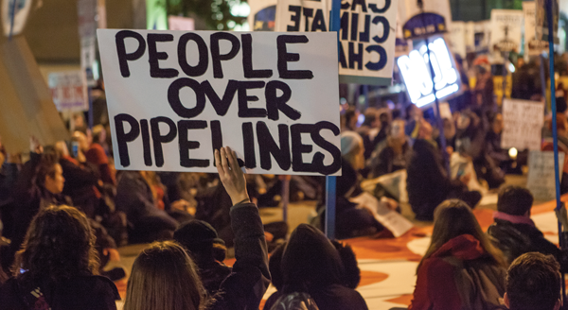
The Economics of Environmental Protection
Across the country, countless people protested, even risking arrest, against the Keystone XL Pipeline. Environmental concerns matter when discussing issues related to economic growth. However, how much should economists factor in these issues when deciding policy? In the case of the pipeline, how do we know how much damage it would cause when we do not know how to put a value on the environment? Would the pipeline’s benefits outweigh the opportunity cost?
Notes:
Across the country, countless people protested, even risking arrest, against the Keystone XL Pipeline. Environmental concerns matter when discussing issues related to economic growth. However, how much should economists factor in these issues when deciding policy? In the case of the pipeline, how do we know how much damage it would cause when we do not know how to put a value on the environment? Would the pipeline’s benefits outweigh the opportunity cost?

Slide 3
The Economics of Pollution₁
The problem of pollution arises for every economy in the world, whether high- or low-income, market-oriented or command-oriented.
Every country needs to strike some balance between production and environmental quality.
Firms may fail to take certain social costs, like pollution, into their planning if they do not need to pay these costs.
Traditionally, policies for environmental protection have focused on governmental limits on how much of each pollutant could be emitted.
Notes:
The problem of pollution arises for every economy in the world, whether high- or low-income, market-oriented or command-oriented. Every country needs to strike some balance between production and environmental quality. Firms may fail to take certain social costs, like pollution, into their planning if they do not need to pay these costs. Traditionally, policies for environmental protection have focused on governmental limits on how much of each pollutant could be emitted.

Slide 4

The Right Balance of Pollution and Production?
What is the environmental cost?
How much will it cost to produce?
How much are we willing to spend to minimize pollution?
Notes:
In order to find the right balance, a firm must think about how much it will cost to produce a certain quantity of output, how much pollution or the environmental cost of producing that quantity, and how much they are willing to spend to cut down or clean up the amount of pollution.

Slide 5
Externality
Pollution is an example of an externality.
An externality is the effect of a market exchange on a third party who is outside or external to the exchange.
Because externalities that occur in market transactions affect other parties beyond those involved, they are sometimes called spillovers.
Externalities can either be positive or negative depending on whether they provide an unintended benefit or unintended cost.
Notes:
Pollution is an example of an externality. An externality is the effect of a market exchange on a third party who is outside or external to the exchange.
Because externalities that occur in market transactions affect other parties beyond those involved, they are sometimes called spillovers. Externalities can either be positive or negative depending on whether they provide an unintended benefit or unintended cost.

Slide 6

Positive Externality
An unintended benefit that falls upon a third party, like getting a vaccination that prevents you and others from getting sick
Notes:
A positive externality is an unintended benefit that falls upon a third party, like getting a vaccination that prevents you and others from getting sick.

Slide 7
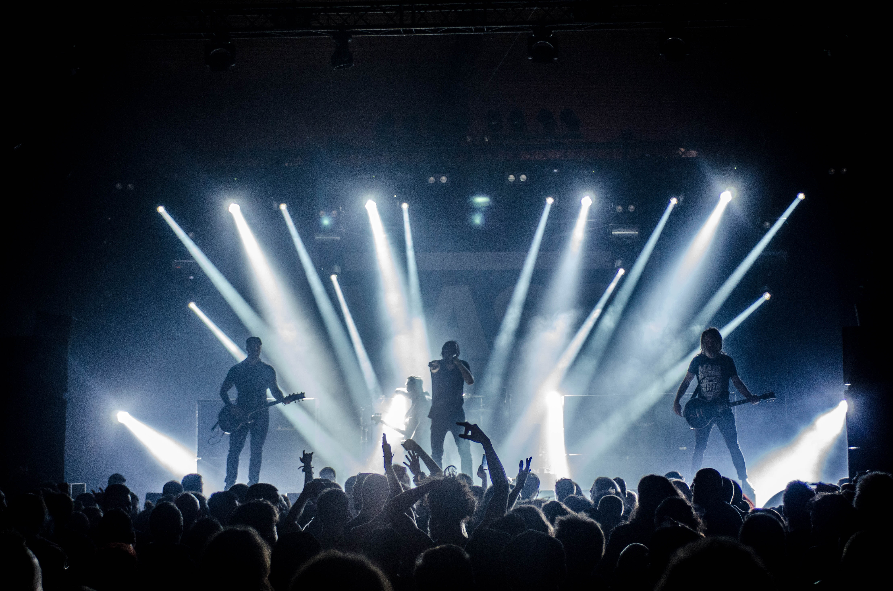
Negative Externality
An unintended cost that falls upon a third party, like loud music from a concert across the street waking you up
Notes:
A negative externality is an unintended cost that falls upon a third party, like loud music from a concert across the street waking you up.

Slide 8
Real-World Discussion₁
Suppose you have a neighbor who decides to install a security light outside his garage. While this provides great light at night, it happens to shine into your bedroom. What would you call this situation? Since you had no say in installing this light, what can you do to restore your sleep?
Notes:
Suppose you have a neighbor who decides to install a security light outside his garage. While this provides great light at night, it happens to shine into your bedroom. What would you call this situation? Since you had no say in installing this light, what can you do to restore your sleep?

Slide 9
Real-World Discussion₂
Suppose you have a neighbor who decides to install a security light outside his garage. While this provides great light at night, it happens to shine into your bedroom. What would you call this situation? Since you had no say in installing this light, what can you do to restore your sleep?
The installation of the light imposes a negative externality on you. You had no involvement in the decision to install the light, yet it has a negative impact on your sleep. You have a few options to try to correct the externality. The first option is to ask your neighbor to move the light. If the neighbor refuses, you can install some window covering to block the light. Unfortunately, you probably cannot force your neighbor to correct this negative externality!
Notes:
Suppose you have a neighbor who decides to install a security light outside his garage. While this provides great light at night, it happens to shine into your bedroom. What would you call this situation? Since you had no say in installing this light, what can you do to restore your sleep?

Slide 10
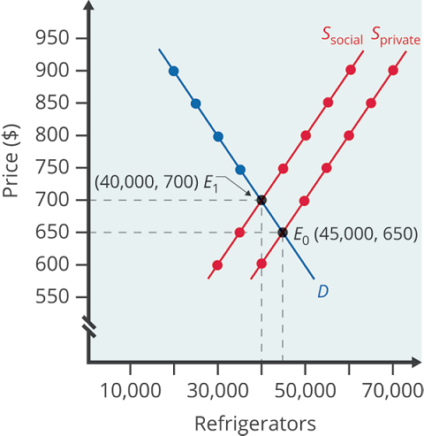
Pollution as a Negative Externality
Pollution is a negative externality that serves as a cost to society.
Economists illustrate the social costs of production with a demand and supply diagram.
Accounting for additional external costs brought on by an externality shifts a firm's supply curve to the left.
Notes:
Pollution is a negative externality that serves as a cost to society. Economists illustrate the social costs of production with a demand and supply diagram. Accounting for additional external costs brought on by an externality shifts a firm's supply curve to the left.

Slide 11
Social Costs
Social costs are the sum or combination of the private costs of production and the costs of externalities, like pollution.
For example, assume that for every refrigerator a firm produces, $100 worth of pollution is emitted.
If the firm is required to pay $100 for the additional external costs of pollution for each refrigerator, the supply curve shifts up by $100.
Private Costs of Production
Costs of Externalities
Social Costs
Notes:
Social costs are the sum or combination of the private costs of production and the costs of externalities, like pollution. For example, assume that for every refrigerator a firm produces, $100 worth of pollution is emitted. If the firm is required to pay $100 for the additional external costs of pollution for each refrigerator, the supply curve shifts up by $100.

Slide 12
Market Failure₁
When the externality of pollution exists, the supply curve no longer represents all social costs.
Externalities represent a case where markets no longer consider all social costs, but only some of them.
Economists commonly refer to externalities as an example of market failure.
In the case of pollution, at the market output, social costs of production exceed social benefits to consumers.
Notes:
When the externality of pollution exists, the supply curve no longer represents all social costs. Externalities represent a case where markets no longer consider all social costs, but only some of them. Economists commonly refer to externalities as an example of market failure.
In the case of pollution, at the market output, social costs of production exceed social benefits to consumers, and the market produces too much of the product.

Slide 13
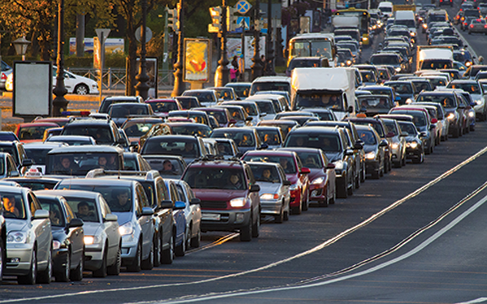
Market Failure₂
Traffic is an example of a market failure of a public good. When roads are overcrowded and traffic is heavy, there are additional external costs, including the opportunity costs of lost time and extra pollution.
Notes:
Traffic is an example of a market failure of a public good. When roads are overcrowded and traffic is heavy, there are additional external costs, including the opportunity costs of lost time and extra pollution.

Slide 14
On Your Own₁
The social costs of production are illustrated using:
☐ The average cost curve
☐ The marginal cost curve
☐ The supply and demand curves
☐ The demand curve
The social costs of pollution include:
☐ The private costs of production
☐ The external costs of pollution
☐ The regulatory cost on the industry
☐ Both the private costs of production and the external costs of pollution
☐ Both the external costs of pollution and the regulatory cost on the industry

Slide 15
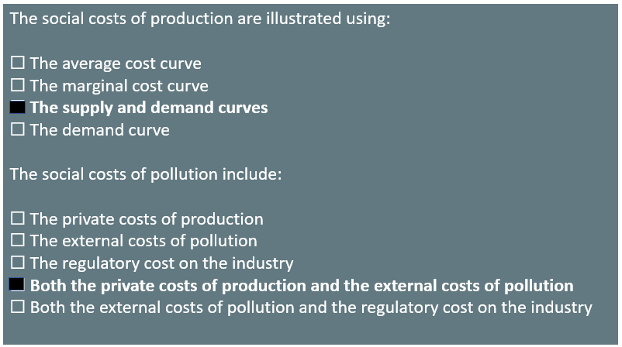
On Your Own₂

Slide 16
Summary
Economic production can cause environmental damage.
An externality occurs when an exchange between a buyer and seller has an impact on a third party who is not part of the exchange.
An externality, which is sometimes called a spillover, can have a negative or a positive impact on the third party.
If those parties that impose a negative externality on others had to account for the broader social cost of their behavior, they would have an incentive to reduce the production of whatever is causing the negative externality.
In the case of a positive externality, the third party obtains benefits from the exchange between a buyer and a seller, but they are not paying for these benefits.

Slide 17




HAWKES LEARNING

