Slide 1
Oligopoly
HAWKES LEARNING
Notes:
By the end of this lesson, you will be able to explain how and why oligopolies exist; contrast collusion and competition; understand the oligopolist prisoner’s dilemma; and evaluate tradeoffs of imperfect competition.

Slide 2
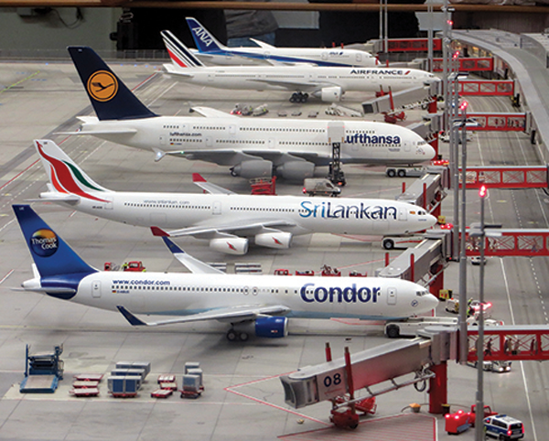
Oligopoly₁
Many purchases that individuals make at the retail level are produced in markets that are neither perfectly competitive, monopolies, nor monopolistically competitive. Rather, they are oligopolies. Oligopoly arises when a small number of large firms have all or most of the sales in an industry.
Notes:
Many purchases that individuals make at the retail level are produced in markets that are neither perfectly competitive, monopolies, nor monopolistically competitive. Rather, they are oligopolies. Oligopoly arises when a small number of large firms have all or most of the sales in an industry.

Slide 3
Why Do Oligopolies Exist?
A combination of the barriers to entry that create monopolies and the product differentiation that characterizes monopolistic competition can create the setting for an oligopoly.
For example, the government could grant a patent to one firm, creating a monopoly, or to multiple firms, creating an oligopoly.
A natural monopoly will arise when the quantity demanded in a market is only large enough for a single firm to operate at the minimum of the LRAC curve.
Quantity demanded in the market may also be greater than the quantity needed to produce at the minimum of the LRAC curve, leading to an oligopoly.
Notes:
The barriers to entry that create monopolies and product differentiation can create the setting for an oligopoly. For example, the government could grant a patent to one firm or multiple firms, possibly creating either a monopoly or an oligopoly. A natural monopoly will arise when the quantity demanded in a market is only large enough for a single firm to operate at the minimum of the long-run average cost curve. Quantity demanded in the market may also be two or three times the quantity needed to produce at the minimum of the average cost curve, which means that the market would have room for only two or three oligopoly firms.

Slide 4
Collusion or Competition?
When oligopoly firms decide what quantity to produce and what price to charge, they face a temptation to act as if they were a monopoly.
By acting together, oligopolistic firms can hold down industry output, charge a higher price, and divide the profit among themselves.
When firms act together in this way to reduce output and keep prices high, it is called collusion.
A group of firms that have a formal agreement to collude to produce the monopoly output and sell at the monopoly price is called a cartel.
Notes:
When oligopoly firms decide what quantity to produce and what price to charge, they face a temptation to act as if they were a monopoly. By acting together, oligopolistic firms can hold down industry output, charge a higher price, and divide the profit among themselves. When firms act together in this way to reduce output and keep prices high, it is called collusion. A group of firms that have a formal agreement to collude to produce the monopoly output and sell at the monopoly price is called a cartel.

Slide 5
On Your Own₁
Choose the best answer for each of the following questions.
When firms act together to reduce output and keep prices high, this is called:
☐ Mutual interdependence
☐ Collusion
☐ A monopoly
☐ Natural monopoly
A group of firms that have a formal agreement to collude is called:
☐ A monopoly
☐ A cartel
☐ A perfectly competitive firm
☐ A price discriminating monopolist

Slide 6
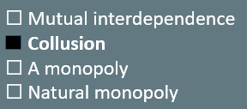
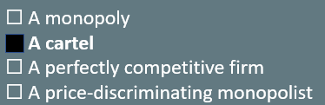
On Your Own₂
Choose the best answer for each of the following questions.
When firms act together to reduce output and keep prices high, this is called:
A group of firms that have a formal agreement to collude is called:

Slide 7
Prisoner’s Dilemma₁
Because of the complexity of oligopoly, there is no single, generally-accepted theory of how oligopolies behave.
Instead, economists use game theory to mathematically analyze oligopoly behavior.
Game theory analyzes situations in which players must make decisions and then receive payoffs based on what other players decide to do.
The prisoner's dilemma is a scenario in which the gains from cooperation are larger than the rewards from pursuing self-interest.
Notes:
Because of the complexity of oligopoly, there is no single, generally-accepted theory of how oligopolies behave. Instead, economists use game theory to mathematically analyze oligopoly behavior. Game theory analyzes situations in which players must make decisions and then receive payoffs based on what other players decide to do. The prisoner's dilemma is a scenario in which the gains from cooperation are larger than the rewards from pursuing self-interest.

Slide 8
Prisoner’s Dilemma₂
The story behind the prisoner’s dilemma goes like this:
Two co-conspiratorial criminals are arrested. When they are taken to the police station, they refuse to say anything and are put in separate interrogation rooms. Eventually, a police officer enters the room where Prisoner A is being held and says, “You know what? Your partner in the other room is confessing. Your partner is going to get a light prison sentence of just one year, and because you’re remaining silent, the judge is going to stick you with eight years in prison. Why don’t you get smart? If you confess too, we’ll cut your jail time down to five years, and your partner will get five years, also.” In the next room, another police officer is giving exactly the same speech to Prisoner B. What the police officers do not say is that if both prisoners remain silent, the evidence against them is not especially strong, and the prisoners will end up with only two years in jail each.
Notes:
Because of the complexity of oligopoly, there is no single, generally-accepted theory of how oligopolies behave. Instead, economists use game theory to mathematically analyze oligopoly behavior. Game theory analyzes situations in which players must make decisions and then receive payoffs based on what other players decide to do. The prisoner's dilemma is a scenario in which the gains from cooperation are larger than the rewards from pursuing self-interest.

Slide 9
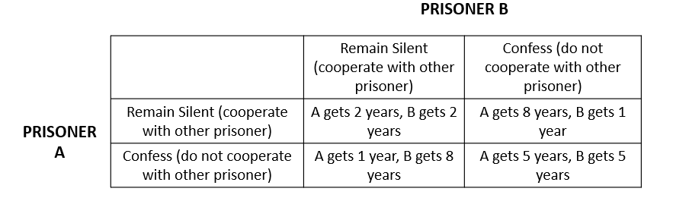
The Prisoner’s Dilemma Problem
If the two prisoners remain silent, they will only have to serve a total of four years of jail time between them. If the two prisoners can work out some way of cooperating so that neither one will confess, they will both be better off than if they each follow their own individual self-interest, which in this case leads straight into longer jail terms. Quite the dilemma!
Notes:
If the two prisoners remain silent, they will only have to serve a total of four years of jail time between them. If the two prisoners can work out some way of cooperating so that neither one will confess, they will both be better off than if they each follow their own individual self-interest, which in this case leads straight into longer jail terms. Quite the dilemma.

Slide 10
The Oligopoly Version of the Prisoner's Dilemma₁
The members of an oligopoly can face a prisoner's dilemma, also.
If each of the oligopolists cooperates in holding down output, high monopoly profits are possible.
Each oligopolist must worry that while it is holding down output, other firms are taking advantage of the high price by raising output.
Game theory can show the prisoner's dilemma for a two-firm oligopoly, known as a duopoly.
Notes:
The members of an oligopoly can face a prisoner's dilemma, also. If each of the oligopolists cooperates in holding down output, high monopoly profits are possible. Each oligopolist must worry that while it is holding down output, other firms are taking advantage of the high price by raising output. Game theory can show the prisoner's dilemma for a two-firm oligopoly, known as a duopoly.

Slide 11
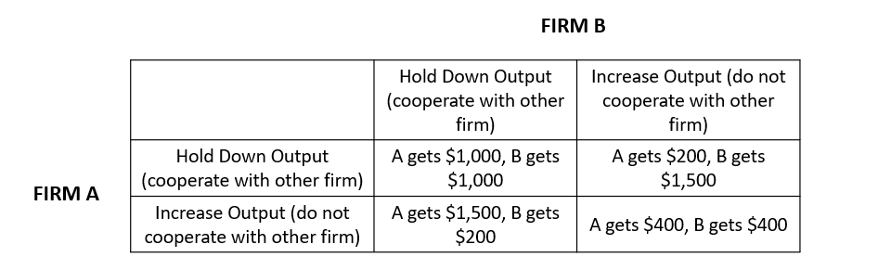
The Oligopoly Version of the Prisoner's Dilemma₂
The result of a prisoner's dilemma in a duopoly is often that even though A and B could make the highest combined profits by cooperating in producing a lower level of output and acting like a monopolist, the two firms may well end up in a situation where they each increase output and earn only $400 each in profits.
Notes:
The result of a prisoner's dilemma in a duopoly is often that even though A and B could make the highest combined profits by cooperating in producing a lower level of output and acting like a monopolist, the two firms may well end up in a situation where they each increase output and earn only $400 each in profits.

Slide 12
How to Enforce Cooperation
The way out of a prisoner's dilemma is to find a way to penalize those who do not cooperate.
An easy approach for colluding oligopolists would be to sign a contract with each other that they will hold output low and keep prices high.
If a group of U.S. companies signed such a contract, however, it would be illegal.
Because oligopolists cannot sign a contract to act like a monopoly, they may instead keep close tabs on what other firms are doing.
Alternatively, oligopolists may choose to act in a way that generates pressure on each firm to stick to its agreed quantity of output.
Notes:
The way out of a prisoner's dilemma is to find a way to penalize those who do not cooperate. An easy approach for colluding oligopolists would be to sign a contract with each other that they will hold output low and keep prices high. If a group of U.S. companies signed such a contract, however, it would be illegal. Because oligopolists cannot sign a contract to act like a monopoly, they may instead keep close tabs on what other firms are doing. Alternatively, oligopolists may choose to act in a way that generates pressure on each firm to stick to its agreed quantity of output.

Slide 13
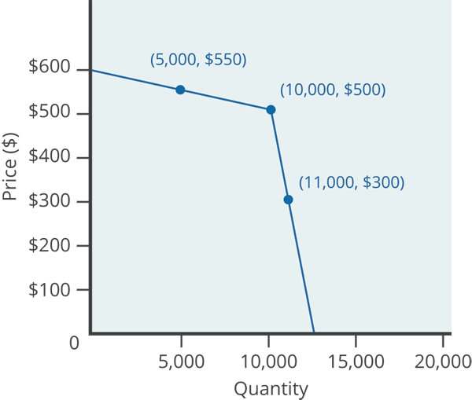
Kinked Demand Curve
A kinked demand curve indicates that oligopoly firms commit to match price cuts but not price increases.
An oligopoly firm agrees with the rest of the cartel to provide a certain quantity and price.
If the oligopoly decides to produce more and cut its price, the other members of the cartel will immediately match any price cuts.
Notes:
A kinked demand curve indicates that oligopoly firms commit to match price cuts but not price increases. An oligopoly firm agrees with the rest of the cartel to provide a certain quantity and price. If the oligopoly decides to produce more and cut its price, the other members of the cartel will immediately match any price cuts.

Slide 14
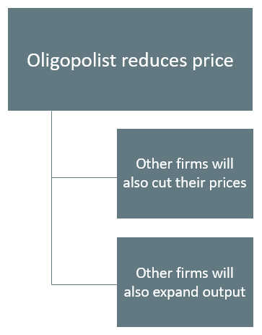
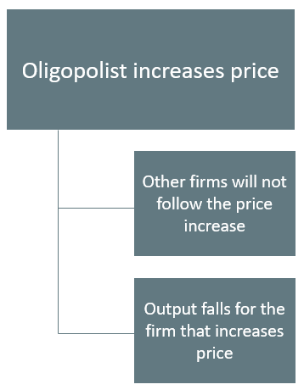
Changes in Price
Notes:
When an oligopolist reduces price, other firms will also cut their prices and also expand output. When an oligopolist increases price, other firms will not follow the price increase and output falls for the firm that increases price.

Slide 15
Summary
An oligopoly is a situation where a few firms sell most or all of the goods in a market.
Oligopolists earn the highest possible profits if they can band together as a cartel and act like a monopolist by reducing output and raising prices.
Since each member of the oligopoly can benefit individually from expanding output, such collusion often breaks down, especially since explicit collusion is illegal.
If the firms in a monopolistically competitive industry are earning economic profits, the industry will attract entry until profits are driven down to zero in the long run.
The prisoner's dilemma is an example of applying game theory to analyze oligopoly.

Slide 16




HAWKES LEARNING

