Slide 1
Section 9.7
Matrices and Gaussian Elimination

Slide 2
Properties: Elementary Row Operations
Interchange two rows.
Multiply a row by a nonzero constant.
Multiply a row by a nonzero constant and add it to another row.
If any elementary row operation is applied to a matrix, the new matrix is said to be row-equivalent to the original matrix.

Slide 3
Example 1: Creating Coefficient and Augmented Matrices
Write the corresponding coefficient matrix and the corresponding augmented matrix.
In the augmented matrix found in part a., interchange rows 1 and 2 and multiply row 3 by

Slide 4
Example 1: Creating Coefficient and Augmented Matrices (cont.)
Solution
Coefficient Matrix Augmented Matrix

Slide 5
Example 2: Creating Coefficient and Augmented Matrices
Write the corresponding coefficient matrix and the corresponding augmented matrix.
In the augmented matrix found in part a., add ─3
times row 1 to row 2. (Note: Row 1 is unchanged in the resulting matrix. Only row 2 is changed.)

Slide 6
Example 2: Creating Coefficient and Augmented Matrices (cont.)
Solution
Coefficient Matrix Augmented Matrix

Slide 7
Note
We will see in dealing with polynomials later that a₁₁ can be read as “a sub eleven.” However, with matrices, we need to indicate the row and column corresponding to the entry. If there are more than nine rows or columns, then commas are used to separate the numbers as a_{10,10}. You will see the commas in use
on your calculator.

Slide 8
Procedure: Strategy for Gaussian Elimination
Write the augmented matrix for the system.
Use elementary row operations to transform the matrix into row echelon form.
Solve the corresponding system of equations by using back substitution.

Slide 9
Example 3: Using Gaussian Elimination
(Two Variables)
Use the Gaussian elimination method with back substitution to solve the system of linear equations.
Solution
Step 1: Write the augmented matrix.
(The following steps show how to use elementary row operations to get the matrix in row echelon form.)

Slide 10
Example 3: Using Gaussian Elimination
(Two Variables) (cont.)
Step 2: Multiply row 1 by so that the entry in the upper left corner will be 1. This will help to get
0 below the 1 in the next step.
Step 3: To get 0 in the lower left corner, add −5 times row 1 to row 2.

Slide 11
Example 3: Using Gaussian Elimination
(Two Variables) (cont.)
Step 4: Now multiply row 2 by
Step 5: The last matrix (in row echelon form) in Step 4 represents the following system of linear equations.

Slide 12
Example 3: Using Gaussian Elimination
(Two Variables) (cont.)
The second equation gives y = −2.
Back substitute to find the value for x.
Thus, the solution is (1, −2).

Slide 13
Example 4: Using Gaussian Elimination
(Three Variables)
Solve the following system of linear equations by using the Gaussian elimination method with back substitution.
Solution
Step 1: Write the augmented matrix.

Slide 14
Example 4: Using Gaussian Elimination
(Three Variables) (cont.)
Step 2: Exchange row 1 and row 3 so that the entry in the upper left corner will be 1.

Slide 15
Example 4: Using Gaussian Elimination
(Three Variables) (cont.)
Step 3: To get a 0 under the 1 in Column 1, add row 1 to row 2.

Slide 16
Example 4: Using Gaussian Elimination
(Three Variables) (cont.)
Step 4: To get a₃₁ to be 0, add −2 times row 1 to row 3.
Step 5: Add row 2 to row 3 to arrive at triangular form.

Slide 17
Example 4: Using Gaussian Elimination
(Three Variables) (cont.)
Step 6: Then multiply row 3 by

Slide 18
Example 4: Using Gaussian Elimination
(Three Variables) (cont.)
Step 7: The row echelon form matrix in Step 6 represents the following system of linear equations.
From the third equation, we have z = 6.

Slide 19
Example 4: Using Gaussian Elimination
(Three Variables) (cont.)
Back substitution into the equation y + 3z = 20 gives
Back substitution into the equation x − y + 2z = 14 gives
Thus, the solution is (4, 2, 6).

Slide 20
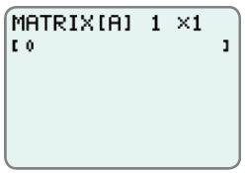
Example 5: Using a Graphing Calculator to Solve Systems of Equations
Use a TI-84 Plus calculator to solve the following system of linear equations.
Solution
Step 1: Press MATRIX and move to the EDIT menu.
Press . The following
display will appear.

Slide 21
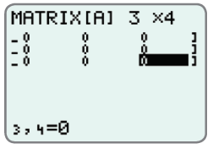
Example 5: Using a Graphing Calculator to Solve Systems of Equations (cont.)
Step 2: The augmented matrix is a
3×4 matrix. So, in the top
line enter , press ,
enter , press , and the
display will appear as shown.
Note: If other numbers are already present on
the display, just type over them. The calculator
will adjust automatically.

Slide 22
Example 5: Using a Graphing Calculator to Solve Systems of Equations (cont.)
Step 3: Move the cursor to the upper left entry position and enter the coefficients and constants in the matrix. As you enter each number, press and the cursor will automatically move to the next position in the matrix. Notice that the double subscripts appear at the bottom of the display as each number is entered. The final display for matrix [A] should appear as shown.

Slide 23
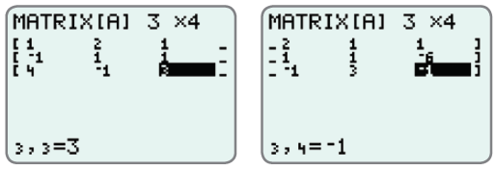
Example 5: Using a Graphing Calculator to Solve Systems of Equations (cont.)
Note: The display only shows three columns at a time.

Slide 24
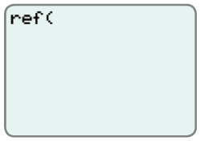
Example 5: Using a Graphing Calculator to Solve Systems of Equations (cont.)
Step 4: Press QUIT, press
MATRIX again, and go to
MATH. Move the cursor
down to A:ref( and press .
The display will appear as shown.

Slide 25
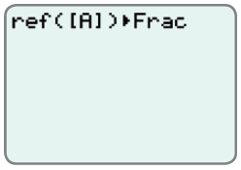
Example 5: Using a Graphing Calculator to Solve Systems of Equations (cont.)
Step 5: Press MATRIX again and
press (this selects the
matrix [A]). Enter a right
parenthesis , press the
key, and choose Frac by pressing . The display will appear as shown.
Note: You must select the matrix from the matrix menu. The calculator will not recognize the matrix if you manually type in [A].

Slide 26
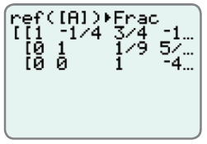
Example 5: Using a Graphing Calculator to Solve Systems of Equations (cont.)
Step 6: Press and the row echelon form of matrix will appear as follows.
Step 7: With back substitution, we get the solution (3,1, −4).

