Slide 1
Section 6.9
Similar and Congruent Triangles

Slide 2
Definition: Similar Triangles
In similar triangles, the corresponding angles have the same measure. (We say that the corresponding angles are congruent.)
In similar triangles, the lengths of the corresponding sides are proportional.

Slide 3
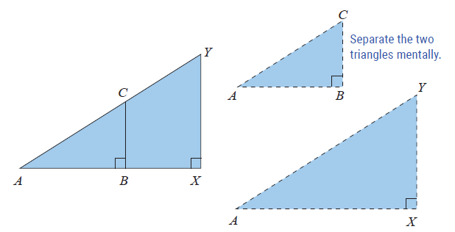
Example 1: Determining Whether Triangles are Similar
Given the two triangles ∆ABC and ∆AXY with
(as shown in the figure)
determine whether or not .

Slide 4
Example 1: Determining Whether Triangles are Similar (cont.)
Solution
We can show that the corresponding angles are congruent as follows.
Because they are the same angle
Because both are right angles (90°)
Because the sum of the measures of the angles in each triangle must be 180°
Therefore, the corresponding angles are congruent, and the triangles are similar.

Slide 5
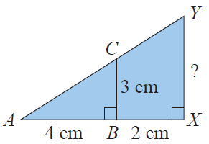
Example 2: Finding Unknown Values Using Similar Triangles
Refer to the given figure. If AB = 4 cm, BX = 2 cm, and BC = 3 cm, find XY.
Solution
From Example 1, we know that ;
therefore, the lengths of their corresponding sides are proportional. Since and are corresponding sides (they are opposite congruent angles) and and are corresponding sides (they are opposite congruent angles), the following proportion is true.

Slide 6
Example 2: Finding Unknown Values Using Similar Triangles (cont.)
Note that AX = AB + BX = 4 + 2 = 6 cm.
Thus,

Slide 7
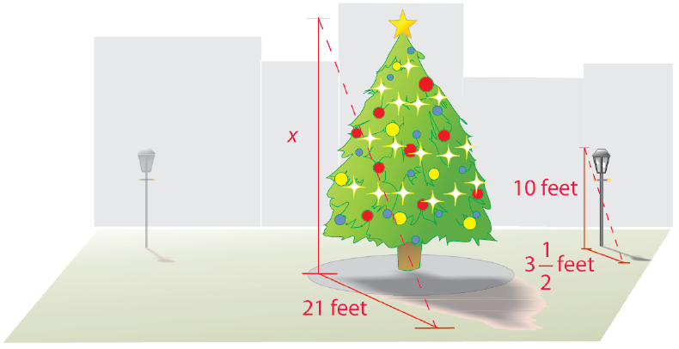
Example 3: Application: Finding Unknown Values Using Similar Triangles
A very tall, magnificently decorated tree was on display in an outside patio area at the mall during the month before Christmas. Joann knew that the height of a nearby lamppost was 10 feet. At 2 p.m. on a Tuesday afternoon,
she measured the shadow of the lamppost to be feet
long and the shadow of the tree to be 21 feet long. With her understanding of similar triangles, Joann was able to calculate the height of the tree. What was the height of the tree?

Slide 8
Example 3: Application: Finding Unknown Values Using Similar Triangles (cont.)
Solution
By letting x represent the height of the tree, Joann set up and solved the following proportion.

Slide 9
Example 3: Application: Finding Unknown Values Using Similar Triangles (cont.)
The tree was 60 feet tall.

Slide 10
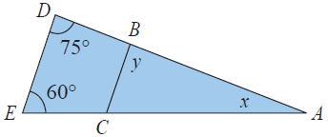
Example 4: Finding Unknown Values Using Similar Triangles
Find the values of x and y in triangles ∆ABC
and ∆ADE where ∆ABC∼∆ADE.

Slide 11
Example 4: Finding Unknown Values Using Similar Triangles (cont.)
Solution
Let x be the measure of ∠A and y be the measure of ∠B in ∆ABC as illustrated. Since y is in the same relative position as 75° in ∆ADE (∠B and ∠D are corresponding angles), we have y = 75°. In ∆ADE, using the fact that the sum of the measures of the angles of a triangle must be 180°, we subtract the values of the two known angles from 180° to find x. Thus, we have
x = 180 − 75 − 60 = 45°.

Slide 12
Properties: Properties of Congruent Triangles
Two triangles are congruent if both of the following are true.
The corresponding angles have the same measure.
The lengths of corresponding sides are equal.

Slide 13
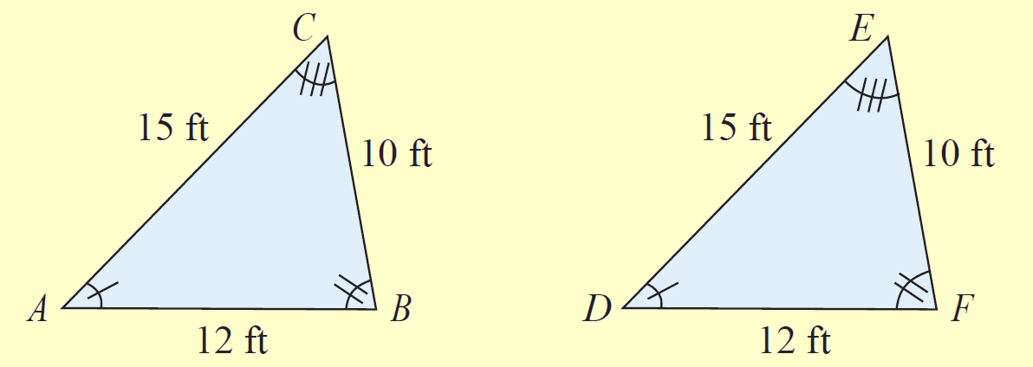
Definition: Determining Congruent Triangles
1. Side-Side-Side (SSS)
If two triangles are such that the lengths of the three sides of one triangle are equal to the lengths of corresponding sides of the
other triangle, then the two
triangles are congruent.
Triangle ABC is congruent to triangle DFE by SSS.

Slide 14
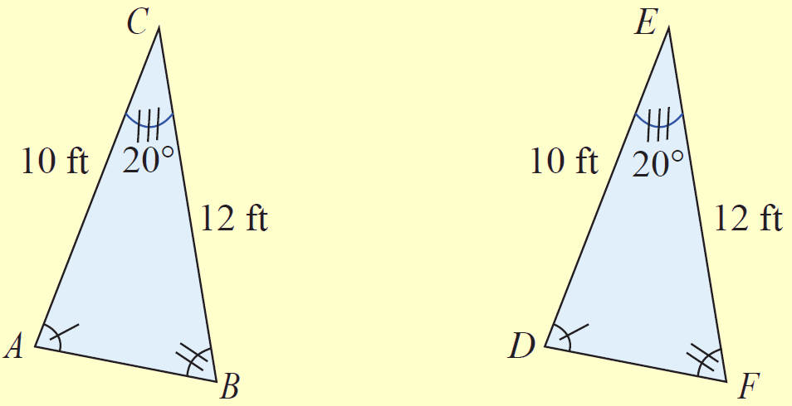
Definition: Determining Congruent Triangles (cont.)
2. Side-Angle-Side (SAS)
If two triangles are such that the lengths of two sides of one
triangle equal the lengths of
corresponding sides of the
other triangle and the angles
included between the sides
are congruent, then the two
triangles are congruent.
Triangle ABC is congruent to triangle DFE by SAS.

Slide 15
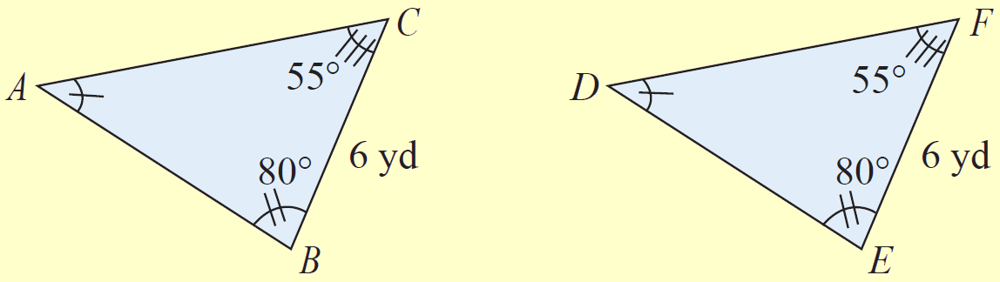
Definition: Determining Congruent Triangles (cont.)
3. Angle-Side-Angle (ASA)
If two triangles are such that two angles in one triangle are congruent to two angles in the other triangle and the lengths of the sides included between the angles are equal, then the two triangles are congruent.
Triangle ABC is congruent to triangle DEF by ASA.

Slide 16
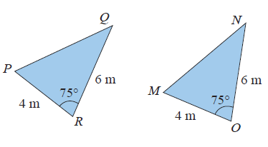
Example 5: Determining Whether Triangles are Congruent
Determine whether triangles
PQR and MNO are congruent.
Solution
From the figure we see that PR = MO = 4, QR = NO = 6, and m∠R = m∠O = 75. As ∠R and ∠O are included between the pairs of equal-length sides, the two triangles are congruent by SAS (Side-Angle-Side).

