Slide 1
Section 6.6
Perimeter

Slide 2
Definition: Polygon
A polygon is a closed plane figure, with three or more sides, in which each side is a line segment.
Each point where two sides meet is called a vertex.
Note: A closed figure begins and ends at the same point.

Slide 3
Definition: Perimeter
The perimeter P of a polygon is the sum of the lengths of its sides.

Slide 4
Finding the Perimeter of a Polygon
From the Metric System | From the US Customary System
millimeter (mm) | inch (in.)
centimeter (cm) | foot (ft)
meter (m) | yard (yd)
kilometer (km) | mile (mi)
Table 1

Slide 5
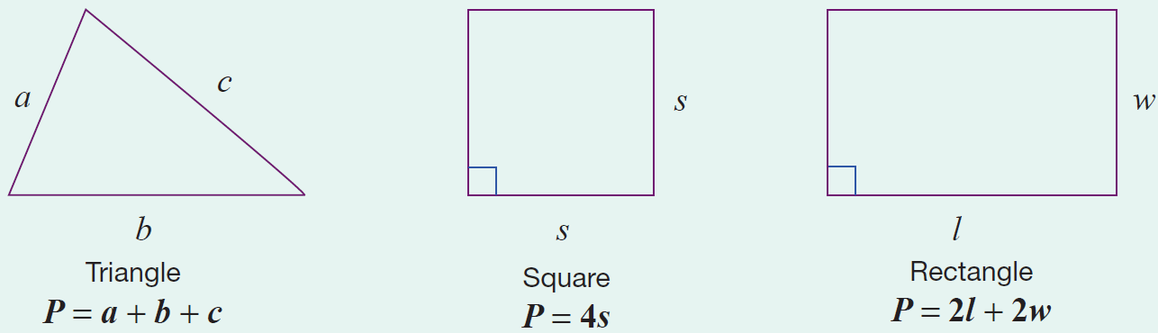
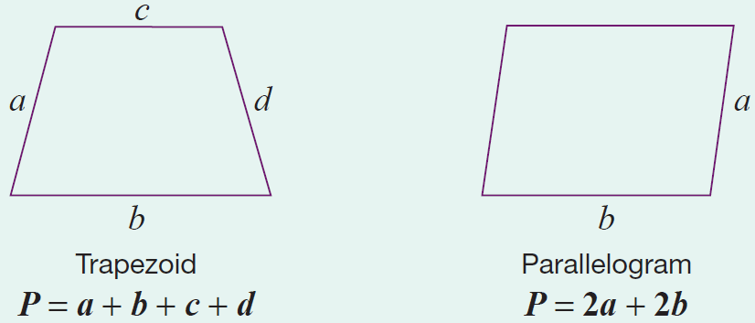
Formula: Perimeter Formulas for Five Polygons
Note that each formula represents the sum of the lengths of the sides.

Slide 6
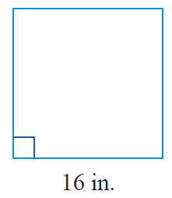
Example 1: Calculating the Perimeter of a Square
Calculate the perimeter of a square with sides of length 16 in.
Solution
Using the formula for the perimeter of a square, we have the following.
The perimeter of the square is 64 in.

Slide 7
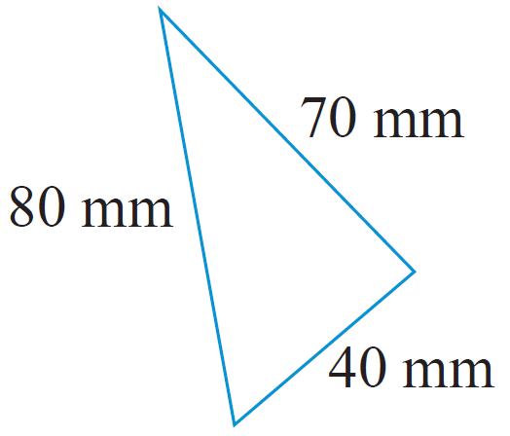
Example 2: Calculating the Perimeter of a Triangle
Calculate the perimeter of a triangle with sides of length 40 mm, 70 mm, and 80 mm.
Solution
First draw a figure and label the lengths
of the sides.
Now, using the formula for the perimeter of a triangle, we have the following.
The perimeter of the triangle is 190 mm.

Slide 8
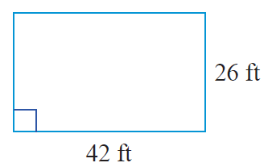
Example 3: Calculating the Perimeter of a Rectangle
Calculate the perimeter of the rectangle.
Solution
Using the formula for the perimeter of a rectangle, we have the following.
The perimeter of the rectangle is 136 ft.

Slide 9
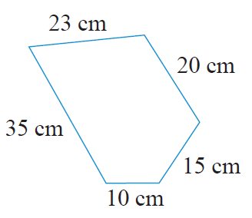
Example 4: Calculating the Perimeter of a Polygon
Calculate the perimeter of the polygon.
(Note: A 5-sided polygon is called a pentagon.)

Slide 10
Example 4: Calculating the Perimeter of a Polygon (cont.)
Solution
The perimeter of any polygon is found by adding the lengths of the sides. Thus, for this pentagon we have the following.
The perimeter of the polygon is 103 cm.

Slide 11
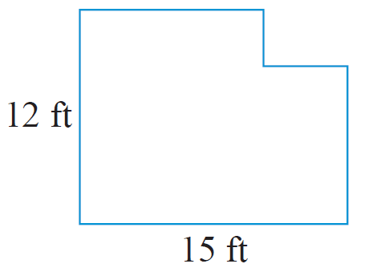
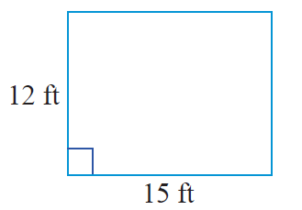
Example 5: Calculating the Perimeter of a Polygon
Calculate the perimeter of the polygon.
Solution
If a rectangle has length 15 ft and width 12 ft, then its perimeter is as follows.

Slide 12
Example 5: Calculating the Perimeter of a Polygon (cont.)
Now, if a small rectangle is cut from one corner of the original rectangle, then a new shape is formed. An interesting fact is that, regardless of the size of the cut out rectangle, this new shape will have the same perimeter as the original rectangle. This is because the length and width of the segments of the indented corner are the same as those of the cut out.

Slide 13
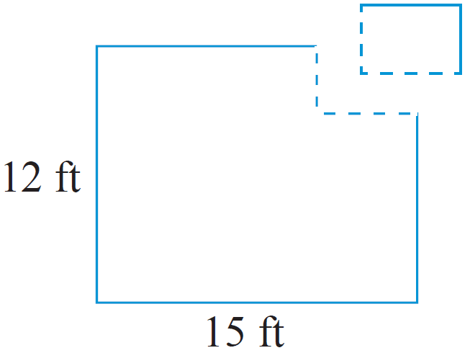
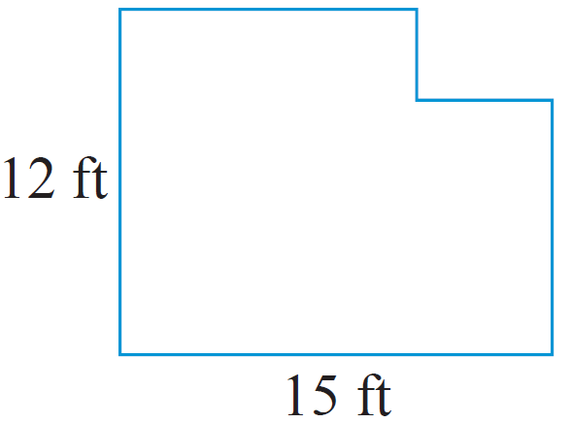
Example 5: Calculating the Perimeter of a Polygon (cont.)
Thus, the perimeter of the polygon is 54 ft.

Slide 14
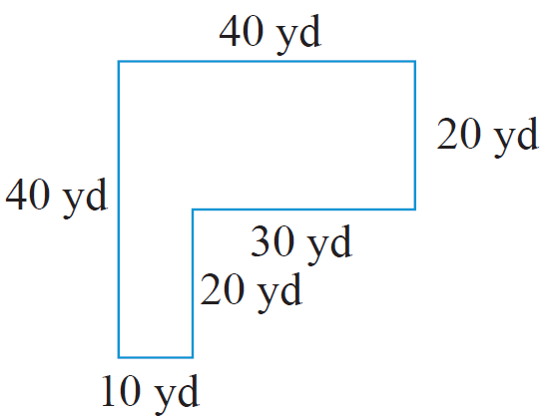
Example 6 Application: Calculating the Perimeter of a Polygon
For security, a chain link fence is to be built on the edge of a property surrounding a new warehouse. The property is L-shaped as shown.
How many yards of fencing will be needed?
How much will be spent on fencing if the fencing that was chosen costs $12.50 per yard?

Slide 15
Example 6 Application: Calculating the Perimeter of a Polygon (cont.)
Solution
As the fence is to be put up along the edge of the property, the amount of fencing needed is equivalent to the perimeter of the property.
They will need 160 yd of fencing.

Slide 16
Example 6 Application: Calculating the Perimeter of a Polygon (cont.)
The cost of the fencing will be $2000.

Slide 17
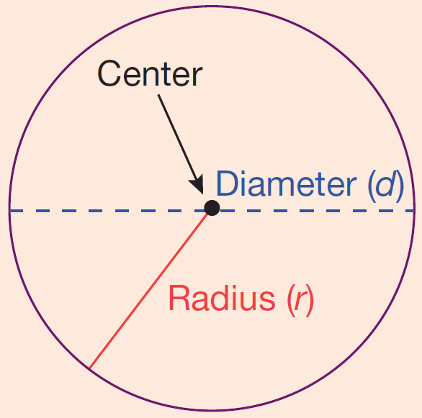
Definition: Circles
Circle: The set of all points in a plane
that are some fixed distance from a
fixed point called the center of the
circle.
Radius: The distance from the center
of a circle to any point on the circle.
(The letter r is used to represent the radius of a circle.)

Slide 18
Definition: Circles (cont.)
Diameter: The distance from one point
on a circle to another point on the
circle measured through the center.
(The letter d is used to represent the
diameter of a circle and d = 2r.)
Circumference: Perimeter of (or distance around) a circle.

Slide 19
Formula: The Circumference of a Circle
To find the circumference C of a circle, use one of the following formulas,
and
where r is the radius and d is the diameter of the circle.

Slide 20
Note
The Greek letter is the symbol used for the constant 3.1415926535…. This number is an infinite nonrepeating decimal number. For our purposes, we will use (accurate to hundredths). However, you should always be aware that 3.14 is only an approximation for and that related answers are only approximations.

Slide 21
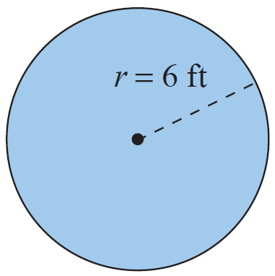
Example 7: Calculating the Circumference of a Circle
Calculate the circumference of a circle with a radius of 6 ft.
Solution
Using the formula for circumference:
The circumference is 37.68 ft.

Slide 22
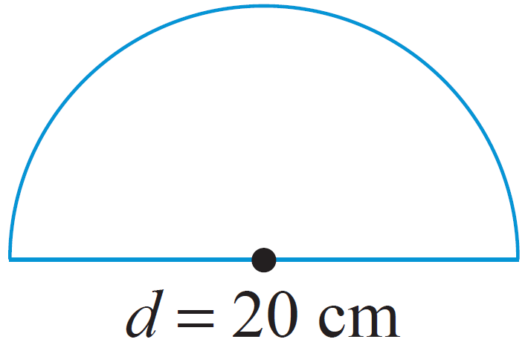
Example 8: Calculating the Perimeter
Calculate the perimeter of the figure shown: a semicircle (half of a circle) and a diameter. The diameter is 20 cm long.
Solution
In order to find the perimeter of the figure, find the perimeter of the semicircle and then add the diameter.
Length of semicircle

Slide 23
Example 8: Calculating the Perimeter (cont.)
Perimeter = semicircle + diameter
= 31.4 cm + 20 cm = 51.4 cm
The perimeter is 51.4 cm.

Slide 24
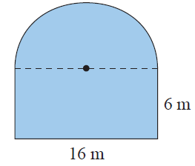
Example 9: Calculating the Perimeter
Calculate the perimeter of the figure shown here with a rectangular base and a semicircle attached to the top. The rectangle has a length of 16 m and a width of 6 m.
Solution
The perimeter of the figure is the sum of the lengths of three sides of the rectangle and the length of the semicircle. (Note: The diameter of the semicircle is 16 m.)

Slide 25
Example 9: Calculating the Perimeter (cont.)
Sum of the lengths of three sides of the rectangle
= 6 m + 16 m + 6 m
Length of semicircle
Perimeter of the figure
= 28 m
= 28 m + 25.12 m
= 53.12 m

