Slide 1
Section 6.4
US and Metric Equivalents

Slide 2
Definition: Temperature
US customary measure is in degrees Fahrenheit ( ).
Metric measure is in degrees Celsius (° ).

Slide 3
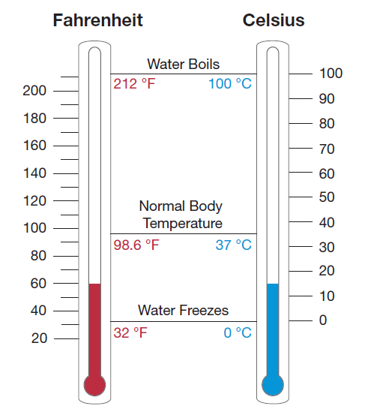
Temperature
Figure 1

Slide 4
Example 1: Equivalent Measures of Temperature
Hold a straight edge horizontally across the thermometers in Figure 1 and you will read the following.

Slide 5
Formula: Temperature Formulas
F = Fahrenheit temperature
and
C = Celsius temperature

Slide 6
Example 2: Converting Units of Temperature
Convert F = 86° to its equivalent measurement in degrees Celsius.
Solution

Slide 7
Example 3: Converting Units of Temperature
Convert C = 35° to its equivalent measurement in degrees Fahrenheit.
Solution

Slide 8
Length
Measurement Conversions
US to Metric | Metric to US
1 in. = 2.54 cm (exact) | 1 cm ≈ 0.394 in.
1 ft ≈ 0.305 m | 1 m ≈ 3.28 ft
1 yd ≈ 0.914 m | 1 m ≈ 1.09 yd
1 mi ≈ 1.61 km | 1 km ≈ 0.62 mi
Table 1

Slide 9
Note
Most of the conversion units are not exact and slightly different answers are possible, depending on the conversion units used. Generally, we will round conversions to the nearest hundredth.

Slide 10
Example 4: Converting Units of Length
Convert each measurement, rounding to the nearest hundredth.
6 in. = ______ cm
25 mi = ______ km
10 km = ______ mi
30 m = ______ ft
100 m = ______ yd

Slide 11
Example 4: Converting Units of Length (cont.)
Solution
a. 6 in.
25 mi
10 km
30 m

Slide 12
Example 4: Converting Units of Length (cont.)
e. 100 m
With this information, do you think that a 100 m dash is longer (or shorter) than a 100 yd dash?

Slide 13
Area
US Customary Units of Area
1 ft² = 144 in.²
1 yd² = 9 ft²
1 acre = 4840 yd² = 43,560 ft²
Table 2

Slide 14
Area (cont.)
Measurement Conversions
US to Metric | Metric to US
1 in.² ≈ 6.45 cm² | 1 cm² ≈ 0.155 in.²
1 ft² ≈ 0.093 m² | 1 m² ≈ 10.764 ft²
1 yd² ≈ 0.836 m² | 1 m² ≈ 1.196 yd²
1 acre ≈ 0.405 ha | 1 ha ≈ 2.47 acres
Table 3

Slide 15
Example 5: Converting Units of Area
Convert each measurement, rounding to the nearest hundredth.
40 yd² = ______ m²
100 cm² = _____ in.²
6 acres = _____ ha
5 ha = _____ acres

Slide 16
Example 5: Converting Units of Area (cont.)
Solution
a. 40 yd²
100 cm²
6 acres
5 ha

Slide 17
Capacity (Liquid Volume)
Measurement Conversions
US to Metric | Metric to US
1 qt ≈ 0.946 L | 1 L ≈ 1.06 qt
1 gal ≈ 3.785 L | 1 L ≈ 0.264 gal
1 mL is equal to 1 cubic centimeter (cc or cm³).
These units are commonly used in medicine.
Table 4

Slide 18
Example 6: Converting Units of Capacity (Liquid Volume)
Convert each measurement, rounding to the nearest hundredth.
20 gal = _____ L
42 L = _____ gal
6 qt = _____ L

Slide 19
Example 6: Converting Units of Capacity (Liquid Volume) (cont.)
Solution
a. 20 gal
42 L
6 qt

Slide 20
Weight (Mass)
Measurement Conversions
US to Metric | Metric to US
1 oz ≈ 28.35 g | 1 g ≈ 0.035 oz
1 lb ≈ 0.454 kg | 1 kg ≈ 2.205 lb
Table 5

Slide 21
Example 7: Converting Units of Weight (Mass)
Convert each measurement, rounding to the nearest hundredth.
5 lb = _____ kg
15 kg = _____ lb
35 oz = _____ g

Slide 22
Example 7: Converting Units of Weight (Mass) (cont.)
c. 35 oz
Solution
5 lb
15 kg

